Slide 1
School Staff Introduction
Notes:
Suggested speaking notes are available for each slide to support delivery.

Slide 2
What is Connect Quest?
Connect Quest is a set of activities and supportive resources that help grades 4-8 students build connections to promote balanced device use and substance use health.
Informed by students, Connect Quest builds skills and connections through age-appropriate discussion, hands-on learning and reflection.
Connect Quest is designed to be student-led, promoting connection as a protective factor for substance use health and balanced device use.
Connect Quest provides flexible “choose your own adventure” learning.
Notes:
Connect Quest is a set of resources that help students build connections to promote balanced device use and substance use health.
It focuses on building skills that promote balanced device use and substance use health through age-appropriate discussion, shared learning, hands-on learning activities and reflection.
Connect quest lives on a student facing website, and inside students will find a menu of activities to choose from along with guides to support them and caring adults as they use the activities and promote connection in their schools.
Connect Quest is intentionally flexible—it’s designed to fit into students’ lives and the rhythm of the school day and complement other work in this area.

Slide 3
Why was it developed?
Ontario students are navigating increasingly complex issues related to substance use, device habits and overall well-being.
Providing students with accurate information and helping them to build strong relationships and skills in the elementary grades can prevent the onset of harmful habits.
Peers are a powerful influence when it comes to substance use health and device use, so resources that leverage this can be a helpful complement to instruction.
Ontario policy (PPM128) prioritizes student well-being, learning and safety regarding substance use and device use.
Research points to the need for practical, school-based supports that reduce and delay substance use harms and promote healthier, more balanced use of digital devices.
Notes:
Students are navigating increasingly complex choices related to substance use and device use, Connect Quest is designed to respond to this reality.
Research shows that providing students with accurate information and helping them to build strong relationships and skills in the elementary grades can prevent the onset of harmful habits involving substances and technology use.
Research points to the need for school-based supports that reduce and delay substance use harms, while also promoting healthier, more balanced use of digital devices.
Connect Quest aligns with PPM 128 and board goals related to substance use health, balanced device use and engagement

Slide 4
Why the focus on connection?
When students have strong positive relationships at school, home, and in the community, they are more likely to make informed choices that support their well-being and are more confident in seeking help when needed.
Connection promotes healthy coping, belonging, and supportive relationships – protective factors for mental health and substance use health.
Connect Quest focuses on three domains of connection:
  connection with yourself (reflecting on personal values and habits)
  connection with community (friends, school, family)
  connection with nature
Notes:
When students have strong positive relationships at school, home, and in the community, they are more likely to make informed choices that support their well-being and are more confident in seeking help when needed.
When students feel connected (to themselves, peers, trusted adults and nature), they are more confident in seeking help and making informed choices about things like devices and substances, that support their identities and well-being.
Research shows that self-awareness, and strong connections to people, community and nature can be protective against risk factors and preventative for mental health and substance use challenges.
Activities focus on three domains of connection: self, community, and nature.

Slide 5
Why use Connect Quest?
Developed with students, for students.
Provide accurate information about substance use health and balanced device use.
Strengthen student sense of belonging and connection.
Build knowledge about coping strategies and help-seeking.
Reduce stigma by fostering compassionate conversations about substance use health and balanced device use.
Help students reflect on their habits and values.
Encourage student leadership.
Notes:
Connect Quest was developed with students, for students.
Connect Quest can be used to:
Provide accurate information about substance use health and balanced device use
Strengthen student sense of belonging and connection.
Build knowledge about coping strategies and help-seeking (through connecting with others, hobbies, time in nature, etc.)
Reduce stigma by fostering compassionate conversations about substance use health and balanced device use.
Help students reflect on their habits and values, including how they use personal devices and connect with others
Encourage student leadership in fostering positive school climates by amplifying messages of connection, community, balance, and belonging.

Slide 6
What’s inside?
The Connect Quest website houses the following resources:
26 ready-to-use activity cards (online and printable PDFs)
Student Leader Guide
School Implementation Guide
Background and Information document
parent/caregiver resource
communication material (posters, visuals, school announcement ideas)
Notes:
Inside the Connect Quest website, you’ll find the following:
26 student activities
A Student Leader Guide to support students leading Connect Quest in their school
School Implementation Guide and additional supports for staff
Background document with research and information
Resource for parents/caregivers to complement the learning, continue conversations and use of connect quest at home
Communication material (posters, visuals, announcement templates) to support schools and students with messaging and sharing Connect Quest

Slide 7
How can I use it?
Individual student use
“Connect with yourself” activities can be done independently to reflect on emotions, build wellness habits and work towards personal goals.
Student-led initiatives
Alongside caring adults at school, students can create a “Quest” or campaign where they choose, adapt and lead Connect Quest activities across their school.
Quests can be carried out over several months, or over a short period of time.
Classroom integration
Educators and student support staff can embed activities into lessons, group opportunities, or clubs.
Family engagement
Parents and caregivers can use activities at home to support healthy routines and conversations about balanced device use and substance use health.
Notes:
Connect Quest is intentionally flexible and can be used in several ways.
Individual student use: “Connect with yourself” activities can be done independently to reflect on emotions, build wellness habits and work towards personal goals.
Student-led initiatives: Alongside caring adults at school, students can create a “Quest” or campaign where they choose, adapt and lead Connect Quest activities across their school to promote connection, balanced device use and substance use health. Student led Quests can be carried out over several months, or over a short period of time (e.g., daily activities during Mental Health Week in May).
Classroom integration: Educators and student support staff can embed activities into lessons, group opportunities or clubs.
Family engagement: Parents and caregivers can use activities at home to support healthy routines and conversations about balanced device use and substance use health.

Slide 8
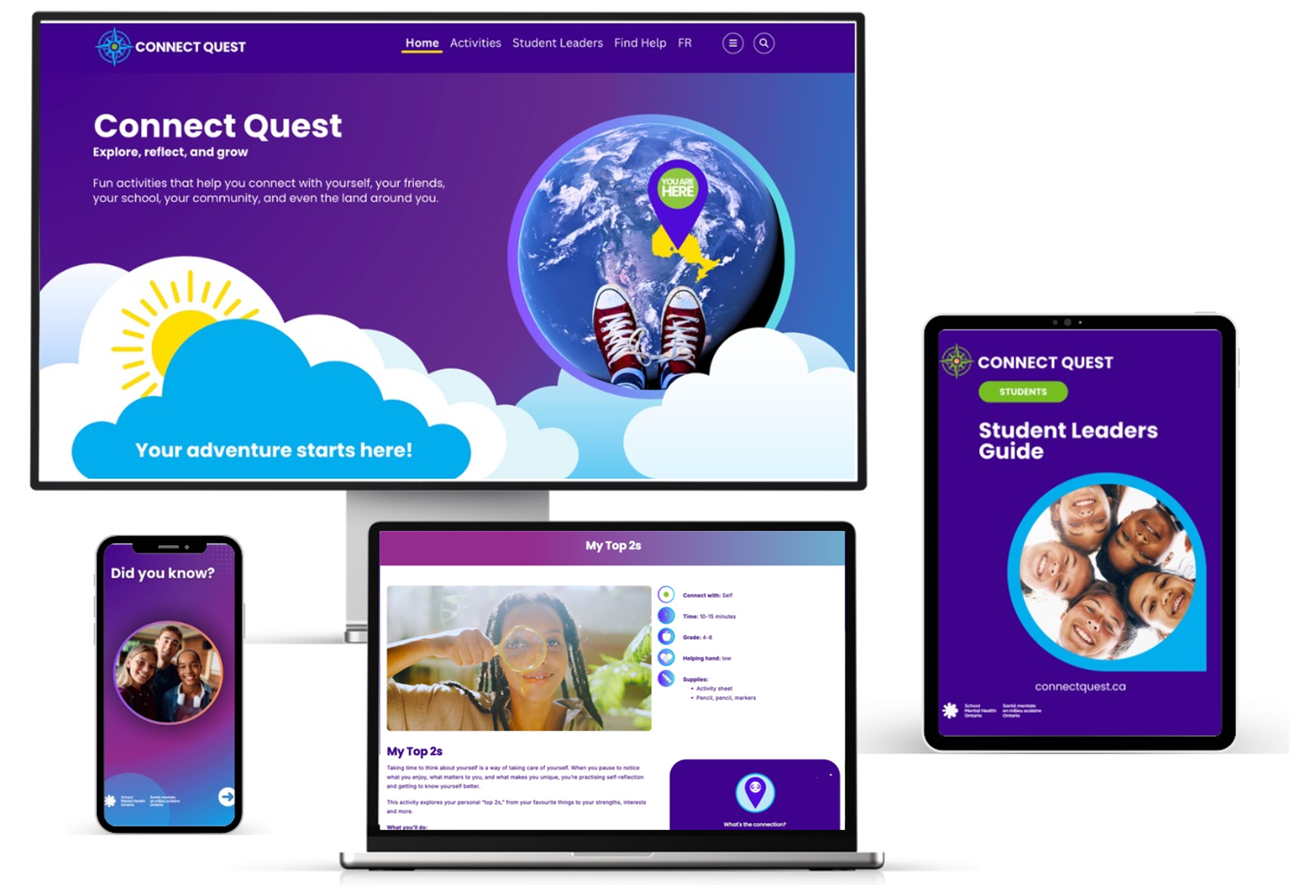
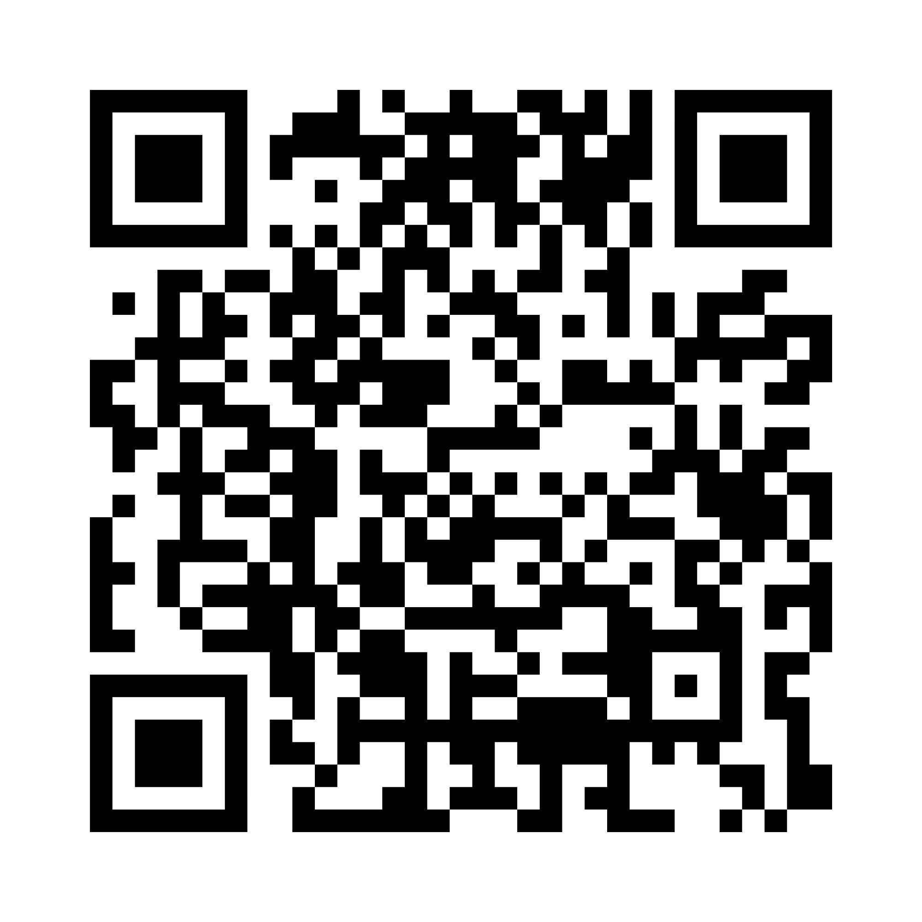
Where can I find Connect Quest?
connectquest.ca
Notes:
Everything you need to get started with Connect Quest is available online. We encourage you to explore the website and consider how Connect Quest can complement your efforts to support balanced device use and substance use health by strengthening student connection.
EN: connectquest.ca
FR: connectquest.ca/fr
The QR code on this slide will also take you directly to the website.

Slide 9
Connect with School Mental Health Ontario

Slide 10
Accessibility statement

