Slide 1
Supporting Digital Citizenship and Online Safety in Grade 6
Notes:
The purpose of this workshop is to make you feel confident about teaching digital citizenship and online safety. Our focus will be on students in grade six, but most of what we cover applies to all students.

Slide 2

Reflection 1
What strategies have you used in teaching digital citizenship and online safety?
What challenges have you encountered?
What successes have you had?
Notes:
Before we start, I’d like you to reflect on three questions:
What strategies have you used in teaching digital citizenship and online safety?
What challenges have you encountered doing that?
What successes have you had?

Slide 3
Grade 6: a snapshot
Grade 6: a snapshot
Notes:
What is going on in kids’ media lives at this age, and what risks are they facing?

Slide 4

Grade 6: a snapshot 2
Big changes:
start of adolescence
starting to use phones and social media
looking for ways to be engaged digital citizens
Notes:
Two big changes happen at this age: the beginning of adolescence and (for most kids) starting to use phones and social media. While younger kids use digital tech, for tweens it is often an essential part of how they develop and grow.

Slide 5

Grade 6: a snapshot 3
Top apps/websites:
9-11 12-13
YouTube 54% 67%
Facebook 42% 53%
TikTok 41% 59%
Instagram 28% 53%
Snapchat 22% 42%
Notes:
At this age they are almost entirely using apps and websites aimed at adults – mostly video sites such as YouTube and TikTok and social networks like Instagram and Snapchat. Many also use Facebook, which shows that at this age social media is as much about keeping in touch with family as with friends.
Although their terms of service require that users are at least thirteen, between a fifth and half of kids ages 9 through 11 have accounts on these apps. Among youth aged twelve to thirteen the number is even higher.

Slide 6

Grade 6: a snapshot 4
Cognitive and moral development:
Moving between concrete and formal operation stage of cognitive development
Morality more focused on peer and social norms than rules or punishments
Notes:
Students at this age are transitioning into more logical thinking, but abstract thinking is still developing. They are starting to understand that online actions can have real consequences: most have reached the "Conventional Level" of moral development, where they begin to understand societal expectations and believe that "good behavior" involves good motives and interpersonal feelings like love, empathy, trust, and concern for others. They’re also starting to question concepts of fairness and equality.

Slide 7




What risks are they facing?
CONTENT
CONDUCT
CONSUMER
CONTACT
Notes:
Now let’s look at the media risks they’re most likely to encounter.
Online safety researchers classify these into four categories:
Content risks, where kids are exposed to or engage with harmful content such as violence, hate, or sexualized media;
Conduct risks that come from what kids do or how they interact with other users;
Consumer risks related to money, advertising, and data collection;
And risks that come from being Contacted by other people.

Slide 8
What risks are they facing? Content
CONTENT:
Now often using platforms designed for adults
Interested in current events and the wider world
Almost two-thirds see misleading content almost every day –
Including about sexual health
Notes:
At the beginning of this stage, children are often becoming more interested in the wider world and may use media to learn about current issues or events.
They are learning to be skeptical of what they see online, but are still learning how to judge whether it’s reliable or not.
They are more likely to see misleading content than any other age group: 59% say they see it every day.
Many tweens will also start to seek out information about sexuality and sexual health, but may not know how to find reliable information or how to avoid seeing inappropriate content.

Slide 9
What risks are they facing? Content 2
CONTENT:
More likely to see hate content
Gender representation and body image are key issues
Most afraid of realistic dangers that they may seek out or see in news
Few have looked for sexual content, but more have seen it
Notes:
They’re also more likely to encounter racism, sexism and other forms of hate content.
Gender representation and body image are key issues at this age, which may explain why this is one of the two periods where social media has the biggest impact on girls’ happiness. This is the age where there is the biggest gap between their images of themselves and the images they feel they should present online. In particular, they feel pressure to make themselves and their lives seem “picture perfect” at all times.
They’re more afraid of realistic dangers than younger children and are more likely to intentionally watch scary or “gross out” content, which may be beyond what they’re able to handle – but are also likely to see content that upsets them in a news context.
Just one in ten intentionally look for pornography or other sexual content at this age, but a quarter have seen it without looking for it.

Slide 10
What risks are they facing? Conduct
CONDUCT:
Becoming more independent but still need support
Strongly influenced by peers and super-peers
Take risks as a way of testing boundaries –
but have trouble foreseeing consequences.
Notes:
They are becoming more independent and pushing for more freedom, but still need support in managing their time and balancing screen use with other activities.
This is actually the age where they are most influenced by peers and “super peers” – influencers, celebrities, friends-of-friends, AI chatbots, and so on. As a result, while they are actually less likely to engage in cyberbullying than other age groups, they are more likely than any other group to say they did it because “my friends were also doing it.”
They’re prone to take risks as a way of testing boundaries and gain status among their peers, at a time when It's hard for them to think clearly about the possible consequences of what they do online.

Slide 11
What risks are they facing? Conduct 2
CONDUCT:
Learning how to manage online conflict and communication
Moving to group interactions with few empathy cues online
Notes:
They are still learning how to manage online conflict and deal with the limitations of online communication. Some students may even need help developing the vocabulary to talk about their feelings – and to be reassured that it’s okay to do so. For boys, in particular, examining the messages they received about gender from media can be key to doing this.
As they reach this age they often move from communicating mostly with one person at a time, through platforms with voice and video, to things like social media or group texts where they are talking to larger audiences with fewer clues about how a message should be interpreted. This can lead to unintentional conflict or “drama” as what they post and read is misinterpreted or taken more seriously than it was meant: they are more likely than older or younger children to say they engaged in cyberbullying to “get even” with someone.

Slide 12
What risks are they facing? Conduct 3
CONDUCT:
Social and design pressures make them vulnerable to excessive use
Almost half worry that they spend too much time online
Notes:
Youth at this stage are also vulnerable to excessive use as their growing social needs, along with expectations of keeping in touch with parents while being more physically independent, happen at the same time as they start using media tools like social media that are designed to keep users engaged. Features like reward loops and social affirmations (e.g., "likes") are intentionally reinforcing and can lead to disappointment or anxiety if expectations aren't met. This design makes it difficult for children (and even adults) to disengage from screens.
This is something that young people themselves are aware of: forty-two percent worry that they spend too much time online. Those who feel this way, though, don’t spend any less time online than those who aren’t concerned about their screen time, which suggests that they need more tools to be able to resist the social and technical pressures that keep them connected.

Slide 13
What risks are they facing? Consumer
CONSUMER:
Little understanding of how digital tools work or what platforms do with their data
Think of privacy mostly in interpersonal terms
Notes:
At the beginning of this stage they still typically have little knowledge of how digital tools such as search engines or AI work.
They are becoming aware of the most abstract traces they leave online, like location tracking and data collection, but generally do not yet understand their possible future consequences. They have little knowledge of what platforms do with the content they post there and the data gathered about them, such as recommending content that keeps them engaged, targeting them with behavioural ads, and in some cases selling it to data brokers whose profiles might affect anything from how much they pay for goods online to whether they’re approved for a mortgage.
Children this age still think of privacy largely in interpersonal terms and are just starting to imagine possible unknown or future audiences for what they post online.

Slide 14
What risks are they facing? Contact
CONTACT:
Use many tools to communicate online
Often explore online subcultures and communities
Notes:
They often use many different tools to keep in touch with friends and family, including games, social networks and messaging apps. This means more different ways that people they don’t know can contact them, and blocking strangers or “randos” becomes a necessary chore. The student tip sheet Communicating Safely Online has information on how to block people on different apps and devices.
As they start to develop an individual identity, they may become interested in subcultures and start exploring online communities. This is generally healthy but may sometimes lead to contact with people they don’t know offline. Online communities based on shared interests, like forums or wikis, give them a chance to develop their identity and to build their skills or knowledge beyond what is possible with offline peers.

Slide 15
What risks are they facing? Contact 2
CONTACT:
Form parasocial relationships with influencers and chatbots
More likely to receive sexts sent by online-only contacts
More vulnerable than older youth to sexploitation
Notes:
Because they are turning increasingly to peers for identity-building and social support, they are also more likely to form parasocial relationships – in which they feel an emotional connection to someone they do not really know – with influencers and even AI chatbots. This can lead them to make unwise purchases, to form unhealthy attachments or a negative self-image, to see inappropriate content, or to get bad or even dangerous advice. Teaching them how chatbots actually work, and how influencers make you feel like you know them, helps kids understand they are not really our friends.
Kids this age are less likely than older teens to have been sent a sext from someone they only know online, but much more likely have gotten one from a total stranger. This reflects the fact that kids this age are most vulnerable to sexploitation, where fake sexts are used to encourage kids to send sexts which are then used to blackmail them.

Slide 16
Reflection 2
Which risks do you think your students encounter most often?
Which do you think they worry about the most?
Which do you think their parents/caregivers worry about?
Notes:
Let’s pause for a moment to reflect on a couple of questions:
Which type of risks do you think your students encounter most often?
Which do you think they worry about the most?
Which do you think their parents worry about? Are those the same as the kids’?

Slide 17
Risk and resilience
Managing risk
Supporting healthy choices
Notes:
Now that we know what risks students are facing at this age, what can we do to help keep them safe?
Our Young Canadians in a Wireless World survey has confirmed what researchers around the world have found: risk and engagement go hand-in-hand. Kids who engage in risky behaviours are also more likely to engage in positive online activities like making media and online activism, as well as routine activities ranging from reading e-books to checking bus schedules online, and more than a decade of scholarship has demonstrated not only that students who engage in positive or useful online activities are inevitably exposed to risk, but that trying to shield them from all risk – rather than teaching them to manage it – actually makes them less safe.

Slide 18

Risk and resilience 2
Notes:
Think about how we keep kids safe when they’re riding bikes. We could, of course, never let kids ride bikes at all. But usually, we recognize the benefits of riding them and teach kids how to ride them safely. When they’re young, that might mean training wheels, keeping just to bike paths, and riding with them; as they get older we’ll let them make some of those decisions for themselves – but expect them to keep taking some steps to keep themselves safe, like wearing a helmet.

Slide 19

Risk and resilience 3
Teach students to…
Recognize and manage risks
Recognize and avoid hazards
Recover from harm
Notes:
So how do we help students learn to engage positively and safely online?
First, teach them to recognize and manage risks;
To recognize and avoid hazards;
And to “bounce back” from harm.

Slide 20


Risk and resilience 4
Notes:
Let’s take a moment to unpack those terms.
What’s the difference between harm and risk?
Harm is when something bad or unpleasant happens.
Risk is the possibility that something bad or unpleasant might happen. When we talk about a risk, we mean something that might have a bad or unpleasant outcome.
The skills students have learned often make the difference between whether or not a risky experience results in long-term harm.
We can foster all these skills through teaching students digital media literacy.

Slide 21

Risk and resilience 5
Notes:
A hazard is a risk that a child isn’t ready to recognize or manage.
For instance, a zipline at a playground that’s a few feet off the ground is a risk: the worst that’s likely to happen are some scrapes and bruises, and most kids will be able to judge for themselves what the risks are and how to manage them (for instance, wearing a helmet and using the harness.)
A zipline that’s significantly higher – or that’s over something dangerous, or that doesn’t have safety gear – would be a hazard.
What is a risk or a hazard depends in part on the individual child: factors like their age and development, disabilities, past experience with an activity, and so on.
In the same way, some apps or games have features that are hazards for any age – for example fully anonymous apps or ones that connect you with random strangers.
Others have features that are risks for some children but hazards for others: chat channels, the ability to send and receive photos, and so on.

Slide 22

Risk and resilience 6
“Adults are responsible for the health of the tree by removing any rotting branches and teaching the children to identify them.
Children are responsible for how high they climb, and which route they take to the top.”
Canadian Public Health Association
Notes:
So our job, as adults in their lives, is, first to eliminate whatever hazards we can; then, to teach students how to recognize hazards, and the skills they need to turn hazards into manageable risks; to manage those appropriate risks; and, finally, the recover from any harms they experience – or to make up for harms they may have done to others.
While our goal is always to keep students safe, therefore, it must also be to make them more independent and able to look after themselves as they get older. As the Canadian Public Health Association puts it in their report Risk, Hazard, and Play, “Adults are responsible for the health of the tree by removing any rotting branches and teaching the children to identify them. Children are responsible for how high they climb, and which route they take to the top.”
For students in Grade Six, we would likely consider unfiltered access to the internet to be a hazard. We can turn that into a risk that students can learn to manage in several ways: by showing them how to turn on content restrictions on browsers and search engines, for instance, or by providing them with custom search engines that only search safe and reliable sites.
On the other hand, we might feel that having students collaborate on an online document, such as a shared Google Doc, is a risk that we can prepare them to manage by teaching them to understand the emotional limits of online communication and establishing clear norms for how to behave online.

Slide 23
Reflection 3
How might you need to address online risks in your classroom?
Who could help?
What challenges or barriers might you have to address?
What supports might be available?
Notes:
Take a moment to think about how you might need to address online risks in your own classroom. (For instance, having students search the web when doing research for a project, or risks to student privacy when using online tools.)
Who might be able to help to address it?
What challenges or barriers might you have to address?
What supports might be available?

Slide 24
Digital media literacy
Digital media literacy
Notes:
Digital media literacy is what we call the things a person has to know, to understand, and to be able to do to be an engaged digital citizen – which includes keeping themselves (and others) safe online.

Slide 25
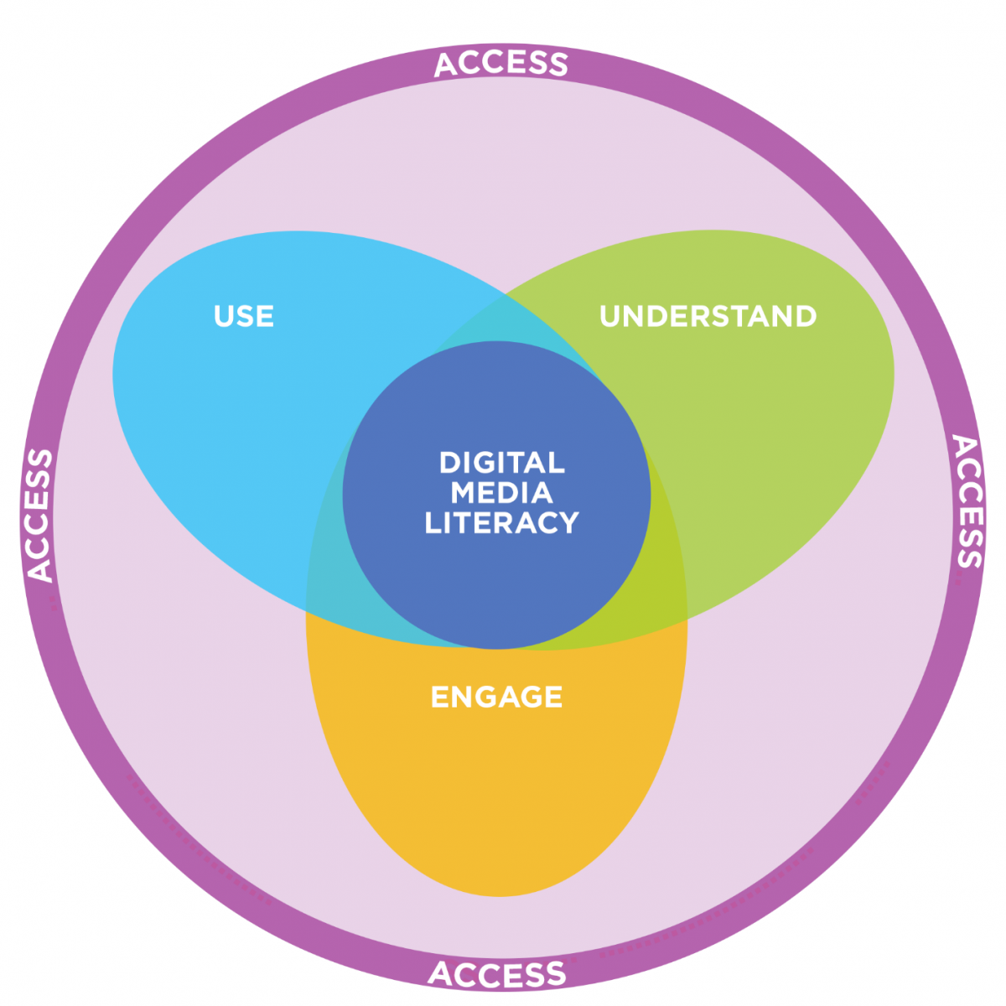
Digital media literacy: competencies and key concepts
Competencies and key concepts
Notes:
Digital media literacy has three elements. The first are the skills or competencies that students need to be able to do – to access media of all kinds, such as using a search engine to find information or accessing a video on a streaming site; to use media safely, ethically, and effectively, for instance connecting with friends and family without getting mixed up in “drama”; to understand media texts and tools, such as analyzing the ways that apps nudge us to use them more often than we might want to; and to engage critically with it and use it for civic engagement – for instance by examining how media communicates stereotypes about gender and how those can influence how we behave online.

Slide 26
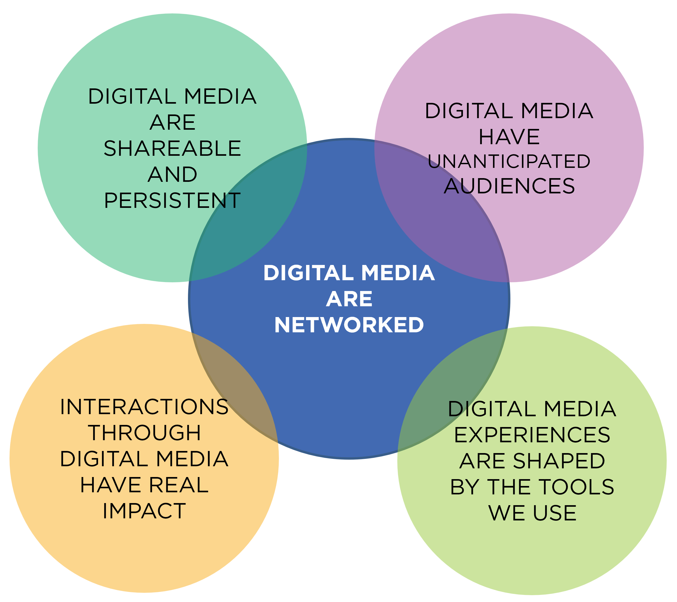
Digital media literacy: key concepts
Key concepts
Notes:
The second element is the key concepts that students need to understand. When it comes to digital media, these are all implications of the idea that digital media are networked: those networked connections mean that digital media are easily shareable and hard to delete, for instance, and that we can interact with other people in ways that may have a negative or positive impact. You can find articles, videos and lessons exploring these key concepts at the MediaSmarts website.

Slide 27

Digital media literacy: topics
Topics
Notes:
And third, the content that students need to know: this ranges from “traditional” media literacy topics like media codes and conventions and media representation, to topics more associated with digital media like privacy and security and ethics and empathy, to topics that span all aspects of media like media health or making and remixing.
While each of these is an essential media literacy topic, for now we’re going to look at the ones that are most relevant to online safety: ethics and empathy, media health, privacy and security, and finding and verifying.

Slide 28
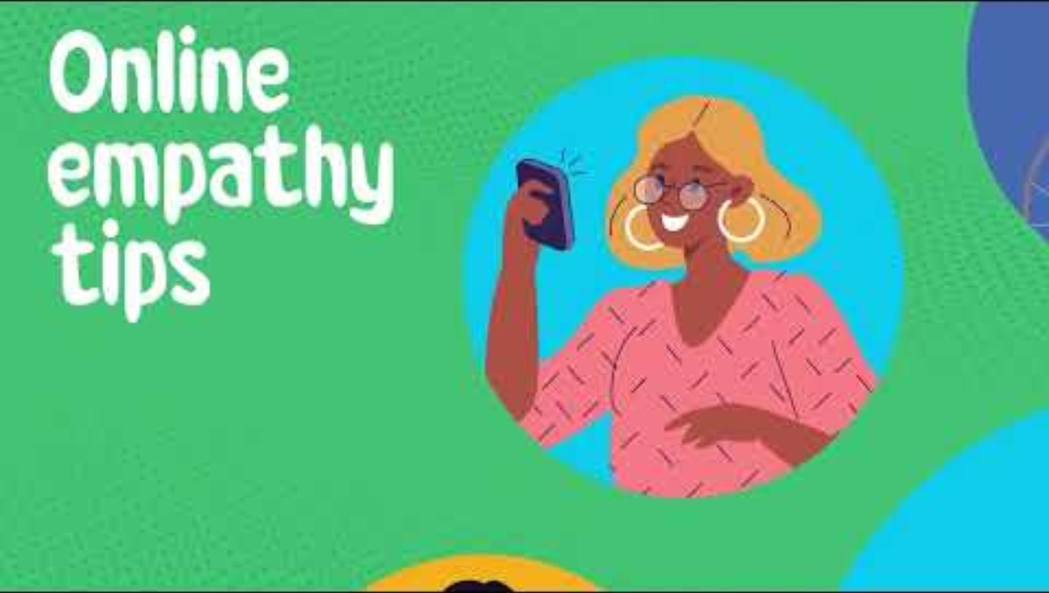
Digital media literacy: Ethics and empathy
Ethics and empathy
Notes:
Online empathy is a good example of what students need to understand, to know, and to be able to do to be digitally literate. As they grow, they become capable of more sophisticated understanding of the key concept that interactions through digital media can have a real impact – for good or ill – on others.
In grade six, this understanding mostly falls under the “Use” competency, as students learn to recognize and manage feelings, especially “hot” emotions which students may not always be consciously aware of, and to defuse conflict instead of letting it escalate.
It’s also essential for them to Know about empathy traps – the aspects of digital communication that make us less likely to recognize how other people are feeling, like the absence of facial expressions or body language – and to learn ways to make up for them.
Whitney Phillips and Ryan Milner, in their book Share Better and Stress Less, suggest what they call “gut check” questions to help youth avoid and defuse conflict: Are you sure this is play? Are you sure this isn’t play? Who isn’t laughing? What is the humor doing and how is it making them feel?
At this age, though, they can begin to learn and practice the Engage competency as well, reflecting on their own values and taking part in shaping the values of their online spaces and communities. Because their morality is shifting from one based on rules and punishments to one based on peer and social norms, students this age are particularly prone to moral disengagement, or what we call “sneaky excuses” in our lessons – the ways we tell ourselves that it’s okay to do something we would otherwise think is wrong (like sharing a sext without the consent of the person in it) or to not do something we know is right (like helping someone who’s a target of cyberbullying.)
Here’s a video that explores this key topic in student-friendly language.

Slide 29
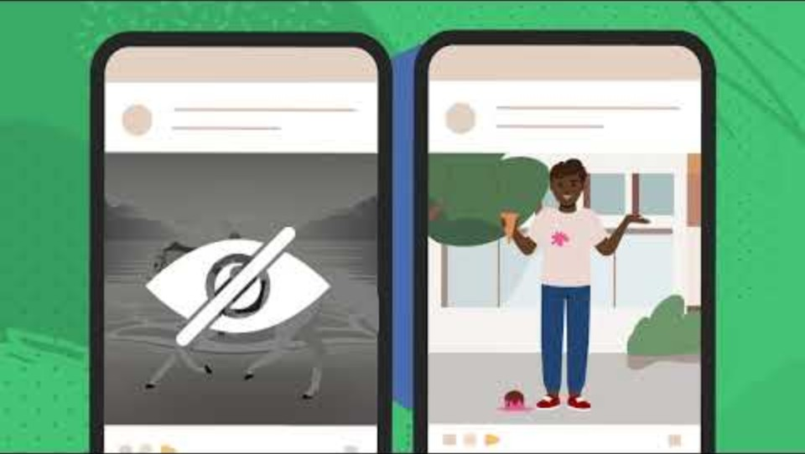
Digital media literacy: Media health
Media health
Notes:
It's crucial for them to understand how the media they use can affect their health. As part of the Understand competency, they can also start to learn the ways that digital tools, particularly online games and social media, are designed to make them spend more time online, then learn and practice ways to Use them more mindfully.
An implication of the key concept that digital media are networked that affects this age group powerfully is the way it exposes us to idealized images of other people and their lives, which can affect their happiness due to comparison and pressure to present a "picture perfect" online image. Here, again, helping students to analyze why digital media – and specific apps in particular – make us likely to do this, and to Understand that everyone else is sharing idealized images of themselves and their lives online, helps them to learn strategies to Use it more healthfully.
We made this video to help explain these ideas and to introduce those skills.

Slide 30
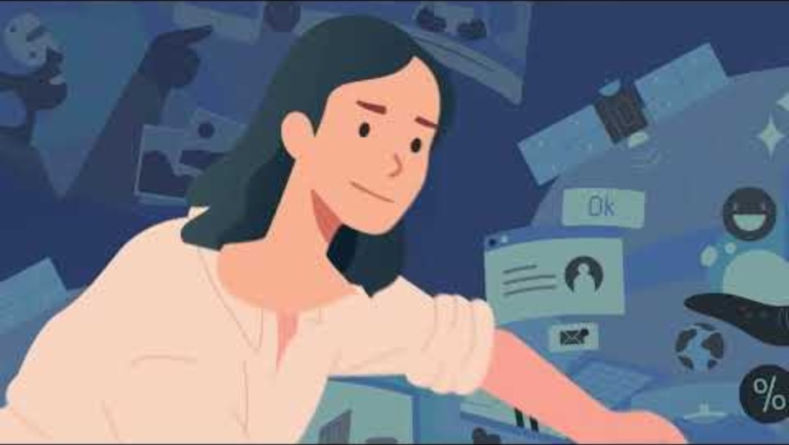
Digital media literacy: Finding and verifying
Finding and verifying
Notes:
One of the key topics related to the Access competency is finding information online.
The key issue for students at this age, though, is limiting themselves to good (and appropriate) content. They do still want to control what they see online: four in ten take steps to avoid seeing pornography. We can help them to do that by teaching them Access skills such as how to use filters themselves and to use search terms and content settings (for instance Restricted Mode on YouTube or TikTok).
When it comes to accessing information, students this age are able to learn and practice all four steps of companion reading – finding the original source of a story or claim, verifying that source, checking it against other sources, and using fact-checking tools – and to follow that up with a skill in the Understand competency, close reading sources that they’ve determined are worth their attention.
This video explains that process of information sorting.

Slide 31
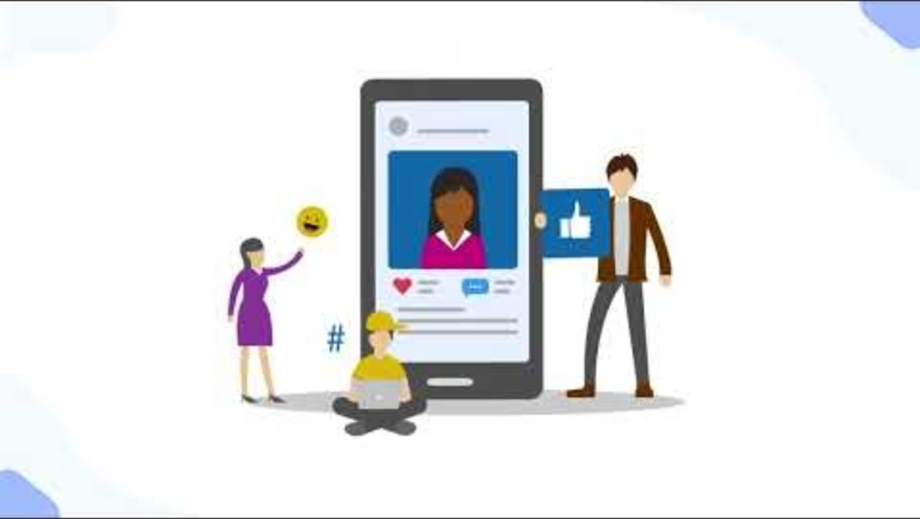
Digital media literacy: Privacy and security
Privacy and security
Notes:
Because digital media are networked, a key part of the Access competency is also controlling who can access your content.
At this age students still mostly understand privacy in personal terms, but they are more aware of the possible risks of sharing content online. We need to encourage them to think about unknown and future audiences for things they post and make sure they know how to use the tools and features available to manage privacy in their apps and games. They need to know how to prevent people they don't know from contacting them in games, social networks, and other online spaces, and how to limit who can see what they post.
Setting their account to private by default is a key strategy to reduce exposure to strangers and unwanted messages. While some platforms default to private for younger users, it's important for students to know how to adjust this themselves – especially since those defaults might not be in place if they lied about their age to sign up.
This video explains the basics of privacy settings.

Slide 32
Reflection 4
How might your identity, beliefs and experiences affect how you approach digital citizenship?
How can you ensure a culturally responsive and inclusive learning environment?
Notes:
Think about the topics we’ve just explored and then take a moment to reflect on your own identity, beliefs and experiences regarding digital media literacy and digital citizenship.
How might these influence how you approach topics like Ethics and Empathy, Media Health, Finding and Verifying or Privacy and Security?
(For example, if most or all of your family and friends live in Canada, you might not appreciate the importance of digital media for keeping some youth in touch with family overseas. You might also, like most adults who are in positions of care for youth with disabilities, underestimate how active they are in using digital media and the risks they encounter there.)
What steps can you take to ensure a culturally responsive and inclusive learning environment?

Slide 33
Best practices
Pitfalls and best practices
Notes:
Now that we know what students need to learn, let’s take a look at how to teach them – as well as some pitfalls to avoid in supporting digital citizenship and on-line safety with elementary students.

Slide 34
Best practices 2
Do:
Empowerment frame
Recognize students’ complex feelings about media
Don’t:
Frame digital citizenship as protection
Notes:
Although we have focused in this workshop largely on the risks that students face from media, it’s important not to frame digital citizenship, or digital media literacy more broadly, in terms of protection. Instead, we should view risk as what students have to learn to manage to access the many benefits they get from media. Starting from the perspective that media in general, or that specific media activities (with a few exceptions) should be minimized, will make students tune you out.
At the same time, we shouldn’t assume that students have unambiguously positive views of the role media plays in their lives, either. Our research has found that young people generally recognize both positive and negative impacts of media, and in many cases do want to mitigate those negatives – but don’t know how to do so.

Slide 35
Best practices 3
Do:
Focus on plausible and relevant risks
Don’t:
Use scare tactics
Notes:
When addressing risks, one of the most common mistakes is to try to keep kids safe by scaring them. While understandable, this doesn’t work for several reasons. First, as they enter into adolescence, students become less and less motivated by fear of consequences. As well, while the most extreme outcomes may get news coverage, they’re unlikely to match students’ experience and so will be dismissed as irrelevant.
Instead, we should focus on more lower-stakes risks that seem plausible and directly relevant such as being embarrassed, having a friend get mad at you or buying something you regret. British neuroscientist Sarah-Jayne Blakemore gives as an example warning teens that smoking “give[s] you bad breath, or put[s] younger children in danger.” As they feel strongly about their newfound independence, they “also respond to the idea that this is an adult industry that is exploiting them to make money.”

Slide 36
Best practices 4
Do:
Give accurate statistics
Teach students to shape social norms
Address them in different contexts
Don’t:
Make risky behaviours seem more common than they are
Make positive behaviours and attitudes seem less common than they are
Notes:
In fact, some of the most effective programs for reducing bullying involve showing students that it is typically less common than students believe. Sharing accurate data from MediaSmarts’ research – for instance, that just one in six students has ever cyberbullied someone else – can go a long way to show that these behaviours are not normal or acceptable.
So can empowering students to shape the social norms of online spaces like games or social networks, where bullying – as well as racism, sexism, homophobia and other forms of prejudice – are often normalized.
In the same way, you want to make sure that they know that many positive behaviours and attitudes are more common than they likely believe: that two-thirds of students this age who witnessed cyberbullying did something to help the target, for instance, that nine in ten trust their parents to make good decisions about them online, and that eight in ten think it’s important to say or do something when you witness prejudice online.
You may not even want to address topics like online hate, sexting or pornography directly at this age, to avoid normalizing them. Instead, you can teach the essential skills and concepts students need in different contexts: teaching students about gender representation and how to find reliable information prepares them for the stereotypes in pornography and makes them less likely to turn it for sexual health education, while you can teach them about respecting consent online in less charged contexts than sexting. (Ideally, of course, they will get more specific lessons on these topics later, but waiting until the topic is appropriate for most students might mean that some who need instruction don’t get it.)

Slide 37
Best practices 5
Do:
Talk about heathy and unhealthy relationships and red flags like:
flattering them
asking to communicate privately
Introducing sexual topics
sharing or offering to share sexual images
asking them to keep the relationship private
Don’t:
Focus on “stranger danger”
Notes:
When we think about online safety, our first instinct is often to focus on warning students about the risks posed by “strangers.” But while they do need to learn how to block or mute “randos” who contact them, most of the risks students face from others come from people they know – and even online-only contacts no longer seem like “strangers” by the time the harm is done.
Instead, they need to understand that the danger online lies in inappropriate behavior, regardless of whether the person is known or a stranger. Teach them to recognize the “red flags” of an unhealthy relationship whether it’s with a peer, someone they already know offline, or an online-only contact: flattering them, especially about how they look; asking about times and places where they could meet or could communicate online in private; introducing sex or sexual topics into the conversation; sharing or offering to share sexual images, either pornography or pictures of the sender; and asking them not to tell their parents or friends about a conversation or about the relationship.

Slide 38
Best practices 6
Do:
Empower witnesses and confront moral disengagement
Don’t:
Blame victims
Notes:
Evaluations of online safety programs have found that when they focus exclusively on the victims of online harm, they can inadvertently lead to blaming those victims. This was found most dramatically with programs on sexting, which often make students feel less sympathy for people whose sexts are shared without their consent and more likely to excuse those who shared them. Similarly, focusing only on what to do when one is a target of cyberbullying can make it seem like harm is the target’s own fault if they don’t do those things.
While it is important to teach students strategies for dealing with cyberbullying if it happens, we should also teach them how they can help if they witness someone else being bullied. Two-thirds of students say they have done this at least once – but about half also say they are sometimes reluctant to do so because they don’t know what to do, or because they are afraid it will make things worse.
In the same way, while we do have a responsibility to make sure students know the risks of sharing potentially embarrassing content online, our main focus should be on addressing the moral disengagement attitudes that might make someone who receives that content think it’s okay to share it without consent.

Slide 39
Best practices 7
Do:
Treat students as authorities on their own experience
Don’t:
Assume students are technical experts
Notes:
Don’t mistake students’ fluency with technology for literacy. While they may master the basic functions of apps and online tools quickly, they often stay at that surface level, and may have little knowledge or understanding of an app’s privacy settings, how to use a search engine effectively, or even how the apps they use make money. Students this age are, in fact, fairly well aware of the limitations of their technical knowledge: 85% say their parents know more about digital technology than they do, and more than half say the same about their teachers.
Where you do want to treat students as authorities, though, is on their own experience – both their personal experiences and their mediaspheres. As much as possible, take their cues about which apps or media texts to cover.

Slide 40
Best practices 8
Do:
Integrate digital media literacy throughout the year and across the curriculum
“Spiral” instruction
Don’t:
Deliver a single “online safety” or “digital media literacy” unit
Focus on just one aspect of digital media literacy
Notes:
Online safety, and digital media literacy more broadly, are often addressed in a single, separate lesson or unit, but research shows consistently that shorter, more frequent lessons spread throughout the year are more effective. While there is a single “digital media literacy” expectation in the Language curriculum, aspects of digital media literacy are also found throughout the A, C, and D strands such as text forms and genres, point of view, critical thinking in literacy and creating texts. Digital literacy is also one of the seven Transferable Skills that are to be assessed “in all of the subjects and disciplines of the Ontario curriculum, from Kindergarten to Grade 12.”
As much as possible, you also want to avoid focusing on just one aspect of digital media literacy or teaching it in the context of only one subject. While we organize them into different topics, all of these aspects of digital media literacy connect to one another – for example, youth who believe traditional gender stereotypes are more likely to share sexts without consent – and connecting to different parts of the curriculum helps to address them from multiple angles. In many cases, such as teaching students to recognize, name and manage their emotions, what’s needed is to ensure that the existing curriculum is extended to the online context.
Don’t assume that students know everything they need to because they received a lesson in a previous year, either. Digital media literacy concepts should also be revisited and built upon, much like math education. “Spiraling” teaching helps students' understanding of online risks evolve along with their cognitive and moral development and their changing digital experiences.

Slide 41
Reflection 5
How can you reframe your language to avoid “scare tactics” and “stranger danger?”
How can you “spiral” digital media literacy throughout the year and across different subjects?
Notes:
Take a moment to think about how you currently teach digital citizenship.
Do you need to reframe your language to avoid “scare tactics” and “stranger danger”? If so, what are some ways you could do that?
How can you “spiral” digital media literacy instruction throughout the year, and across different subjects?

Slide 42
Effective teaching strategies
Effective teaching strategies:
Skill-building and simulation
Role-playing and moral dilemmas
  “What would you do if you’re on a group text and someone says they want to restart the group text without you?
  What will you do if someone says something mean about a teacher or another friend?
  What could you say to a friend who is texting you too much, and you need a break?”
Notes:
Particularly at this age, as students are just becoming comfortable with more abstract thinking, one of the most effective approaches to teaching digital citizenship is through skill-building: having a sense of our own efficacy is an essential element of resilience.
One of the best ways of doing this is through simulating risk experiences that are likely to encounter. Depending on the specific topic, these don’t necessarily have to be “high-fidelity” simulations: role-playing scenarios and, particularly, moral dilemmas (which force students to weigh two values against one another, rather than having a single right answer) are highly effective.
Digital citizenship expert Devorah Heitner suggests a few simple questions to help students practice the pressures of communicating online:
What would you do if you’re on a group text and someone says they want to restart the group text without you?
What will you do if someone says something mean about a teacher or another friend?
What could you say to a friend who is texting you too much, and you need a break?

Slide 43
Effective teaching strategies 2
Effective teaching strategies:
Making media and analysis
Balancing skills, knowledge and understanding
Civic engagement
Notes:
Making media is always an engaging way of teaching digital citizenship, but it’s important to teach students how to analyze media as well – in particular, looking at the way media influence our sense of reality and the ways in which digital media influence how we use them. Research has shown that teaching students the “design tricks” that apps use to nudge us to use them longer or come back to them more often is an important part of helping to use them more mindfully.
As we noted earlier, digital media literacy consists of competencies, topics and key concepts. While it’s not enough just to teach content, students do need some direct instruction to be able to do things like manage privacy settings or critically engage with advertising.
We can also take advantage of the fact that students are full citizens online to frame digital citizenship in a more positive, empowering way.

Slide 44
Effective teaching strategies 3
Effective teaching strategies:
Use media to provide multiple means of representation, expression and engagement
Recognize unique vulnerabilities and benefits
Notes:
Integrating digital media literacy into your classroom is also a way of providing students with the multiple means of representation, expression and engagement that are central to universal design for learning. This is particularly true of media-making activities, which Jeannine Chartier and Yonty Friesem point out can “teach students that there are many diverse roles on a production team; for example, a student with learning disabilities may have trouble expressing themselves through writing, but can articulate visually through use of a storyboard.”
It’s important to make sure your instruction is inclusive of all students. In particular, research has found that while adults typically underestimate the online risks that youth with disabilities are exposed to, they actually experience more risk – and gain more benefits – from being online than any other group. As well, different students may not experience the same harms from similar risks: research that found screen time was associated with anxiety and depression in neurotypical youth found no association between them among youth with autism. The same may be true for other aspects of students’ identity: some research has found that unlike cisgender youth, trans and non-binary young people may experience positive effects on their body image as a result of using digital media specifically.

Slide 45
Effective teaching strategies 4
Effective teaching strategies:
Positioning students as mentor
Whole-school approach
Involving parents
Modeling
Notes:
Another empowering approach is to position students as mentors. By grade six, students are old enough to teach younger students "what they wish they had known"! This can also be combined with other strategies, such as having them design a version of an app that they feel would be safe for younger children to use.
Whenever possible, work together with other teachers, school support staff and administrators for a whole-school approach; this is particularly important for issues where social norms play a big role, such as cyberbullying. At the very least, make sure that you’re familiar with your school or board’s policies on reporting student disclosures.
It’s also essential to involve parents whenever possible, such as by sending home parent guides and tipsheets that support the classroom learning.
Finally, the behaviour we model to our students has a powerful impact, such as showing respect for students’ online privacy. But it’s important not to present ourselves as infallible: being open about our own struggles with balancing our device use, acknowledging our vulnerability to advertising tricks, and encouraging critical thinking by talking about times we’ve changed our mind on important topics model the idea that we are all learners when it comes to media and technology – and that that learning doesn’t stop when we leave school.

Slide 46
Reflection 6
Think of one thing you will change about how you teach online safety and digital citizenship.
What supports are available?
What else will you need?
Notes:
Let’s pause for one final reflection and think of one thing that you will change about how you teach digital citizenship, digital media literacy, or online safety as a result of this workshop.
Once you’ve identified that, think about what supports you already know are available to help you do that, and then what else you might need that isn’t already available.
If you are facilitating a live session: If you want, you can share your answers with us. You may already know about a resource somebody else needs, or vice-versa!

