Slide 1
Healthy Choices: Substance Use and Digital Safety Modules for Grade 6 Students
Overview slide deck

Slide 2
What are the learning modules?​
two 60-minute lesson plans from the Ministry of Education about digital safety and substance use health
curriculum-aligned resource materials to deliver Health and Physical Education and Language curriculum expectations and support consistent in-person learning
The focus of the learning is on knowing the facts and developing strategies to help make healthy and safe decisions.

Slide 3


Digital Media: Safe and Healthy Personal Choices
Curriculum expectations
Language
A2.2 demonstrate an understanding of how to navigate online environments safely, manage their privacy and personal data, and interact in a way that supports their well-being and that of others, including seeking appropriate permission
Health and Physical Education
D2.3 apply social-emotional learning skills to promote positive interaction and avoid or manage conflict in social situations, in person or online

Slide 4
Digital Media: Safe and Healthy Personal Choices - 2
Digital Media: Safe and Healthy Personal Choices
Learning goals
Identify practices that can help us safely navigate and positively contribute to online environments.
Describe positive digital media habits that protect our privacy and support the well-being of ourselves and others.
Engage in informed and healthy digital media choices that work best for each of us.

Slide 5
Digital Media: Safe and Healthy Personal Choices - 3
Digital Media: Safe and Healthy Personal Choices
Lesson plan
Minds On | Action | Consolidation
Understanding key terms Build shared understanding of key terms needed for the lesson. | Level up Identify some of the privacy and safety risks that exist online and explore tools to help students take charge of their digital media experience and support their relationships/interactions online. | Sharing strategies and learnings Students reflect on the learning and share their ideas.
Notes:
This slide outlines the purpose of each part of the module and provides a few sample activities. There is so much more included. We hope you'll take a look.

Slide 6
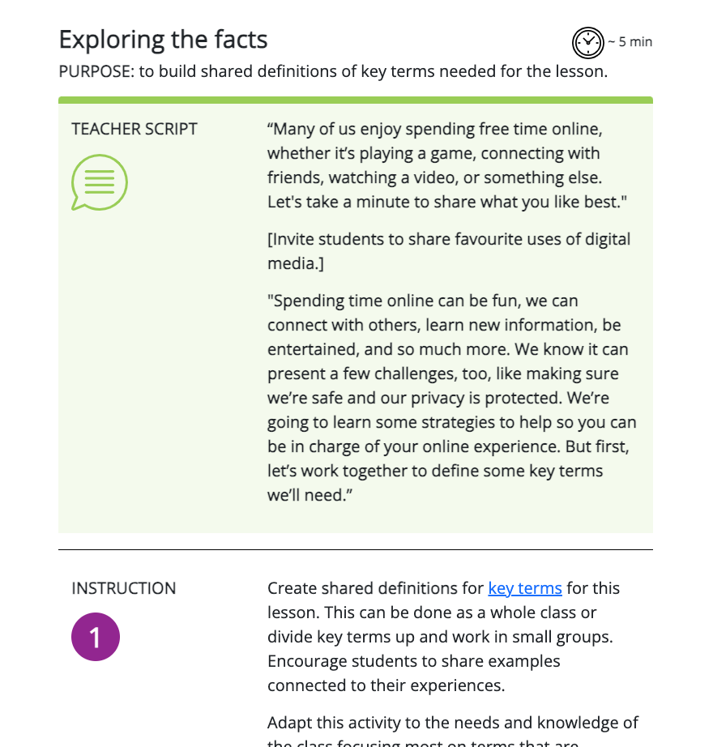
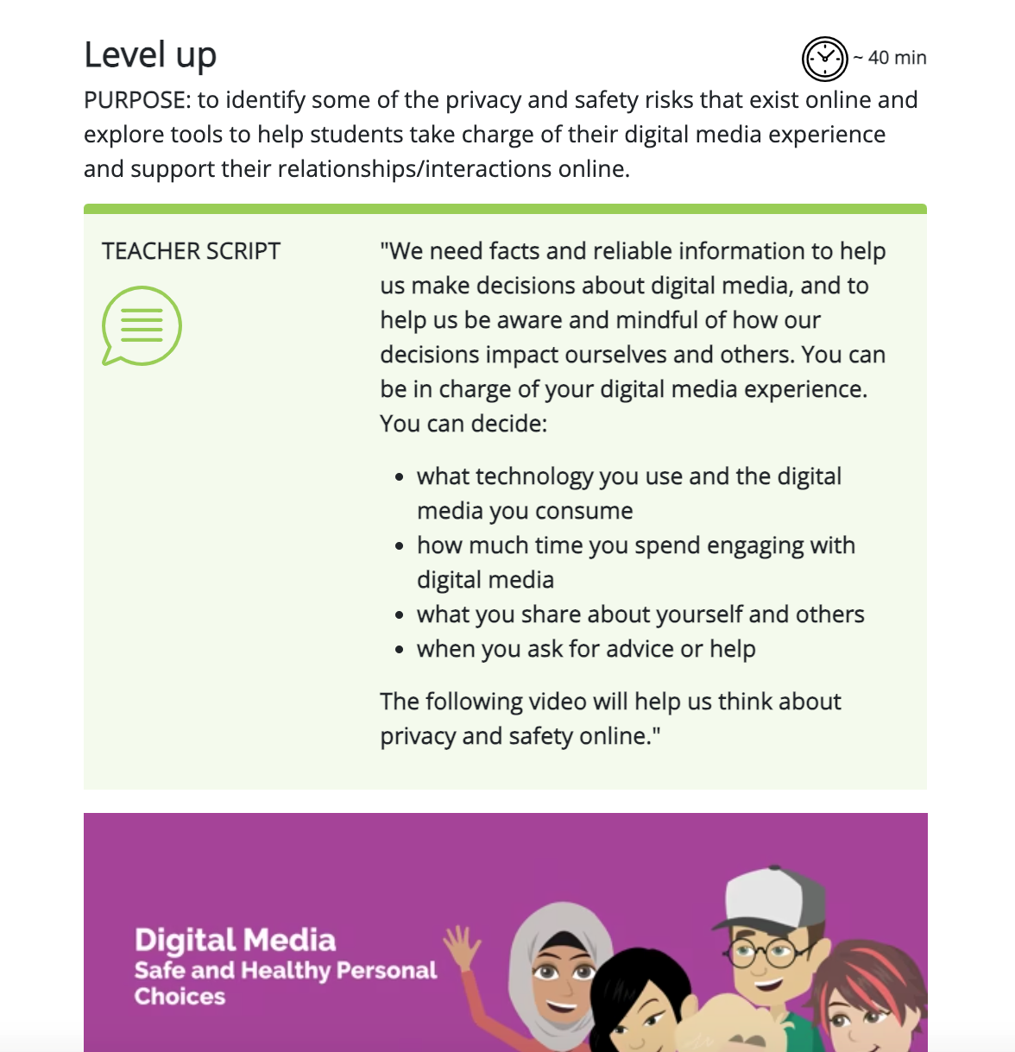
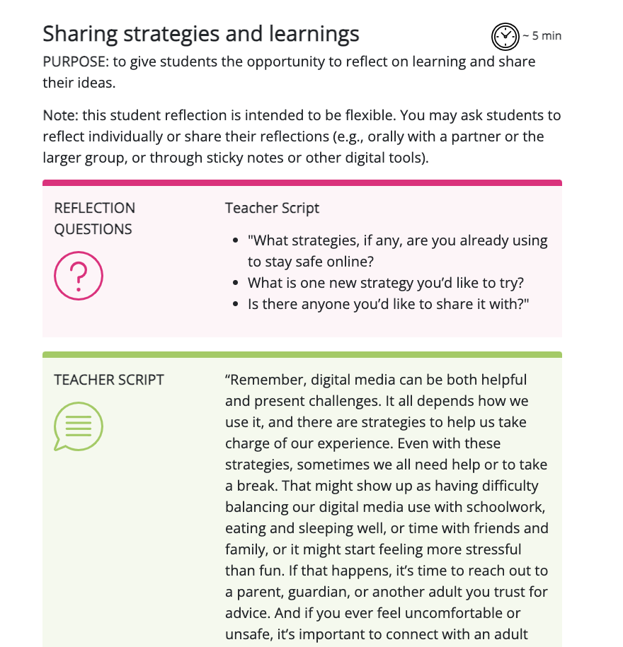
Digital Media: Safe and Healthy Personal Choices - 4
Digital Media: Safe and Healthy Personal Choices
Minds On | Action | Consolidation
Notes:
This slide outlines the purpose of each part of the module and provides a few sample activities. There is so much more included. We hope you'll take a look.

Slide 7
Substance Use: Addictions and Related Behaviours
Curriculum expectations
Health and Physical Education
D1.2 describe the range of effects associated with using cannabis, other drugs, and intoxicating substances
D2.4 use decision-making strategies and skills and an understanding of factors influencing drug use to make safe personal choices about the use of drugs such as alcohol, tobacco, and cannabis, and about activities such as vaping, including the choice to abstain

Slide 8
Substance Use: Addiction and Related Behaviours - 2
Substance Use: Addictions and Related Behaviours
Learning goals
Explore the range of effects associated with various substances, including cannabis, vapour and tobacco products, and alcohol.
Identify factors that can influence our decisions about substance use.
Analyze and practice decision-making skills and refusal strategies to identify those that would work best for each of us.

Slide 9
Substance Use: Addiction and Related Behaviours - 3
Substance Use: Addictions and Related Behaviours
Lesson plan
Minds On | Action | Consolidation
Exploring the facts Support students in understanding substance use vocabulary and introduce students to the range of effects. | Building a shared understanding Learn more about students’ pre-existing knowledge and perceptions of substance use and to dispel some common myths and misconceptions related to substance use. | Making informed choices Provide an opportunity to think about and practice substance use decision-making strategies.
Notes:
This slide outlines the purpose of each part of the module and provides a few sample activities. Once again we hope you will explore everything else offered.

Slide 10
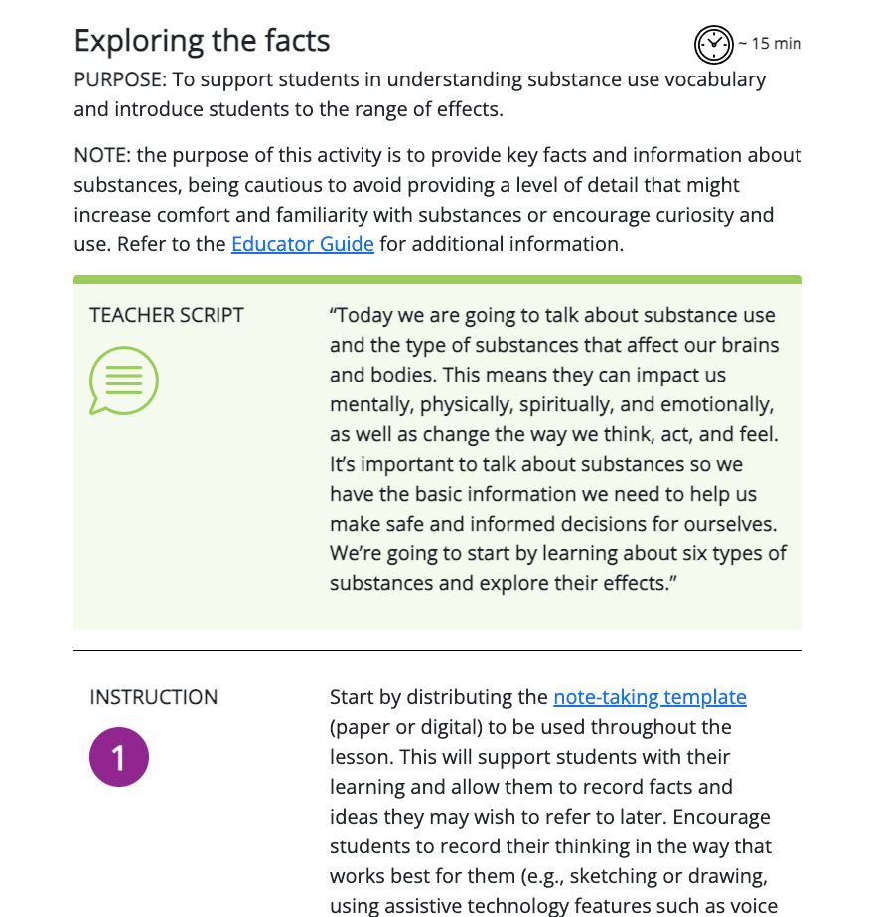
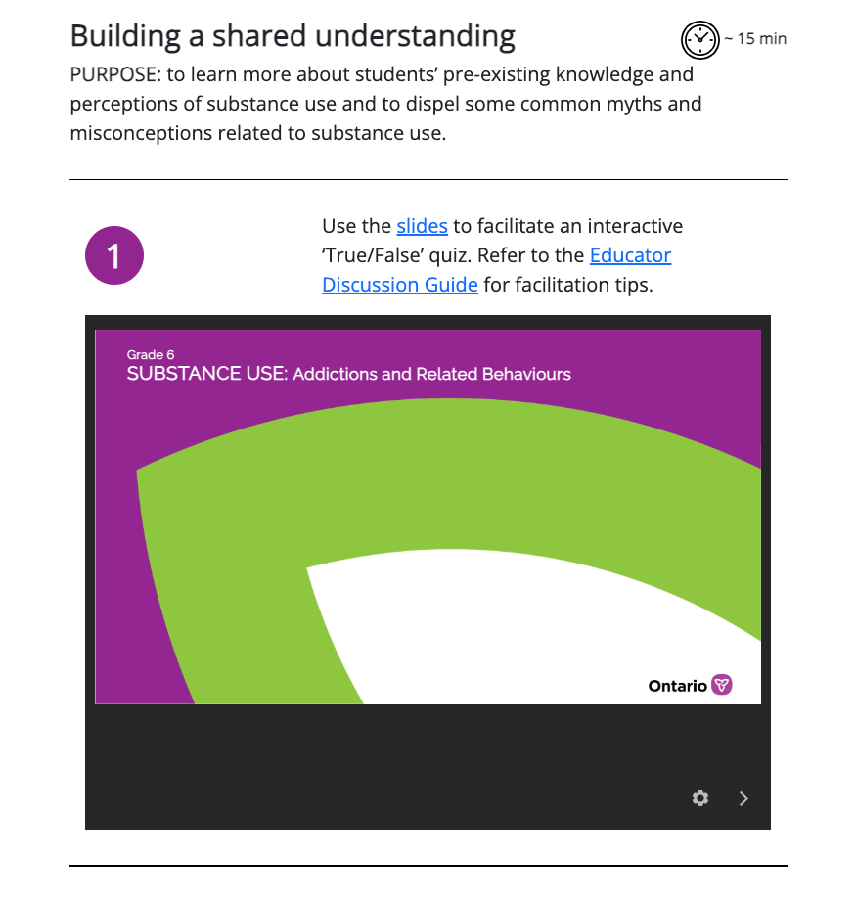
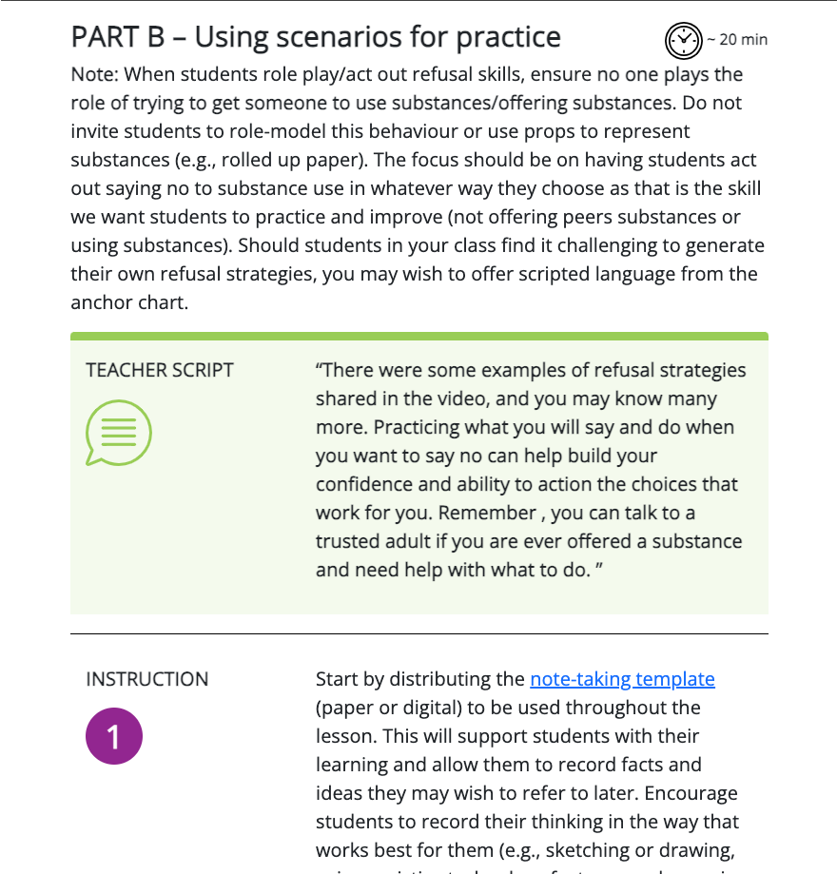
Substance Use: Addiction and Related Behaviours - 4
Substance Use: Addictions and Related Behaviours
Minds On | Action | Consolidation
Notes:
This slide outlines the purpose of each part of the module and provides a few sample activities. Once again we hope you will explore everything else offered.

Slide 11
Added benefits of this learning
Grade 6 students face increasing opportunities to engage with digital media and substances – this learning is proactive.
The modules offer a consistent framework for navigating digital safety, making informed choices about substance use and promote a positive school climate and student well-being.
Making informed choices that align with our identities, values, and goals can help support student mental health and well-being, which in turn supports student learning and achievement.

Slide 12


What else is included?
Additional materials are provided to help educators customize and enhance the learning, if they wish. For example:
extension activities
choice of assessment tools
educator guides with background
information to support planning and
understanding

Slide 13
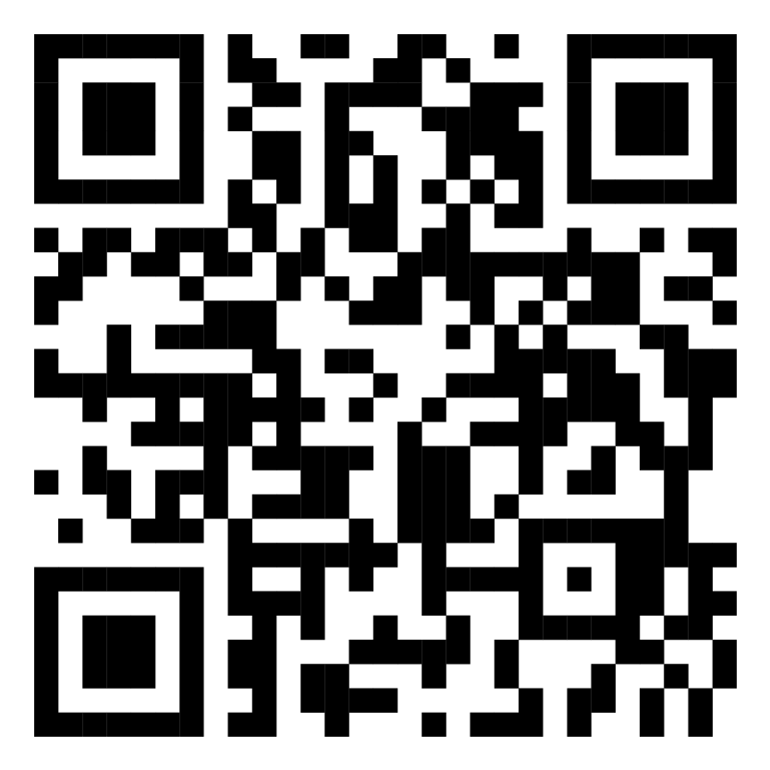
Where can I find the modules?
All materials are available through the Ministry of Education’s virtual learning environment (Ontario’s VLE).
Each school board has a Technology-Enabled Learning and Teaching (TELT) contact that can provide assistance.
To access, start at your school board’s virtual learning environment
  go to d2l.com/k-12/Ontario and select your school board
Notes:
[Boards may wish to add information/images about their board VLE on this slide.]

Slide 14
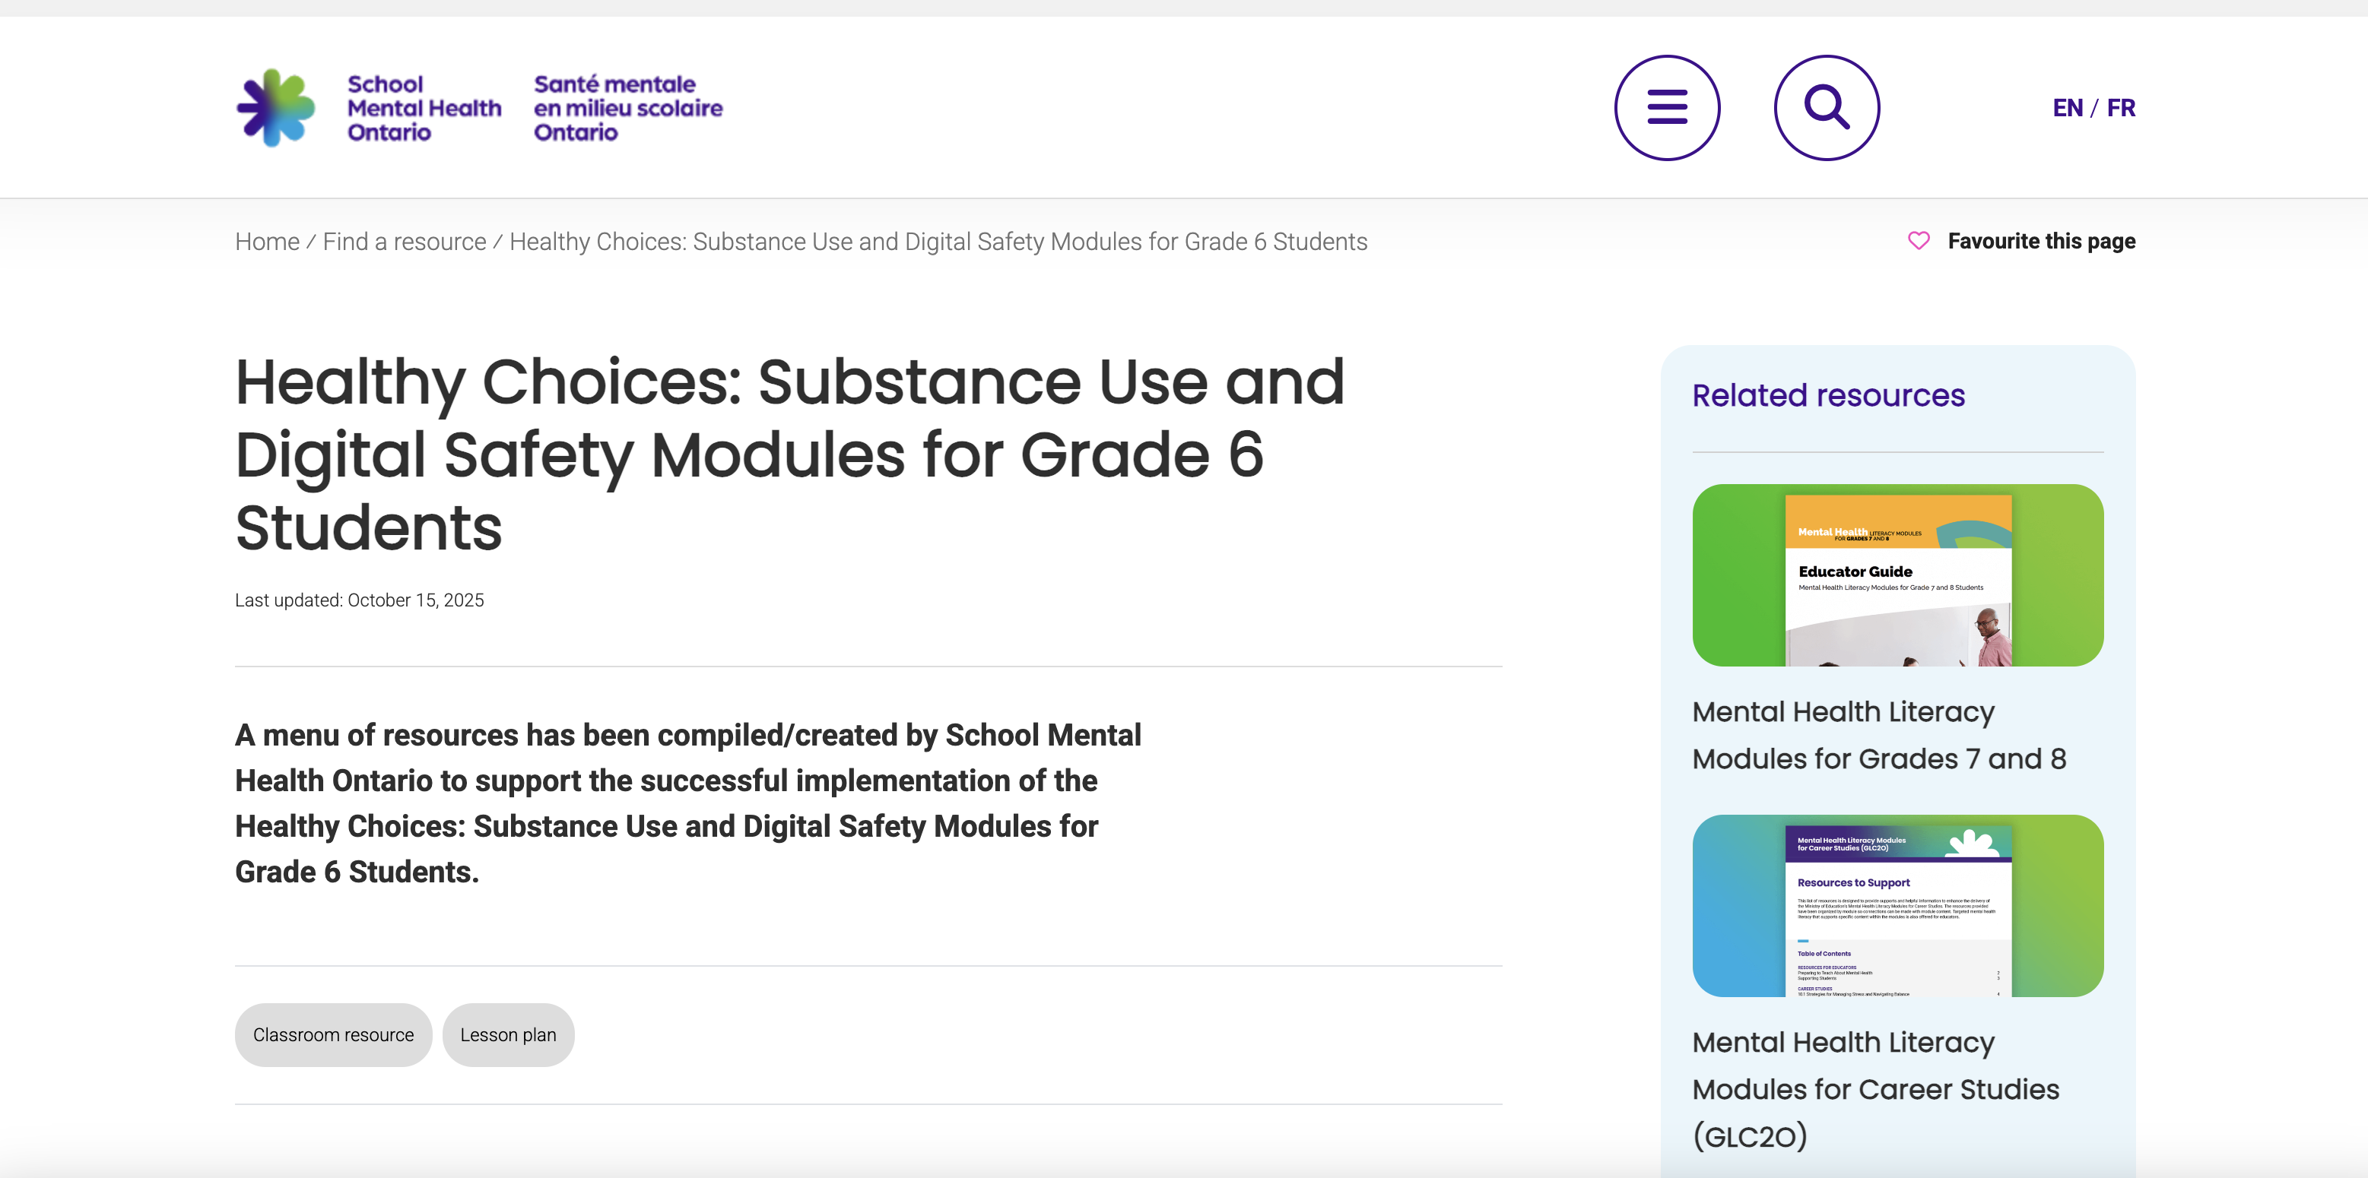
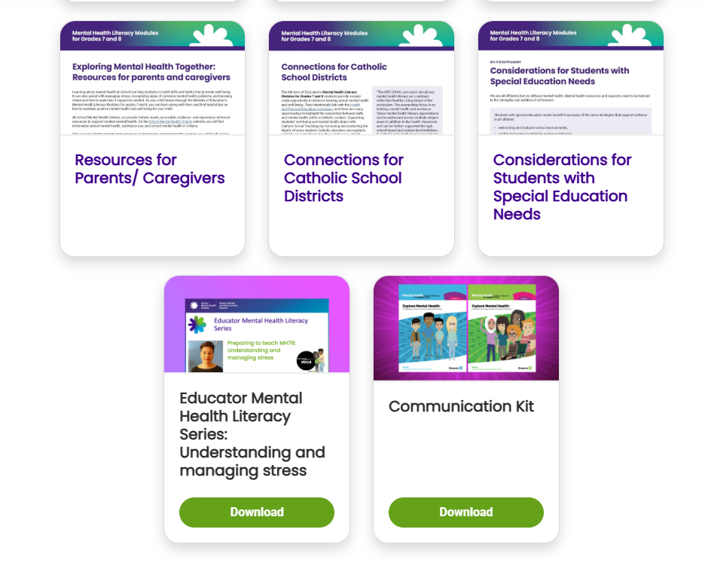
Are other supports available?
In addition to the modules and resources found in the virtual learning environment (VLE), supplementary resources are available on School Mental Health Ontario's website. For example:
help navigating the VLE
complementary resources
opportunities for professional learning
Notes:
https://smho-smso.ca/online-resources/healthy-choices-substance-use-and-digital-safety-modules-for-grade-6-students/

