Slide 1

Healthy Choices: Substance Use and Digital Safety Modules for Grade 6 Students
Orientation for educators
Notes:
Welcome to the Ministry of Education's Healthy Choices: Substance use and digital safety modules for grade 6 students. This brief overview will provide an orientation to the modules and content. I’m Stephanie Oliver, a seconded educator from the Ottawa Catholic School Board, and I work in the Mental Health Promotion and Literacy team here at School Mental Health Ontario. Thank you for joining me and let's dive in!

Slide 2

Our time together
Overview of the modules
Digging deeper
  Digital Media: Safe and Healthy Personal Choices
  Substance Use: Addiction and Related Behaviour
Supportive resources
Accessing the modules
Next steps
Notes:
In our time together today, we will share a little about why this learning matters. Then we'll provide an overview of the modules, alignment with curriculum, special features, and supportive resources. We'll also offer a quick look at the modules as teachers will see them on the VLE. Finally, we offer some possible next steps.

Slide 3

Overview of the modules
Notes:
This section will walk through the main learning themes and give you a sense of what you can expect within the modules.

Slide 4

What are the learning modules?​
two 60-minute lesson plans from the Ministry of Education about substance use and digital safety
curriculum-aligned resources to help deliver select Grade 6 Health and Physical Education and Language curriculum expectations
The focus of the learning is on knowing the facts and developing strategies to help make healthy and safe decisions.
Notes:
The two 60-minute modules are designed to be delivered by educators to support expectations within the Health and Physical Education and Language curricula.
The modules are available in both English and French.

Slide 5

Why is this learning important in grade 6?
Many students begin experimenting with substances such as cannabis or alcohol by Grades 7 or 8.
50% of students report having their own cell phone by age 11.
The majority of students under 13 years of age have at least one social media account.
Notes:
Student reports of substance use, such as the Ontario Student Drug Use and Health Survey (2023) (https://www.camh.ca/en/science-and-research/institutes-and-centres/institute-for-mental-health-policy-research/ontario-student-drug-use-and-health-survey---osduhs) indicate that many students begin increasingly experimenting with substances, such as cannabis or alcohol, in Grades 7 and 8. Therefore, it is essential that learning focuses on understanding the effects of substance use, developing decision-making strategies, and an understanding of factors influencing drug use.
Young Canadians in a Wireless World, a research study on youth technology and social media use, indicates that a majority of young students (under the age of 13) have accounts on at least one social media platform. Additionally, 50% of students report having their own smartphone by age 11. Therefore, as students increasingly engage with technology and the internet, they need to develop digital media literacy skills to help them stay safe, healthy and well.

Slide 6
Added benefits of this learning
Grade 6 students face increasing opportunities to engage with digital media and substances – this learning is proactive.
Lessons support a positive and respectful school climate.
Making informed choices that align with our identities, values, and goals can help support student mental health and well-being, which in turn supports student learning and achievement.
Notes:
Student reports of substance use, such as the Ontario Student Drug Use and Health Survey (2023) (https://www.camh.ca/en/science-and-research/institutes-and-centres/institute-for-mental-health-policy-research/ontario-student-drug-use-and-health-survey---osduhs) indicate that many students begin increasingly experimenting with substances, such as cannabis or alcohol, in Grades 7 and 8. Therefore, it is essential that learning focuses on understanding the effects of substance use, developing decision-making strategies, and an understanding of factors influencing drug use.
Young Canadians in a Wireless World (https://mediasmarts.ca/research-and-evaluation/young-canadians-wireless-world), a research study on youth technology and social media use, indicates that a majority of young students (under the age of 13) have accounts on at least one social media platform. Additionally, 50% of students report having their own smartphone by age 11. Therefore, as students increasingly engage with technology and the internet, they need to develop digital media literacy skills to help them stay safe, healthy and well.
The Ontario Ministry of Education's Policy Program Memorandum 128: The Provincial Code of Conduct and School Board Codes of Conduct (2024) (https://www.ontario.ca/document/education-ontario-policy-and-program-direction/policyprogram-memorandum-128) provides a framework for fostering a positive and respectful school climate. By teaching about substance use, such as vaping nicotine and cannabis, educators are directly supporting the provincial code of conduct.
As the Ontario Ministry of Education's Policy Program Memorandum 169: Student Mental Health (2024) (https://www.ontario.ca/document/education-ontario-policy-and-program-direction/policyprogram-memorandum-169) states, mental health is a critical component of overall student success. Making informed choices that align with our identities, values, and goals can help promote our mental health and well-being. Consequently, programs that guide students in making safe and healthy choices, such as these lessons, can contribute to both increased student achievement and improved overall well-being.

Slide 7

Module structure
Learning is presented in a three-part lesson plan:
  Minds on
  Action
  Consolidation
Notes:
The modules follow a familiar three-part lesson format, including a Minds On, Action Tasks, and a Consolidation.
Optional Activities to wrap up the learning in a supportive way and help students transition to the next part of their day are also provided.

Slide 8

Special features
Tip sheets and discussion guides
Teacher scripts with helpful language
Prepared slide decks
Click and play videos
Notes:
Both lessons have a variety of special features built in to support delivery and the educator's experience.
Tip sheets and discussion guides "pop up" just at the right time.
Teacher scripts can be used as a guide for facilitating informed discussions that foster meaningful, respectful, and inclusive learning.
Prepared slide decks
Click and play videos with accessibility features such as described audio and closed captions.
Healthy Choices Promotional video (Vimeo): https://vimeo.com/1109973709/6922b77701

Slide 9

Digging deeper
Notes:
Today we are excited to be able to dig deeper and explore the specific themes and content s of each modules to assist you in your planning.

Slide 10
Digital Media: Safe and Healthy Personal choices

Slide 11



Digital Media: Safe and Healthy Personal Choices - 2
Digital Media: Safe and Healthy Personal Choices
Curriculum expectations
Language
A2.2 demonstrate an understanding of how to navigate online environments safely, manage their privacy and personal data, and interact in a way that supports their well-being and that of others, including seeking appropriate permission
Health and Physical Education
D2.3 apply social-emotional learning skills to promote positive interaction and avoid or manage conflict in social situations, in person or online
Notes:
The digital media module offers a complete lesson that address learning related directly to these two curriculum expectations. Consider how this learning might also connect with other teaching/learning or events related to digital media literacy and digital citizenship within your class and the school as a whole.

Slide 12

Digital Media: Safe and Healthy Personal Choices - 3
Digital Media: Safe and Healthy Personal Choices
Learning goals
Identify practices that can help us safely navigate and positively contribute to online environments.
Describe positive digital media habits that protect our privacy and support the well-being of ourselves and others.
Engage in informed and healthy digital media choices that work best for each of us.
Notes:
This lesson helps students...

Slide 13

Digital Media: Safe and Healthy Personal Choices - 4
Digital Media: Safe and Healthy Personal Choices
Lesson plan
Minds On | Action | Consolidation
Understanding key terms Build shared understanding of key terms needed for the lesson. | Level Up Identify some of the privacy and safety risks that exist online and explore tools to help students take charge of their digital media experience and support their relationships/interactions online. | Sharing strategies and learnings Students reflect on the learning and share their ideas.
Notes:
This slide outlines the purpose of each part of the module and provides a few sample activities. There is so much more included. We hope you'll take a look.

Slide 14
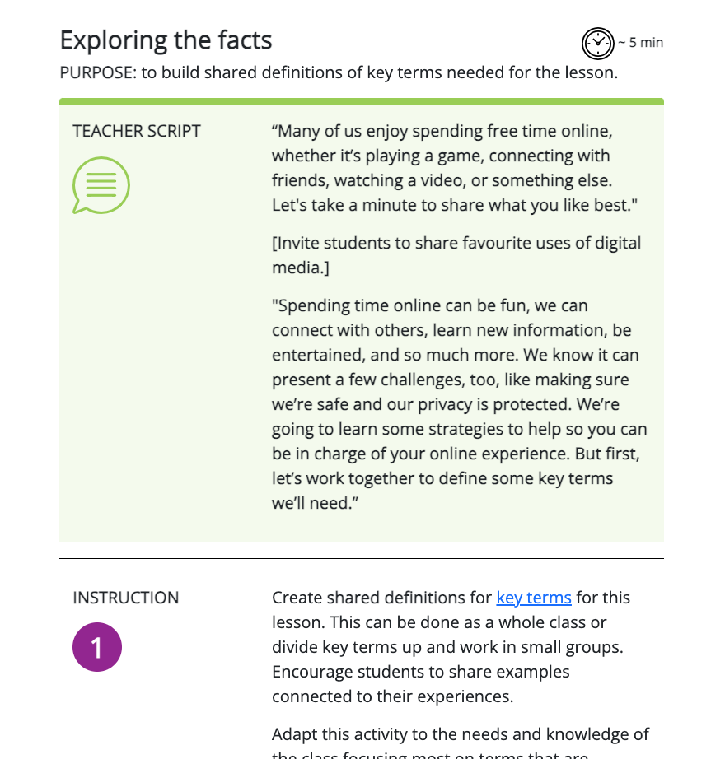
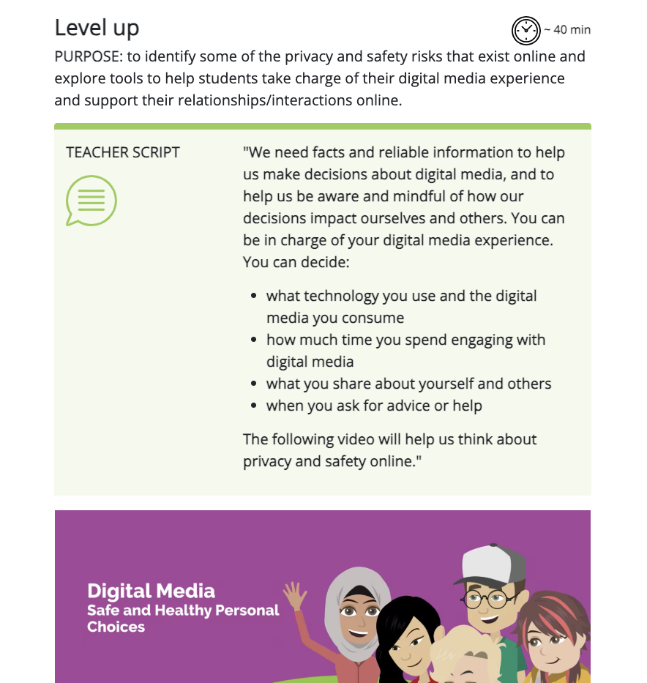
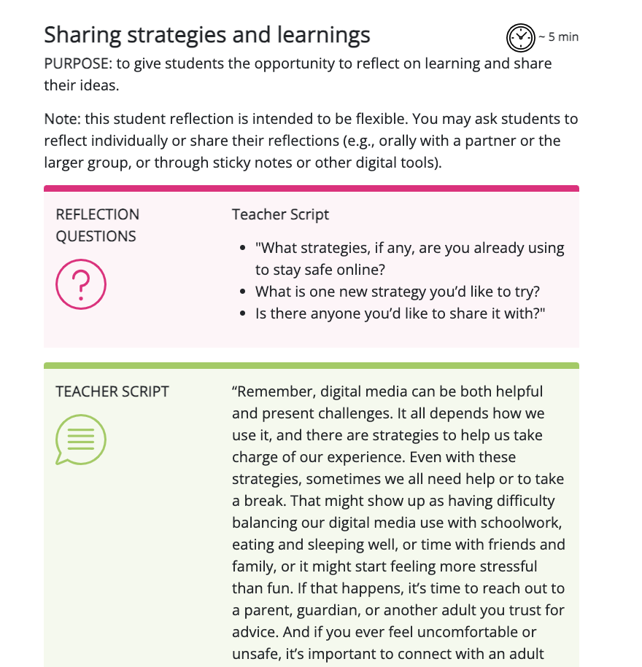
Digital Media: Safe and Healthy Personal Choices - 5
Digital Media: Safe and Healthy Personal Choices
Minds On | Action | Consolidation
Notes:
This slide outlines the purpose of each part of the module and provides a few sample activities. There is so much more included. We hope you'll take a look.

Slide 15
Substance Use: Addictions and Related Behaviours

Slide 16
Substance Use: Addictions and Related Behaviours
Curriculum expectations
Health and Physical Education
D1.2 describe the range of effects associated with using cannabis, other drugs, and intoxicating substances
D2.4 use decision-making strategies and skills and an understanding of factors influencing drug use to make safe personal choices about the use of drugs such as alcohol, tobacco, and cannabis, and about activities such as vaping, including the choice to abstain
Notes:
Substance use: addiction and related behaviours module offers a complete lesson that address learning related directly to these two curriculum expectations. Consider how this learning might also connect with other teaching/learning or events related to safe and healthy choices and substance use within your class and the school as a whole.

Slide 17

Substance Use: Addiction and Related Behaviours - 2
Substance Use: Addictions and Related Behaviours
Learning goals
Explore the range of effects associated with various substances, including cannabis, vapour and tobacco products and alcohol.
Identify factors that can influence our decisions about substance use.
Analyze and practice decision-making skills and refusal strategies to identify those that would work best for each of us.

Slide 18

Substance Use: Addiction and Related Behaviours - 3
Substance Use: Addictions and Related Behaviours
Lesson plan
Minds On | Action | Consolidation
Exploring the facts Support students in understanding substance use vocabulary and introduce students to the range of effects. | Building a shared understanding Learn more about students’ pre-existing knowledge and perceptions of substance use and to dispel some common myths and misconceptions related to substance use. | Making informed choices Provide an opportunity to think about and practice substance use decision-making strategies
Notes:
This slide outlines the purpose of each part of the module and provides a few sample activities. Once again we hope you will explore everything else offered.

Slide 19
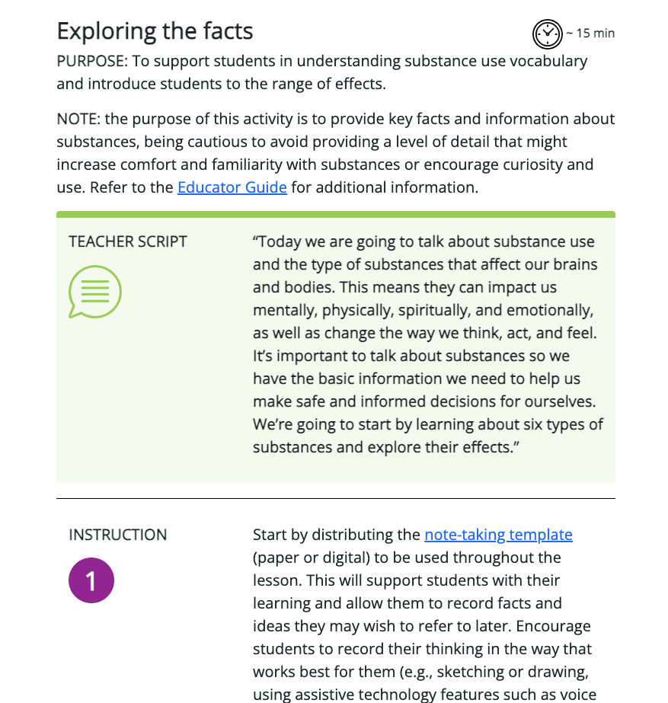
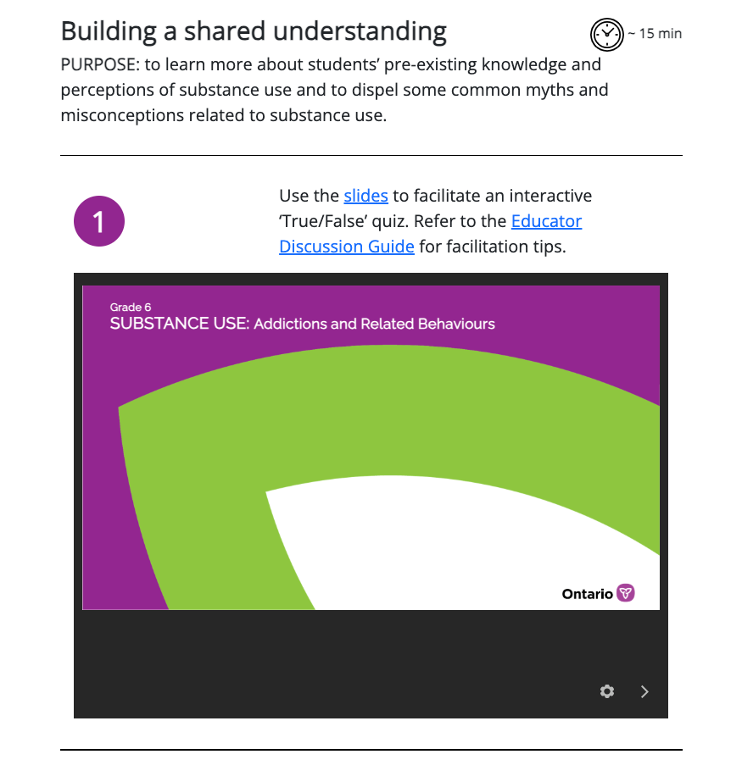
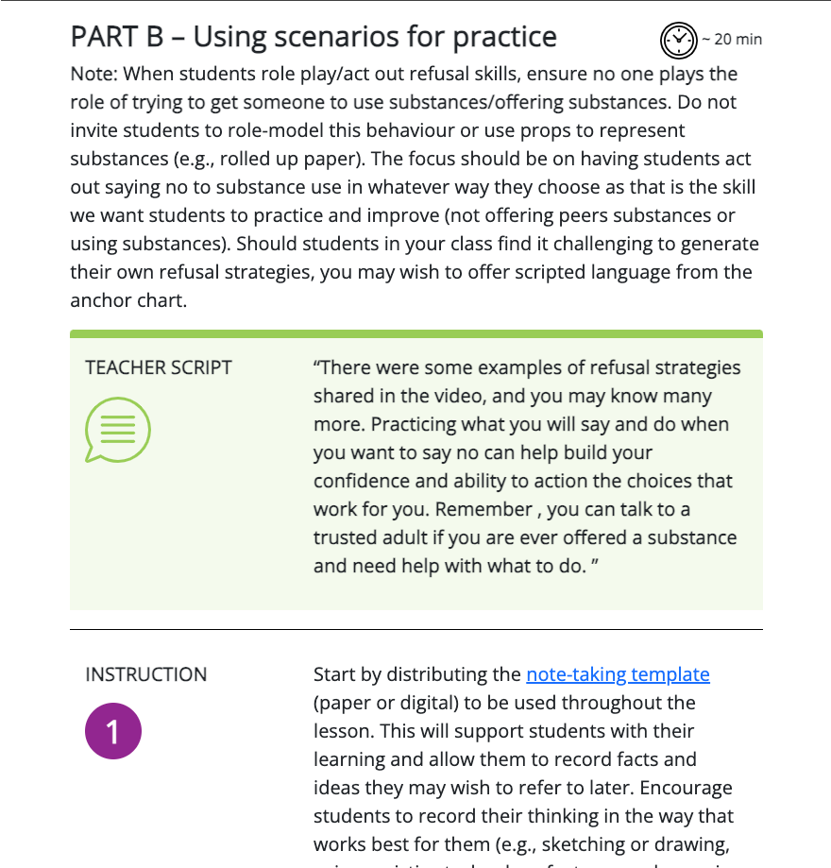
Substance Use: Addiction and Related Behaviours - 4
Substance Use: Addictions and Related Behaviours
Minds On | Action | Consolidation
Notes:
This slide outlines the purpose of each part of the module and provides a few sample activities. Once again we hope you will explore everything else offered.

Slide 20

Supportive resources
Notes:
This section provides additional supports and resources to support the modules.

Slide 21



Educator guides
suggestions for preparation to teach about substance use and digital medias
ideas on how to help if a student needs extra support
background information for educators on substance use and digital media
Notes:
Each modules has its own accompanying educator guide with many helpful components such as...

Slide 22

What else is included?
Additional materials are provided to help educators customize and enhance the learning, if they wish. For example:
optional extension activities
choice of assessment tools
ready-made optional communication for
parents/caregivers
educator guides with background information
to support planning and understanding
Notes:
Additional materials are provided to help you customize and enhance the learning.
For example:
Extension activities
Choices of assessment tools
And ready-made communication for parents and caregivers

Slide 23

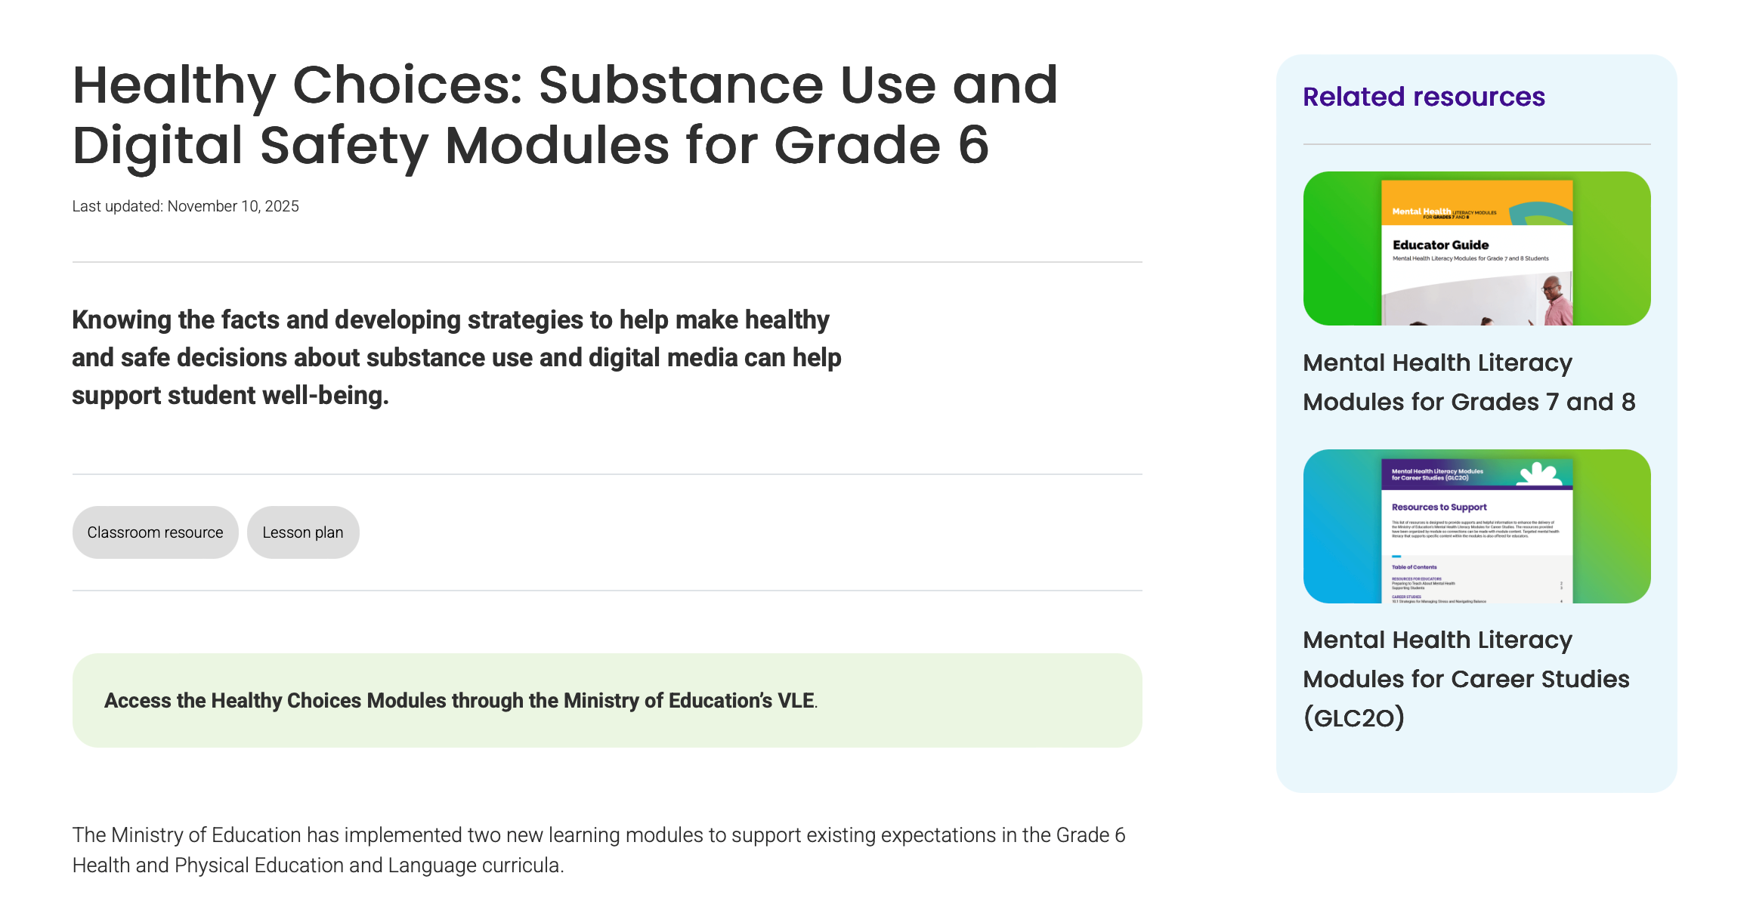
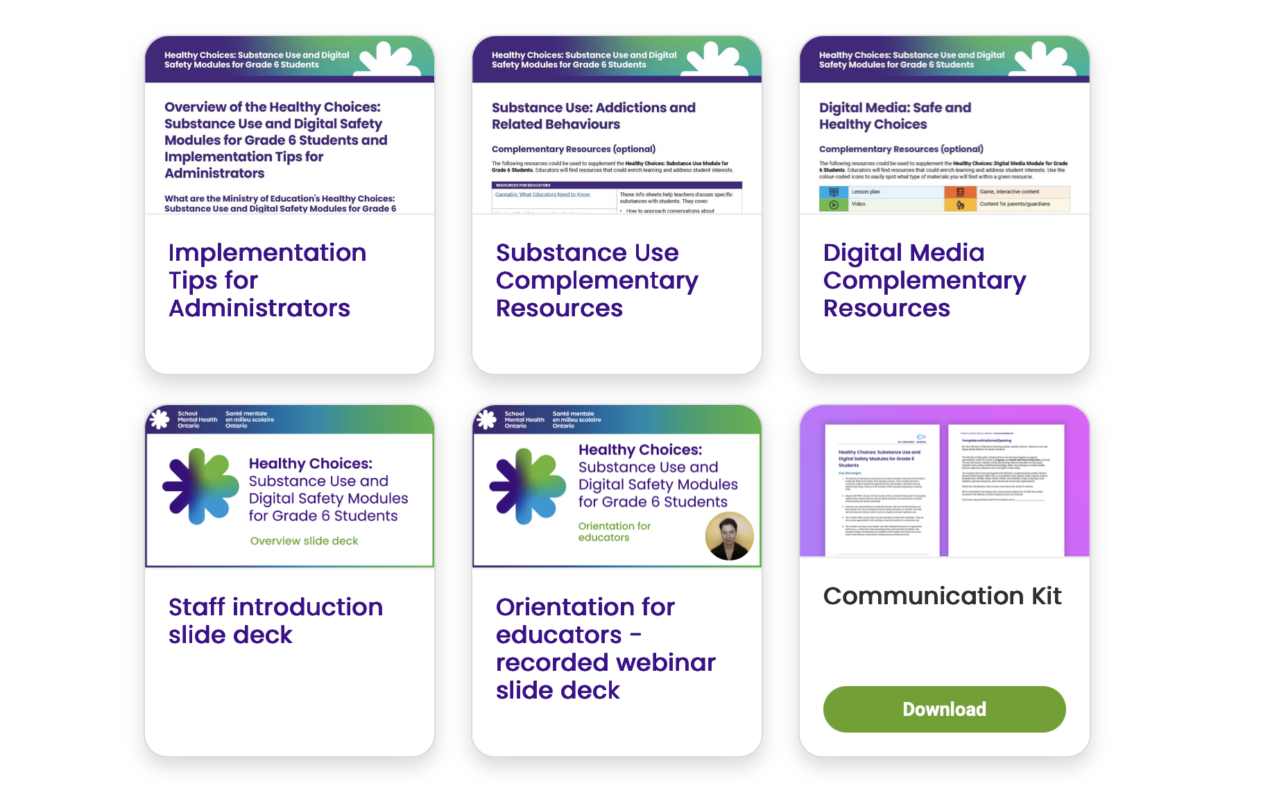
Are other supports available?
In addition to the modules and resources found in the virtual learning environment (VLE), supplementary resources are available on School Mental Health Ontario's website. For example:
help navigating the VLE
complementary resources
opportunities for professional learning
Notes:
School Mental Health Ontario has created a variety of additional supports to complement the Ministry modules. These can be accessed on the Healthy Choices: Substance Use and Digital Safety Modules for Grade 6 students page of the SMH-ON website.
https://smho-smso.ca/online-resources/healthy-choices-substance-use-and-digital-safety-modules-for-grade-6/

Slide 24
Accessing the modules

Slide 25
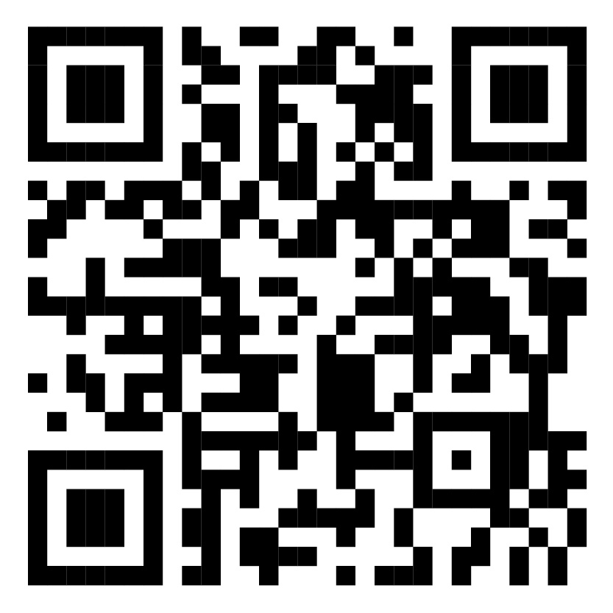

Where can I find the modules?
All materials are available through the Ministry of Education’s virtual learning environment (Ontario’s VLE).
To access, start at your school board’s virtual learning environment
  go to d2l.com/k-12/Ontario and select your school board
Each school board has a Technology-Enabled Learning and Teaching (TELT) contact that can help.
Notes:
All materials are available through the Ministry of Education’s virtual learning environment (Ontario’s VLE) but to get there you need to start at your board's virtual learning environment. Each board has their own VLE and the addresses are unique. You can easily find your boards address on the website outlined currently on screen. Choosing your board in the drop down menu will also show you the name and contact information of your technology enabled learning and teaching contact who can provide you with assistance in accessing and navigating the modules within the VLE.
SMHON also created a short brief video that explains in detail how to access and navigate the modules within the VLE. You can find the video on SMHON<s Healthy Choices webpage.

Slide 26
Next steps
Notes:
All materials are available through the Ministry of Education’s virtual learning environment (Ontario’s VLE).

Slide 27

Consider the opportunities!
Lean into the voice and ask students what questions they have. That could really be the North Star for where we need to go in terms of supporting students.
— Ontario educator
It's important for students to be able to think critically about what they are being exposed to and decide, does this align with who I want to be as a person? Does it align with my values? Does it align with what my culture teaches? Does it align with the messages I'm receiving from parents and guardians?
— Ontario educator
This learning prompted
some self-reflection.
— Ontario educator
Notes:
The modules may serve as a spark for other connected learning or student engagement. They may also connect and align with other opportunities within your school community.

Slide 28

Thank you
By embedding opportunities to learn about healthy and safe choices in the classroom, Ontario schools can contribute to well-being and success of all students.
Thank you!
Notes:
Thank you for taking the time together with us today to consider this exciting opportunity, and for all you do EVERY day to support students!

Slide 29

About Us
Notes:
You can connect with SMH-ON on our website and socials linked here but you can also sign up for our newsletter! Thank you for joining me. Wishing you an amazing day.

Slide 30
Accessibility and mental health are related.
Ensuring inclusion in Ontario’s schools, and throughout society helps to support individual’s mental health. We’re committed to equal access, complying with the standards defined within the Accessibility for Ontarians with Disabilities Act (AODA) and endeavour to remove barriers in order to accommodate and fully include our stakeholders. If there is a document that does not meet your accessibility needs, please contact us and we will provide alternate formats as requested.

