Slide 1

Module D :
When might students need more support?
Notes:
This facilitation slide deck accompanies Module D from the one-hour Intro to MH LIT: Mental Health in Action for Educators course.

Slide 2

Notes for facilitation
This slide deck contains information from Intro to MH LIT, a one-hour mental health literacy course for educators. This slide deck offers related content in a format that may be offered at staff meetings or other professional learning opportunities.
Adjust the slides to meet your needs. They can be edited/reordered. Consider which optional extensions are relevant or fit within your allotted timeframe.
Consider supplementing the materials with additional activities/information specific to your region and board (e.g., local mental health programs or educational opportunities, etc.).
Consider inviting staff to complete the online course. It's free, self-paced, and a certificate is provided upon completion.

Slide 3





Notes for facilitation 2
Materials needed:
Sticky notes, pens
Chart paper, markers
Devices to access the online course (should you wish to introduce it as part of the learning)
Look for the following symbols to help with facilitation, as well as alignment with the course:

Slide 4
By the end of this module, we will be able to:
Increase awareness of when students need additional mental health support.
Understand the importance and role of educators in the early identification of student mental health concerns and accessing support.

Slide 5
What Ontario students shared about help seeking
Society has made it looked down upon for students to have mental health issues as we’re young and ‘don’t have anything to worry about'
— Ontario student
I feel kind of embarrassed because there is kind of a standard where someone like me wouldn't have any problems, so why would we talk about them?
— Ontario student
Most students feel that seeking support for their mental health is very important
— Ontario student
I feel like people are going to see me as less than them or that I’m not capable of doing certain things
— Ontario student
Nowadays I believe it’s a lot easier to find resources about mental health
— Ontario student
I would say do it get help when you feel you need it
— Ontario student
Notes:
Many students still feel stigma related to seeking mental health support while others are noting positive shifts. Schools are an ideal place for highlighting the problem of stigma for those who experience mental health problems. When we create spaces where it is okay to talk about mental health and mental illness, we encourage help-seeking for those who need it.

Slide 6
Reflect
What do the students you connect with say?
Do you think they would agree or disagree?
Have they raised other concerns or points to consider?
Notes:
Facilitator script: "As educators, how we view mental health and mental illness influence our approach and conversations about these topics with students. It's important to examine our assumptions and biases. These may be influenced by our experiences, our knowledge or lack of knowledge, or the views of those around us. By building our knowledge like we are today, we can help dispel myths and reduce stigma."

Slide 7
Understand the topic
Notes:
This section corresponds to the main content of the learning.

Slide 8
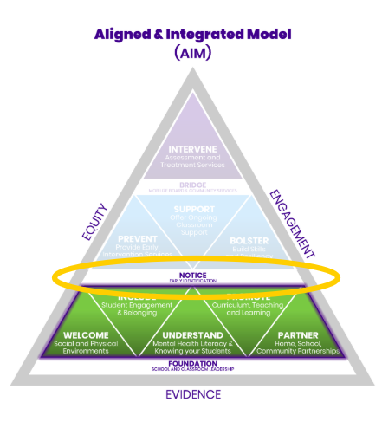
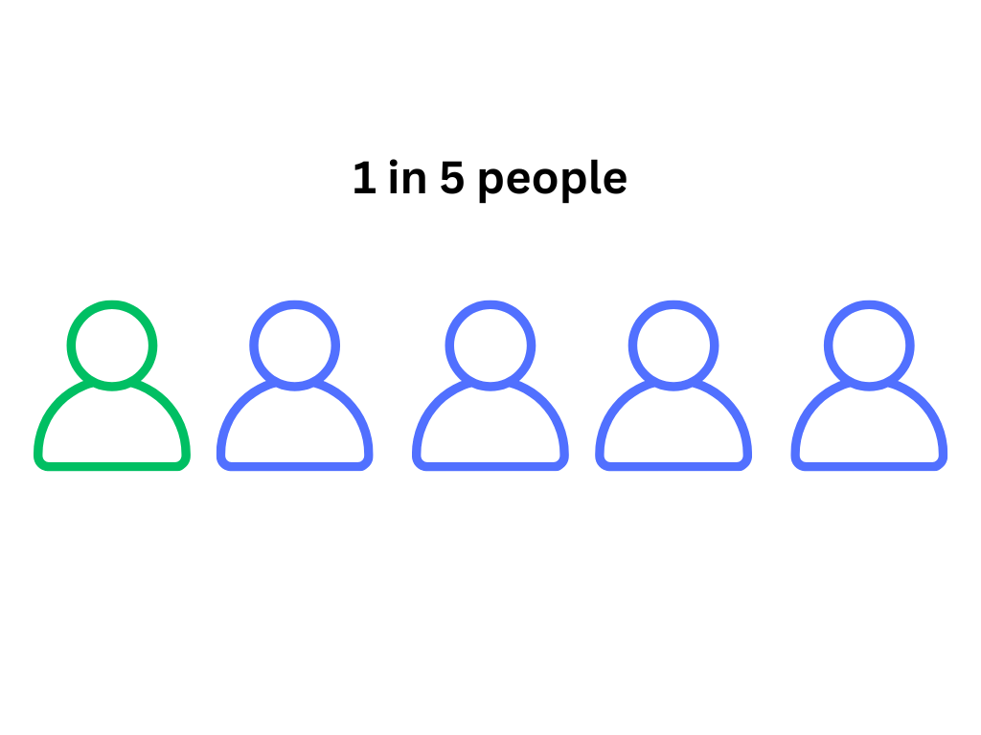
What is your role when you notice student mental health concerns?
Notes:
In Ontario, an estimated one in five children and youth experience a mental health challenge. Early identification and prevention services can make a big difference, and you can be part of the process. As an educator, it’s beyond your role to assess or diagnose a mental health illness. However, your work to notice and document concerns is crucial. You are a critical and supportive link between students and the resources they may need.

Slide 9
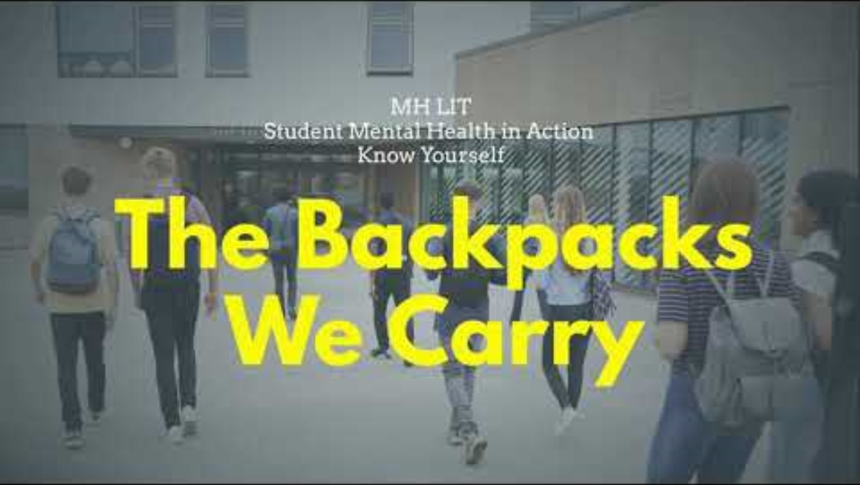
Video: The Backpacks we Carry
Notes:
This video is part of MH LIT: Student Mental Health in Action - School Mental Health Ontario. It's featured in Lesson 4: Help Yourself (a lesson on seeking mental health support created in partnership with Kids Help Phone).
Facilitator script: “As we play the video, picture all of the thoughts, feelings, stresses, responsibilities, expectations, and so on that students may experience as physical objects they carry in a backpack. You may close your eyes and imagine or watch the video, if you prefer.”

Slide 10

Reflect 2
What would it be like if we could see everyone's backpack?
Consider your school context and student's lived experiences.
How might awareness of these 'invisible backpacks' shape the way we create spaces that feel supportive and affirming?
Notes:
When educators consider their school and community, they may wish to think about things such as recent tragic events, financial issues, the availability of resources and supports, and so on.
Additional optional reflection questions:
Imagine carrying a backpack like this all the time. How would it feel?
Would someone be able to carry it by themself? For how long?
What kind of items might be too heavy to carry alone?

Slide 11
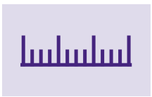

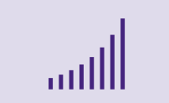

NOTICE...
Frequency
Impact
Intensity
Duration
How can you tell a student is experiencing something more than the typical ups and downs all students face? What signs do you notice?
Notes:
Facilitator script: “Everyone has ups and downs, and we all experience occasional changes in our mood, stress level, appetite, and so on. Everyone responds differently when that happens, but we all have times we don’t feel as mentally well. Changes in feelings and emotions are part of life, and usually, we can ride them out and get back to feeling like ourselves. But sometimes we need support. How do you know when that might be the case for a student?"
The key to noticing when students may need support is developing relationships with students so you know when something has changed. Many students show signs that might or might not indicate a mental health concern, so focus on changes that persist in frequency, intensity and duration, and the degree to which they affect a student's day-to-day life.

Slide 12
Did you know?
Systemic and social inequities (e.g., racism, poverty, homophobia, ableism) can increase risk for experiencing mental health concerns.
Barriers accessing services (e.g., long wait times, lack of culturally responsive care, gaps in special education supports) can make it harder for some students to get the help they need.
Students with marginalized identities (including those navigating special education supports) may encounter unique stressors, discrimination, or barriers in systems that affect their mental health and access to care.
Notes:
Educators should be aware that of the historical and present impact of police violence on Black, Indigenous, and racialized communities when responding to mental health concerns, and that calling 9-1-1 may not feel safe for some students. When we discuss help-seeking, it's important that a variety of options are shared.

Slide 13
Quote from a SMHP
Schools have a unique opportunity to bring mental health supports and services where students already are.
— School mental health professional
Notes:
Did you know?
If children and youth do have contact with a mental health provider, school is the most common place where they access support.
The main role of schools is to offer welcoming environments and mental health promotion for all students. (Right Time, Right Care)
As children and youth spend most of their day in school, educators also have an important role in helping to identify students in need of more support. Some of this support might be provided in schools and many schools and boards have mental health professionals. However, schools are part of a larger system of care.

Slide 14
Reflect 3
Every school community is different. Take a moment to reflect on the people at your school and board you could go to for support, should you have a mental health concern about a student.
What is the pathway to help connect students to what they may need? What are your board policies and protocols?
Notes:
When we all work together to support mental health promotion and literacy, fewer students should require specialized supports to maintain their mental health. However, there will always be some students who need more support.

Slide 15
Explore strategies

Slide 16

Barriers to help seeking
Ontario students say privacy is one of their biggest concerns about seeking mental health support.
What other barriers might there be?
What actions are being taken? What other steps might help?
Notes:
Note: if students ask what educators would share if they told educators about a mental health problem, they might say... “Your privacy is important to me. I will only share the specific information I need to with the specific people who need it in order to help you or keep everyone safe.”
Some additional potential barriers to accessing support:
• not knowing the resources available or if a problem is big enough to ask for help
• costs (including transportation)
• lack of time to go or way to get to in-person services
• services that are not culturally responsive (e.g., that don’t represent one’s culture or language)
• stigma (feeling embarrassed, that you will be judged, or that you should be able to manage)

Slide 17
Build your toolbox

Slide 18
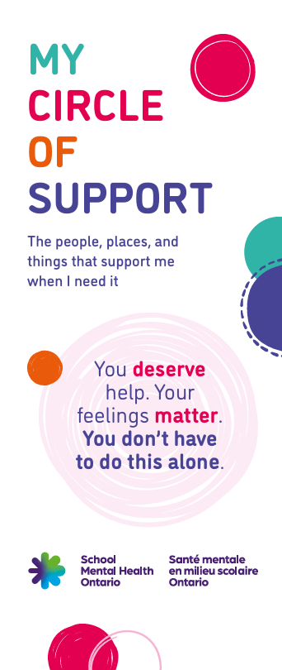
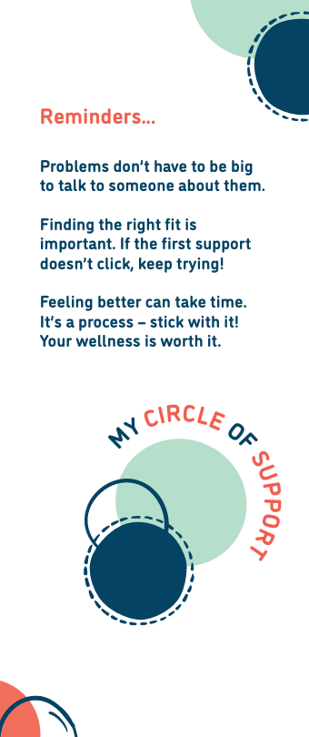
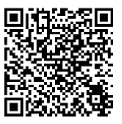
My Circle of Support
Where might these resources be best positioned in our school(s)?
What opportunities do we have to share them with parents and caregivers?
Notes:
My Circle of Support – Student Help-Seeking Resource - School Mental Health Ontario
Two versions are available:
One for junior students and students in older grades who might benefit from simplified text and the inclusion of visuals (an accompanying educator guide and parent/caregiver communication are available).
One for students in grades 7 and up.
Note: although there isn't a version available for the early years, this is an opportunity to discuss the value of teaching even young students simple ways to express what they need and ask for help.
Facilitator script: “There are many supports, resources, and services, both formal and informal. Support for students can come from their personal lives, school, community, or online. We are all unique and the support students choose can be different for each of them. The supports each play different roles, but they are all important and having a wide circle of support can help us all feel our best." It's never to early to focus on the value of asking for help. Young students

Slide 19
Dig deeper

Slide 20

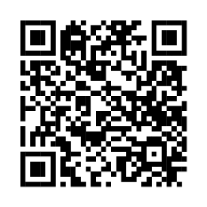
ONE-CALL Desk Reference
A step-by-step approach to support students when they exhibit signs of a mental health concern
Notes:
The ONE-CALL desk reference can help with:
Early identification and support
Building supportive relationships
Guidance for action when you have concerns
Facilitator script: "ONE-CALL is not a checklist. It's a tool that offers guidance for school staff about noticing and responding to potential mental health concerns. This guidance should always be considered within the context of our school board policies, protocols and pathways regarding mental health."

Slide 21
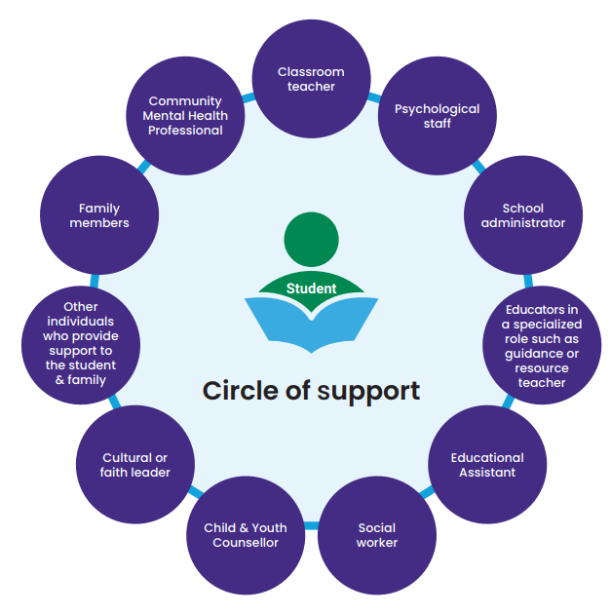
ONE-CALL - Circle of Support
It's important to remember we are not alone.
Look at the Circle of Support on page two in ONE-CALL. Take some time to name and identify the people that make up the circle of support for students in your school.
Notes:
This is a great time to provide information about supports in your Board and community. You may wish to invite available mental health staff in your school or Board to drop in and share how to connect with them.

Slide 22

Your mental health matters, too
As you consider the circle of support for students, consider who could be in your own circle of support.
[Insert information about local supports – e.g., Board Employee Assistance Program, local union/federation, free help lines, etc.]
Notes:
Note the prompt to add local supports to this slide. (optional)
Facilitator script: “An important strategy to support our mental health and well-being is reaching out when we need to. This is true for all of us, educators included. Prioritize your own mental health, alongside the mental health of students."

Slide 23
Share your learning
What is something you learned that you think could be helpful to another educator?
Is there anyone else who else might benefit from the information we discussed (consider both your professional and personal life)?
How and when could you share what you learned?
Notes:
Facilitator script: “There is a lot of misinformation, disinformation, and malinformation about mental health out there, and many of people don’t have the basic information about mental health they need to help them take care of their own well-being and the well-being of others. You can help by sharing what you learned."
As a goal, encourage participants to think of one learning, fact, or resource they will share with one other person within one week.

Slide 24
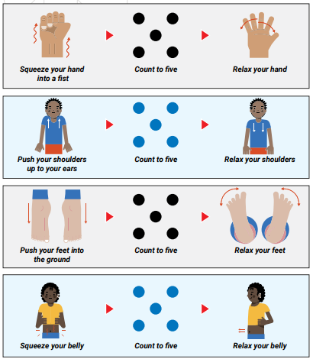
Tense and relax
Notes:
Facilitator script: "Try out this optional activity as a way to transition from this learning. It's a chance to experience a strategy you might bring to students, and to move on to the next part of your day in a thoughtful way."
Taken from Tense and Relax poster – part of the SEL poster set (elementary, secondary)
Note: another option is provided on the next slide.

Slide 25
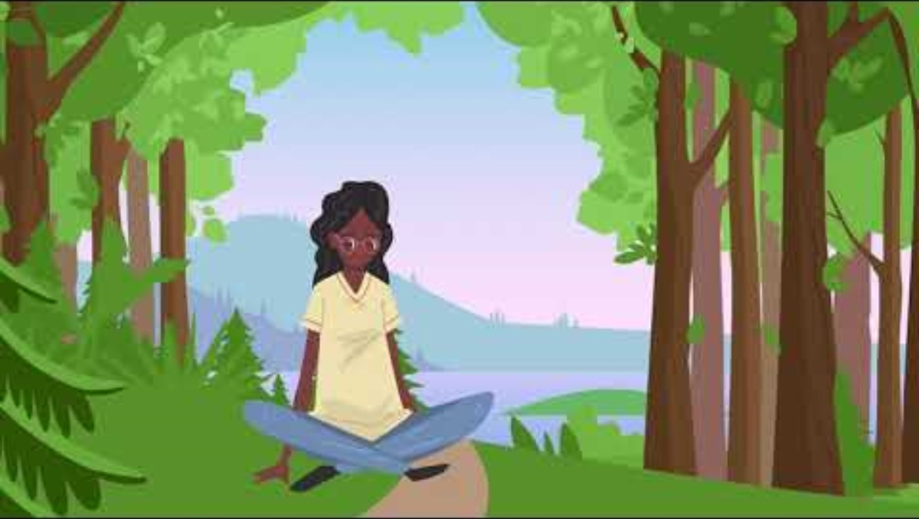
Finding calm – Forest visualization
Notes:
Another option for a supportive transition: https://www.youtube.com/watch?v=s0PO2xo7I9g&t=3s

Slide 26


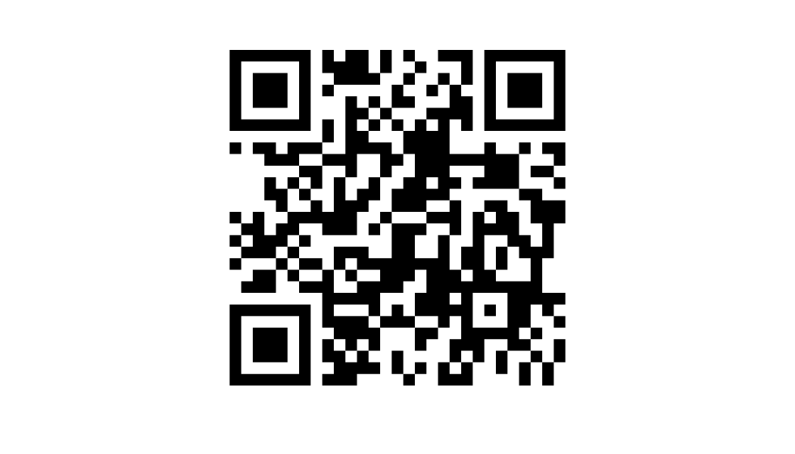
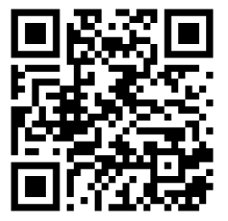


Connect with SMH-ON
Continue the learning and conversations about mental health by exploring the SMH-ON website.
QR CODE
Subscribe to Educator updates
QR CODE
Instagram SMH-ON
Notes:
Encourage participants to explore https://smho-smso.ca/ or refer back to Wayfinder (downloaded in Module A) to continue their mental health literacy learning and sharing.

