Slide 1

Module C:
What does mental health in the classroom look like?
Notes:
This facilitation slide deck accompanies Module C from the one-hour Intro to MH LIT: Mental Health in Action for Educators course.

Slide 2

Notes for facilitation
This slide deck contains information from Intro to MH LIT, a one-hour mental health literacy course for educators. This slide deck offers related content in a format that may be offered at staff meetings or other professional learning opportunities.
Adjust the slides to meet your needs. They can be edited/reordered. Consider which optional extensions are relevant or fit within your allotted timeframe.
Consider supplementing the materials with additional activities/information specific to your region and board (e.g., local mental health programs or educational opportunities, etc.).
Consider inviting staff to complete the online course. It's free, self-paced, and a certificate is provided upon completion.

Slide 3





Notes for facilitation 2
Materials needed:
Sticky notes, pens
Chart paper, markers
Devices to access the online course (should you wish to introduce it as part of the learning)
Look for the following symbols to help with facilitation, as well as alignment with the course:

Slide 4
By the end of this module, we will be able to:
Describe the role of an educator in supporting identity-affirming student mental health.
Discuss factors that contribute to a mentally healthy classroom.
Explain ways to bring mental health promotion and literacy to students.

Slide 5
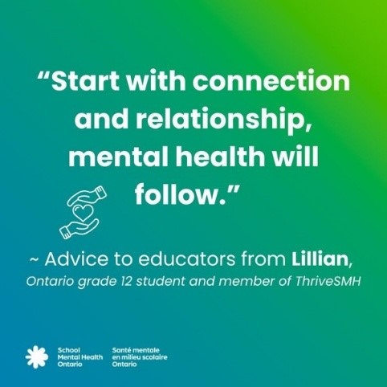
Student quote
Notes:
Students have noted that sometimes school staff seem to think we need to do new or different things to support their mental health. But the fundamentals—like caring relationships and connections—still matter. These are ideas educators have been prioritizing for years, and so they have been supporting student mental health in meaningful ways all along.

Slide 6
Understand the topic 1
Notes:
This section corresponds to the main content of the learning.

Slide 7
Reflect 1
Take a moment to think about the ways you:
Welcome and include students daily
Build relationships in order to better understand students
Promote mentally healthy habits
Partner with families, students, and other staff to create a supportive environment

Slide 8
Role of an educator
As educators, we are comfortable with our role teaching curriculum and providing opportunities for students to learn, explore and be curious. But what about mental health?
What is the role of educators in mental health promotion?
Notes:
Break into small groups to discuss followed by a large group share back.

Slide 9
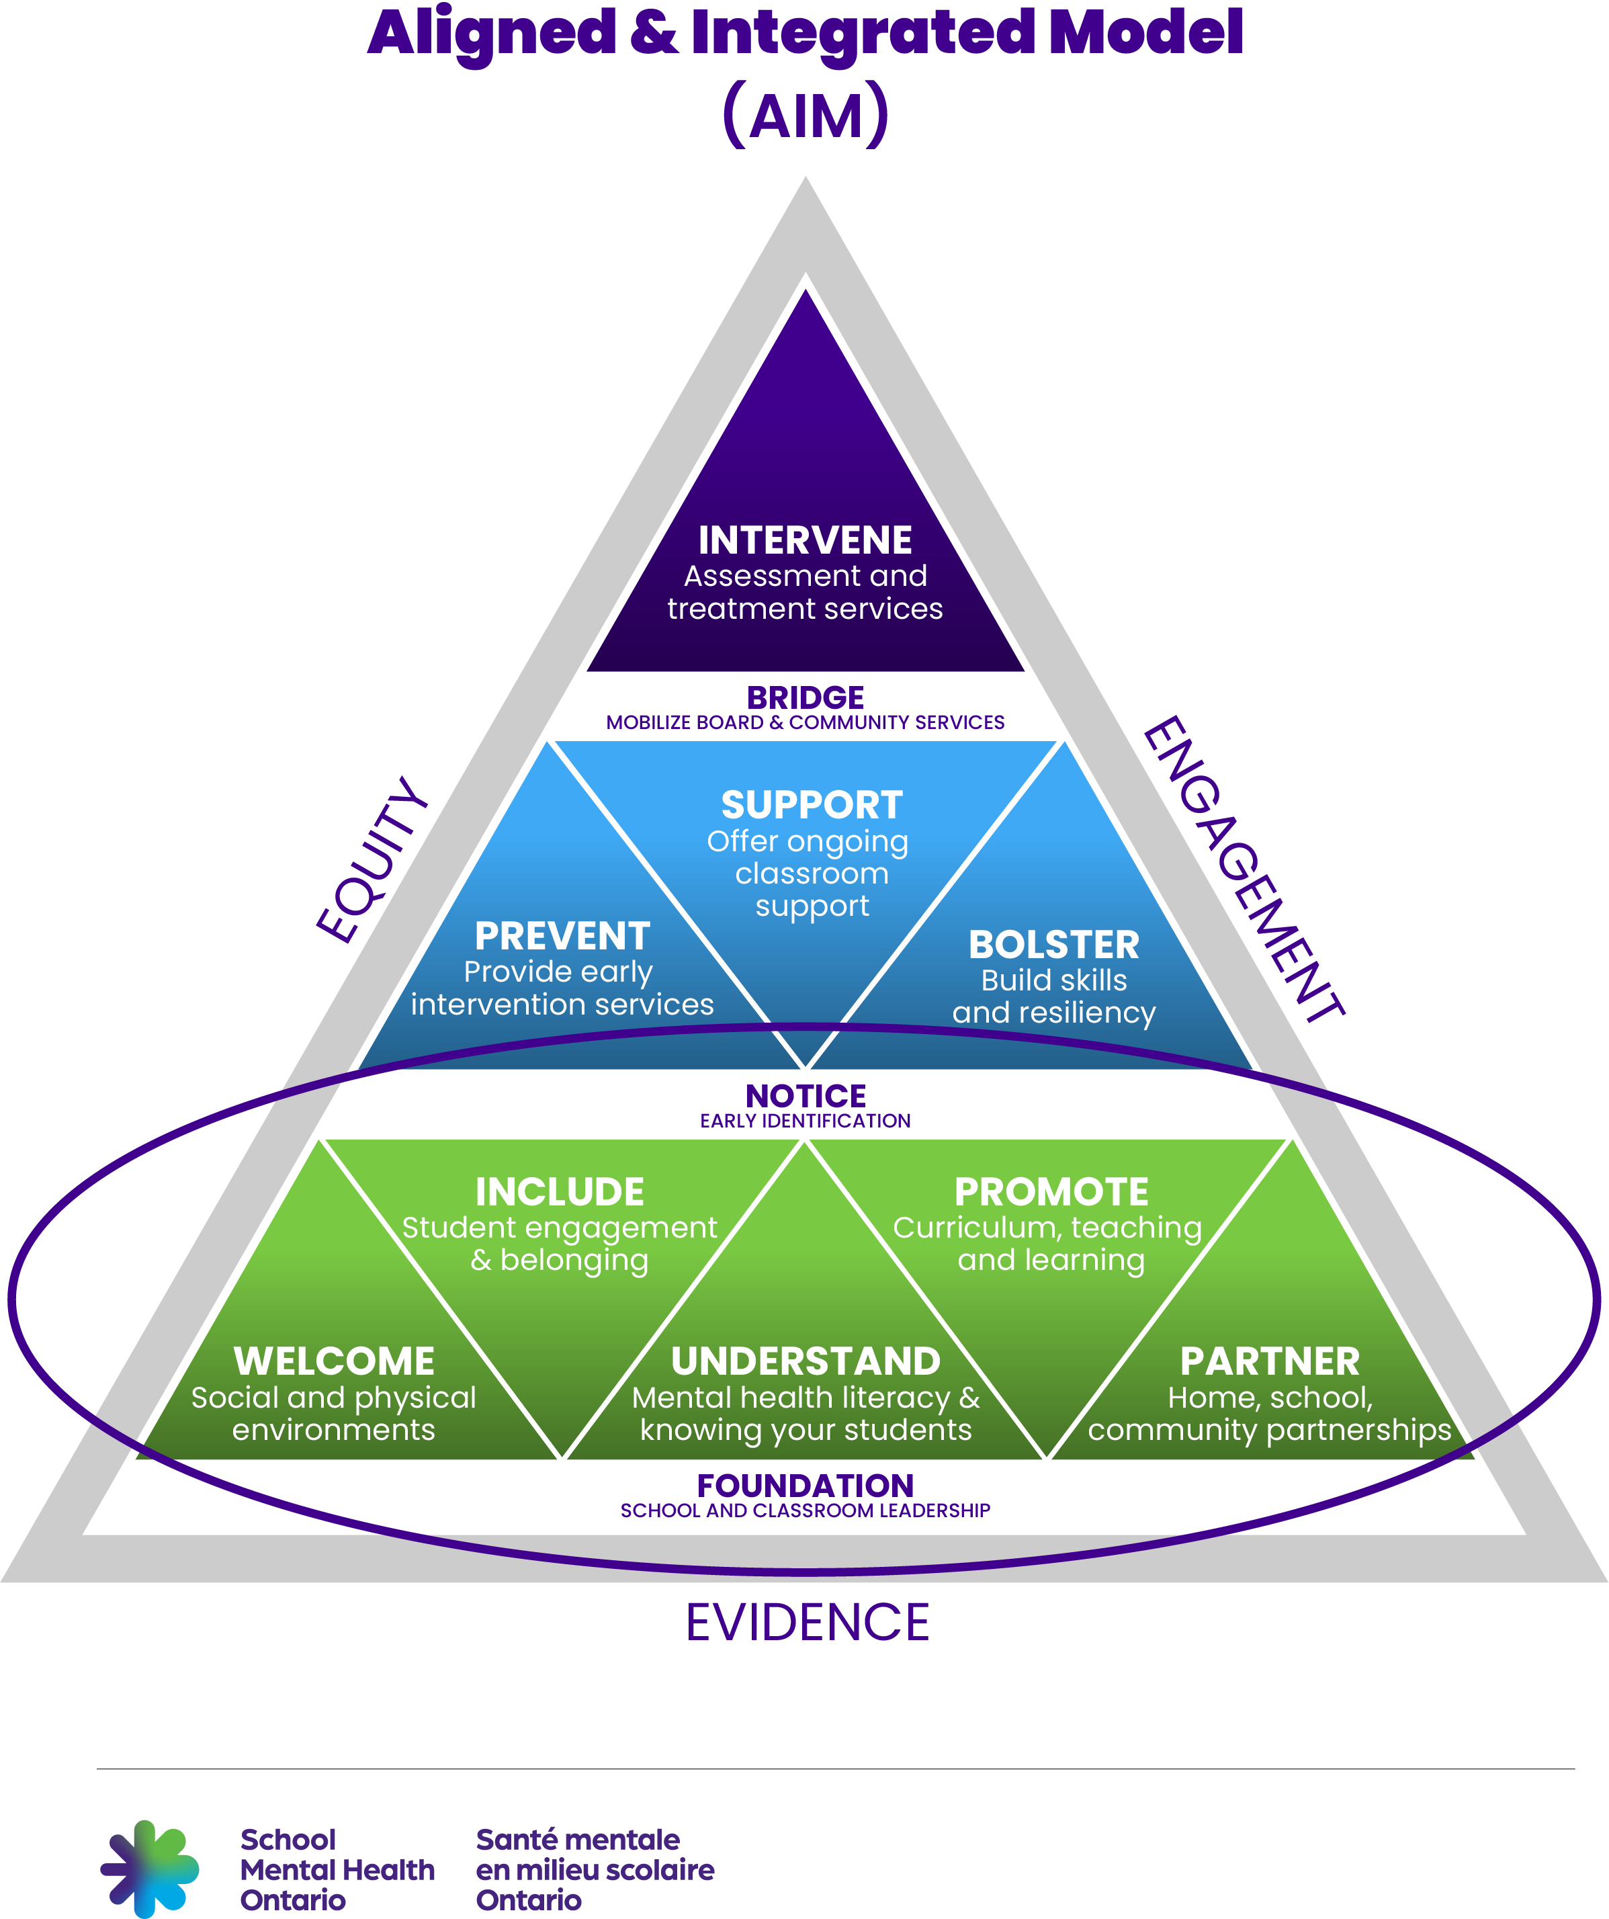
Role of an educator (continued)
Mental health promotion is the foundational everyday work that educators and school staff do within and beyond the curriculum to welcome and include students, to understand them, to build knowledge of mental health, to promote mentally healthy habits and to partner with families, students and other staff to create a supportive environment.
- PPM169
Notes:
The AIM (Aligned and Integrated Model) triangle introduced in the course helps define school mental health. Tier 1 shows the foundational role of educators. Tier 1 includes mental health promotion and mental health literacy. This slide provides an opportunity to link back to the earlier conversation about educators are already engaged in this work.

Slide 10
Literacy
The Ontario Ministry of Education defines literacy as the ability to understand, interpret, create, communicate, and compute using printed and written materials in various contexts.
Mental health literacy includes the knowledge, understanding, skills, and confidence that help us care for our mental health, support others, and know how to seek help, when it’s needed.
Notes:
Compare and contrast these two definitions. Remind educators that we are focusing on mental health, rather than mental illness. Educators are well equipped to teach literacy, including literacy that includes strategies to be well and to seek support, when we need it.

Slide 11
Reflect 2
What connections did you find between mental health literacy and other types of literacy?
How could thinking about mental health from a literacy perspective help educators see themselves as not only able, but skilled to contribute?
Notes:
Some educators may feel that mental health is beyond their role or outside their skill set. How can thinking about mental health through a lens that focuses on literacy help educators understand the ways they are uniquely positioned to support student mental health?

Slide 12
Explore strategies

Slide 13

Examples of tier one in action
Notes:
Facilitator script: "The good news is that you’re likely already supporting student mental health in many ways."
Using a digital (e.g., Padlet or shared document) or physical space (white board, chart paper) to post the headings for each category within Tier 1 – Welcome, Include, Understand, Promote, Partner. Invite educators to write examples on sticky notes and post them under each category. Answers will vary and could include examples of caring actions, modeling, ways they explicitly teach or reinforce mental health strategies, and more. There are several examples listed in the course. Encourage educators to include examples specific to their community, school, and students.

Slide 14
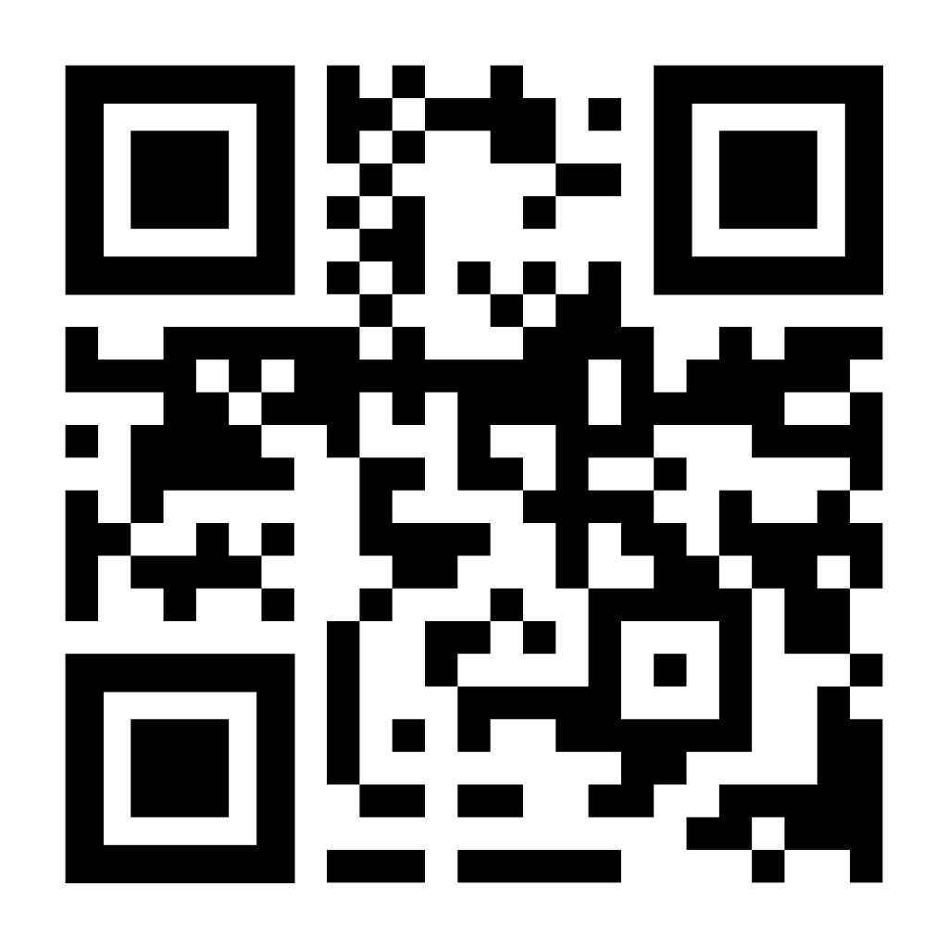
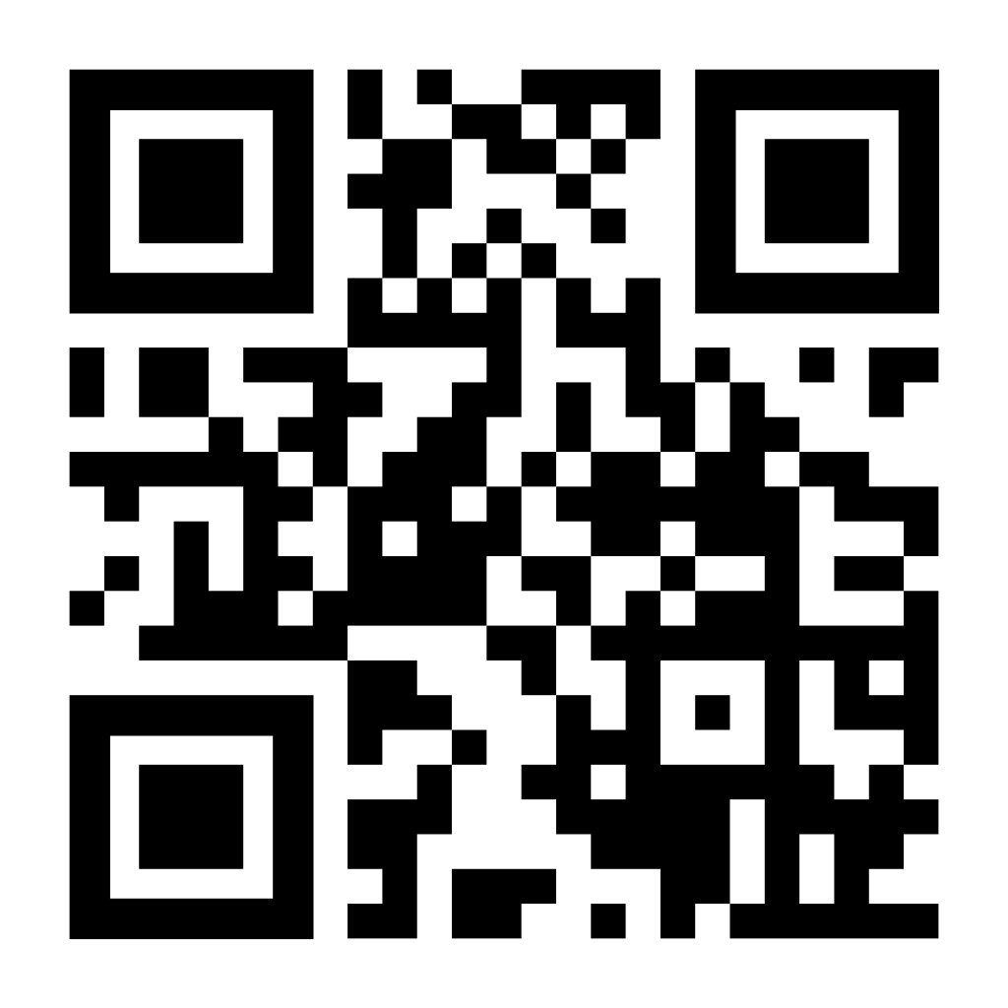
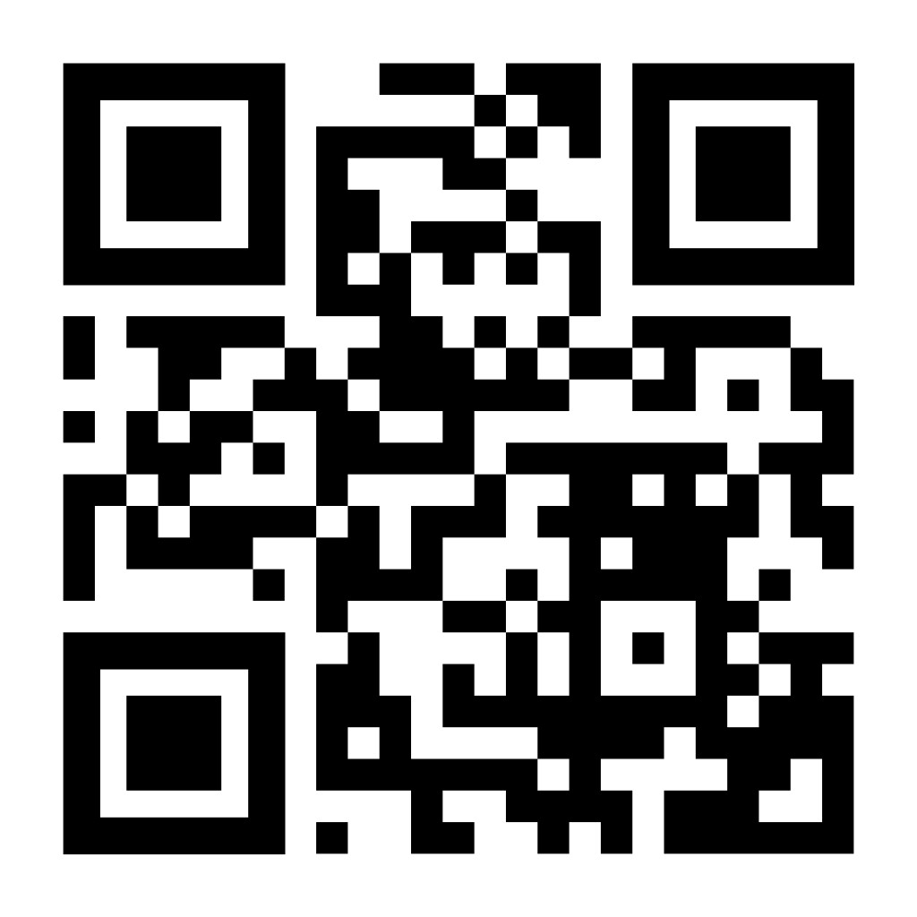
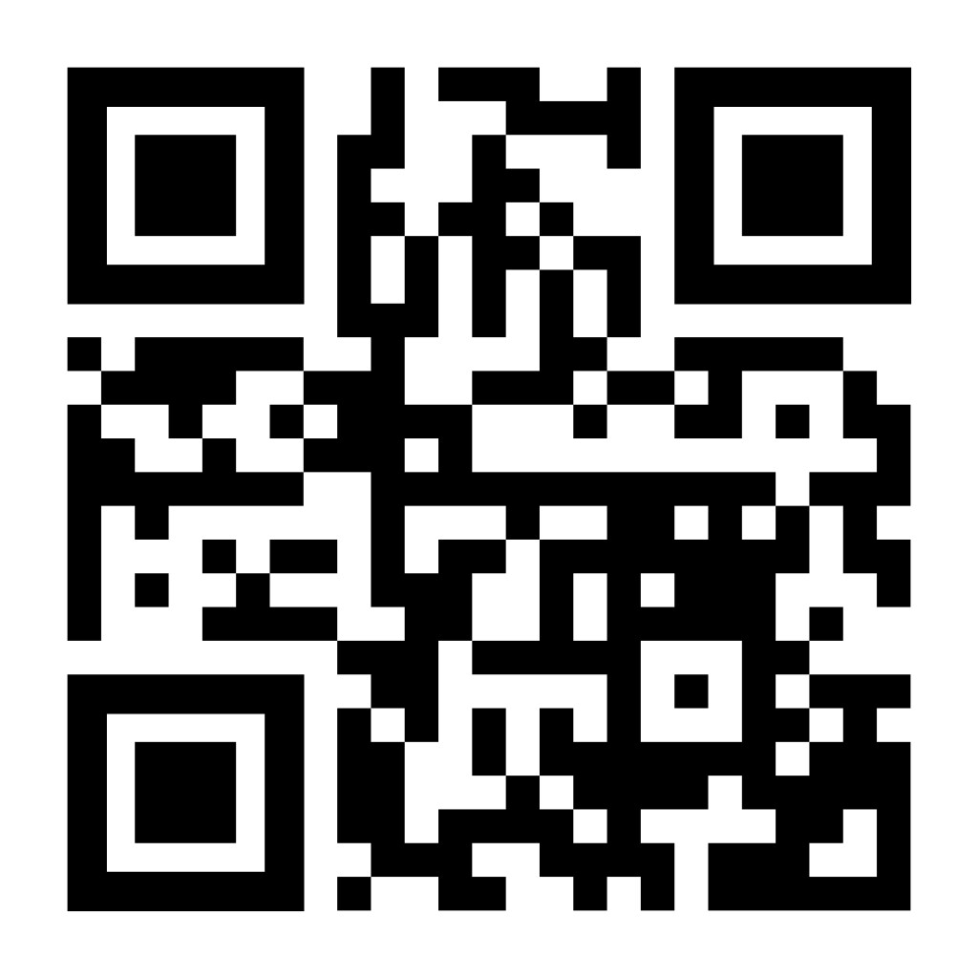
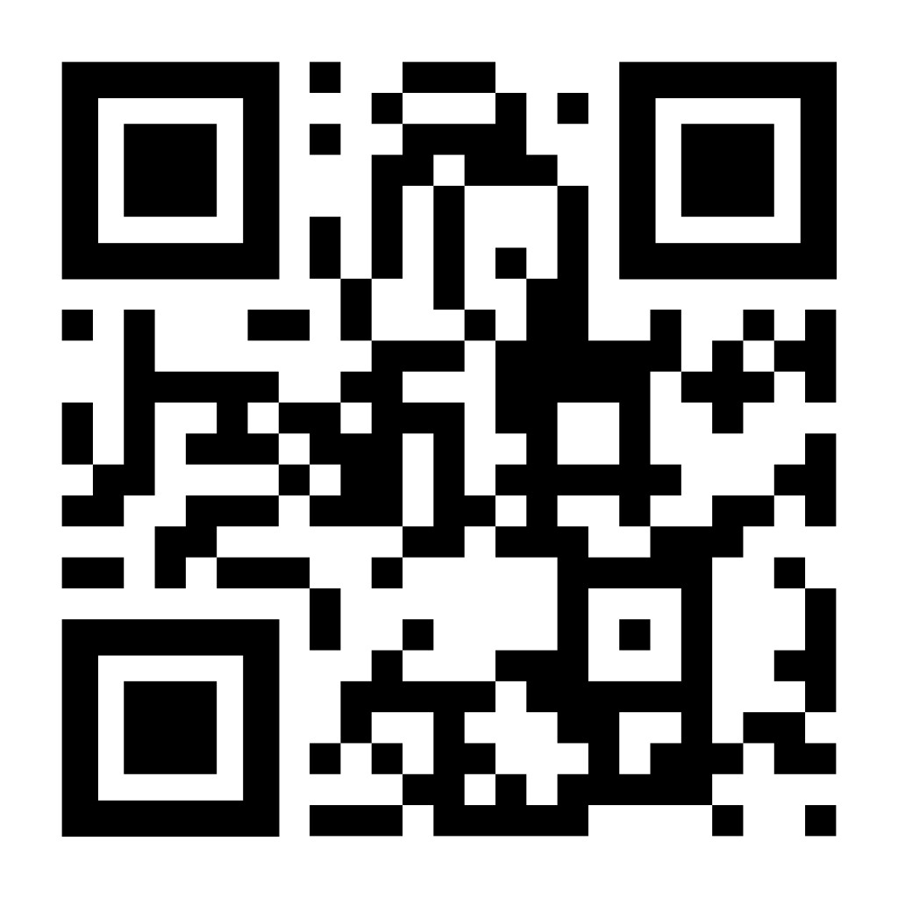
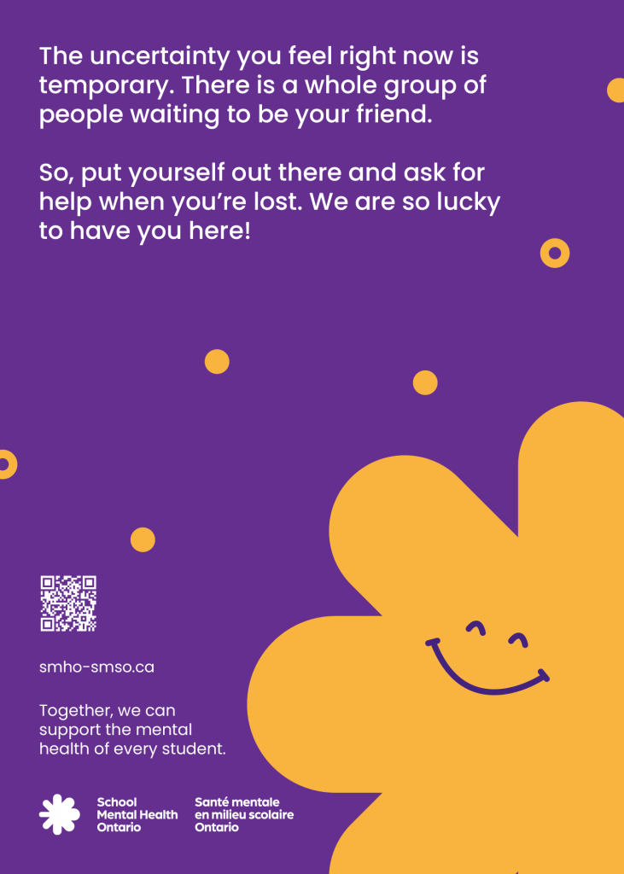
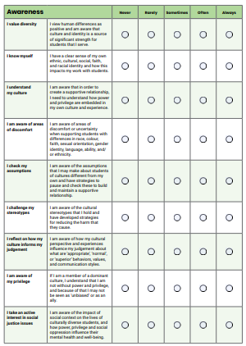
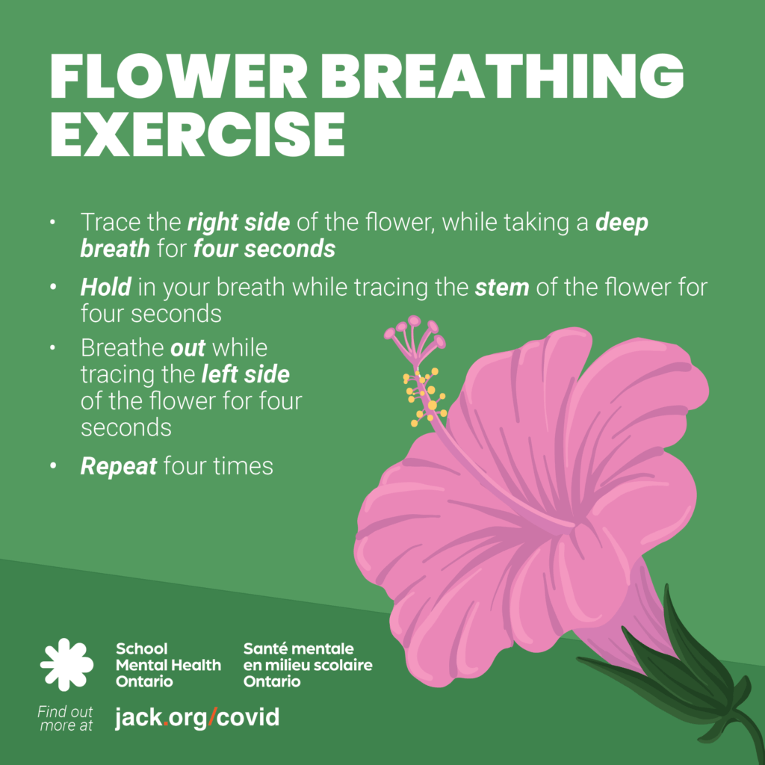


Exploring resources
WELCOME |  | INCLUDE | UNDERSTAND |  | PROMOTE | PARTNER
 | Welcome Cards to support Newcomer students | Student Engagement Toolkit |  | Cultural Humility Self-Reflection Tool | Social Media bundles | By Your Side – parent/caregiver website
Notes:
Invite participants to choose a resource to explore and identify something they might try in their classroom/school. This could be done by table group, individually, or in partners. Offer an opportunity to debrief so participants can share a summary of what they found.

Slide 15
Understand the topic 2
Notes:
This section corresponds to the main content of the learning.

Slide 16
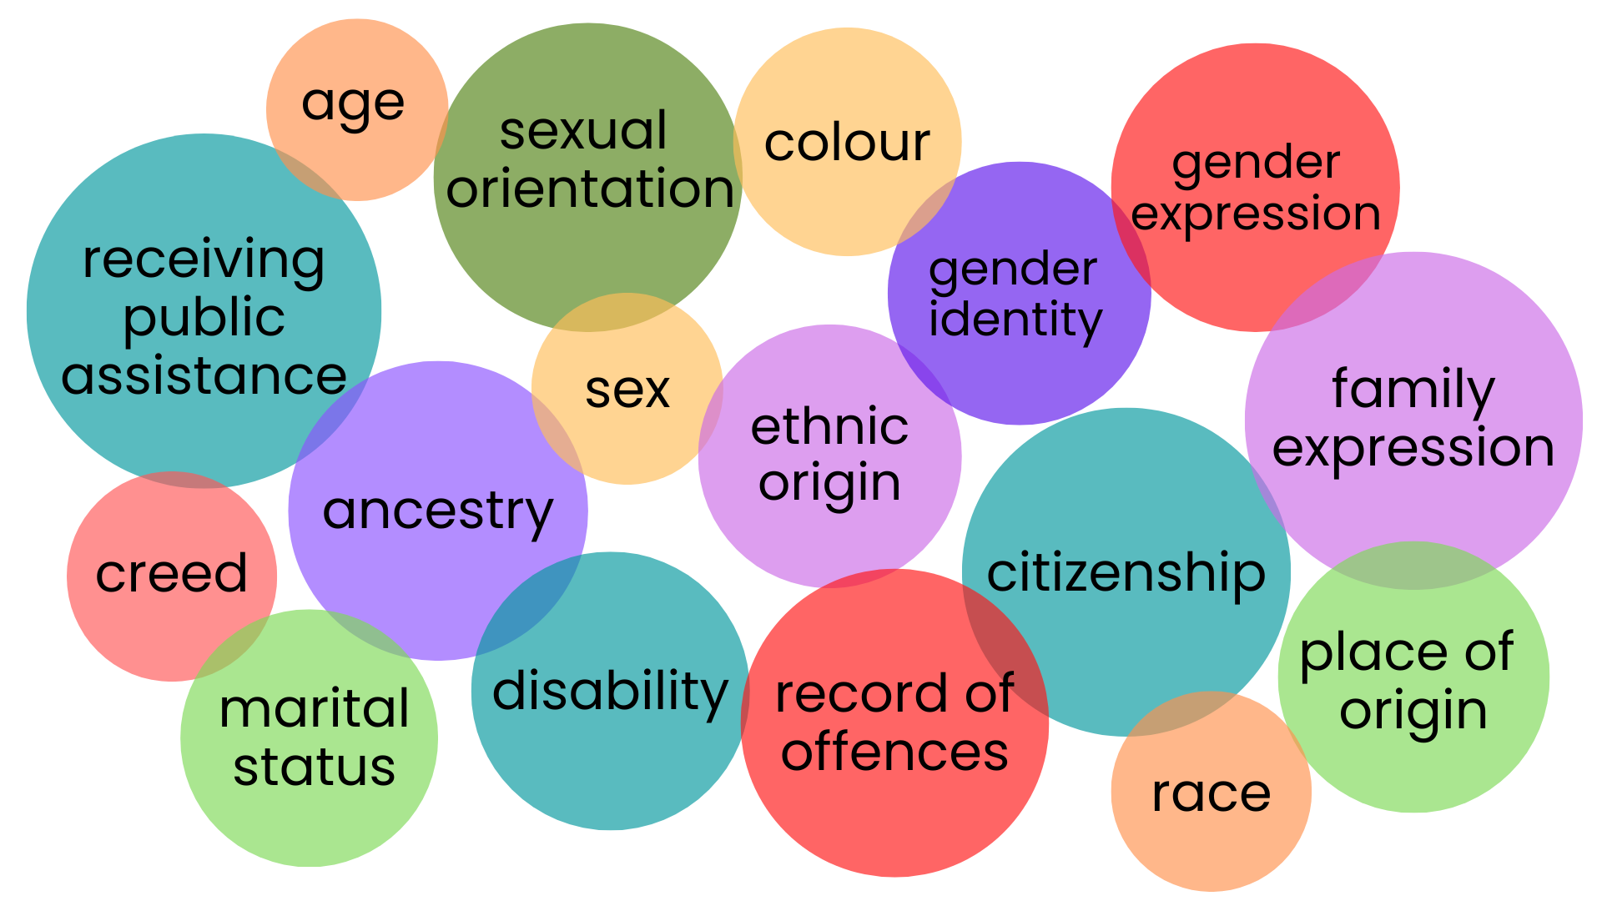
Identity
Notes:
Identity refers to the various aspects of a person’s sense of self, as they define it. These aspects can include but are not limited to race, gender, sexuality, culture, religion, faith, health/mental health, and socioeconomic status.
Identity and mental health are inextricably linked. Who you are affects how you feel. And when your identity is affirmed, reflected, and celebrated, you’re more likely to feel a strong sense of positive mental health, well-being, and connection.

Slide 17
Reflect 3
Think of a time when you felt your own identity/identities were celebrated.
How did it impact your mental health and well-being?
Notes:
Affirming and celebrating identity involves:
• Building positive connections, by acknowledging, validating, and respecting, a person’s unique identity (including but not limited to race, ethnicity, gender, sexual orientation, cultural background, socioeconomic status, and abilities)
• Prioritizing cultural knowledge and practices that are responsive to every person

Slide 18

Video: Identity-affirming frame
Notes:
Watch this 90-second video to learn more about identity-affirming school mental health.

Slide 19
Reflect 4
What are the unique strengths, identities, needs, and natural supports of the students you serve?
How do you value them when they differ from your own?
What does partnering with students and parents/caregivers with cultural humility mean?

Slide 20
Student quotes
Normalize conversations about mental health and practicing strategies throughout the year.
Ontario student
Find what works for you and what doesn't, everyone's different after all.
— Ontario student
Show us some chill ways to take care of ourselves and where to go if we need help.
— Ontario student
Notes:
Throughout the modules, we have grounded ourselves by considering students and what they have to say about mental health. They are the reason we are here together today for this learning. Here is some of what they have to say. Students also tell us they want greater access to tools and education to support their mental health, cope with stress, and navigate how to support their friends.

Slide 21
Build your toolbox

Slide 22
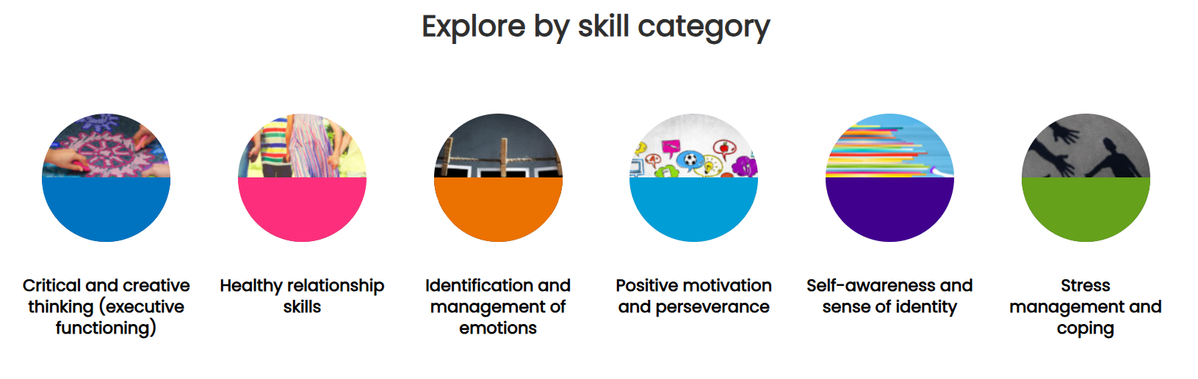
Everyday practices to support mental health
Notes:
Four versions of the resource are available:
Everyday Mental Health Classroom Resource - A Daily Mental Health Resource - Elementary
Everyday Mental Health Classroom Resource - A Daily Mental Health Resource - Secondary
Faith and Wellness - A Daily Mental Health Resource - Elementary
Faith and Wellness - A Daily Mental Health Resource - Secondary
Encourage participants to go to the site appropriate for their school system and the age and grade of students in their classroom. They may pick a category and explore one practice by reading about it, modeling it for others, discussing it with a partner, or another method they choose. This is also an opportunity to talk about the value of everyday practices, versus a "special event" approach to mental health.

Slide 23
Dig deeper

Slide 24
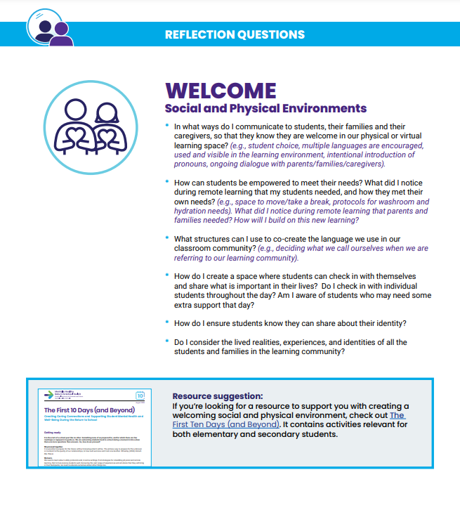
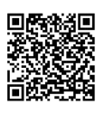
Mentally Healthy Classroom Reflection Tool
Prompts thinking about building a mentally healthy class community
Sparks ideas for actions that enhance conditions for learning
Provides possible strategies to support student mental health and well-being
Review the ideas to WELCOME students and share your own practices!
Notes:
Mentally Healthy Classroom Reflection Tool - School Mental Health Ontario
This is an opportunity to learn a new practice and affirm practices educators already use.

Slide 25
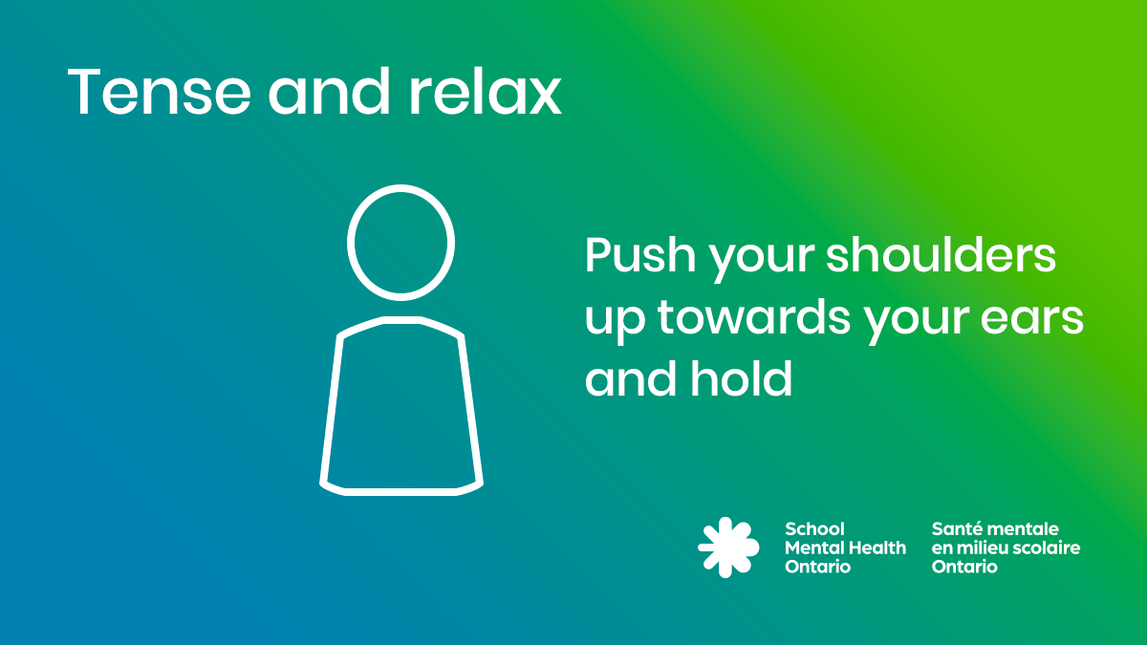
Video: Tense and relax
Notes:
This is a simple way to transition to the next part of the day that may also be used with students. Many mental health practices only take a few moments.

Slide 26


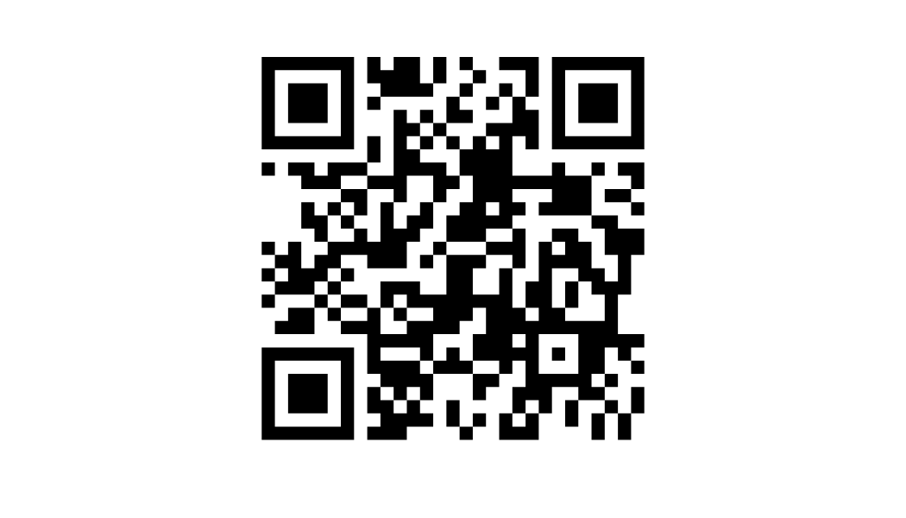
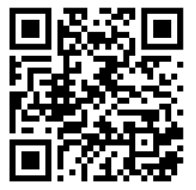


Connect with SMH-ON
We hope you’ll continue the conversation by following on Instagram and subscribing to the SMH-ON educator mailing list!
QR CODE ​
SMH-ON Instagram
QR CODE
Educator Mailing List

