Slide 1

Module B:
Why does school mental health matter?
Notes:
This facilitation slide deck accompanies Module B from the one-hour Intro to MH LIT: Mental Health in Action for Educators course.

Slide 2

Notes for facilitation
This slide deck contains information from Intro to MH LIT, a one-hour mental health literacy course for educators. This slide deck offers related content in a format that may be offered at staff meetings or other professional learning opportunities.
Adjust the slides to meet your needs. They can be edited/reordered. Consider which optional extensions are relevant or fit within your allotted timeframe.
Consider supplementing the materials with additional activities/information specific to your region and board (e.g., local mental health programs or educational opportunities, etc.).
Consider inviting staff to complete the online course. It's free, self-paced, and a certificate is provided upon completion.

Slide 3





Notes for facilitation (continued)
Materials needed:
Sticky notes, pens
Chart paper, markers
Devices to access the online course (should you wish to introduce it as part of the learning)
Look for the following symbols to help with facilitation, as well as alignment with the course:

Slide 4
By the end of this module, we will be able to:
Discuss why mental health learning is relevant for all students.
Explain how mental health connects with student achievement.
Describe how mental health learning supports and connects with curriculum.

Slide 5
Educator quotes
There’s so much pressure on teachers to get through the curriculum and to make sure everyone’s needs are being met….[Using an SMH-ON resource] brought to my attention how important this part of learning is, and it gave me the confidence to say, ‘You know what, I am going to take the time to do it because it is that important’.
Grade 2 OECTA educator
Mental health is our starting point, the foundation of everything.
focus group member in response to being asked “What does Leading Mentally Healthy Schools mean?”
Notes:
Facilitator script: "Sometimes mental health can feel like one more thing to do in an already busy day. But, as these educators noted, mental health is the foundation for everything else. As one administrator said, '...the work of promoting mental health and well-being was not an add on. It was not one more thing on our plates. But rather, it was the plate.'"
Susanna Neblett (Secondary Vice Principal) - Voices from the Field - Video Testimonial #1 - Durham DSB

Slide 6
Understand the topic
Notes:
This section corresponds to the main content of the learning.

Slide 7

Video
Notes:
Students tell us that they want this type of learning at school. It’s relevant for all because we ALL have mental health, and it impacts us no matter our age, grade, community, culture, or career path. Watch this short video about why students think this learning is important.

Slide 8
Reflect
In the video, what stood out for you? ​
What are students in your classroom saying about mental health?

Slide 9
Reflect 2
What do you think teaching about mental health means?
Notes:
This prompt is an opportunity to have participants think about what teaching about mental health means, which leads into the following slide about places they are already doing this teaching through curriculum.

Slide 10
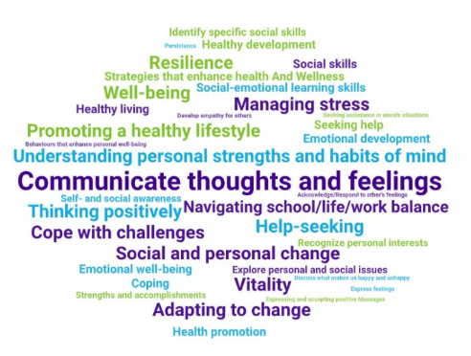
Word cloud
Notes:
This word cloud was generated by taking words and phrases directly from Kindergarten to grade 12 curriculum expectations (across a wide variety of courses) as examples of mental health learning happening in Ontario classrooms.
Facilitator script: "There are connections to mental health throughout curriculum from Kindergarten to grade 12. These connections might be new to you, but this teaching isn’t. Educators have been teaching about mental health for years, and they are well positioned to do so."

Slide 11
Reflect 3
Were there any words or phrases that stood out as particularly important for you in your role with students?
What mental health learning is embedded in the curriculum for the students you teach or support?
Think of a lesson you taught recently (in any subject). How could you embed mental health learning in that lesson?
Notes:
Learning about mental health goes beyond being part of specific curriculum. It is also necessary and helpful because mental health learning supports ALL learning. Good mental health is foundational to achievement. It helps students feel prepared to learn, supports a sense of belonging at school, and can improve academic performance (PPM 169).

Slide 12
Student quote
I know I am not the only student feeling overwhelmed with the ‘resource overload’ that occurs outside of class. These are critical conversations and I appreciate your efforts to facilitate them within classrooms and combat a greater, deeply-rooted issue that is the stigmatization of mental health.
Ontario student
Notes:
Students tell us that school is the protected time they have for learning, including learning about mental health. They also tell us that, when this learning comes to them at school, they feel they can rely on it more than mental health information that may come to them in other ways. There is so much mental health information out there. Having caring adults at school sift and sort it into key concepts can be helpful for students.

Slide 13

Learning about mental health at school can...
help students in need reach support.
promote positive mental health and prevent mental health problems.
reduce stigma.
Notes:
Invite a conversation about these benefits. Do they resonate with educators? Do they see these benefits appearing in their school?

Slide 14
Reflect 4
What might be some other benefits of learning about mental health at school?
What efforts have you noticed in your school/board to support mental health learning?

Slide 15
Build your toolbox

Slide 16
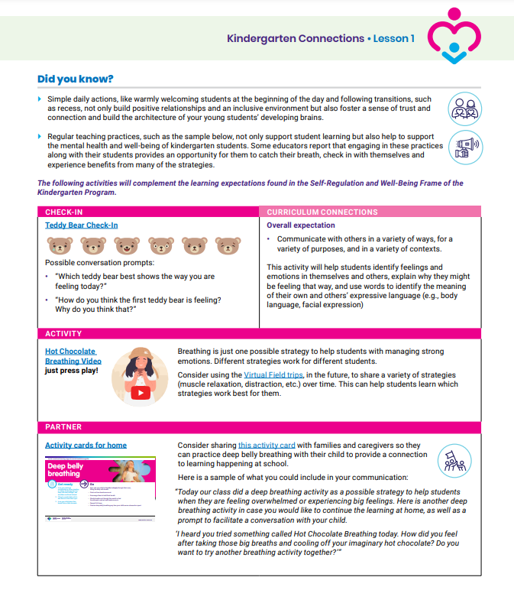
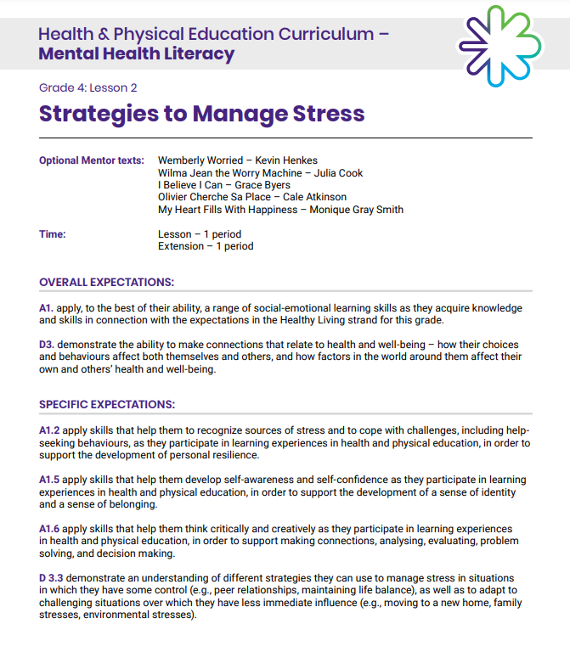
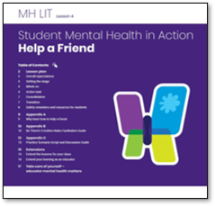
Resources per grade
Kindergarten
Grade 1 -8
Secondary
Explore the resource(s) appropriate for your grade(s).
Do you see connections to the benefits previously discussed (e.g., stigma reduction)?
Notes:
In addition to these lessons, there are mental health modules for grades 7, 8, and 10 available from the Ministry of Education, and many other mental health activities and resources are available on the School Mental Health Ontario website. (Remind participants that resources are embedded within the Wayfinder tool they downloaded in Module A).

Slide 17
Dig deeper

Slide 18

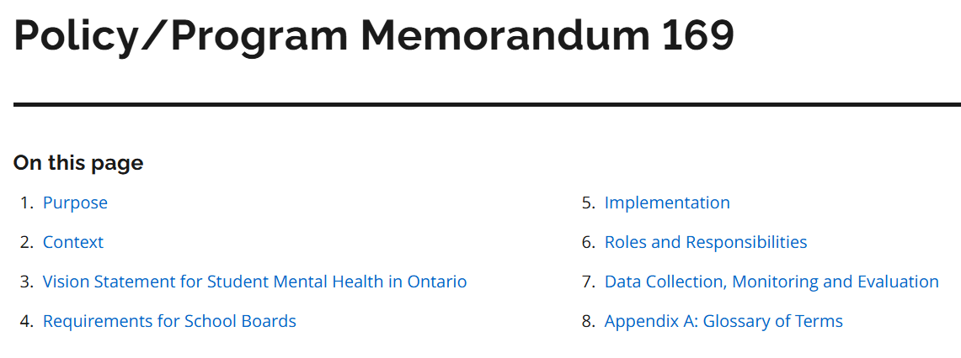
Search and find
Explore PPM 169 and find...
  The vision statement for student mental health in Ontario
  The roles and responsibilities outlined for educators
  The definition of culturally responsive
Notes:
Policy/Program Memorandum 169 | Education in Ontario: policy and program direction | ontario.ca
Purpose of the PPM: to outline requirements to provide culturally responsive, evidence-informed student mental health promotion, prevention and early intervention supports and services that respect students as individuals with diverse needs and experiences.
Facilitator script: "School mental health is a clearly defined priority by the Ministry of Education, as demonstrated by Policy/Program Memorandum (PPM) 169. The PPM is one is an example of how the importance of school mental health is being more clearly articulated than ever before."

Slide 19


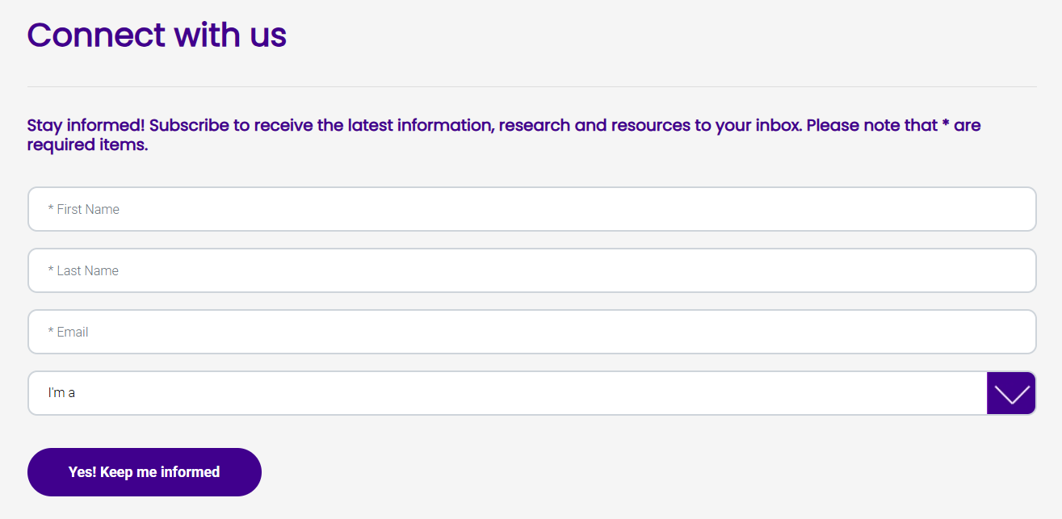
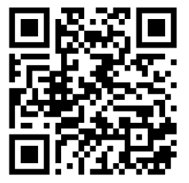
Connect with SMH-ON
Consider subscribing to School Mental Health Ontario's educator email list to receive monthly messages with resources and learning opportunities straight to your inbox.

