Slide 1

Module A:
What is mental health?
Notes:
This facilitation slide deck accompanies Module A from the one-hour Intro to MH LIT: Mental Health in Action for Educators course.

Slide 2

Notes for facilitation
This slide deck contains information from Intro to MH LIT, a one-hour mental health literacy course for educators. This slide deck offers related content in a format that may be offered at staff meetings or other professional learning opportunities.
Adjust the slides to meet your needs. They can be edited/reordered. Consider which optional extensions are relevant or fit within your allotted timeframe.
Consider supplementing the materials with additional activities/information specific to your region and board (e.g., local mental health programs or educational opportunities, etc.).
Consider inviting staff to complete the online course. It's free, self-paced, and a certificate is provided upon completion.

Slide 3





Notes for facilitation 2
Materials needed:
Sticky notes, pens
Chart paper, markers
Feelings flashcards (optional)
Devices to access the online course (should you wish to introduce it as part of the learning)
Look for the following symbols to help with facilitation, as well as alignment with the course:

Slide 4
By the end of this module, we will be able to:
Describe mental health and mental illness and explain how they are related.
Access resources to further support your role.
Notes:
Note: this is a great opportunity to seek additional ideas about mental health topics staff would find meaningful for professional learning.

Slide 5
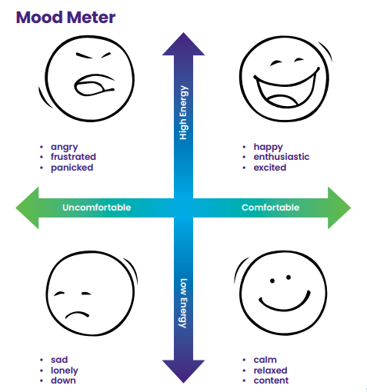
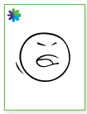
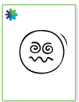

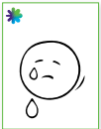
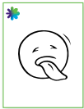
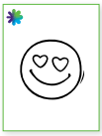
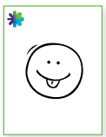
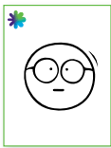
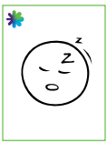
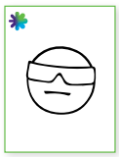
Check-in
Reflect on how you're feeling as you enter this learning using the Feelings Flashcards and blank Mood Meter chart on your table or in the online course.
Notes:
Facilitate this 'check in' digitally through the course or prepare materials to do it at tables. Alternatively you can choose a different activity from one of the options on the next slide.
Facilitator script: "As we enter this learning, take a moment to reflect on how you're feeling using the Feelings Flashcards and blank Mood Meter chart on your table or in the online course. This kind of simple activity is a great way for all of us, staff and students included, to reflect on how we are feeling and consider what we need before engaging in learning."
Materials:
chart paper with the two labelled arrows
printed feelings flashcards (https://smho-smso.ca/wp-content/uploads/2022/01/Grab-and-go-feelings-flashcards.pdf )

Slide 6
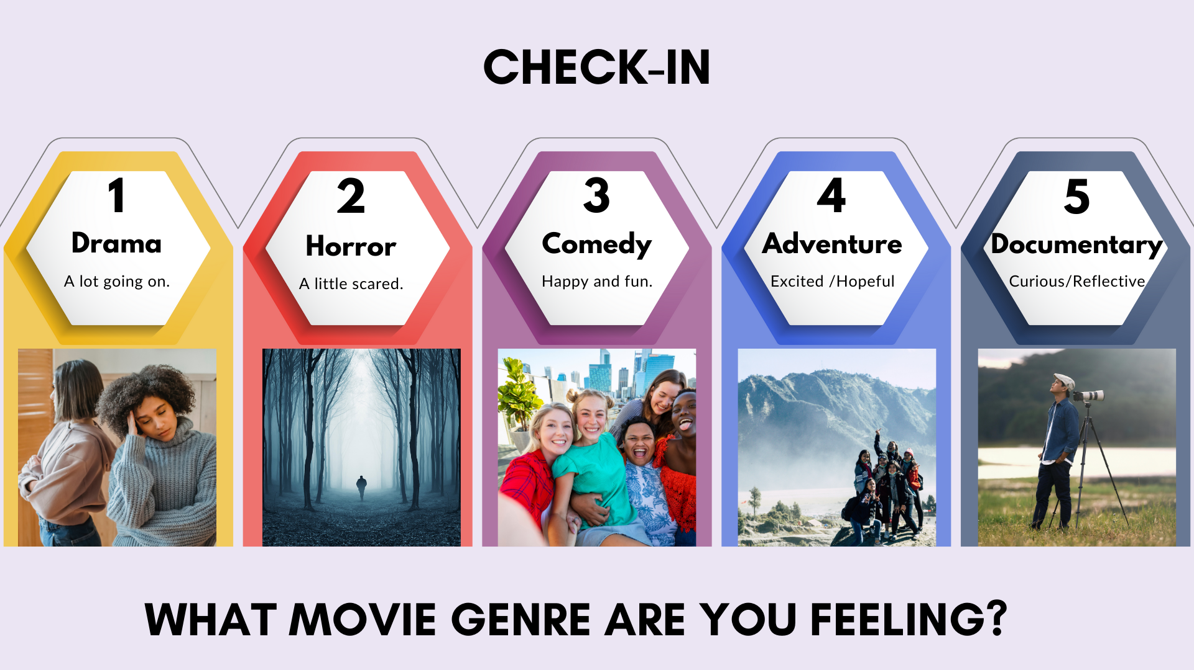
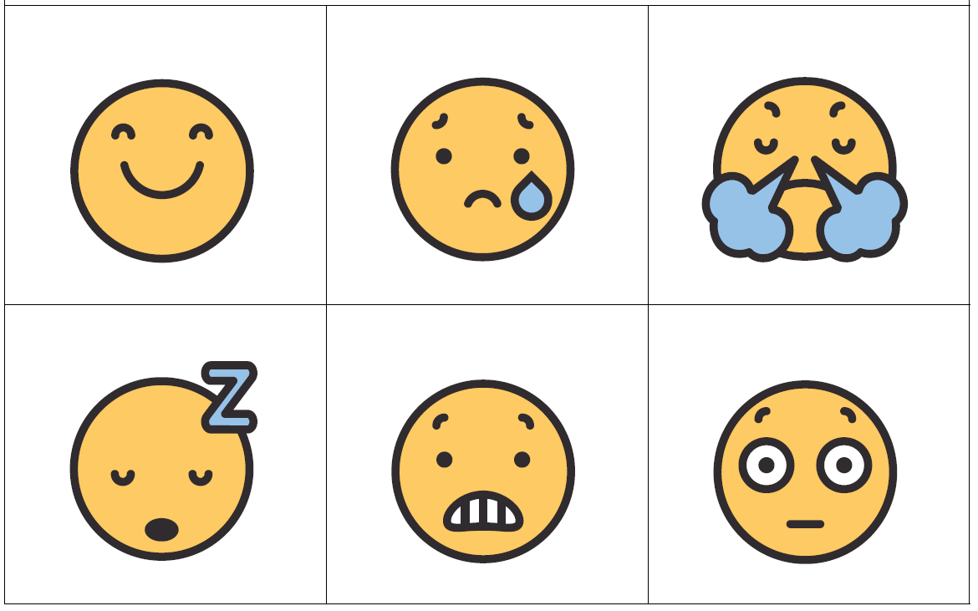
Check-in options
Use these or one of the check in tools from School Mental Health Ontario: https://smho-smso.ca/online-resources/grab-go-tools/
Notes:
Select a tool that provides participants both the opportunity to check in and models a possible resource for educators to use with their students.
Facilitator script: "As we enter this learning, take a moment to reflect on how you're feeling. This kind of simple activity is a great way for all of us, staff and students included, to reflect on how we are feeling and consider what we need before engaging in learning."

Slide 7

Connection options
Sharing stories
Find an item (in your bag/pocket/on your phone) that tells something about yourself
Share at your table (introduce yourself, your item and why you chose it)
Sharing favourites
What is your favourite
outdoor space?
Notes:
Depending on the group, it may be helpful to have a connection activity rather than, or in addition to, a check in. This activity may be offered in multiple ways, depending on the needs and preferences of the group (e.g., with a partner or small group).
Facilitator script: "As we enter this learning, take a moment to check-in connect using one of these sharing options. This kind of simple activity is a great way for all of us, staff and students included, to build connections and learn more about others."

Slide 8
Understand the topic
Notes:
This section corresponds to the main content of the learning.

Slide 9

What are 3 words that come to mind when you think about mental health?
Jot one word on each sticky note
Post your sticky note on the chart paper titled mental health
Notes:
Sticky note activity

Slide 10
What are 3 words that come to mind when you think about mental illness?
Jot one word on each sticky note
Post your sticky note on the chart paper titled mental illness
Notes:
Sticky note activity

Slide 11
Reflect
Consider the two chart papers.
Were the words that came to mind similar?
Did they describe mental illness both times?
If so, why do you think that happened?
Notes:
Debrief the activity by considering the responses. Were they similar? Varied? Positive? Not so much?
Facilitator script: "Not long ago responses to this activity tended to focus almost exclusively on mental illness. Over the past few years, we have seen a shift to also include mental health – ideas to be and stay well. This is a wonderful change as now we are thinking more fully about BOTH mental health and mental illness. Both are important and can impact our lives."
Note: this activity comes from MH LIT: Student Mental Health in Action - School Mental Health Ontario, a series of secondary school lesson plans to support the development of basic mental health knowledge and help-seeking skills.

Slide 12
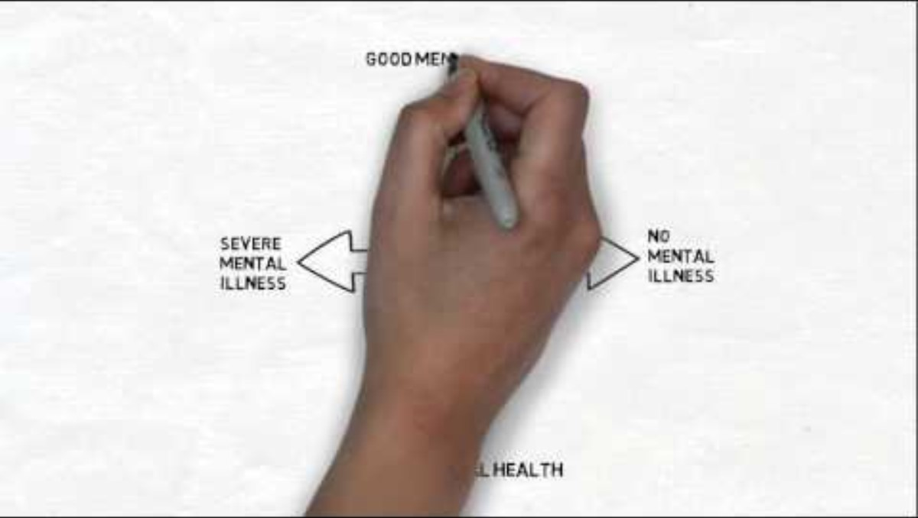
Video: Shared language
Notes:
Optional: watch the video together if learning is synchronous. (6 minutes)

Slide 13



3 – 2 – 1 handout
Three new learnings or ideas
Two things to share with students or colleagues
One thing you'd like to learn more about
Notes:
Offer different ways to engage in the activity, depending on the needs of the group (e.g., a pair and share, a personal reflection to take away for further steps, a group discussion). You may also with to offer participants the option of choosing one of these prompts to respond to, if there is not sufficient time for all three.

Slide 14
Reflect 2
How do your identity, background, faith, culture, and/or lived and personal experiences influence your understanding of mental health and mental illness?
How might your unique perspective inform your approach with students? How will you make space for perspectives that may differ from your own?
Notes:
Facilitator script: "Reflecting deeply on our own personal values, beliefs and biases is an important step toward providing identity-affirming and culturally responsive support to every student."
Optional extension – invite staff to consider the Cultural Humility Self-Reflection Tool for School Staff - School Mental Health Ontario
Facilitator script: "The tool is meant to be completed individually to help us be more intentional, mindful, and reflective about our social location and biases and how they impact our work. When we enter a teaching or student support relationship with cultural humility, we can engage in more authentic interactions that promote better mental health for the students we serve."

Slide 15
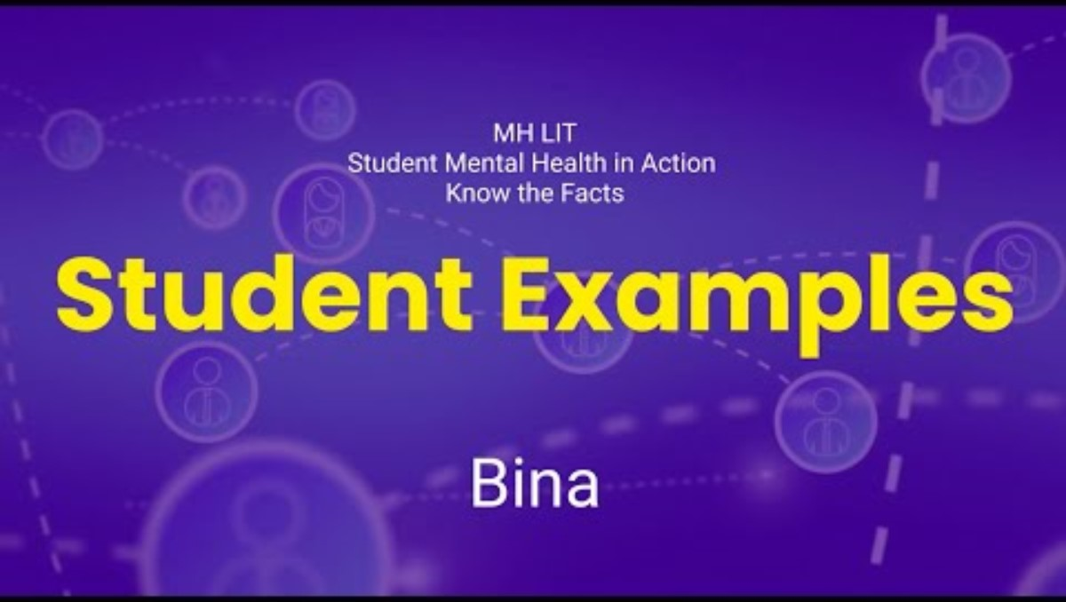
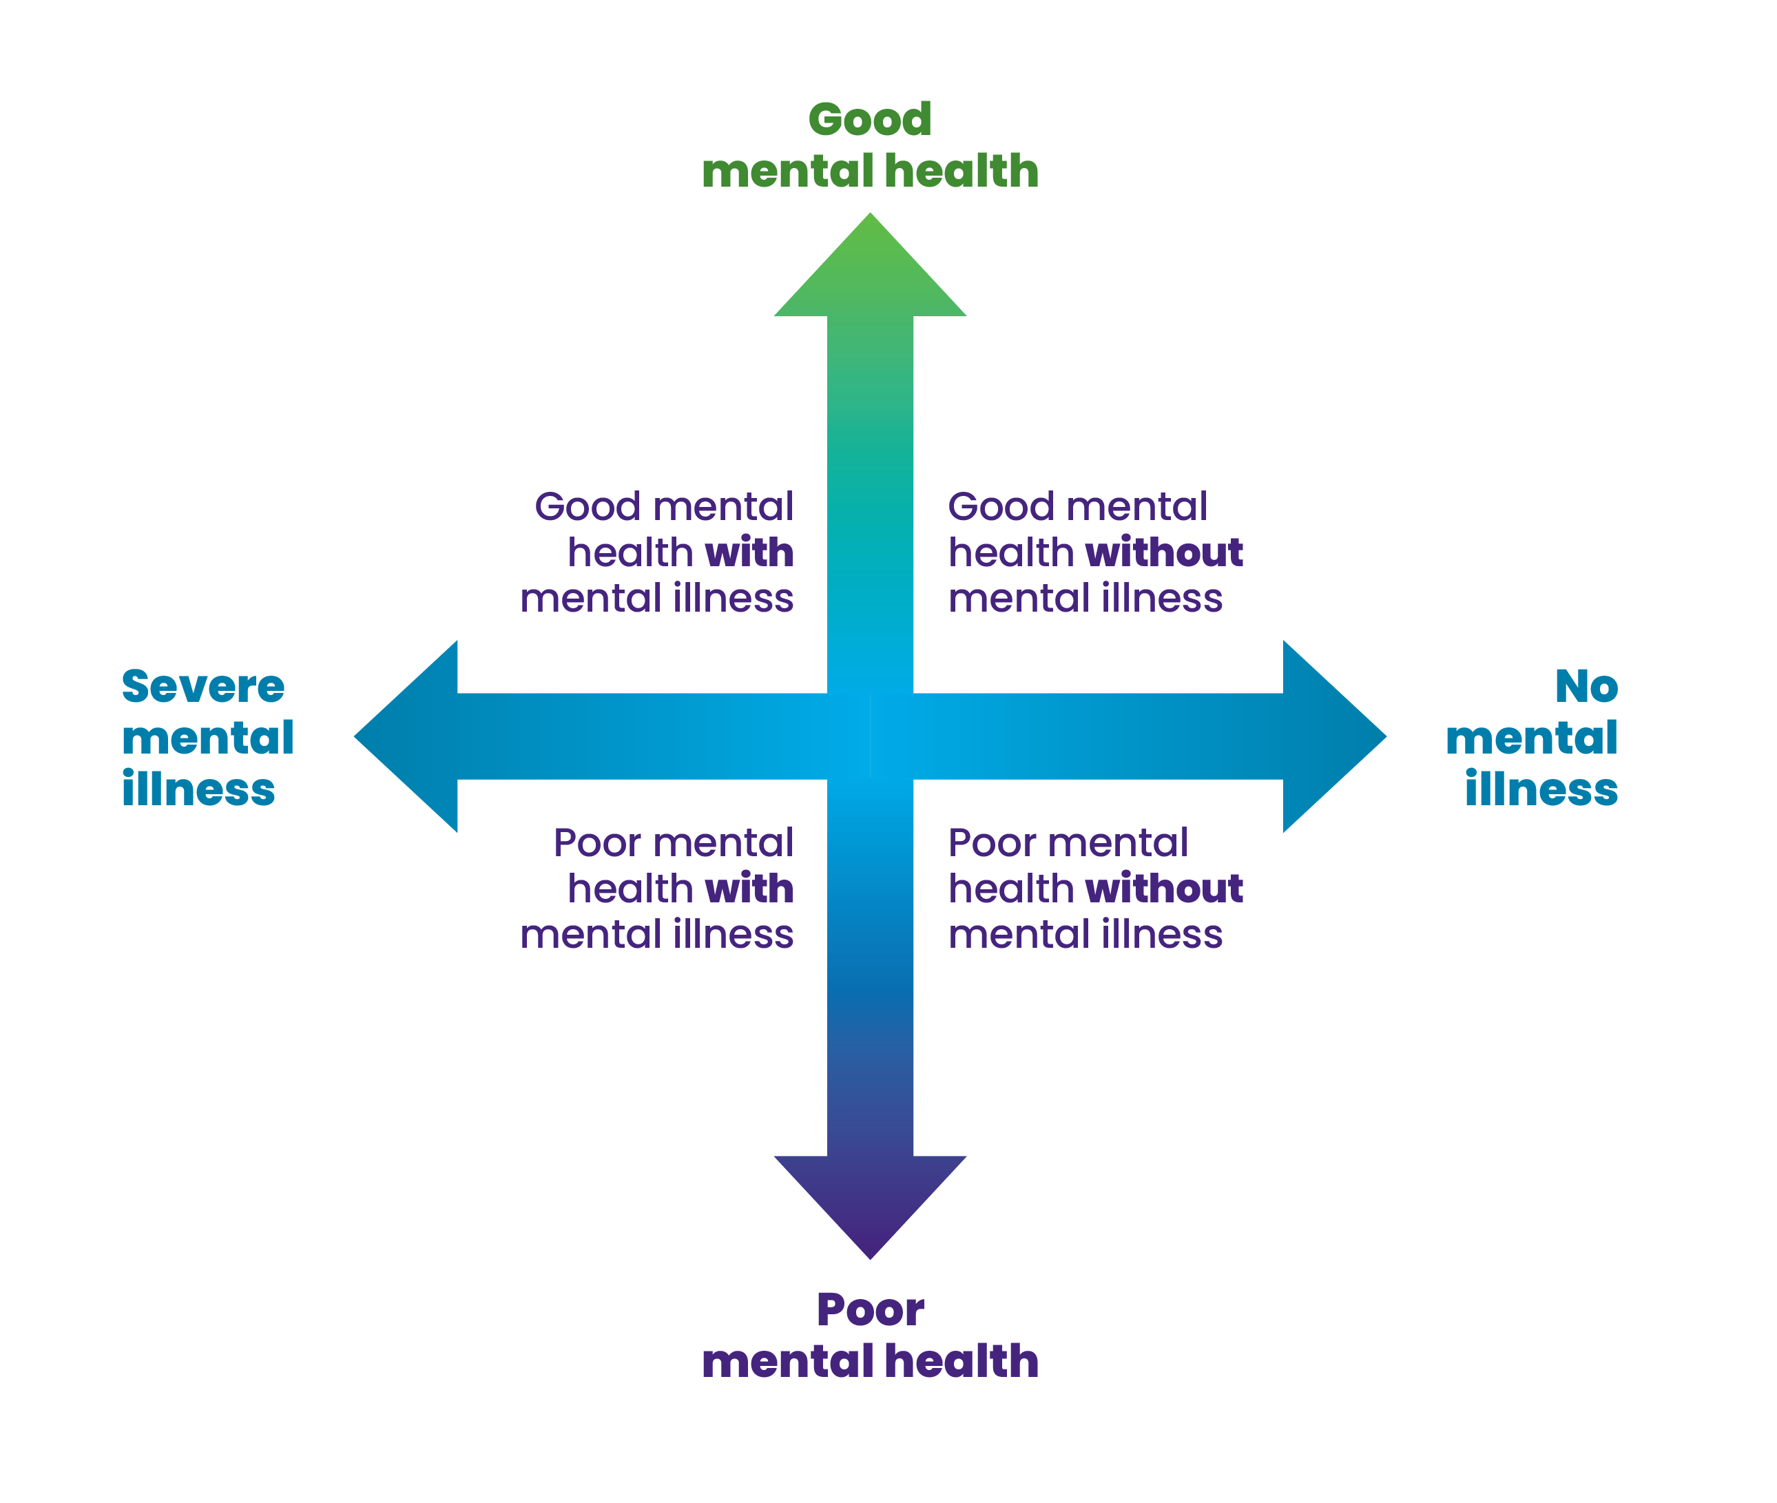

Unpacking the dual continuum
Notes:
Optional extension – use the Jayden and Bina videos to further unpack the dual continuum.
Youtube links are embedded in the slides
Note: these videos come from MH LIT: Student Mental Health in Action - School Mental Health Ontario, a series of secondary school lesson plans to support the development of basic mental health knowledge and help-seeking skills.
Facilitator script: "This is one way to think about mental health and mental illness that many students find helpful. Not having a mental illness doesn't guarantee we feel great all the time. And all of us, including those with mental illness, can feel well with the support we need. This is a new idea for many students, and one that they find hopeful."
Invite a conversation re: how staff feel about the dual continuum. Does the dual continuum make sense? Do they find it hopeful? Would they be excited to share it with students?

Slide 16
Build your toolbox

Slide 17

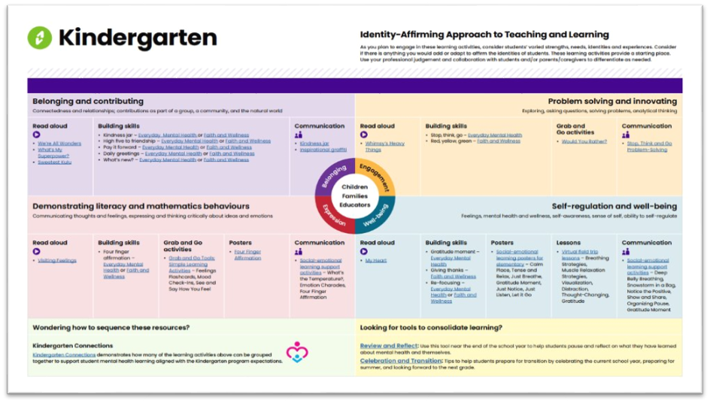
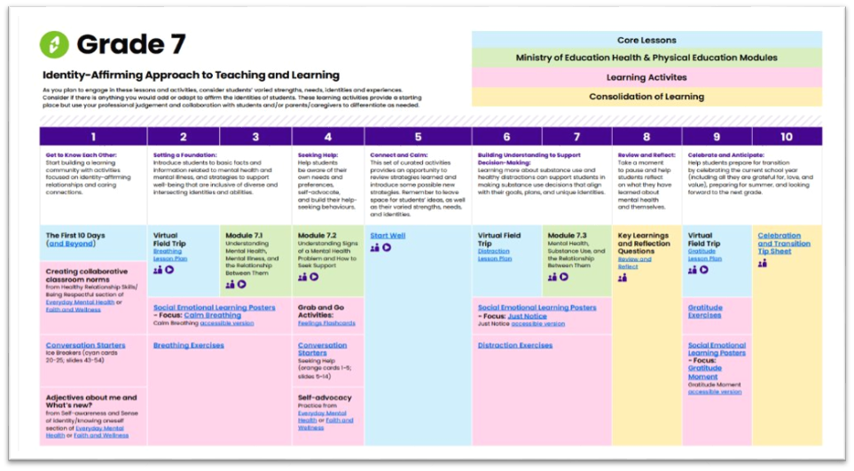
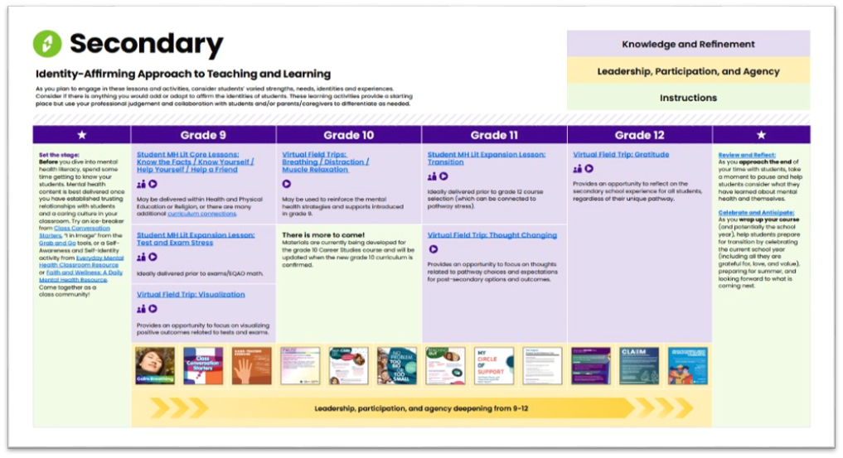
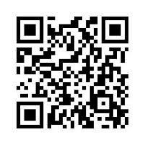
SMH-ON Wayfinder
Try it!
Download and explore the chart for your grade. Is there a lesson plan or activity that interests you?
Notes:
Wayfinder - Download your sequenced guide to teach about mental health
Facilitator script: "When you sign up for Wayfinder, you will receive an email asking you to confirm your subscription. Once you've done that, you will get a second email with links to Wayfinder charts for each grade. In the future you'll also receive an email when any updates are made, as Wayfinder is regularly revised as new resources are added."

Slide 18
quote
There are so many different initiatives competing for teacher time, but this is of central importance. I think this (mental health learning) is number one.
Ontario educator
Notes:
Invite a conversation about the value of this learning. Where have participants already had mental health learning opportunities? Where else would they like to experience them? What do they already know? What would they still like to learn? What are the roadblocks and how can we navigate them?

Slide 19
Dig deeper

Slide 20
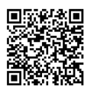
Mental Health Literacy for educators
Dig deeper by exploring an extended course.
Topics include:
Educator's role in student mental health
Mentally healthy classrooms
Social-emotional learning skills
Teaching about mental health
Understanding common mental health problems
When students need additional support
Notes:
Mental health literacy course for educators - Educators and student support staff - School Mental Health Ontario
Note: the course is hosted in the Ministry of Education’s e-community, an online learning hub. The following groups currently have access:
Educators, including occasional teachers and early childhood educators, school leaders and superintendents currently employed by a publicly funded school board in Ontario
Mental health leaders and managers of social work and psychology
To access the course:
Go to the login page for your school board instance of the virtual learning environment (https://xxxxx.elearningontario.ca). If you’re not sure how to find the page, use the dropdown menu.
Sign in using your school board credentials.
Once logged in, scroll down the page until you see a box labelled My Courses in Other Orgs.
Inside the box, you will see a link to a community called eCommunities Available for Self-Registration.
Click on that link and you will be taken directly into eCommunity. Choose Professional Learning and Teaching. You will see Mental Health In Action for Elementary Educators. Click to self register.
Versions are also available for special education resource teachers and guidance educators: Learn - School Mental Health Ontario

Slide 21

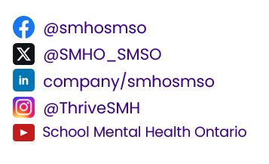
Connect with SMH-ON
We hope you’ll continue the conversation by connecting with SMH-ON on social media.
@smho_smso

