Slide 1


Expansion module:
How can schools support identity-affirming social-emotional skill development?
Notes:
This facilitation slide deck accompanies an expansion module to the one-hour Intro to MH LIT: Mental Health in Action for Educators course (https://smho-smso.ca/online-resources/intro-to-mh-lit/).

Slide 2

Notes for facilitation 2
This slide deck contains information to complement Intro to MH LIT, a one-hour mental health literacy course for educators. This slide deck offers related content in a format that may be offered at staff meetings or other professional learning opportunities.
Adjust the slides to meet your needs. They can be edited/reordered. Consider which optional extensions are relevant or fit within your allotted timeframe.
Consider supplementing the materials with additional activities/information specific to your region and board (e.g., local mental health programs or educational opportunities, etc.).
Consider inviting staff to complete the online course. It's free, self-paced, and a certificate is provided upon completion.

Slide 3
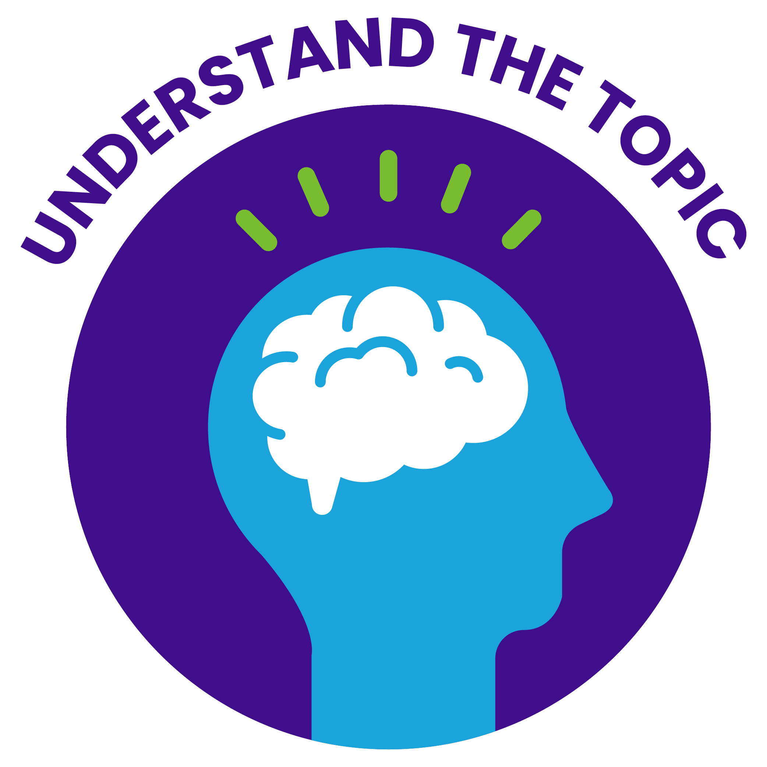

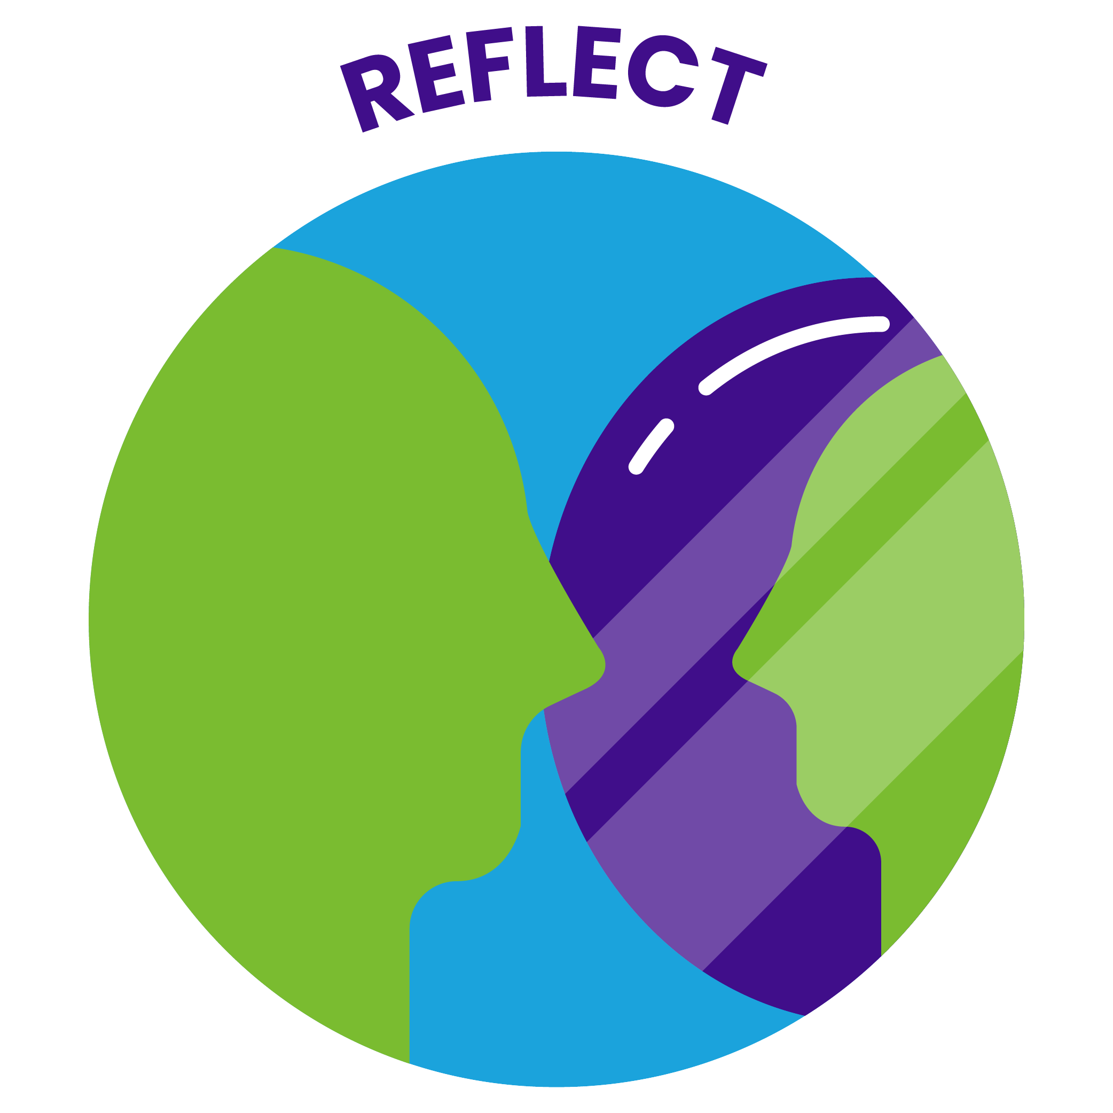


Notes for facilitation 22
Materials needed:
sticky notes, pens
chart paper, markers
devices to access the online course (should you wish to introduce it as part of the learning)
Look for the following symbols to help with facilitation, as well as alignment with the course:

Slide 4

By the end of this module, we will be able to:
understand culturally responsive and identity-affirming approaches to social emotional skill development and why they are important
describe the six social-emotional learning (SEL) competencies, as outlined by the Ministry of Education
name and identify cautions to be aware of when supporting social emotional skill development
share practical strategies to support identity-affirming approaches to social emotional skill development

Slide 5
Understand the topic
Notes:
This section corresponds to the main content of the learning.

Slide 6
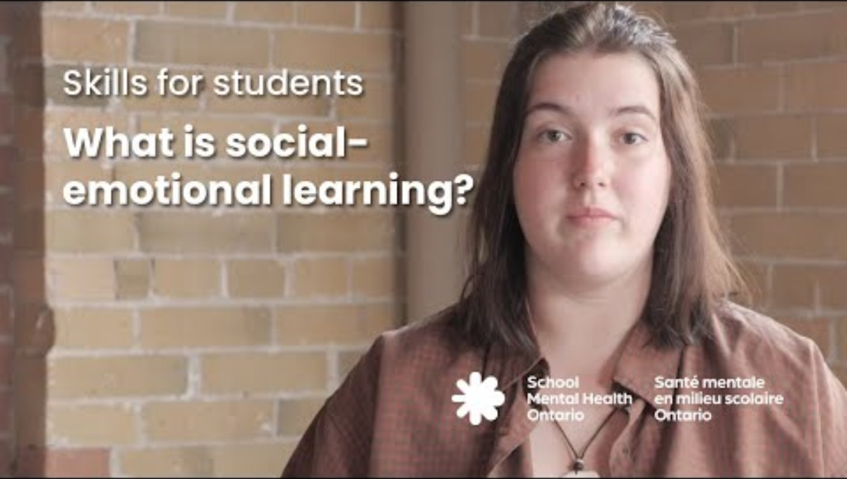
IA-SEL video
Notes:
This one-minute video describes an identity-affirming approach to SEL and its potential benefits.

Slide 7
The Ministry of Education notes many potential benefits
Social-emotional learning skills help students foster overall health and well-being, good mental health, and support the ability to learn and thrive.
– PPM 169
Implemented thoughtfully and intentionally, SEL has tremendous potential to create the conditions for student affirmation, youth agency and civic engagement and, ultimately, social change.
– 2020 Ontario Math curriculum
Notes:
Social-emotional skill development has long been embedded in Ontario schools through everyday interactions and learning experiences. In 2020, the Ontario Ministry of Education also updated the curriculum to include social-emotional learning as a distinct component, and in 2023, social-emotional learning was included as one of 11 requirements for student mental health in PPM 169. Given the expectations outlined in PPM 169, advancing social-emotional skill development best practices is a priority for school boards throughout the province.

Slide 8
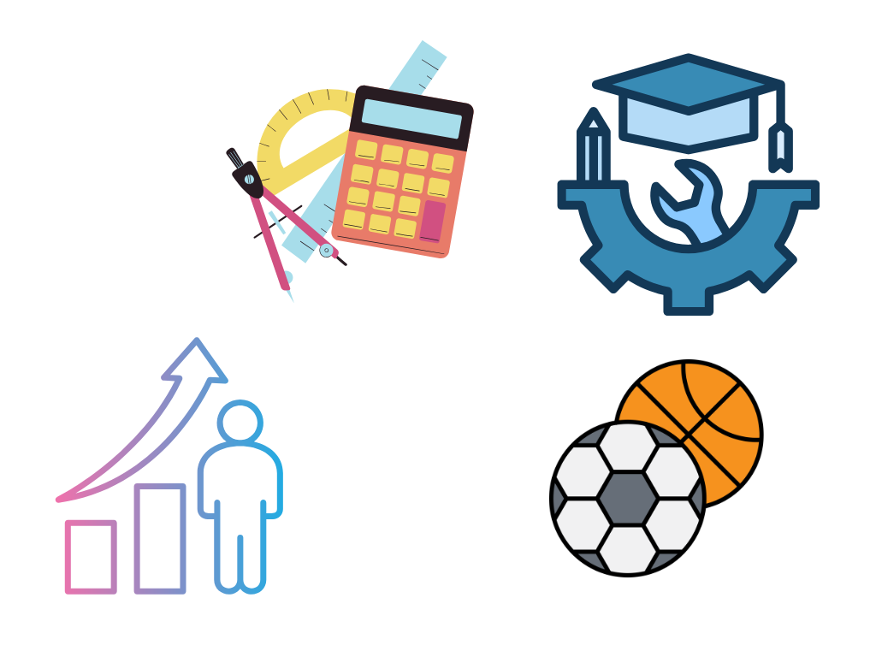
Social-emotional skill development supports the curriculum
in the Elementary Health and Physical Education (HPE) curriculum
in the Elementary Mathematics curriculum
across the Elementary curriculum, as well as in the revised Early Years program
in the Career Studies curriculum
Notes:
Invite participants to discuss consider and share additional curriculum connections. Are there additional places they think social-emotional skill development has a particular presence?
Program Planning: "Social-emotional learning skills are an explicit component of learning in the elementary health and physical education curriculum. However, there are opportunities for students to develop SEL skills in connection with their learning in all subjects and disciplines. Skills to support mental health and well-being can be developed across the curriculum, in the context of school activities, at home, and in the community."

Slide 9
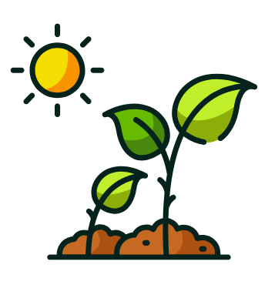
First, a few foundations...
Social emotional skill development: a lifelong process that follows predictable stages and can be enhanced through interaction and support; nurtured at home, school and in the community
Social emotional skills: help individuals and groups to achieve their goals, build trusting relationships, and cultivate identity and resilience
Social-emotional skill categories: offer ways of grouping social–emotional skills for instruction; different organizing systems for social emotional skills have been used, but none is deemed better than another
Teaching, learning and practicing social emotional skills adds to social-emotional development and is called social-emotional learning.

Slide 10
Social-emotional skill development can be taught in different ways:
Teaching method | This can look like...
Implicit support of social-emotional skill development | modelling skills through interactions recognizing and responding to teachable moments as they naturally occur reinforcing skills through consistent supportive relationships
Explicit support of social-emotional skill development | free-standing lessons focusing on specific skills where staff co-lead and co-learn with students embedding brief “kernels” or daily activities into classroom practice instruction integrated within academic content across subject areas
Notes:
Implicit support of social-emotional skill development is embedded in all aspects of the school environment through everyday interactions.
Explicit support of social-emotional skill development is intentionally taught through dedicated lessons and structured activities.
Invite participants to consider the ways they currently teach social-emotional skill development. Do they tend to fall in one category? Do they vary? Is there room to expand the way they approach this learning?

Slide 11

Did you know?
Social-emotional skill development and mental health literacy are related but distinct areas that contribute to well-being.
Teaching social-emotional skills supports well-being.
Mental health literacy builds the understanding needed to care for one’s own mental health and the mental health of others.

Slide 12
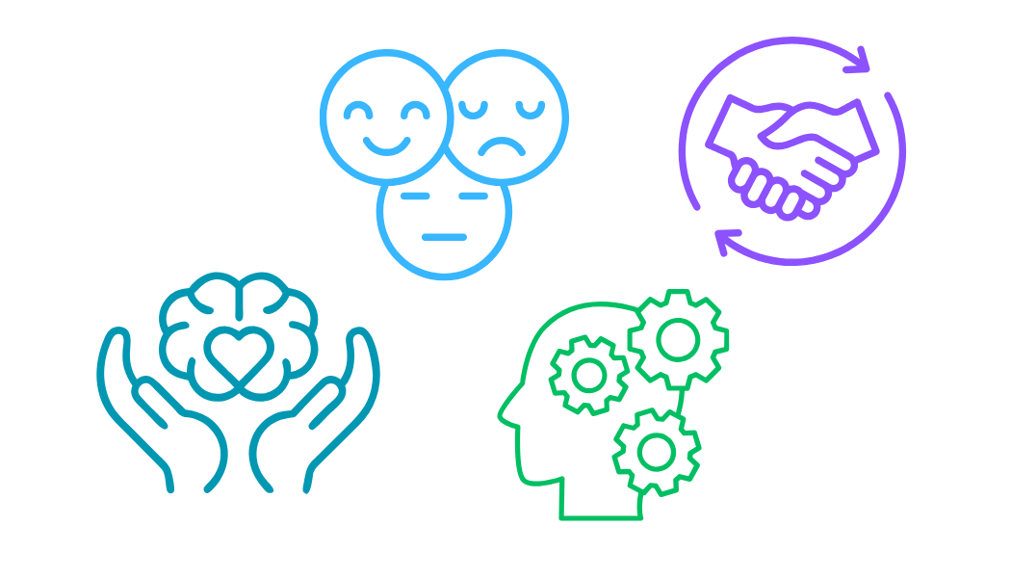
SEL competencies
Students will learn skills to...
identify and manage emotions
recognize sources of stress and cope with challenges
maintain positive motivation and perseverance
build healthy relationships
develop self-awareness and confidence
think critically and creatively
Notes:
These are the social-emotional learning skills that are embedded in the Ontario curriculum, as outlined by PPM 169.

Slide 13
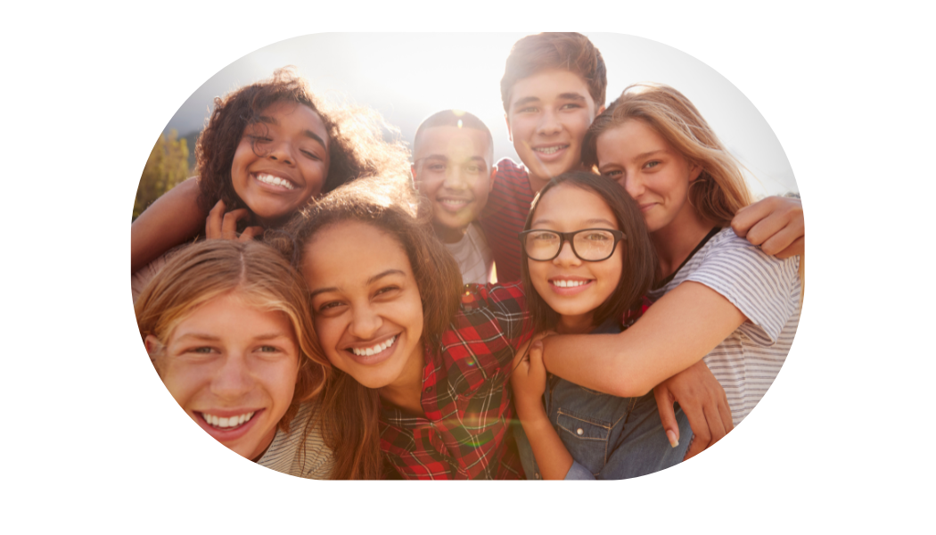
These SEL competencies can help students to...
express their feelings and understand the feelings of others
develop personal resilience
foster a sense of optimism and hope
support healthy relationships and respect diversity
develop a sense of identity and belonging
make informed decisions and solve problems
Notes:
Each SEL skill has the potential to lead to benefits for students.

Slide 14
An important caution
Not all approaches to social-emotional skill development support students or lead to the intended outcomes.
Students who experience oppression or racism or who do not see themselves reflected in the teaching of social-emotional skills may not benefit from this instruction, and in fact may be negatively affected or further harmed.
Notes:
While social-emotional skill development can have many benefits, it's important to be aware that concerns have been raised about it, too.
To truly support every learner's social-emotional skill development, efforts must affirm who students are and the strengths, experiences, and strategies that students already bring. When these efforts are not grounded in students’ lived realities, they can unintentionally suggest that only some students possess or need these skills, rather than recognizing that all students demonstrate and develop them in diverse ways.
As a result, the Ministry of Education has directed that while this learning should be supported and embedded into all areas of daily life at school, it is not to be evaluated.
Yoder, N., & Skoog-Hoffman, A. (2021). Introduction: Motivating the SEL Field Forward Through Equity. Emerald Publishing Limited. 10.1108/S0749-742320210000021001.

Slide 15
Reflect
What messages have you received about SEL?
Has it ever been promoted to you as a behaviour management tool or tool to promote the “ideal” way to express and manage emotions?
How could this negatively impact students?
Notes:
As an example, social-emotional skill development focused only on politeness, cooperation, or listening can reinforce the idea that “quiet and cooperative” students are ideal, sidelining those who express themselves differently or resist injustice. This can cause harm—especially for racialized and neurodivergent students. How else might social-emotional skill development have the potential to cause harm?
As an additional example:
Facilitator script: "Do you consider your own biases when it comes to attributing social-emotional skills to gender or even personality types? In the areas of Critical Thinking and Positive Motivation for example, are some quiet students perceived as "good listeners" and "thoughtful" whereas other quiet students are viewed as inattentive or disengaged?"

Slide 16
Explore strategies
Notes:
This section outlines ways educators can support culturally responsive, identity-affirming approaches to social-emotional skill development in their school.

Slide 17
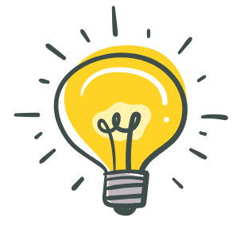
Ways to support culturally responsive, identity-affirming approaches to social-emotional skill development in your school
Carefully consider the identities of students.
Explicitly build on students' existing skills, perspectives, world views, and strengths.
Address barriers students encounter associated with their identities.
Notes:
When we get to know students and understand their identities as well as our own, we are in a better position to provide meaningful social-emotional skill development strategies that help students flourish in school and throughout life.

Slide 18
Keys to identity-affirming approaches to social-emotional skill development
Try...
seeing students through an asset lens that affirms who they are and the diversity of world views and experiences they bring to school
acknowledging the deep impacts of racism, oppression, marginalization, and colonization on student wellness and responding with a focus on reconciliation, equity, human rights, and social justice
prioritizing student voice, leadership, and agency

Slide 19
Keys to identity-affirming approaches to social-emotional skill development 2
Avoid...
conveying that there is one right way to behave or express emotion
inadvertently problematizing the emotional responses of students with certain identities
approaching social-emotional skill development as only being rooted in personal skill development (which can emphasize independence and self-reliance over community and connection)

Slide 20
Reflect 2
It is important to remember that students come to school with social-emotional skills shaped and informed by their families, cultures, communities, and experiences.
What social emotional skills and approaches do students bring to your school?
What social emotional skills and approaches do you bring, as an adult?
Notes:
It is important to remember that students come to school with social-emotional skills shaped and informed by their families, cultures, communities, and experiences—and adults do, too. Staff members’ own social-emotional awareness, beliefs, and cultural lenses influence how they interpret and respond to students’ emotions and behaviours, and how they approach social-emotional skill development with students.
Facilitator script: "As adults, we all have social-emotional skills, too. Educator social-emotional skills support you in your role as an effective role model for students. They are also support your own mental health and well-being."

Slide 21
Actions educators can take to support students
Increase capacity (learning and unlearning)
Co-create conditions for mentally healthy school and learning environments
Select resources that reflect diverse human experiences.
Weave social-emotional instruction into daily practice
Key actions

Slide 22
Considerations to support IA approaches to SEL
Ensure the use of strength-based
programming
Use teachable moments.
Reflect on your own positionality, privilege, and biases.
Consider differentiated approaches.
Model skills in everyday interactions.
Recognize and shift when SEL is used as a behaviour management tool.
Support anti-racist and anti-oppressive
conditions for learning.
Build asset-based mindsets.
Use culturally relevant and responsive teaching practices.
Build consistent, caring relationships.
Commit to learning about the impact of bias and oppression on social-emotional skill development.
Choose resources that centre student needs.
Co-lead and co-learn with students and families.
Notes:
These considerations can help support identity-affirming approaches to social emotional skill development:
Commit to learning about the impact of bias and oppression on social emotional skill development
Reflect on your own positionality, privilege, and biases.
Build asset-based mindsets in yourself and students.
Support anti-racist and anti-oppressive school and classroom conditions for learning.
Use culturally relevant and responsive teaching practices.
Recognize and shift when SEL is inadvertently used as a behaviour management tool.
Ensure the use of practices and materials are strength-based and reflective and relevant to the identities of students.
Consider differentiated approaches to social emotional skill development that take into account various lived experiences and worldviews.
Choose resources that centre student needs father than staff concerns.
Co-lead and co-learn by inviting student and family practices into the classroom.
Model social-emotional skills in everyday interactions with students, staff, and families.
Build consistent, caring relationships as the foundation for social emotional skill development.
Use teachable moments to name, notice, and reinforce social emotional skills (e.g., embed SEL language into routines and transitions, connect social emotional skill development to learning during collaboration and problem-solving).

Slide 23
Did you know? 2
In the past, there was a reliance on sequenced manualized SEL programs that are often costly and do not always support every student in the ways intended.
More recent guidance recommends an approach that focuses on core practices or kernels—small, flexible, evidence-informed strategies that can be woven into everyday classroom routines and relationships.
Notes:
In the past, there was a reliance on sequenced manualized SEL programs. These programs are often costly and, more importantly, do not always support every student in the ways intended. More recent guidance recommends an implementation-sensitive approach that focuses on core practices or kernels—small, flexible, evidence-informed strategies that can be woven into everyday classroom routines and relationships (Oulette et al., 2024). These approaches honour educator judgment, allow for cultural and contextual adaptation, and make efforts to support social-emotional skill development more responsive, sustainable, and relevant to all learners.
Ouellette, R.R., Strambler, M.J., Genovese, M.A., Selino, S., Joyner, L., Sevin, S., Granzow, E., & Connors, E.H. (2024). Selecting, Adapting and Implementing Classroom Kernels for Student Social and Emotional Development and Resilience in Local Elementary Schools: A Community–University Partnership Approach. School Mental Health.

Slide 24
Reflect 3
Social-emotional skill development is most effective when it is:
developmentally appropriate
identity-affirming
embedded into all aspects of a student's school experience.
What could this look like in your classroom and school?
Notes:
Facilitator script: "Social-emotional skill development is most effective when it is developmentally appropriate, identity-affirming, and embedded into all aspects of a student's school experience. What could this look like in your classroom and school? "

Slide 25
Build your toolbox

Slide 26
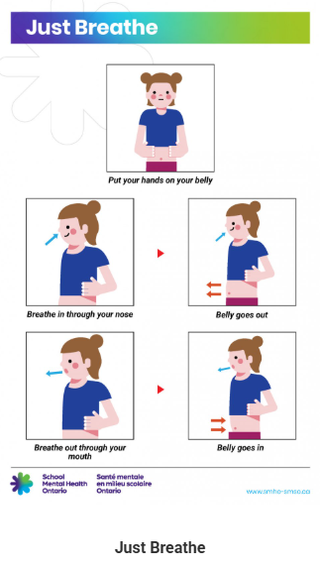
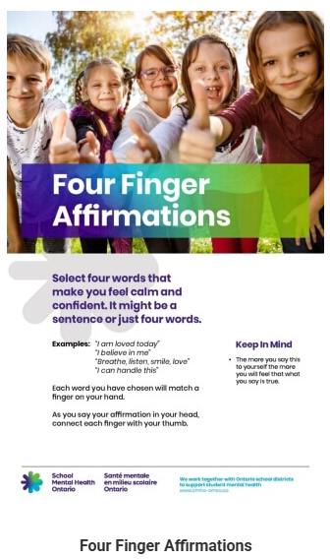
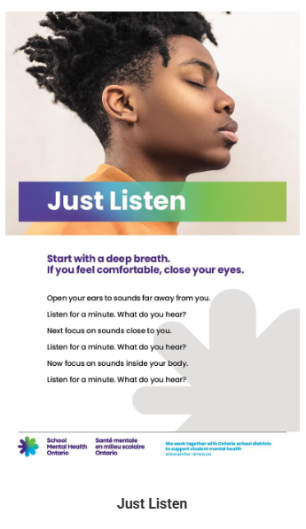
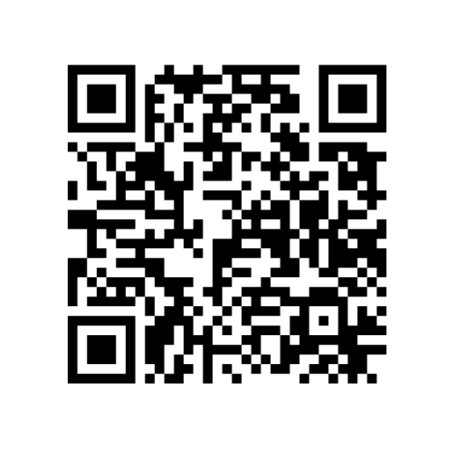
Social-emotional learning posters
These social-emotional learning posters highlight everyday school-based mental health practices.
Elementary, secondary and adapted versions with more visuals are available.
Notes:
Social-Emotional Learning Posters (https://smho-smso.ca/online-resources/sel-posters/)
Facilitator script: "Download some or all of the posters to display at your school or share digitally. There are versions for elementary students, secondary students, students who could benefit from more visuals, and versions of the secondary posters translated into 16 different languages."

Slide 27
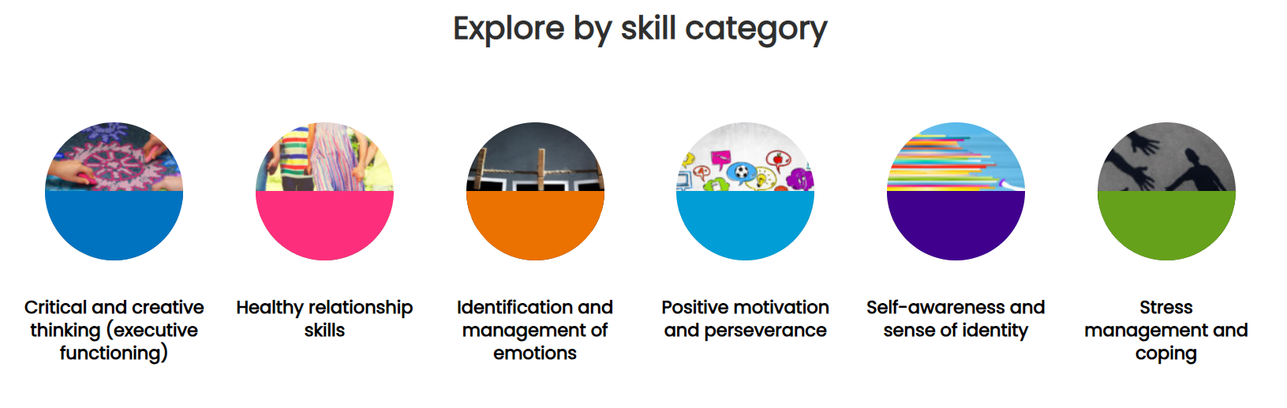
Everyday practices to support mental health
Notes:
Four versions of the resource are available:
Everyday Mental Health Classroom Resource - A Daily Mental Health Resource - Elementary
Everyday Mental Health Classroom Resource - A Daily Mental Health Resource - Secondary
Faith and Wellness - A Daily Mental Health Resource - Elementary
Faith and Wellness - A Daily Mental Health Resource - Secondary
Encourage participants to go to the site appropriate for their school system and the age and grade of students in their classroom. They may pick a category and explore one practice by reading about it, modeling it for others, discussing it with a partner, or another method they choose. This is also an opportunity to talk about the value of everyday practices, versus a "special event" approach to mental health.

Slide 28
Dig deeper

Slide 29
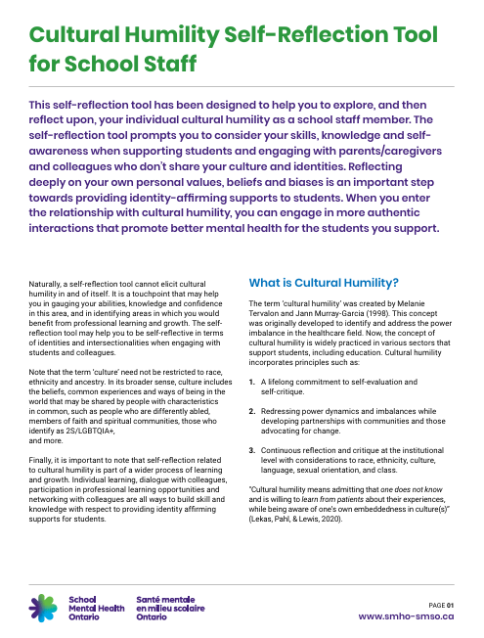
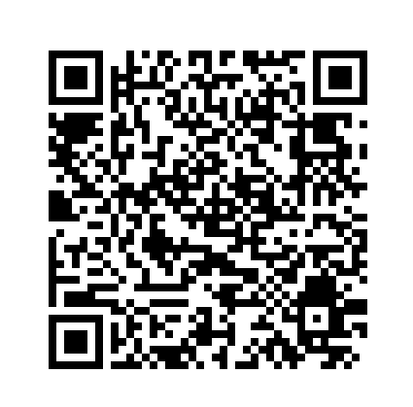
Cultural Humility Self-Reflection Tool
Exploring and reflecting upon your cultural humility as a school staff member helps you provide identity-affirming support to every student.
Notes:
Cultural Humility Self-Reflection Tool for School Staff - School Mental Health Ontario
Facilitator script: "Reflecting deeply on your own personal values, beliefs and biases is an important step toward providing identity-affirming and culturally responsive support to every student."

Slide 30

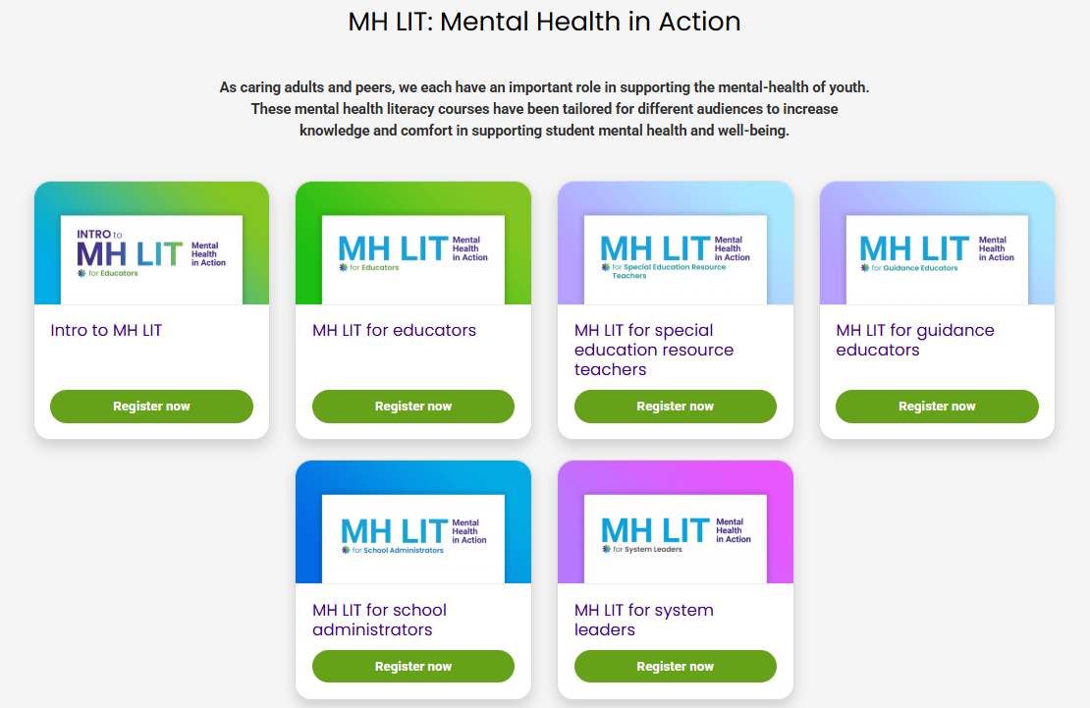
Connect with SMH-ON
Continue the learning by exploring the foundational Intro to MH LIT course for educators.
Notes:
Encourage participants to explore Intro to MH LIT (https://smho-smso.ca/online-resources/intro-to-mh-lit/) to continue their mental health literacy learning and sharing.

