Slide 1
Managing Stress at School and in the Workplace
Lesson 5

Slide 2
We are learning
To increase understanding of how well-being strategies can support future goals.
Improve understanding of when to seek support.

Slide 3
Warm up
You have two minutes!
Name as many stress management strategies as you can.
Notes:
MINDS ON - Warm up activity
Teacher prompt: “The right amount of stress can be a helpful motivator and can actually fuel our performance, like on tests or in sports. If we are nervous, it means we care, and when we care, we work hard. When we manage our stress, we can perform at our best. Learning helpful habits for managing stress, helps us at school, at work, in sports, and in our relationships with others.”
Set a timer for 2 minutes then ask student to provide as many stress management strategies as they can.
Optional: You can use a « word cloud » option on Mentimeter or ask student to add their ideas on Jamboard.

Slide 4

Debrief
Notes:
After the 2 minutes are done... debrief:
Teacher prompt:
“How did you find having a limited time available to provide your answers?”
How did it make you feel?
Motived?
Unmotivated?
Nothing in particular?
Did you have the impression that you would have had more ideas to share or that you weren’t able to access all of your ideas because of the time constraints?
Other impressions?
NOTE: This can be done as a class discuss, or as an anonymous online survey through Mentimeter, Jamboard or another platform.
Teacher prompt:
“We all experience stress and will react differently to it. How we react can be influenced by different variables, such as dealing with many stressors at once, having difficulty managing emotions or the impression that you aren’t able to face the situations that are causing the stress.
The good news? It’s possible de reduce and manage stress through simple daily strategies.”

Slide 5

How can we manage stress?
Notes:
Teacher prompt: “We can’t always choose whether we experience stress, but we can choose how we get ready for it. Instead of reacting to it, we can be intentional about how we respond when it appears. That’s what we’re going to learn more about today. I would also encourage you to think about the people at school who can help you plan for your future, such as guidance staff. Reach out to them early and often! Reach out to other people in your life who are there to help, too, such as your parents/caregivers, mentors, Elders, coaches, and other trusted adults.”

Slide 6
How can we manage stress?
Step 1: Anticipate and get ready for stress
Step 2: Manage stress early when it appears
Step 3: Seek support when you need it
Notes:
Teacher prompt: “How can we get ready for and manage stress, so it works for us and helps us achieve our goals, instead of working against us? Here are some strategies that can help.”

Slide 7
Notebook personal stress management plan
Add your ideas and thoughts to develop a list of personal strategies.
Notes:
Teacher prompt: “In this section, add your ideas and thoughts in your Notebook: Personal Stress Management Plan. Consider moments when you were stressed in the past, how you overcame these and who helped you. You can also include any new ideas. This will help you develop a list of personal strategies that you can use when needed.”

Slide 8
Get ready!
What helps you be at your best in different contexts (e.g., at school or at work) so you are better able to manage challenges?
Notes:
Teacher prompt: “What helps you be at your best?
Remember: These stress management strategies are transferable to other contexts.”
You can choose to read these questions to the class and ask students to offer their suggestions, then follow up with a discussion using the points offered in the next slide.
You can also offer some time when students can complete their plan individually.

Slide 9
A few ideas
!
Challenge your thinking
Build healthy habits
Know your supports
Notes:
NOTE: A discussion guide about stress is available in Appendix A.

Slide 10
Manage stress
How can you tell you are starting to get stressed so you can begin using strategies early?
What helps you manage stress when it appears?
How have you managed stress in the past?
Notes:
You can choose to read these questions to the class and ask students to offer their suggestions, then follow up with a discussion using the points offered in the next slide.
You can also offer some time when students can complete their plan individually.

Slide 11
A few ideas
!
Identify and rely on your strengths
Stay connected to others
Be kind to yourself
Notes:
NOTE: A discussion guide about stress is available in Appendix A.

Slide 12
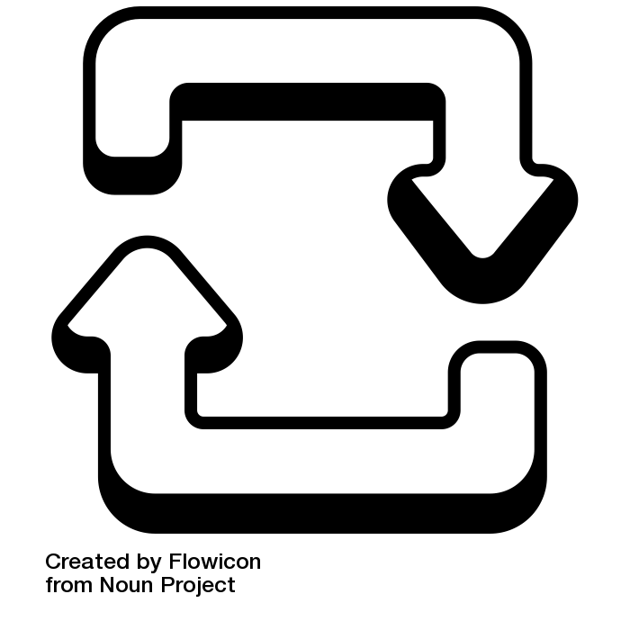
Quick strategy
Square breathing
Imagine you are tracing the outside of a square, then:
Inhale for a count of 4 (1-2-3-4)
Pause for a count of 4 (1-2-3-4)
Exhale for a count of 4 (1-2-3-4)
Pause for a count of 4 (1-2-3-4)
Notes:
Teacher prompt: “Guided breathing exercises are an effective and useful tool to help us check-in with ourselves and manage our emotions. These types of interventions can help decrease how our body physically reacts to stress, and helps us calm our mind.
This breathing technique is a quick and easy strategy to use before a test, when starting a big assignment, before a free throw, or any time you feel somewhat anxious.”

Slide 13

Quick strategy
Secret calming
Find a word, saying or phrase that you can use when you need it:
“All I can do is my best!”
“I can do this”
“I believe in myself”
“Breathe”
Notes:
Teacher prompt:
“Find a word, saying or phrase that you can use when you need it.”
“You can also add this to your “square breathing” by saying your words during the 4 second pause.”

Slide 14
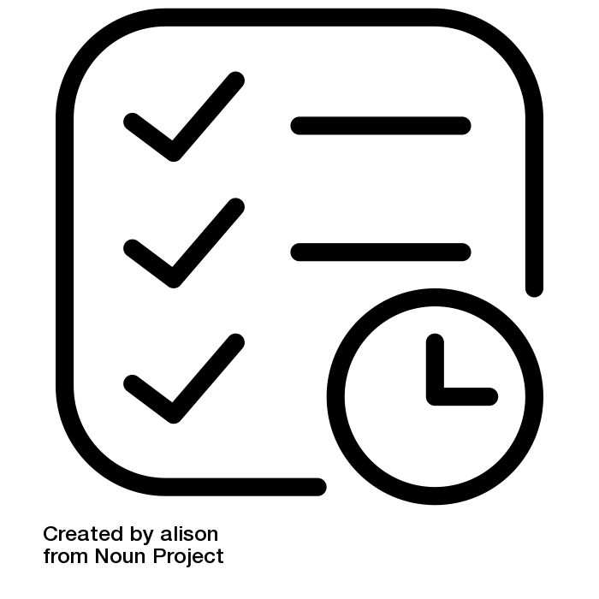
Quick strategy
Time management
  Split up difficult tasks into manageable steps. That will help reduce stress.
Notes:
Teacher prompt:
“At times we can feel overwhelmed by many commitments and stressors. Sometimes one task feels so large that we begin to feel stressed about it.
When people manage their time effectively, it can reduce their stress by knowing what’s to be expected and by minimizing the need to rush, cram, or compromise on the quality of their work.
Here’s a trick! Breakdown difficult tasks into steps, this helps relieve stress.
Practice using time management skills by creating checklists and adding the items to your calendar. You can use your electronic devices or your day planner to organize your time and activities”.

Slide 15
Seek support
How would you know what you are feeling was more than the usual stress?
How would you know it was time to reach out for support?
How could you normalize reaching out for support?
Notes:
NOTE: A discussion guide about stress is available in Appendix A.
You can choose to read these questions to the class and ask students to offer their suggestions, then follow up with a discussion using the points offered in appendix A.
You can also offer some time when students can complete their plan individually.

Slide 16
Transferable knowledge!
!
You can use the same strategies when seeking feedback to reach out for help.
Notes:
You can provide a reminder of the feedback strategies learning in lesson 2 can be used as a help-seeking approach.

Slide 17
If you are feeling unwell (e.g., overwhelmed, anxious, sad), you can talk to a teacher or another trusted adult.
There are people who work in the school, and in the community, who are there to help you find ways to feel better.
Black Youth Helpline
Call: 416-285-9944 or toll-free 1-833-294-8650
LGBT YouthLine
Call: 1-800-268-9688
Text: 647-694-4275
One Stop Talk
Call: 1-855-416-8255
Chat: https://onestoptalk.ca
Talk Suicide Canada
Call: 1-833-456-4566
Text: 45645
First Nations and Inuit Hope for Wellness Help Line
Call: 1-855-242-3310
Trans Lifeline
Call: 877-330-6366
Kids Help Phone
Call: 1-800-668-6868
Text: CONNECT to 686868
Text: RISE to 686868 (specific support to Black youth)
Notes:
Let students know that some phone lines are open 24/7 and some have certain hours. Encourage students to check out the ones they prefer.
Teacher prompt: “While there are many things we can do to help during stressful situations, we can’t and we don’t control everything, and sometimes things get in the way of our ability to manage. Our ability to manage stress can also be impacted things such as loss, health or financial issues, how safe we feel, and many others. If you try the strategies discussed and they aren’t helping, or if your stress is really big, long-lasting, and getting in the way of your day-to-day life, you don’t have to manage alone. There are people who can help and remember, you deserve support. If you aren’t sure how to start the conversation, you can use words such as these:
Something has been bothering me. Can you help me find someone to talk to about it?
I’ve been feeling stressed a lot lately. Can I talk to you about it?
Do you have some time to meet with me? There’s something I need help with.”
Teacher prompt “This resource can help you identify the people, places, and things that are there to support you when you need it. It’s important to update your Pocketbook from time to time. As you follow your path, you will meet new people who may become strong allies and supports for you. Add them to your Pocketbook! And if you travel to new places, pay attention to formal mental health services, too. There is always help through any tough time you might experience.”

Slide 18
Notebook circle back
Revisit your encouraging message from lesson 1.
Do you want to add or edit anything in light of everything you’ve learned in this S4L unit?
Notes:
Teacher prompt: “Take a few moments and revisit your lesson 1 “Message of Hope”. In light of everything you’ve learned throughout the S4L unit, is there anything you would like to add or modify from your original message?”

Slide 19

Wrap up
In the changing world of work, as responsibilities for workers’ health and safety shift, what can you do to look after your own physical, mental, and emotional health in the workplace?
Notes:
Teacher Prompt: “As this is the last lesson in the S4L unit, I’d like you to take a moment to reflect on the following consolidation question. If you wish, you can add you thoughts to your Notebook.”

