Slide 1
Understanding Stress and
Managing Transitions
Lesson 4

Slide 2
We are learning
To normalize stress related to change.
To increase knowledge needed to care for well-being during times of transition.

Slide 3
Warm up
What are three words that come to mind when you think about transitioning from secondary school and moving on to whatever you are pursuing next.
Notes:
MINDS ON - Warm up activity
Teacher prompt: "Today, we're going to reflect on the transition from secondary school and discuss some of the emotions we might feel as we move on to that next phase. Before we begin, I want you to take a moment to think about this transition and the feelings it evokes. Consider what three words come to mind when you think about moving on to whatever you are pursuing next. These words can be related to your hopes/dreams, emotions, challenges, or anything else that captures the essence of this transition.”
After students have shared their thoughts… Debrief

Slide 4

Why transitions might be stressful?
Notes:
Teacher prompt: “Stress is defined as the pressure, tension, physical discomfort, and sometimes worry that comes from many different situations, like when we have a big test coming up, we are trying out for a team, or we are excluded from our peers or made fun of for something that’s important to us. Sometimes even things we are looking forward to can cause stress, such as graduation, a big party, or a class trip, because they require us to adapt, grow, and try new things”.

Slide 5
Why transitions might be stressful?
Moving on from secondary school is a big life transition.
Change—even good change we are looking forward to—can cause stress because it requires us to adapt and grow.
Some students may not feel ready to move on from secondary school and were still hoping for more from the experience.
Students often see an idealized version of what life ‘should’ look like after secondary school or hear this is the best time of life.
There are also many life events outside of our control that can add to the amount of change we deal with and the stress we need to manage.​
Notes:
Teacher prompt: “It can feel confusing to look forward to moving on from secondary school and then find parts of the experience stressful when it arrives. We may wonder if we’ve made the right choices or if we are handling things well. But it’s okay to feel some stress related to transition—in fact, it’s to be expected, and those feelings are just as valid as excitement we may feel.”

Slide 6
Exciting or challenging?
Moving on to something new and different

Slide 7
Activity
Think about the following elements that come with a transition and share whether you think they are more CHALLENGING or EXCITING.
Notes:
Activity: Using the slide deck, ask students to think about the elements that come with a transition and share whether you think they are more CHALLENGING or EXCITING.
Optional: you can ask students to: answer anonymously online (Mentimeter, Jamboard, etc.), give their answers out loud, sit or stand up or to move to one side of the classroom or the other depending on their answer.

Slide 8
Exciting or challenging?
Having greater independence

Slide 9
Exciting or challenging?
Having the chance to focus more on what you like/are interested in

Slide 10
Exciting or challenging?
Meeting new people and having new experiences

Slide 11
Exciting or challenging?
Feeling one step closer to the future you want

Slide 12
Exciting or challenging?
Having many decisions to make (e.g., choosing a career path, where to apply to school or for a job, where to live, who to live with, etc.)

Slide 13
Exciting or challenging?
Figuring out your identity and who you want to be

Slide 14
Exciting or challenging?
Exploring new paths and having big changes ahead

Slide 15

Pathway stress
Notes:
Teacher prompt: “We can’t choose when we will experience stress, but we can choose how we get ready for it. That’s what we’re going to learn more about today. I would also encourage you to think about the people we have in our school to help you plan for your future, such as our guidance staff. Reach out to them early and often! Reach out to other people in your life who are there to help, too, such as your parents/ caregivers, mentors, Elders, coaches, and other trusted adults.”
Educator note: it may be helpful to continue to provide reminders throughout the lesson about help available as students work toward graduation.

Slide 16
Pathway stress
Managing personal expectations ​
Managing pressure from others (e.g., parent/caregiver) ​
Being in a competitive environment (e.g., when applying for post-secondary programs or jobs) ​
Societal expectations (following a path that makes you feel different or left out​)
Feeling you lost time during the pandemic, or it was a difficult time to make decisions about post-secondary​
Notes:
Teacher prompt: “One source of stress that many students feel is the pressure to choose the right pathway. That can involve things like:

Slide 17
Balanced self-talk activity
Challenge some self-talk messages you may give yourself that aren’t helpful
Notes:
Teacher prompt: “When faced with a life circumstance over which we have little or no control, it is easy to let our emotions or unhelpful or unbalanced thoughts take the lead. These thoughts are common like, “this is impossible” or “I’m not good enough”, but oftentimes we can tune them out and move on. Sometimes though, unhelpful thinking starts to become a habit, and can influence our mood and well-being. Catching these thoughts early, and challenging them with more helpful and balanced thoughts, is a helpful coping strategy.”
“We’re going to complete an activity to help you consider a balanced way to think about the pathway choice and some of the related pressures. Looking at things in a balanced way involves noticing all aspects of a situation—the positive, negative, and neutral, not just the ones you are stressed about.”
“But first, here are a few tips.”

Slide 18
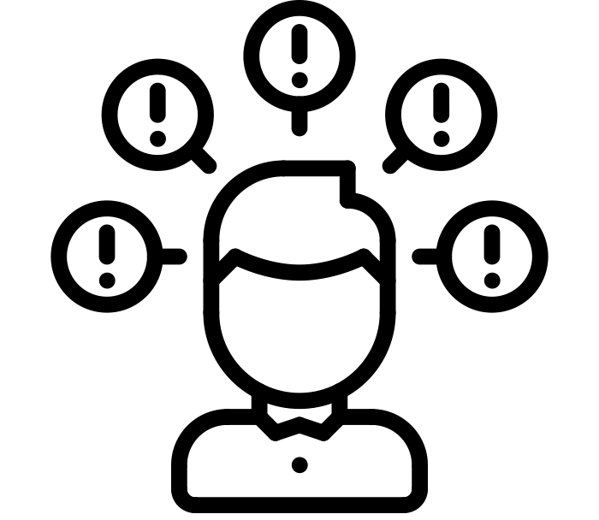
Quick Tips
  How likely is it?
  Is there another way to think about things?
  Are there other explanations or viewpoints?
Notes:
Teacher prompt: “When Listening to your Self-Talk, Ask Yourself…”

Slide 19

Quick Tips
Catch yourself saying you “should” do things (I should do, act, feel better).
“Should” often just makes us feel guilty and judge ourselves.

Slide 20

Quick Tips
What would I say to a friend?
Notes:
Teacher prompt: “Consider what you would say to a friend. Most of us would never be friends with someone who spoke to us the way we sometimes speak to ourselves. We deserve compassion and support, too.”

Slide 21
Instead of…I could try…
Instead of… (Unbalanced thoughts) | I could try… (Balanced thoughts)
If I don’t get the job I want, my life will be ruined. | My happiness in life will come from many things. Work is only one of them.
Grade 11 is when I need to make all the decisions that will impact the rest of my life. | Decisions for post-secondary are not permanent. I’m never stuck. Many people change paths.
My sibling/friend had much better grades and was more successful than I will be. | My sibling/friend and I are different people and have had different experiences. It isn't fair for me to compare us.
Notes:
Read the examples.

Slide 22
Let’s Practice!
Instead of… (Unbalanced thought)
There is one right choice and I need to figure it out. Everything else would be a huge mistake.
Notes:
Teacher prompt: « We will now practice how to find balanced thoughts to overcome unbalanced thoughts. I will read an unbalance thought statement and you will offer some alternative suggestions. »
Optional: You can ask students to add their ideas to a white board or Jamboard.

Slide 23
Let’s Practice!
Instead of… (Unbalanced thought) | I could try… (Balanced thoughts)
There is one right choice and I need to figure it out. Everything else would be a huge mistake. | There is no one perfect career. People don’t have one job their entire lives anymore, either. Many people shift and change programs and jobs once they try them out. I won’t truly know how much I like or don’t like a program or job until I try it.

Slide 24
Let’s Practice!
Instead of… (Unbalanced thought)
My sibling/friend had much better grades and was more successful than I’ll be.

Slide 25
Let’s Practice!
Instead of… (Unbalanced thought) | I could try… (Balanced thoughts)
My sibling/friend had much better grades and was more successful than I’ll be. | My sibling/friend and I are different people and have had different experiences. It isn't fair for me to compare us. No one else is like me and my version of success could look different from my sibling/friend.

Slide 26
Let’s Practice!
Instead of… (Unbalanced thought)
I should be able to handle the stress. Everyone else is.

Slide 27
Let’s Practice!
Instead of… (Unbalanced thought) | I could try… (Balanced thoughts)
I should be able to handle the stress. Everyone else is. | Many people are stressed. We just don’t always talk about it, and social media doesn’t help. I will try my best to handle the stress, but it’s okay to ask for help if I need it. Many people ask for help and it can be part of having a successful year.

Slide 28

Debrief
Notes:
Debrief the activity.
What were some of your takeaways from this activity?
Did you find it easy or difficult to find alternative balanced thoughts?
Invite students to add their reflections to their Notebook.
Teacher prompt: « We can sometimes think negatively about ourselves, our abilities, and our futures. But that doesn’t mean they are true, and this kind of thinking can add to our stress. When you notice unhelpful thoughts happening, challenge them! Try to talk back to them with more balanced thinking. Balanced thinking isn’t the same as positive thinking. It’s fair and realistic thinking that looks all aspects of a situation (the positive, negative, and neutral), not just one point of view.”

Slide 29
Notebook self-reflection
What are some of my unbalanced thoughts?
How can I respond to them?
Notes:
This activity can be done in class or at home.
Teacher prompt: « You are now invited to think about how you would respond to some of your unbalanced thoughts. You can add your answers in your Notebook. »
Reminder: The Notebook is for personal reflection only.

Slide 30
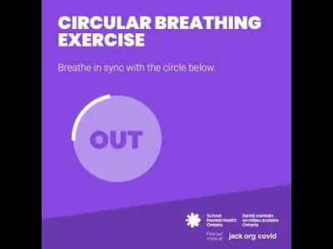
Breathing exercise
Notes:
Teacher prompt: « We will end today’s lesson with a brief activity that helps manage stress, which is the topic for our next lesson. You’re invited to take a big breath. Deep breathing can help still our minds, calm our bodies, and control feelings of stress. The following video is offered to guide you.”
Video link: https://youtu.be/boT7p5kw-MQ

Slide 31

Wrap up
Change, even positive, can be stressful.
We all have unbalanced thoughts… to avoid having these add to your stress, it’s important to challenge them with balanced thinking.

