Slide 1
Exploring Identity/
Acknowledging Strengths
Lesson 2
Notes:
Teacher Prompt: This lesson will encourage students to reflect on their strengths, interests, passions, and values, and explore their aptitudes and career options.

Slide 2
We are learning
To identify personal interests, roles, goals, and strengths.
How identified assets/strengths connect to decision making and personal well-being.

Slide 3
Group brainstorm
What are things people like/enjoy doing?
What are some strengths, gifts, talents people have? How do you know?
Do you think any of these can be applied or transferred to a career?
Notes:
Warm Up Activity
Teacher prompt: “Part of our identity is composed of, and shaped by our strengths (or qualities), which is defined as a good or beneficial quality or attribute of a person and our skills, which can be defined as the ability to do something well after learning and practicing it.
There is no right or wrong answer when it comes to listing strengths. We all have different experiences, cultures, faiths and backgrounds that may influence what we consider strengths. Things we are good at and enjoy will change many times throughout our lives and it is important to be kind to ourselves and patient as we discover our ever-evolving identity.
To help generate new and creative ideas to help students identify their strengths, encourage them to brainstorm some ideas as a class.
Optional: You can also use Career Cruising or MyBlueprint surveys depending on your Board.
NOTE: you can choose to discuss some or all of the suggested questions.

Slide 4
Transferable strengths and skills
Critical thinking and problem solving
Innovation, creativity and entrepreneurship
Self-directed learning
Collaboration
Communication
Global competence
Technological fluency
Notes:
Teacher prompt: Here are a few strengths and skills that can be transferable within the workplace.
Can you see yourself in any of these transferable skills? Are there any skills you want to learn or improve on?”

Slide 5

Debrief
Notes:
Debrief the activity.
What were some takeaways from this reflection?
Do students think that strengths can easily be used as a skill in their future job/career?
Teacher prompt: There are many skills that we each have and many that we may notice in the people around us that inspire us to learn more. The great thing is that skills can be developed. As well as skills, we each have strengths and interests, that can help us to explore options for our future jobs and careers. That’s why in today’s lesson, we’ll be thinking about our personal interests, strengths, and exploring our goals.

Slide 6
Notebook Self-Reflection
What are you passionate about?
What are you good at?
What are you interested in?
Notes:
Teacher prompt: “To get us started, we are going to take a moment so you can reflect upon and articulate some of your interests, passions and things you are good at.”
Ask students to complete the ’I AM’ handout 2.1 in their Notebook to capture some of their strengths and skills. Students can choose to write or draw their answers in the table provided. Note: The Notebook is not for submission. It is for personal reflection only.
Encourage them to consider:
What they are passionate about
What they are good at
What they are interested in
Optional: Once students are done completing the I AM table, you can invite them to share anonymously on a Jamboard or a sticky note – 1 strength or 1 thing they enjoy.

Slide 7

My Strengths & Skills!
Notes:
Teacher prompt: We all have days when we feel down, uncomfortable, anxious, or like nothing is going right. That is a part of life. If we focus on our weaknesses, it’s easy to get caught up in feeling negative. And that can make us feel sick, tired, sad, and disconnected.
The good news is that if we focus on our individual strengths (bravery, kindness, optimism), skills (being good at math, sports, or music), and supports (family, faith community, and/or our culture) we can overcome tough times and feel more positive about our future. If we focus on the good stuff that helps make us who we are, we can become more resilient.
This reflection can help you notice the multiple strengths, skills and supports that you have in your life.
Turn to My Strengths Handout 2.2 in their notebook and have students record their strengths, skills and interests. This exercise will help guide them to think about their skills/strengths in a variety of different areas. Students can use their “I AM” table to see if they can repurpose some of their ideas.
Optional: Name a strength or a skill for each student to help get them started (you can use the Indeed.com link provided in the additional resources).
This table can be revisited to help them inform their resumé.

Slide 8
Brainstorm
How do strengths and skills contribute to your goals and personal/professional growth?
Notes:
Teacher prompt: “We’ve discussed the concepts of strengths and skills and you’ve started to identify your own. Now I’d like for us to brainstorm how strengths and skills can contribute to your goals and personal/professional growth.”

Slide 9
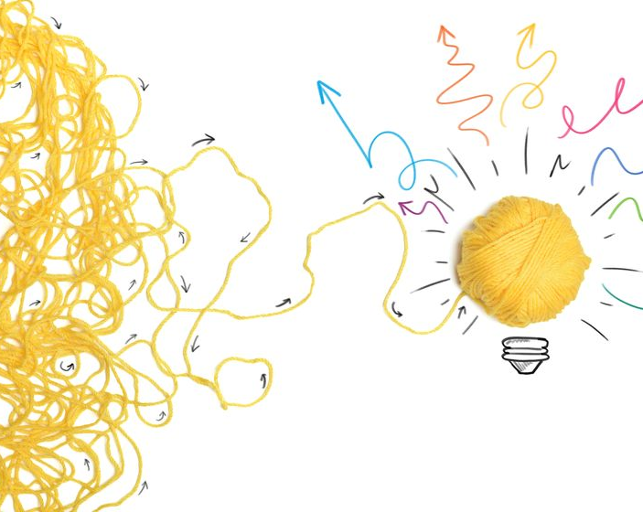
Debrief
Notes:
Debrief the activity.
What were some takeaways from this reflection?
Teacher prompt: “Strengths and skills are the drivers that help you to reach your goals. When we set goals for ourselves, we need to plan on how we want to achieve these. Sometimes, we have all the strengths and skills needed to successfully achieve the goal, while at other times, we might need to learn and practice new skills to meet our objective. By being aware of our strengths and skills, we are in a better position to determine which ones we want/need to bolster to continue to grow personally and professionally.”

Slide 10
Brainstorm
What are some other ways we can learn about our strengths or what we are good at?
Notes:
Discuss with the class other ways that they can learn about their strengths and what they are good at.
Responses could include:
ask parents,
family members,
caregivers,
teachers,
Elders,
Faith Leaders
friends,
skills inventories,
make a list of accomplishments,
personal reflection,
etc.
Introduce the concept of seeking feedback from others and encourage students to think of other sources of information/feedback that could explore to gain a broader perspective on their personal strengths and areas of growth.
Provide guidance on how to approach others for feedback and encourage students to record the feedback they receive in their notebook.

Slide 11

Tips when seeking feedback
Is this the right time & right place to ask for feedback?
Notes:
Teacher Prompt:
"Approaching others for feedback can be a valuable learning experience. When seeking feedback, it's important to approach with an open and positive mindset. Remembering that feedback is a valuable tool for self-improvement.”
Consider the following guidance as you approach others for feedback:
Choose the right time and place: Make sure the person is available and receptive.
You can ask, them explicitly, “I’d like your thoughts and feedback about some of my skills and strengths. Is now a good time to talk?”

Slide 12

Tips when seeking feedback
Be specific about what you're seeking feedback on
Notes:
Be specific about what you're seeking feedback on.
Clearly communicate and let the person know that you value their input and would appreciate their honest observations and suggestions.
For example: 'What strengths do you think I have in this area?' or ‘Do you have any suggestions for my personal growth?

Slide 13

Tips when seeking feedback
When receiving feedback, listen attentively, without interruption
Notes:
Active listening: When receiving feedback, listen attentively without interruption.

Slide 14

Tips when seeking feedback
Be receptive. Feedback is meant to help you grow. Stay open-minded!
Notes:
Be receptive: Remember that feedback is intended to help you grow. Stay open-minded and avoid becoming defensive or dismissive of constructive criticism.

Slide 15

Tips when seeking feedback
Express gratitude. After receiving feedback, thank the person for their time and insights.
Notes:
Express gratitude: After receiving feedback, express your gratitude to the person for their time and insights. Let them know that their feedback is valued and will contribute to your personal development.

Slide 16
Notebook Challenge
Seek feedback from 2 trusted sources and see if you learn anything new about yourself!
Notes:
Invite students to a ‘Notebook Challenge’!
Teacher prompt: “Now it’s your turn! Go and ask feedback from two trusted sources, such as teachers, coaches, mentors, peers, Elders, knowledge keepers, knowledge holders, and employers and to add your findings to your Notebook.”
Be curious and see if you learn something new about yourself!

Slide 17
Notebook Reflection
Explore some careers that are aligned with your strengths and interests
Notes:
Teacher prompt: Explore some careers that are aligned with your strengths and interests and add the results in your Notebook.

Slide 18
Notebook Extension
How can you use social media to demonstrate your interests, strengths, and skills to potential employers?
Notes:
Teacher prompt: How can you use social media to demonstrate your interests, strengths, and skills to potential employers? How does using media in this way contribute to the development of your sense of self and to the way you present yourself to the world [e.g., building a “personal brand”]?

Slide 19

Wrap up
Strengths, skills and interests are great things to know about yourself, as they can help you in your personal life, and in your post-secondary life!
Notes:
Teacher prompt: Strengths, skills and interests are great things to know about yourself, as they can help you both in your personal life and in your post-secondary life.

