Slide 1
Promoting Mattering for Self and Others
Lesson 1

Slide 2
Skills4Life goals
In this unit, we will:
Understand the importance of mattering and positive motivation
Explore our identities and acknowledge our strengths
Learn effective communication and conflict resolution skills
Examine the stress linked to change and transitions and
Identify strategies to help manage stress
Notes:
S4L focuses on equipping you with life skills to help you navigate post-secondary transitions and support your well-being in the process.
In this unit, we will:
Understand the importance of mattering and positive motivation
Explore our identities and acknowledge our strengths
Learn effective communication and conflict resolution skills
Examine the stress linked to change and transitions and
Identify strategies to help manage stress

Slide 3
We are learning
To demonstrate an understanding of mattering and its connection to well-being.
To practice skills that contribute to creating a positive and inclusive culture that promotes mattering for oneself and others.

Slide 4
Co-creating shared classroom agreements to guide discussion
For example:
There is room for everyone to contribute, but you don’t have to share if you don’t want to.
Be open to each other’s experiences and appreciate differences. Value everyone’s voice…
Remember: this is a school lesson, not a time to share sensitive personal stories.
Notes:
Teacher prompt: The goal of co-creating shared Classroom agreements is to promote a supportive learning environment that will encourage everyone to share their thoughts, experiences, and aspirations, while respecting and valuing the diverse identities and backgrounds of others.
Spend a few minutes talking with the class about what students need to feel comfortable discussing mental health. Acknowledge there is stigma related to the topic. Collaboratively create some “ground rules” or shared norms to guide the discussion. Here are some suggestions:
Be open to learning.
There is room for everyone to contribute, but you don’t have to share if you don’t want to.
Allow space for people to speak. One person speaks at a time.
Use thoughtful, non-stigmatizing language that promotes inclusivity, respect and empathy for people’s backgrounds and lived experiences. Listen to and respect each other’s opinions and points of view, even if you disagree.
Be open to each other’s experiences and appreciate differences. Value everyone’s voice.
Respect the privacy and confidentiality of others when discussing our experiences, ensuring a supportive and trusting environment for open conversations.
Ask for additional ideas from the group.
Teacher prompt: “In these lessons, we’ll be focusing on sharing facts and reliable information rather than sensitive personal stories, which take time and attention to share and may be upsetting for some. If there is a personal situation you would like to speak about, please see me. I’ll also be sharing some resources at the end of the lesson.
If a student does start to make a disclosure during class, you may redirect them using a statement such as the following: “Thank you for sharing. This is important and I want to give it the time and attention it deserves. Let’s check in afterwards.”

Slide 5
Group brainstorm
What does it mean to matter?
What does it look like, sound like, feel like?
What does it mean to not matter?
What does it look like, sound like, feel like?
Notes:
Teacher prompt: We just established a shared agreement so that all students in the classroom will feel comfortable participating. We all matter! But what does it mean to matter? Let’s brainstorm…

Slide 6
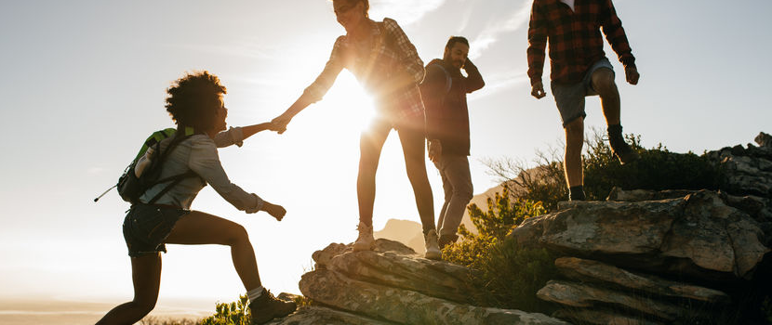
I MATTER
Notes:
Distribute NOTEBOOK 1.1
Teacher prompt:
We encounter groups of people everywhere we go. People may belong to many different types of groups: a family, a social circle, a religious group, a cultural group, a workplace, a school/classroom, a sports team, etc. We are each connected to others in unique ways, and those connections are important to our sense of how we matter in the world.
There are people who rely on you, value you, believe in you, and want you to succeed at school, at work, and in life in general. When you are feeling down and disconnected, it can be helpful to think about groups you are a part of, and remind yourself that you matter to people (and pets too!). Remember that your impact on people and the world isn’t always visible, but it’s always there!
Look at the list provided in your Notebook and check all the boxes that apply to you. Think of it in terms of “I am”. There is space to add other groups or communities not on the list.

Slide 7
Drawing Connections
Why is it important to matter at work?
Notes:
Teacher prompt: After defining what it means to matter and identifying areas in our lives where we matter, let’s consider how this concept connects to the workplace.
Why is it important to matter at work?

Slide 8

Debrief
Notes:
Debrief the activity.
Teacher prompt: In 2022, the U.S. Surgeon General named “mattering at work” a top priority for improving mental health. The announcement reaffirms what we’ve known for many years: Mattering and well-being are inseparable, especially where humans spend 35% of their waking lives at work.

Slide 9
Drawing Connections
What can I do to promote mattering at school/work?
Notes:
Teacher prompt: Research shows how important it is for everyone to feel like they matter… so how can we help promote a culture of mattering at school and at work?

Slide 10

Tips: Supporting a culture of mattering
Notice others and authentically be interested in what’s going on in their lives.
Notes:
Teacher prompt: How would you go about doing this?
For example:
saying good morning
knowing their name
checking in on them
…

Slide 11

Tips: Supporting a culture of mattering
Communicate others’ importance by telling them about how their specific strengths, aptitudes, and behaviors make a difference.
Notes:
Teacher prompt: How would you go about doing this? For example:
Be specific about the skill/strength you have noticed
Highlight the positive impact their specific actions make

Slide 12

Tips: Supporting a culture of mattering
Show people they are needed.
Notes:
Teacher prompt: How would you go about doing this? For example:
Recognize and value their contributions to a conversation or a team project
Express appreciation and gratitude for their contributions​
Actively seek their feedback​
Welcome and celebrate diversity and different perspectives

Slide 13

Revisiting the shared agreement
Any additions or modifications?
Notes:
Teacher prompt: Given what we’ve discussed about the importance of mattering, and thinking about the shared classroom agreements we’ve co-created, are there any additions or modifications we’d like to make?

Slide 14
Notebook
Think about your next year self.
Write yourself an encouraging message!
Notes:
Teacher prompt: “In addition to the importance of mattering and contributing to a culture that promotes mattering in everyday life, at school and at work, it is also essential to matter to yourself and to maintain a positive outlook.
To do so, we are going to create a message of hope to your next year self. Think about where you may be and what you may be doing. Then create an encouraging and positive message for yourself.”

Slide 15
A few ideas/ reminders
Strategies you’ve used to overcome past challenges
Situations where the outcome wasn’t as you expected it and it turn out okay
Encouraging words
Notes:
Teacher prompt:
reminders of how you have been able to get through challenging times in the past and the strategies used
reminders that sometimes things haven’t turned out the way you expected and that it was okay and even led to learning, growth, and other positive outcomes
encouraging words

Slide 16
SAMPLE MESSAGE
Dear next year self,
I want to tell you how proud I am of you. You’re trying so many new things, which isn’t always easy for you. But you are doing it. I know not everything has turned out exactly as you had planned, and that’s okay! You can’t and you don’t control everything. You’re challenging yourself and doing something different. You’re outside your comfort zone and that takes courage. Ups and downs are part of the process. Everyone has them, and you will, too. And you’re never stuck! You’re learning things you didn’t know before and you might start to see things differently or become interested in something you hadn’t thought of before. If you change direction and it’s going to make you happier, that’s a GOOD thing. No one has this all figured out, and you don’t have to, either. Just take it one step at a time, focus on what’s important to you, and stay connected to the people who matter most. Take care of yourself and take some time to do what makes you happy now and then, too. You deserve it. And I know you like to do things yourself, but it’s okay to ask for help if you need it.
Remember, you are so much more than your marks or job, and you are valuable no matter what career you have. Be kind to yourself. It may not always be easy, but you are doing the best you can and that’s enough.
Keep going. You can do this, too. I believe in you. Yours truly,
Your last year self
Notes:
Teacher prompt: “In your Notebook there’s a sample letter to inspire you. If you prefer, you can create an audio message or video for yourself, too. The important thing is that you offer yourself some compassion and encouragement, whatever format you choose. Remember: you matter!”

Slide 17
Notebook Wrap Up
For myself and for others:
What am I already doing well?
What would I like to try?
Notes:
Teacher prompt: “During this S4L unit and beyond, notice how you are contributing towards promoting a sense of mattering, both for yourself and others. To help you increase your self-awareness, ask yourself :
Add these reflections to your Notebook!

Slide 18

Key messages
Mattering is important.
So is positively contributing to a culture that promotes mattering for yourself and others.
Notes:
Teacher prompt:

