Slide 1
Instructions
This slide deck contains information for grades K-12.
It can easily be customized by sharing only the grade-specific slides relevant for your school (see slides 8-11). For example, for a K-8 school, exclude slide 11.
Suggested speaking notes are available for each slide to support delivery.

Slide 2
Staff Introduction to Wayfinder
Notes:
Note: this staff introduction slide deck is appropriate for all educator audiences. It provides a brief overview and video of the tool Wayfinder.

Slide 3
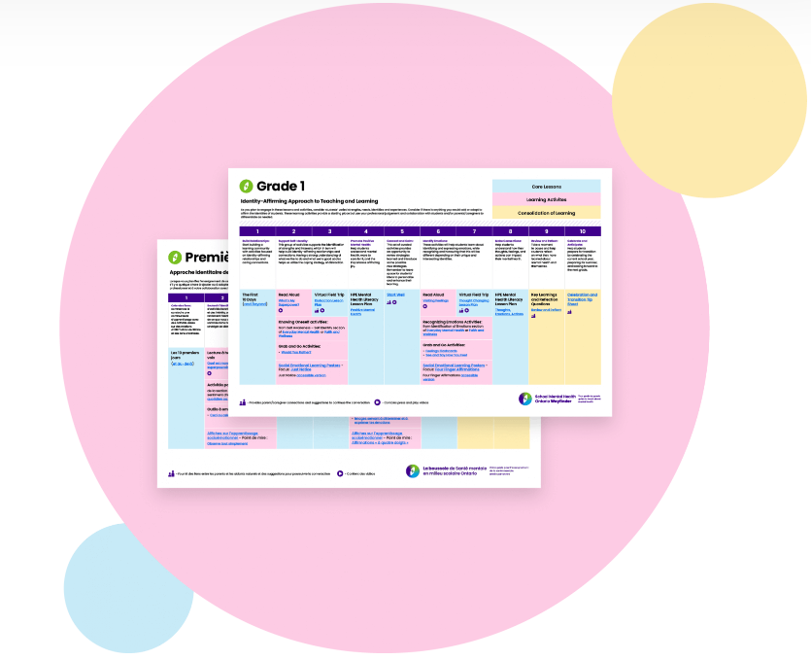


What is Wayfinder?
Wayfinder is a digital, clickable guide for educators that gathers mental health learning resources in an easy-to-use and sequenced way.
  organized by:
    core mental health learning
    complementary activities
    tools to support and consolidate learning
  highlights resources that include:
    press and play videos
    parent/caregiver communication supports
Notes:
Note: point out to staff the icons that highlight easy to use videos and ready-made communication supports.

Slide 4
Why use Wayfinder?
created for educators by educators and mental health professionals
connected to Ontario curriculum
focuses on affirming student identity
a free alternative to packaged mental health and social-emotional learning programs
easy to download and use
Notes:
Wayfinder saves educators time by putting all the links and resources in one place. In addition, it includes MANY course and curriculum connections, both broad and specific, that support dedicating instructional time to learning about mental health and practising strategies to support it.

Slide 5
How can Wayfinder be used?
Begin the school year with Wayfinder’s suggested progression plan.
Find other entry points into the learning (e.g., during mental health week or before EQAO).
Access individual resources in the way that works best for you.
Notes:
Wayfinder is meant to be flexible, as per educator and classroom needs. It offers one of many ways to bring together the resources available through School Mental Health Ontario for each grade and the related Ontario curriculum.
For older students, a coordinated approach can help ensure students don't receive the same information in multiple classes (although repetition across grades can support learning!). For instance, the educator for Health and Physical Education might be responsible for the specific Health and Physical Education lessons, and a homeroom teacher might be responsible for the remaining core lessons.
Educators working with split or multiple grades can treat the lessons and activities within Wayfinder the same way they might manage other learning.

Slide 6

Introducing SMH-ON Wayfinder
Notes:
Press play to view a short informative video.

Slide 7
Let's take a look!
Notes:
Note: a sample from each grade division is included below. Please select the specific grade sample(s) most relevant for your school/audience.

Slide 8
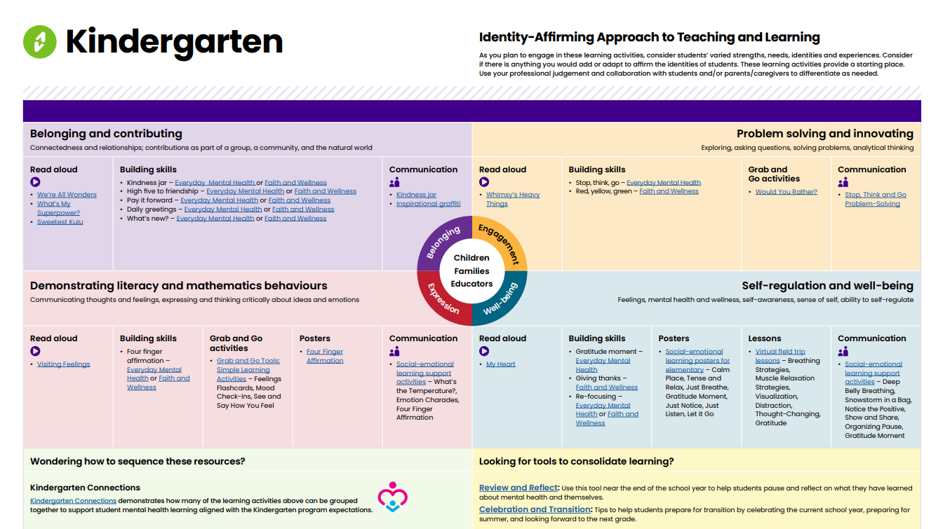
Wayfinder Kindergarten
Notes:
Wayfinder for Kindergarten contains a variety of learning activities that have been sorted and colour coded to align with the Four Frames of the Kindergarten program. It is meant to be used over the course of the two year program.

Slide 9
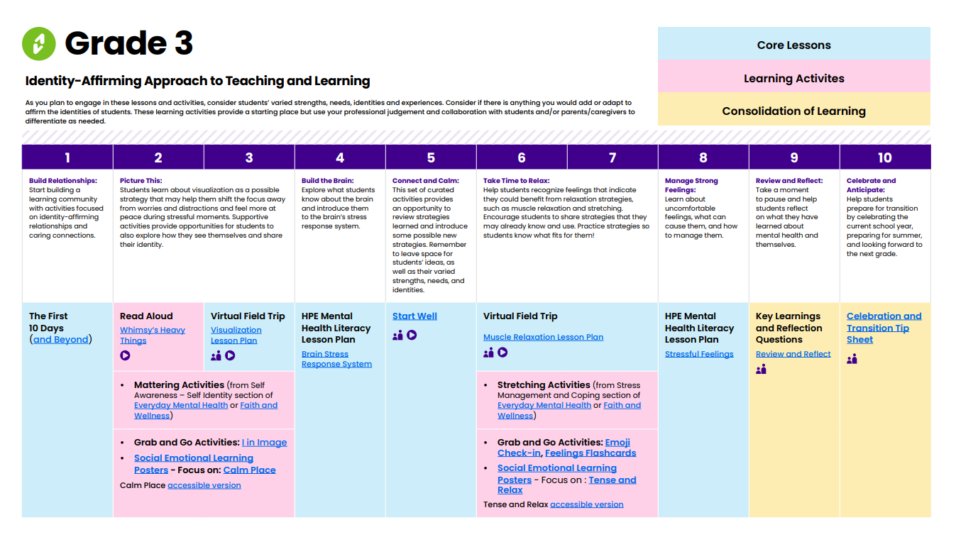
Wayfinder Grade 3
Notes:
Each Wayfinder for Grades 1 – 6 includes SMH-ON lesson plans that are linked to specific expectations within the Health and Physical Education curriculum. The sections are colour coded to show the types of learning included—core lessons, learning activities, and consolidation of learning.

Slide 10
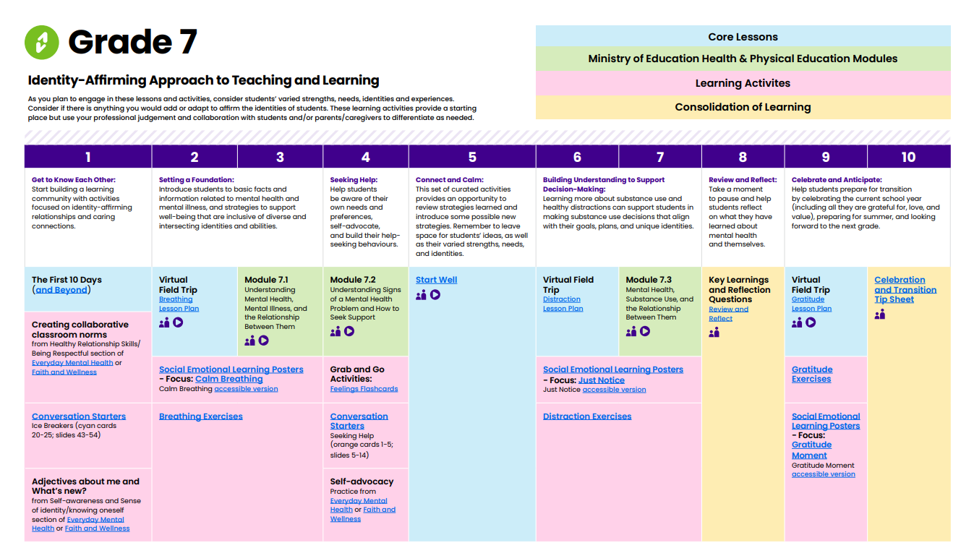
Wayfinder Grade 7
Notes:
Wayfinder for Grade 7 and 8 includes the Mental Health Literacy Modules from the Ministry of Education that are linked to specific expectations within the Health and Physical Education curriculum (which also contain several cross-curricular connections). Like grades 1–6, the sections are colour coded to show the types of learning included—core lessons, Ministry modules, learning activities, and consolidation of learning.

Slide 11
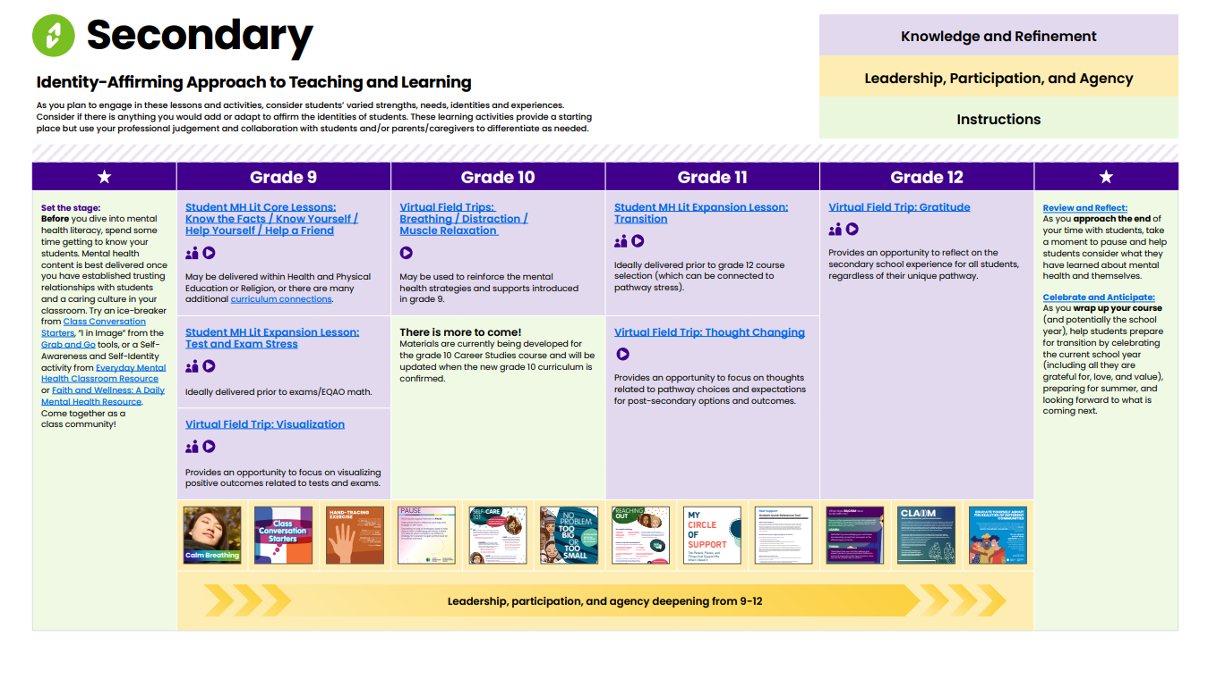
Wayfinder Secondary
Notes:
Secondary Wayfinder includes a progression for grades 9-12. It provides a ready-made opportunity to bring the topic of mental health learning into the classroom in a thoughtful and sequenced way. Wayfinder also offers materials and tools that promote student engagement and leadership in school mental health promotion and support students to make decisions, advocate, and drive change in their own lives and the spaces/communities that impact them.

Slide 12
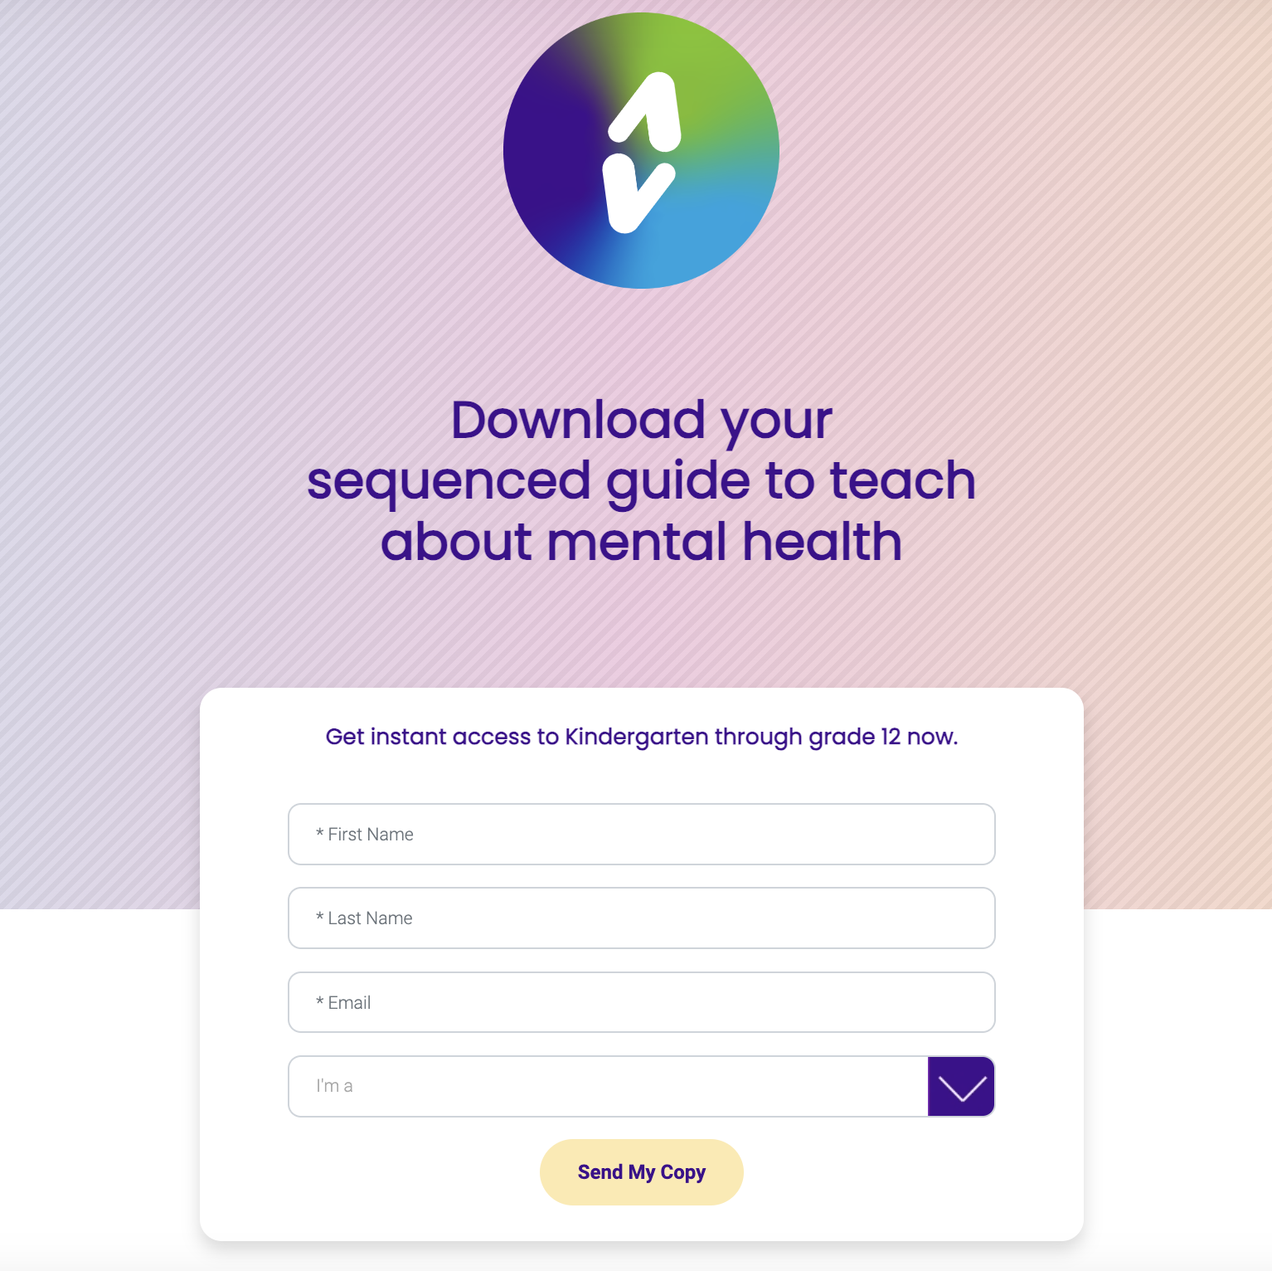
How can I get Wayfinder?
How can I get Wayfinder?
Visit smho-smso.ca/Wayfinder and sign up!
Notes:
Wayfinder - Download your sequenced guide to teach about mental health (smho-smso.ca)
Each individual staff member is encouraged to sign up through the Wayfinder landing page whenever possible because there are several benefits. (See next slide)

Slide 13
Why sign up?
When you sign up, you’ll also receive regular email messages offering:
  tips
  support
  updates
  new classroom resources/complimentary resources
  the opportunity to provide feedback and ask questions
Notes:
When educators sign up they will be subscribed and receive:
automatic updates on Wayfinder and new resources delivered directly to their inboxes
opportunities to provide direct feedback and ask questions
related and complimentary resources from SMH-ON

Slide 14

Wayfinder invitation
smho-smso.ca/wayfinder
Notes:
Everything you need to get started is just a click away. Download Wayfinder for your grade and take the guesswork out of mental health promotion and literacy planning. Practicing mental health strategies with students can support educator mental health, too! https://smho-smso.ca/wayfinder/
FR: https://smho-smso.ca/la-boussole

