Slide 1

Notes for facilitation
This slide deck is designed to provide an overview of the Student Engagement Toolkit and information to enhance meaningful student engagement initiatives.
  Two slide decks are available: a shorter version that offers a brief introduction and encourages the audience to explore the toolkit further on their own, and a longer version that provides a comprehensive overview.
  The slide decks are not intended to replace the toolkit.
Adjust the slides to meet your needs.
Consider supplementing the materials with additional activities or information specific to your region and board.

Slide 2
Notes for facilitation 2
Notes for facilitation
Throughout the slide decks, there are spaces to pause and reflect. Here are some strategies that may help facilitate discussion:
Invite participants to reflect individually for a few minutes, then discuss in pairs or small groups.
Create space for both successes and tensions.
Consider using anonymous sticky notes or digital tools (e.g., Padlet, Mentimeter) if participants are hesitant to share.

Slide 3





Notes for facilitation 3
Notes for facilitation
Look for the following symbols to help with facilitation.

Slide 4

Student Engagement Toolkit
A brief overview for school staff
Notes:
Note:
The information in this presentation has been pulled from the Student Engagement Toolkit (https://smho-smso.ca/online-resources/student-engagement-toolkit/)
Consider an icebreaker or provocation to start the thinking related to student engagement. A student video might be useful to begin your conversation, or you might choose to draw inspiration from videos, art, quotes, data, or something else from within your community (video link: https://smho-smso.ca/candid-conversations-student-insights-on-mental-health/).
-----
The Student Engagement Toolkit offers practical strategies for supporting diverse student leadership styles and promoting mental health initiatives within school and system settings. It addresses the interest among students to participate in mental health leadership roles and provides guidance for creating environments that support student engagement in promoting mental health and wellness.
There were many folks involved in the development of the toolkit such as student support staff, educators, administrators, board staff, students, and more.
The toolkit has been designed with several short resources. It has been designed to be an evergreen resource where we continue to add to the toolkit as we continue to learn and grow together.
These are the pieces available:
Our Model of Student Engagement – key insights into what student engagement is and the benefits of it.
Foundations of Effective Student Engagement – key concepts that serve as the cornerstones for fostering meaningful and authentic student engagement.
Degrees of Student Engagement in School Mental Health Promotion Initiatives – broad approaches to how students might engage in school mental health initiatives.
Special Considerations for School-Based Mental Health Promotion and Literacy Initiatives – specific considerations for creating supportive and effective environments for students involved in mental health promotion and literacy activities.
Actions of a Caring Adult in Student Engagement Initiatives Related to Mental Health – a set of actions and reflective exercises you can do to be a caring adult for the students you serve.
Recruitment for Student Engagement Initiatives Related to Mental Health – considerations for actively recruiting students and centring students as valued members and stakeholders in school mental health initiatives.
Case studies – examples of student engagement initiatives from schools and boards

Slide 5

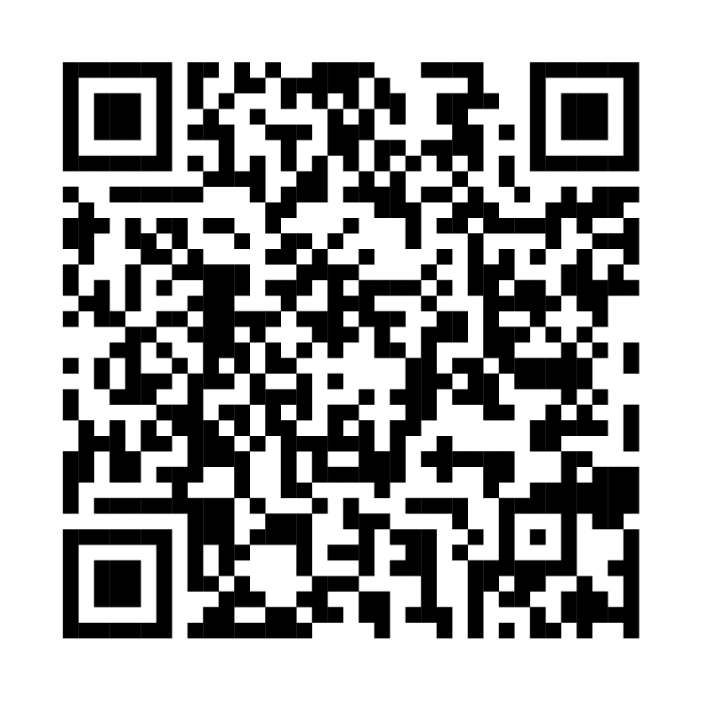
Student engagement toolkit
A series of concise resources to support student engagement
Information and guidance on understanding student engagement in mental health promotion and stigma reduction, inclusive recruitment practices, tips for caring adults and more!
Goal: increased knowledge among school staff of student engagement benefits and meaningful practices with a focus on engaging a wide variety of students
Audience: all school and board staff
Notes:
School Mental Health Ontario has developed a Student Engagement Toolkit to help guide you through this work. The toolkit explores their model of student engagement more deeply and offers a range of resources to support you and your team. The content from this presentation has been developed using content from the toolkit. This presentation only provides a short overview of what is available. We encourage to familiarise yourself with the toolkit and check back to it regularly.
Remember, student engagement is a journey that requires consistent, small steps moving forward.
See https://smho-smso.ca/online-resources/student-engagement-toolkit/

Slide 6
What is student engagement?
Student engagement is an ongoing process committed to co-creating conditions and opportunities with students to meaningfully participate and influence outcomes that may affect them.
True engagement centres on valuing and amplifying perspectives and experiences of every student. This requires a practice of critical reflection by school and system staff on personal and positional biases, and systemic barriers that impact engagement.
Notes:
As staff, you may already be involved in many initiatives that are informed by students, led by students, or where students play a central role.
Student engagement is defined as: an ongoing process committed to co-creating conditions and opportunities with students to meaningfully participate and influence outcomes that may affect them. True engagement centers on valuing and amplifying the perspectives and experiences of every student. This requires a practice of critical reflection by school and system staff on personal and positional biases, and systemic barriers that impact engagement.
Some notes on the bolded words:
Ongoing process: Student engagement is way of operating. It is a continuous practice and an outcome for young people
Co-creating: highlights collaboration between students and staff to shape the initiatives that they are offered and a part of​
Meaningful: students are connected to opportunities that grow their network, feed their interests, and that they find important​
Valuing: actively recognizing the worth, dignity, and insights of all students, honoring their identities, lived experiences, and contributions as essential​
Amplifying: intentionally “turning up the volume of voices often sidelined or silenced”(Higgs et al., 2021), ensuring those most often marginalized are heard, respected, and able to influence decisions​
Critical reflection: calls for thoughtful examination by staff to ensure that opportunities are available to every student

Slide 7

Benefits of student engagement
Students shared that being engaged:
helps them feel more involved and supported in their school
reduces stigma around mental health
makes school more fun!
For caring adults, schools, and systems:
enhanced understanding of students’ needs and wants
new perspectives and creative solutions
increased use of mental health programs or services
Student engagement is a protective factor
for students’ mental health.
Notes:
When consulting with students while building the toolkit, School Mental Health Ontario asked them what they felt the benefits of student engagement were. They shared this list. Each of these, rooted in student experience, is supported by literature as well.

Slide 8
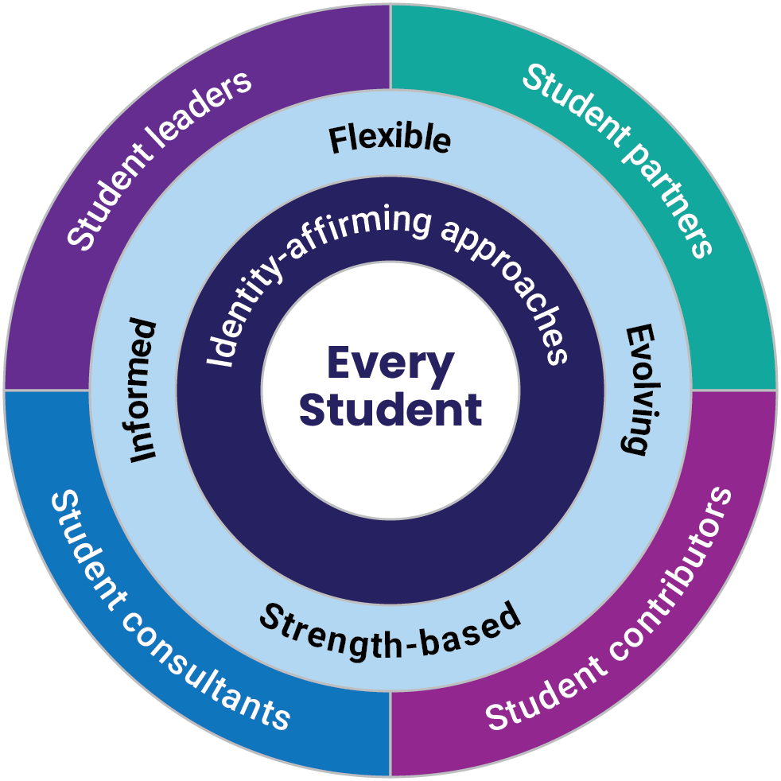
School Mental Health Ontario’s model of student engagement
UNDERSTAND THE TOPIC
1
Notes:
On the screen is School Mental Health Ontario’s model of student engagement.
At the centre of the diagram is 'Every Student', who play an active role in shaping their engagement in school initiatives.
Surrounding 'Every Student', are 'Identity-affirming approaches; Identity-affirming student engagement recognizes, validates, and respects every student's intersecting identities, backgrounds and experiences.
The next ring following that, emphasizes flexibility, recognizing and nurturing students' strengths, making informed decisions, and adapting strategies to meet their evolving needs as foundations underscoring each initiative.
The final and outer ring, are the various degrees of engagement:
Student consultants
Student leaders
Student partners
Student contributors

Slide 9
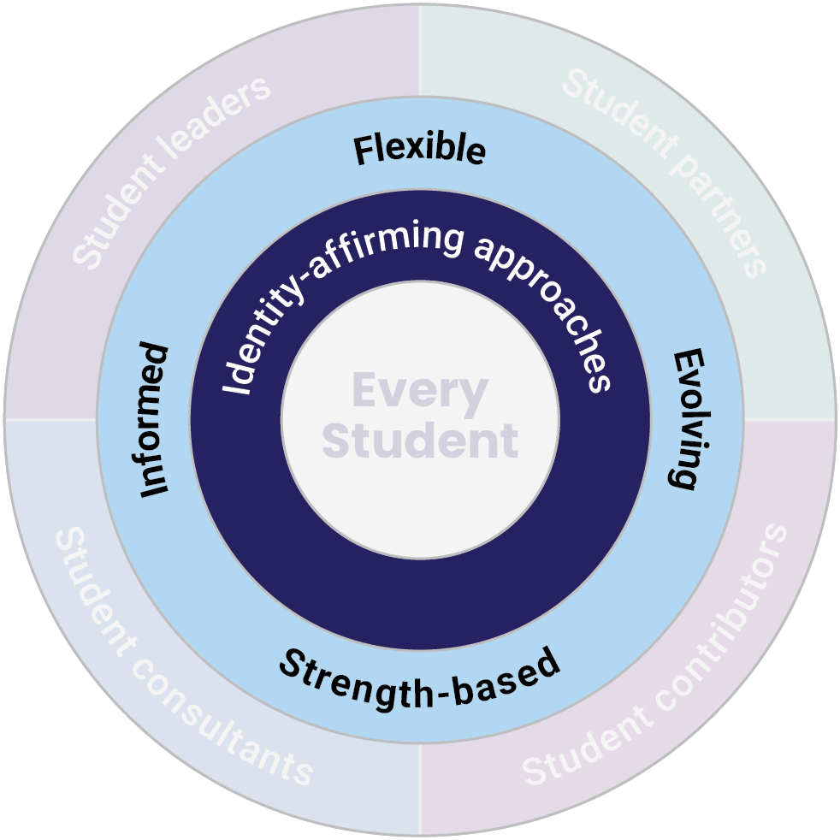
Foundations of student engagement
Identity-affirming approaches centre the identities, expertise and lived identities of each student; supporting student wellness can be enhanced when engagement initiatives are reflective and response to student perspectives and ways of knowing and being
Flexible – providing a variety of opportunities, accommodating to diverse schedules, and encourage open dialogue
Strength-based – recognizing and respecting students as experts about themselves and offering opportunities to showcase strengths
Informed – selecting activities with student input, and collaborating in evaluating initiatives
Evolving – adapting to and reflecting on the changing needs, ideas, and strengths of students
Notes:
Surrounding every student are identity-affirming approaches.
The intersection of equity and mental health remains one of the top priorities identified by students across Ontario. Identity-affirming student engagement recognizes, validates, and respects students’ intersecting identities, backgrounds, and experiences. It involves dismantling systemic barriers to engagement, adapting initiatives to meet students’ needs, and fostering an environment where they feel comfortable showing up as their whole selves.
When supporting student engagement, it is important to:
Recognize the interconnected nature of students’ identities and the social barriers that often intersect in their lives, impacting their sense of wellness.
Understand that stigma related to mental health can prevent young people from participating in mental health promotion activities at school.
Acknowledge the systems of oppression affecting many students and how these can create barriers to engagement. Work to disrupt and remove these obstacles.
Recognize that individual students cannot serve as representatives for their entire group, but they can share strengths and ideas that resonate with others.
Critically reflect on your practices and explore your identities to understand how they impact your work and relationships.
Effective student engagement starts with each unique student in mind, particularly those who experience marginalization and oppression, ensuring that space is intentionally created for their voices to be heard. Support for wellness is enhanced when diverse perspectives and ways of knowing are included in the planning and delivery of student engagement initiatives.
Underscoring each student engagement initiative are four main pillars: Flexible, Strength-based, Informed and Evolving.
Flexible: Effective student engagement initiatives must be adaptable to accommodate the diverse lives of young people. This involves:
Providing various opportunities for students to choose their level of involvement and responsibility.
Offering engagement opportunities at different times of the day, week, or year to accommodate students’ schedules and commitments.
Encouraging open and ongoing dialogue with students to understand their evolving wants and needs.
Understanding that some students who volunteer to help with wellness promotion and stigma reduction at school may themselves be struggling with a mental health problem or may live closely with someone who is. Encourage healthy boundaries and self-care so they can be at their best while participating at a level that is right for them.
Strength-based: Engagement should emphasize recognizing and nurturing students' unique strengths and skills. This involves:
Recognizing and respecting that students are experts about themselves.
Offering opportunities for students to showcase their strengths and abilities, develop new skills, and build confidence.
Normalizing mistakes and offering students support as they exercise their strengths, skills, and abilities.
Keeping the focus on mental health and wellness promotion, rather than on topics beyond the scope of student knowledge and skills (e.g., avoid initiatives related to mental illnesses or suicide prevention, or those requiring students to take on a peer support / counselling role).
Informed: Engagement should be informed by student input, ensuring transparency and accountability. This involves:
Recognizing that students know what they need and listening to what is important to them.
Involving students in developing monitoring, evaluation, and feedback processes to support their skill development and sense of ownership.
Evaluating outcomes to celebrate successes and identify areas for improvement to enhance the impact of student engagement initiatives.
Evolving: Engagement is an evolving process that adapts to the changing goals, ideas, and strengths of students. This involves
Recognizing that the student audience and their wants, needs, ideas, and strengths continue to change and evolve.
Leading with students’ desires and giving room for student-driven initiatives and ideas; these outcomes might not be exactly as you had imagined at the beginning and that’s okay!
For more on these foundations, see the Student Engagement Toolkit: https://smho-smso.ca/online-resources/student-engagement-toolkit/

Slide 10
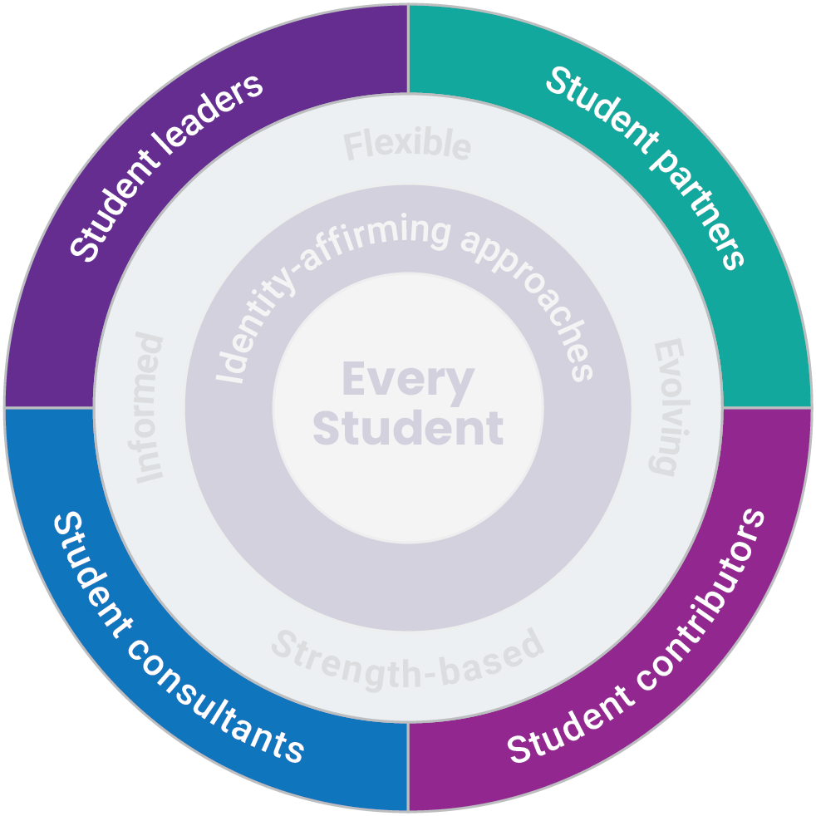
Degrees of student engagement
Student as leaders –students are responsible for all phases of a project or program
Students as partners – students are engaged in an active partnership and open dialogue throughout all stages
Students as contributors – students are invited to offer their ideas and perspectives at key points in the project
Students as consultants – students are consulted for their ideas and perspectives in a specific or limited way.
Notes:
The outer ring highlights the degrees of student engagement.
When conceptualizing student engagement initiatives, often hierarchies are used in diagrams in the form of ladders or triangles, prioritizing some forms of engagement over others. In many conversations, SMH-ON heard that folks didn’t want hierarchies – it was important to offer multiple entry points for students, enabling them to engage in initiatives that align with their interests and abilities.
Hence, they used quadrants to demonstrate that each degree is important, and no degree is more important than others. Opportunities may also incorporate multiple degrees of engagement offering students diverse skill development, commitment levels, and influence over outcomes as they wish.
Quadrants also allow for greater movement – up, down, left, right and across. These degrees are fluid - we do not have to be tied to a degree if it is not responsive to the needs of students.
The degrees of student engagement are as follows:
Student as leaders – students are responsible for all phases of a project or program
Students as partners – students are engaged in an active partnership and open dialogue throughout all stages
Students as contributors – students are invited to offer their ideas and perspectives at key points in the project
Students as consultants – students are consulted for their ideas and perspectives in a specific or limited way.
Check out the Student Engagement Toolkit for more information on these degrees and examples from boards: https://smho-smso.ca/online-resources/student-engagement-toolkit/

Slide 11
Reflection
REFLECT
Think of a recent student engagement initiative in your community​
How were the foundations of student engagement demonstrated? ​
What degree(s) did the initiative fall within?​
How have you critically reflected on your own identities, and how they might influence your interactions with students and the work that you do?
Notes:
Notes:
Invite participants to reflect individually for a few minutes then discuss in pairs or small groups.
Create space for both successes and tensions
Consider using anonymous sticky notes or digital tools (e.g., Padlet, Mentimeter) if participants are hesitant to share.
-----

Slide 12
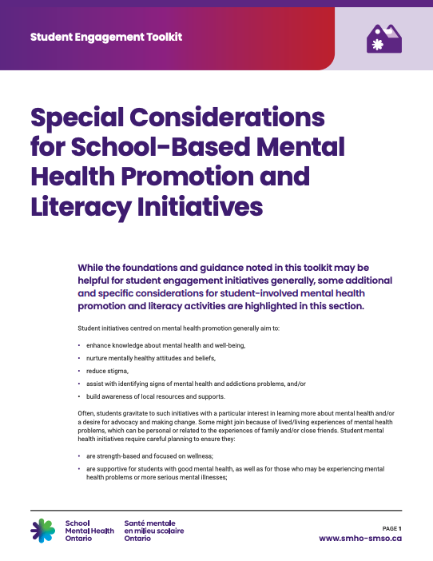
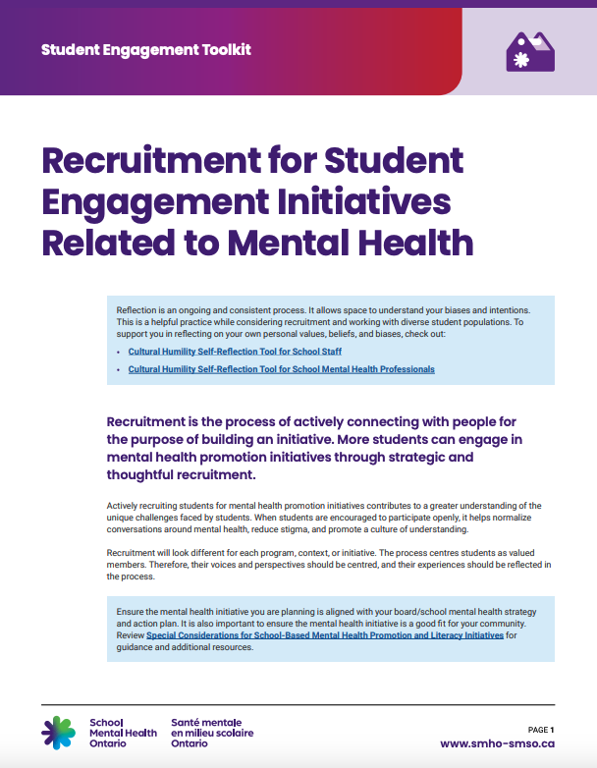
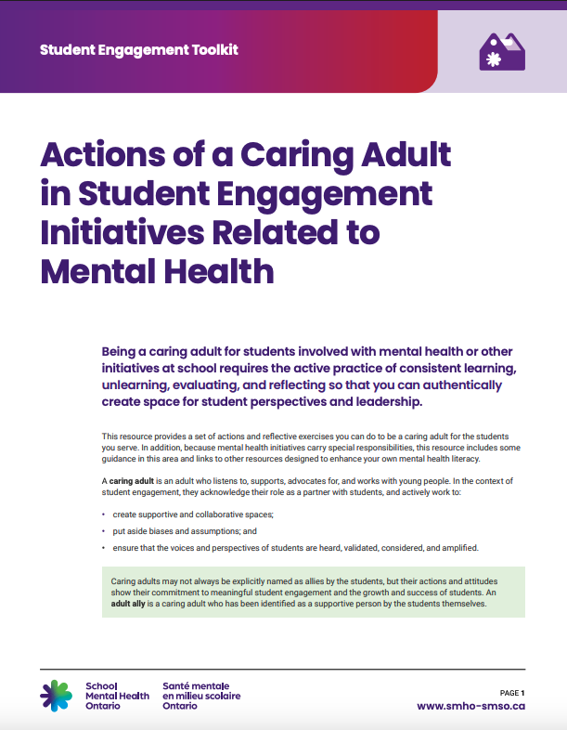
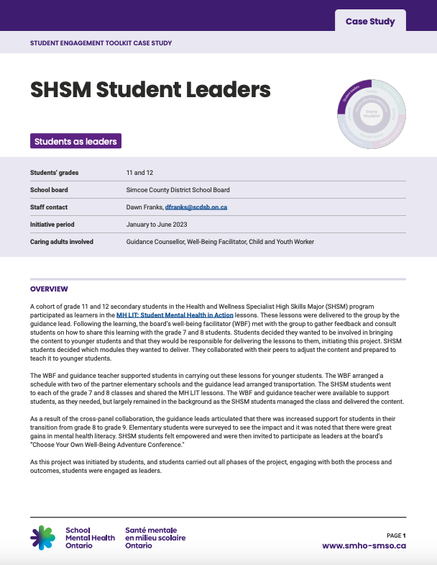
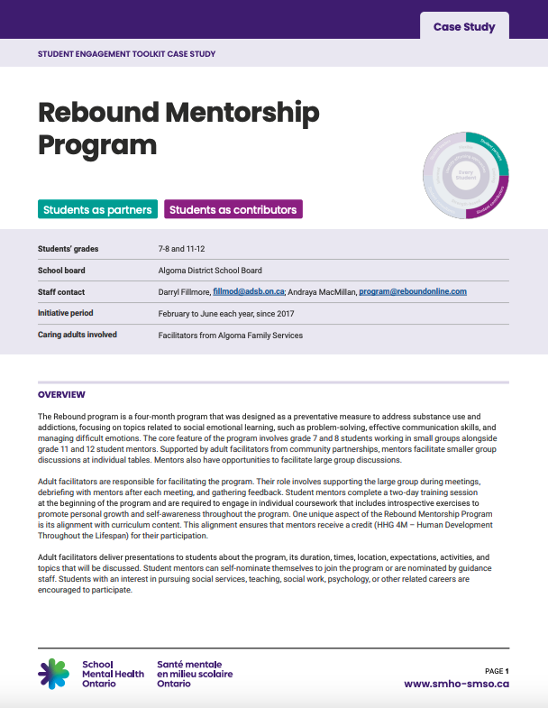
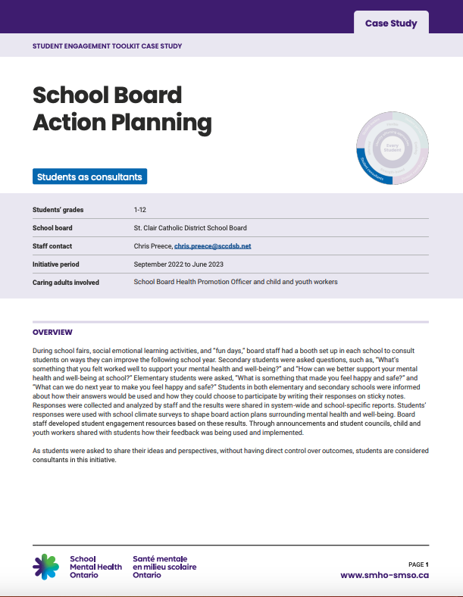
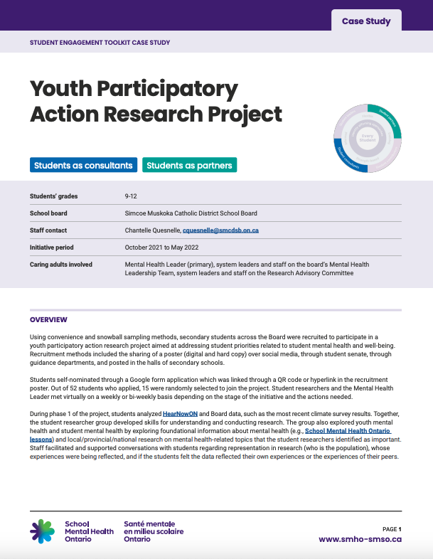
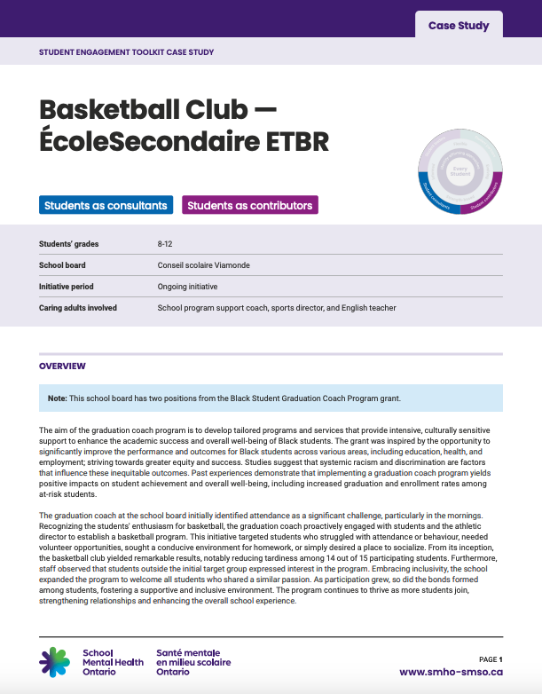
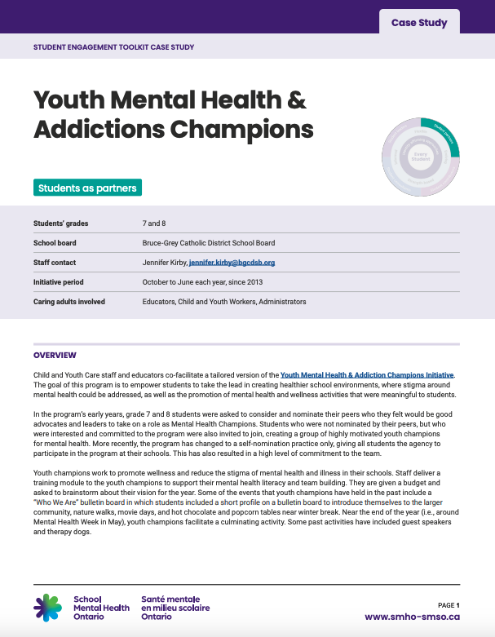
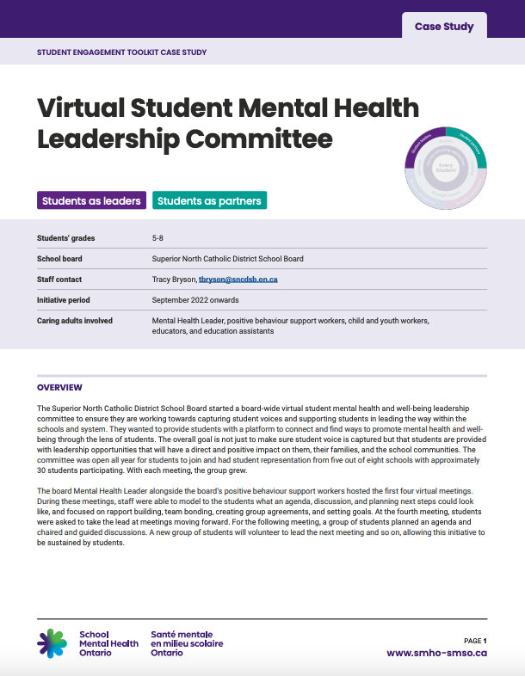
Resource spotlight
Special Considerations for School-Based Mental Health Promotion and Literacy Initiatives
Actions of a Caring Adult in Student Engagement Initiatives Related to Mental Health
Recruitment for Student Engagement Initiatives Related to Mental Health
BUILD YOUR TOOLBOX
Case studies
Notes:
Student engagement can feel daunting, especially if you’re just getting started or balancing competing priorities. If you’re feeling overwhelmed or unsure of where to begin, you’re most certainly not alone. The good news is that there are supports available.
There are a number of resources and case studies available in the student engagement toolkit to support this work. Below is an overview of the current resources available:
Special Considerations for School-Based Mental Health Promotion and Literacy Initiatives – specific considerations for creating supportive and effective environments for students involved in mental health promotion and literacy activities.
Actions of a Caring Adult in Student Engagement Initiatives Related to Mental Health – a set of actions and reflective exercises you can do to be a caring adult for the students you serve.
Recruitment for Student Engagement Initiatives Related to Mental Health – considerations for actively recruiting students and centring students as valued members and stakeholders in school mental health initiatives.
Case studies – examples of student engagement initiatives from schools and boards.
ℹ️ Source: https://smho-smso.ca/online-resources/student-engagement-toolkit/

Slide 13
“All of our students are student leaders”
- Daunte Hillen
Notes:
Daunte Hillen, a ThriveSMH member, said, “all of our students are student leaders”
This is a reminder to all of us, that as we continue to endeavor in student engagement, we recognize the strengths that each student possesses, and we continue to challenge our own assumptions about student leadership and remain open to continue learning from the very young people we work with.
ℹ️ Source: https://smho-smso.ca/candid-conversations-student-insights-on-mental-health/

Slide 14
About us

Slide 15
Accessibility and mental health are related

Slide 16
Student Engagement Toolkit overview – extended presentation
Student Engagement Toolkit
An overview for school staff
Notes:
Note:
The information in this presentation has been pulled from the Student Engagement Toolkit (https://smho-smso.ca/online-resources/student-engagement-toolkit/)
Consider an icebreaker or provocation to start the thinking related to student engagement. A student video might be useful to begin your conversation, or you might choose to draw inspiration from videos, art, quotes, data, or something else from within your community (video link: https://smho-smso.ca/candid-conversations-student-insights-on-mental-health/).
-----
The Student Engagement Toolkit offers practical strategies for supporting diverse student leadership styles and promoting mental health initiatives within school and system settings. It addresses the interest among students to participate in mental health leadership roles and provides guidance for creating environments that support student engagement in promoting mental health and wellness.
There were many folks involved in the development of the toolkit such as student support staff, educators, administrators, board staff, students, and more.
The toolkit has been designed with several short resources. It has been designed to be an evergreen resource where we continue to add to the toolkit as we continue to learn and grow together.
These are the pieces available:
Our Model of Student Engagement – key insights into what student engagement is and the benefits of it.
Foundations of Effective Student Engagement – key concepts that serve as the cornerstones for fostering meaningful and authentic student engagement.
Degrees of Student Engagement in School Mental Health Promotion Initiatives – broad approaches to how students might engage in school mental health initiatives.
Special Considerations for School-Based Mental Health Promotion and Literacy Initiatives – specific considerations for creating supportive and effective environments for students involved in mental health promotion and literacy activities.
Actions of a Caring Adult in Student Engagement Initiatives Related to Mental Health – a set of actions and reflective exercises you can do to be a caring adult for the students you serve.
Recruitment for Student Engagement Initiatives Related to Mental Health – considerations for actively recruiting students and centring students as valued members and stakeholders in school mental health initiatives.
Case studies – examples of student engagement initiatives from schools and boards

Slide 17
Student engagement toolkit 3
A series of concise resources to support student engagement
Information and guidance on understanding student engagement in mental health promotion and stigma reduction, inclusive recruitment practices, tips for caring adults and more!
Goal: increased knowledge among school staff of student engagement benefits and meaningful practises with a focus on engaging a wide variety of students
Audience: all school and board staff
Notes:
School Mental Health Ontario has developed a Student Engagement Toolkit to help guide you through this work. The toolkit explores our model their student engagement more deeply and offers a range of resources to support you and your team. The content from this presentation has been developed using content from the toolkit.
Throughout today’s session, we encourage you to reflect on your work and explore new ways to enhance, amplify, and expand your efforts. We hope this webinar supports you in considering your current approach to student engagement, envisioning where you want to go, and identifying a few strategies to help you take the next step. Remember, student engagement is a journey that requires consistent, small steps moving forward.
See https://smho-smso.ca/online-resources/student-engagement-toolkit/

Slide 18
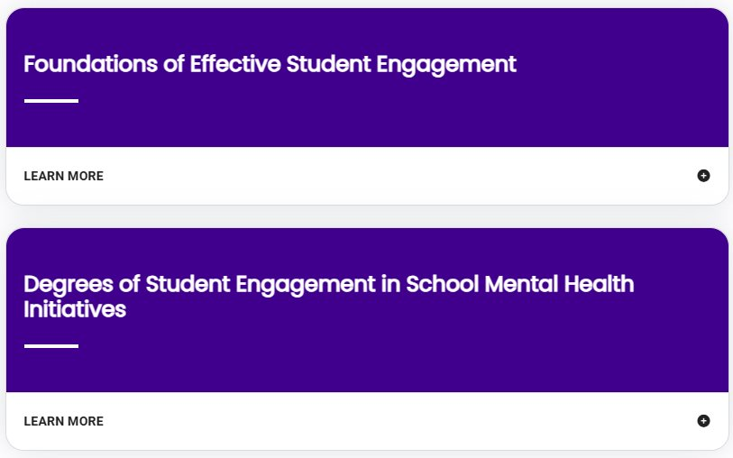
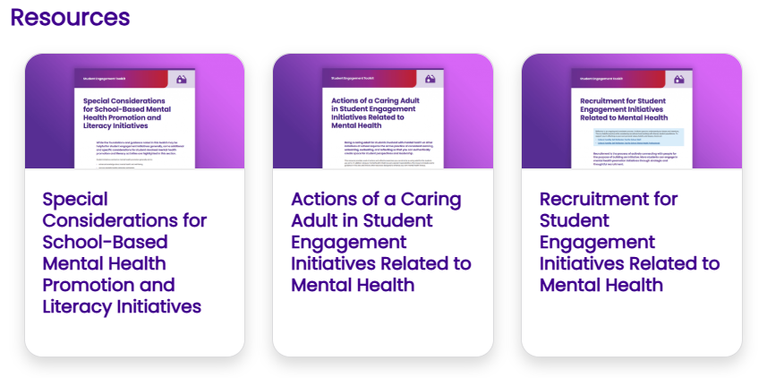
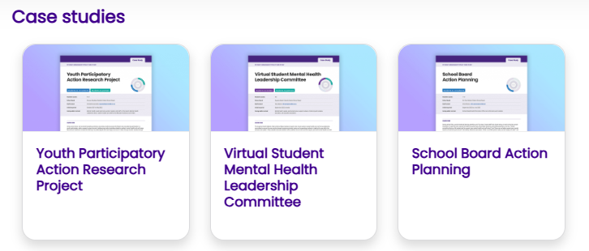
Presentation overview
Understanding student engagement
School Mental Health Ontario’s model of student engagement
Resources to support student engagement
Case studies
Notes:
This slide gives you a roadmap of what we’ll be exploring together as we deepen our understanding of student engagement in school mental health initiatives.

Slide 19
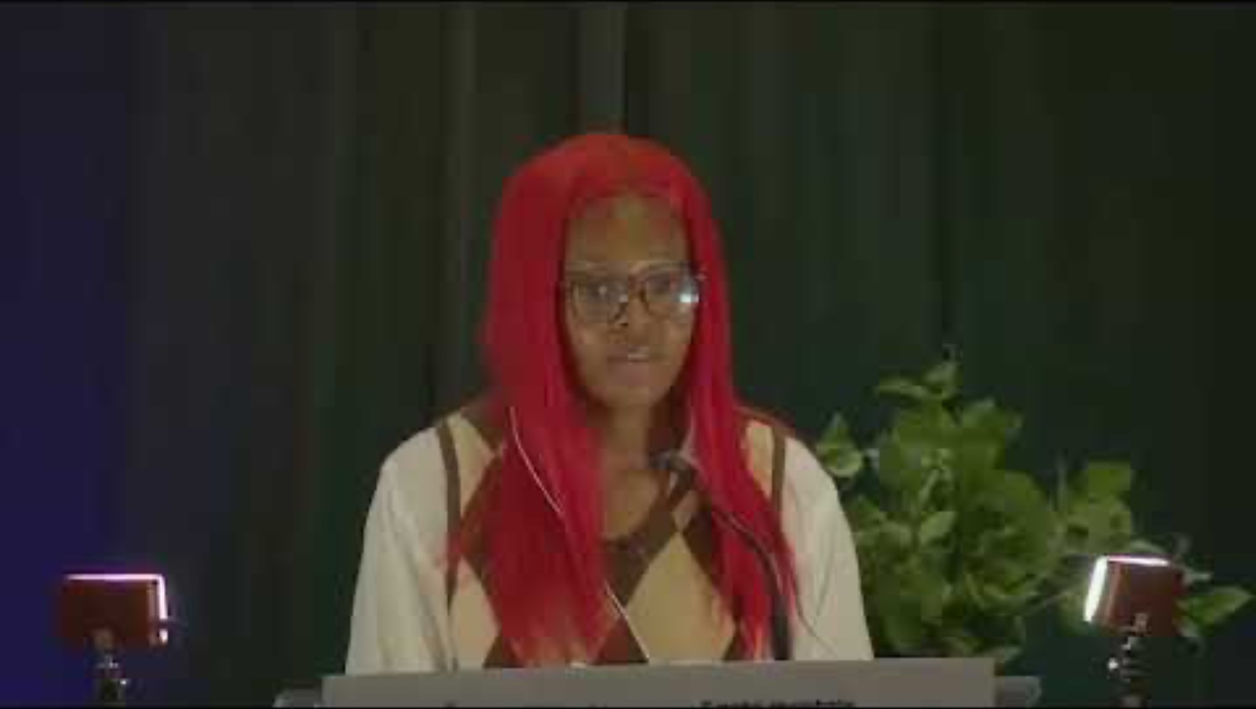
Minds on: Gwen’s reflections
Notes:
To get us started on thinking about student engagement, Gwen shares her reflections on the impact of mental health initiatives in addressing individual needs with personal, equitable support.
Take a moment to reflect on your experiences:
Have you ever felt like just a number in a large system? How did that affect your sense of belonging?
Can you think of a time when a small gesture made you feel truly seen, included, or supported? How could you replicate that with the staff/students you serve?
ℹ️ Source: https://smho-smso.ca/candid-conversations-student-insights-on-mental-health/

Slide 20
Understanding student engagement
UNDERSTAND THE TOPIC
1

Slide 21

What are the first words that come to mind when you think about student engagement?
REFLECT
Notes:
Notes:
Invite participants to reflect individually for a few minutes then discuss in pairs or small groups.
Create space for both successes and tensions
Consider using anonymous sticky notes or digital tools (e.g., Padlet, Mentimeter) if participants are hesitant to share.
-----

Slide 22

What is student engagement? 2
Student engagement is an ongoing process committed to co-creating conditions and opportunities with students to meaningfully participate and influence outcomes that may affect them.
True engagement centres on valuing and amplifying perspectives and experiences of every student. This requires a practice of critical reflection by school and system staff on personal and positional biases, and systemic barriers that impact engagement.
Were the words that came to mind similar? ​
How might your answer change now that you’re aware of this definition?
Notes:
As staff, you may already be involved in many initiatives that are informed by students, led by students, or where students play a central role.
Student engagement is defined as: an ongoing process committed to co-creating conditions and opportunities with students to meaningfully participate and influence outcomes that may affect them. True engagement centers on valuing and amplifying the perspectives and experiences of every student. This requires a practice of critical reflection by school and system staff on personal and positional biases, and systemic barriers that impact engagement.
Some notes on the bolded words:
Ongoing process: Student engagement is way of operating. It is a continuous practice and an outcome for young people
Co-creating: highlights collaboration between students and staff to shape the initiatives that they are offered and a part of​
Meaningful: students are connected to opportunities that grow their network, feed their interests, and that they find important​
Valuing: actively recognizing the worth, dignity, and insights of all students, honoring their identities, lived experiences, and contributions as essential​
Amplifying: intentionally “turning up the volume of voices often sidelined or silenced”(Higgs et al., 2021), ensuring those most often marginalized are heard, respected, and able to influence decisions​
Critical reflection: calls for thoughtful examination by staff to ensure that opportunities are available to every student

Slide 23
Reflection - 3
REFLECT
What are the benefits of student engagement?
(for students, caring adults, schools, and school systems)
Notes:
Notes:
Invite participants to reflect individually for a few minutes then discuss in pairs or small groups.
Create space for both successes and tensions
Consider using anonymous sticky notes or digital tools (e.g., Padlet, Mentimeter) if participants are hesitant to share.
-----

Slide 24
Benefits of student engagement
Students shared that being engaged:
helps them feel more involved and supported in their school
reduces stigma around mental health
makes school more fun!
For caring adults, schools, and systems:
enhanced understanding of students’ needs and wants
new perspectives and creative solutions
increased use of mental health programs/services
Student engagement is a protective factor
for students’ mental health.
Notes:
When consulting with students while building the toolkit, School Mental Health Ontario asked them what they felt the benefits of student engagement were. They shared this list. Each of these, rooted in student experience, is supported by literature as well.

Slide 25
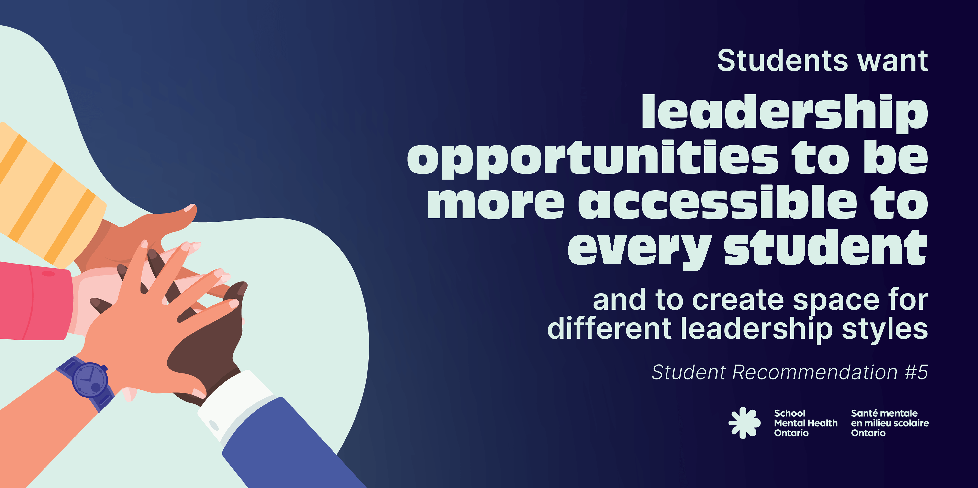
Source: #HearNowON 2021
Notes:
Beyond what the literature shares about the benefits of student engagement, students have also shared their interest in participating in student leadership and mental health promotion initiatives in their school communities.
In HearNowON 2021, Ontario students named they want leadership opportunities to be more accessible to every student, and to create space for different leadership styles.
Students want diverse leadership styles to be recognized and supported by offering various opportunities for leadership roles.
Students would like greater representation in mental health initiatives to encourage participation amongst diverse students.
Students want opportunities to learn and practice new skills to support their leadership and participation.
ℹ️ Source: #HearNowON 2021: Student Voices on Mental Health – Final Report (https://smho-smso.ca/online-resources/hearnowon-2021-student-voices-on-mental-health-final-report/)

Slide 26
School Mental Health Ontario’s model of student engagement 2
UNDERSTAND THE TOPIC
1
School Mental Health Ontario’s model of student engagement
Notes:
On the screen is School Mental Health Ontario’s model of student engagement.
At the centre of the diagram is 'Every Student', who play an active role in shaping their engagement in school initiatives.
Surrounding 'Every Student', are 'Identity-affirming approaches; Identity-affirming student engagement recognizes, validates, and respects every student's intersecting identities, backgrounds and experiences.
The next ring following that, emphasizes flexibility, recognizing and nurturing students' strengths, making informed decisions, and adapting strategies to meet their evolving needs as foundations underscoring each initiative.
The final and outer ring, are the various degrees of engagement:
Student consultants
Student leaders
Student partners
Student contributors

Slide 27
Identity-affirming approaches 2
Identity-affirming student engagement centres the identities, expertise and lived identities of each student.
Supporting student wellness can be enhanced when engagement initiatives are reflective and response to student perspectives and ways of knowing and being.
Notes:
In the next few slides, we will be focusing on the foundations of student engagement, looking closer at the centre two rings of the model.
Surrounding every student are identity-affirming approaches.
The intersection of equity and mental health remains one of the top priorities identified by students across Ontario. Identity-affirming student engagement recognizes, validates, and respects students’ intersecting identities, backgrounds, and experiences. It involves dismantling systemic barriers to engagement, adapting initiatives to meet students’ needs, and fostering an environment where they feel comfortable showing up as their whole selves.
When supporting student engagement, it is important to:
Recognize the interconnected nature of students’ identities and the social barriers that often intersect in their lives, impacting their sense of wellness.
Understand that stigma related to mental health can prevent young people from participating in mental health promotion activities at school.
Acknowledge the systems of oppression affecting many students and how these can create barriers to engagement. Work to disrupt and remove these obstacles.
Recognize that individual students cannot serve as representatives for their entire group, but they can share strengths and ideas that resonate with others.
Critically reflect on your practices and explore your identities to understand how they impact your work and relationships.
Effective student engagement starts with each unique student in mind, particularly those who experience marginalization and oppression, ensuring that space is intentionally created for their voices to be heard. Support for wellness is enhanced when diverse perspectives and ways of knowing are included in the planning and delivery of student engagement initiatives.
🧩 Related resource: Identity-affirming school mental health: a frame for reflection and action (https://smho-smso.ca/about-us/identity-affirming/)

Slide 28
Foundations of effective student engagement
Flexible – providing a variety of opportunities, accommodating to diverse schedules, and encourage open dialogue
Strength-based – recognizing and respecting students as experts about themselves and offering opportunities to showcase strengths
Informed – centers students in the selection and co-creation of activities and initiatives, prioritizing their input throughout the process
Evolving – adapting to and reflecting on the changing needs, ideas, and strengths of students
Notes:
Underscoring each student engagement initiative are four main pillars: Flexible, Strength-based, Informed and Evolving.
Flexible: Effective student engagement initiatives must be adaptable to accommodate the diverse lives of young people. This involves:
Providing various opportunities for students to choose their level of involvement and responsibility.
Offering engagement opportunities at different times of the day, week, or year to accommodate students’ schedules and commitments.
Encouraging open and ongoing dialogue with students to understand their evolving wants and needs.
Understanding that some students who volunteer to help with wellness promotion and stigma reduction at school may themselves be struggling with a mental health problem or may live closely with someone who is. Encourage healthy boundaries and self-care so they can be at their best while participating at a level that is right for them.
Strength-based: Engagement should emphasize recognizing and nurturing students' unique strengths and skills. This involves:
Recognizing and respecting that students are experts about themselves.
Offering opportunities for students to showcase their strengths and abilities, develop new skills, and build confidence.
Normalizing mistakes and offering students support as they exercise their strengths, skills, and abilities.
Keeping the focus on mental health and wellness promotion, rather than on topics beyond the scope of student knowledge and skills (e.g., avoid initiatives related to mental illnesses or suicide prevention, or those requiring students to take on a peer support / counselling role).
Informed: Engagement should be informed by student input, ensuring transparency and accountability. This involves:
Recognizing that students know what they need and listening to what is important to them.
Involving students in developing monitoring, evaluation, and feedback processes to support their skill development and sense of ownership.
Evaluating outcomes to celebrate successes and identify areas for improvement to enhance the impact of student engagement initiatives.
Evolving: Engagement is an evolving process that adapts to the changing goals, ideas, and strengths of students. This involves
Recognizing that the student audience and their wants, needs, ideas, and strengths continue to change and evolve.
Leading with students’ desires and giving room for student-driven initiatives and ideas; these outcomes might not be exactly as you had imagined at the beginning and that’s okay!

Slide 29
Degrees
of student engagement
3
Notes:
The outer ring of the model represents the degrees of student engagement.
In developing this model, School Mental Health Ontario intentionally moved away from traditional hierarchies (like ladders or pyramids) that are often used to show levels of engagement. Through consultations, they consistently heard that folks didn’t want engagement to be ranked or seen as linear. Instead, they wanted to reflect the idea that there are multiple entry points for students, and that every form of engagement has value.
That’s why quadrants were used here. This format reinforces that no single degree of engagement is more important than another. Each offers unique opportunities for student contribution based on their interests, comfort, and capacity at any given time.
Engagement opportunities might reflect one or several degrees at once. This allows for variation in how students participate; whether they’re just beginning to engage or taking on a deeper role in planning and decision-making. It also supports different kinds of growth, influence, and skill development.
Another strength of using quadrants is that they allow for movement in all directions (e.g., left, right, up, down), acknowledging that engagement is fluid, not fixed. As student needs, contexts, or interests shift, so too can their roles in an initiative.
In the next section, we’ll walk through each of these degrees in more detail, with examples to show how they might look in practice.

Slide 30
Degrees of student engagement 2
Student as leaders – students are responsible for all phases of a project or program.
Students as partners – students are engaged in an active partnership and open dialogue throughout all stages.
Students as contributors – students are invited to offer their ideas and perspectives at key points in the project.
Students as consultants – students are consulted for their ideas and perspectives in a specific or limited way.
Notes:
The outer ring highlights the degrees of student engagement.
When conceptualizing student engagement initiatives, often hierarchies are used in diagrams in the form of ladders or triangles, prioritizing some forms of engagement over others. In many conversations, SMH-ON heard that folks didn’t want hierarchies – it was important to offer multiple entry points for students, enabling them to engage in initiatives that align with their interests and abilities.
Hence, they used quadrants to demonstrate that each degree is important, and no degree is more important than others. Opportunities may also incorporate multiple degrees of engagement offering students diverse skill development, commitment levels, and influence over outcomes as they wish.
Quadrants also allow for greater movement – up, down, left, right and across. These degrees are fluid - we do not have to be tied to a degree if it is not responsive to the needs of students.
The degrees of student engagement are as follows:
Student as leaders – students are responsible for all phases of a project or program
Students as partners – students are engaged in an active partnership and open dialogue throughout all stages
Students as contributors – students are invited to offer their ideas and perspectives at key points in the project
Students as consultants – students are consulted for their ideas and perspectives in a specific or limited way.
Check out the Student Engagement Toolkit for more information on these degrees and examples from boards: https://smho-smso.ca/online-resources/student-engagement-toolkit/

Slide 31
Reflection - 2
REFLECT
Think of a recent student engagement initiative in your school or board. What foundations of engagement were present, and how did students influence decisions or outcomes?
What are you hearing from students about their priorities and what opportunities do they have (or need) to lead or act on them?
How are the needs and identities of underserved or historically excluded students reflected in your engagement practices? What could strengthen that alignment?
Notes:
Notes:
Invite participants to reflect individually for a few minutes then discuss in pairs or small groups.
Create space for both successes and tensions
Consider using anonymous sticky notes or digital tools (e.g., Padlet, Mentimeter) if participants are hesitant to share.
-----

Slide 32
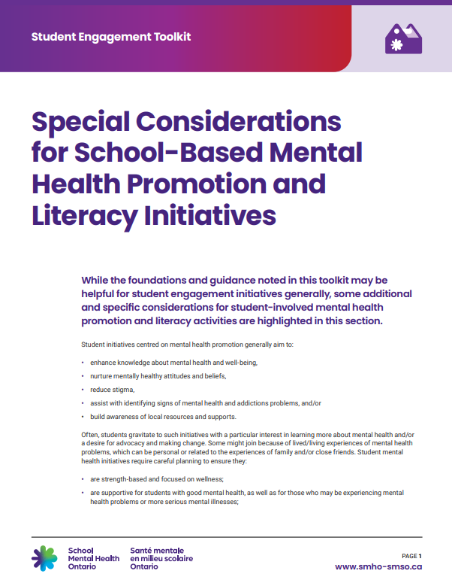
Student engagement in mental health promotion initiatives
EXPLORE STRATEGIES
1
Special Considerations for School-Based Mental Health Promotion and Literacy Initiatives
Notes:
We will now shift our focus to the Special Considerations for School-Based Mental Health Promotion and Literacy Initiatives resource.
Student engagement can happen in many different settings and focus on many different topics. When considering mental health specifically, student mental health initiatives require careful planning to ensure they:
are strength-based and focused on wellness;
are supportive for students with good mental health, as well as for those who may be experiencing mental health problems or more serious mental illnesses;
produce the intended positive effects, such as helping students build skills for maintaining good mental health, reducing stigma, or raising awareness about how and where to seek help when mental health problems arise.
Students are well-positioned to help one another and promote good mental health and well-being. Mental health promotion initiatives can involve:
helping students build life skills and learn more about mental health and well-being
modelling healthy coping attitudes and strategies
helping students know the resources and support around them
encouraging students to seek help if they need it
decreasing mental health stigma
🧩 Related resources
School Mental Health Decision Support Tool: Student Mental Health Awareness Initiatives – Version for School Administrators (https://smho-smso.ca/online-resources/school-mental-health-decision-support-tool-student-mental-health-awareness-initiatives-version-for-school-administrators)
Decision Support Tool for Classroom Teachers – Checklist for Educators for the Planning of Student Mental Health-Related Activities (https://smho-smso.ca/online-resources/decision-support-tool-for-classroom-teachers-checklist-for-educators-for-the-planning-of-student-mental-health-related-activities)
School Mental Health Decision Support Tool: Peer Support Initiatives (https://smho-smso.ca/online-resources/school-mental-health-decision-support-tool-peer-support-initiatives-version-for-system-and-school-leaders)
Peer Support Reference Tool for Students (https://smho-smso.ca/online-resources/peer-support-reference-tool-for-students)
Your board Mental Health Leader (https://smho-smso.ca/about-us/find-your-mental-health-leader/)

Slide 33

Considerations before you engage students in mental health promotion initiatives
Check in on yourself.
Build your knowledge.
Know the pathways to support.
Engage co-facilitators.
Consider the timing.
Notes:
Before you engage with students:
Check in on yourself: Taking care of your mental health is crucial. Take the time to check in on your readiness to take on this supportive role. If needed, seek support from available resources.
Build your knowledge: Build your knowledge related to mental health, equity, and reconciliation. Utilize resources like School Mental Health Ontario’s free mental health literacy modules and cultural humility reflection tools.
Know your pathways to support: Familiarize yourself with your school's pathways to support students with mental health issues. If the initiative is taking place after school hours, consider how your pathways to support may also change.
Engage co-facilitators: Consider engaging co-facilitators, inviting educators or student support staff to share responsibilities. Co-facilitation allows one person to focus on supporting conversations while the other monitors student reactions and addresses any issues. In some cases, you or your co-facilitator may not be at a school every single day. This may be an opportunity to discuss with students who else may be part of the team of caring adults and may be available more frequently. Consider the parameters of your initiative to determine who might be best positioned to co-facilitate and support the development of a space to promote positive mental health.
Consider the timing: Be mindful of the timing of meetings, to ensure that you have time to monitor students following the meeting. Avoid scheduling mental health-related activities on Fridays and carefully consider initiatives during postvention periods.
🧩 Related resources:
Personal Resiliency Tips – Take Care of Yourself (https://smho-smso.ca/online-resources/personal-resiliency/)
Mental health literacy course for educators (https://smho-smso.ca/educators-and-student-support-staff/mh-lit-online-course/)
Mental health literacy course for school administrators (https://smho-smso.ca/school-administrators/mental-health-literacy-course/)
Cultural Humility Self-Reflection Tool for School Staff (https://smho-smso.ca/online-resources/cultural-humility-self-reflection-tool-for-school-staff/)
Cultural Humility Self-Reflection Tool for School Mental Health Professionals (https://smho-smso.ca/online-resources/cultural-humility-self-reflection-tool-for-school-mental-health-professionals/)
Circle of Support and System Pathways – Flowchart, Planner and Desk Reference (https://smho-smso.ca/online-resources/circle-of-support-and-system-pathways-flowchart-planner-and-desk-reference/)
ONE-CALL Desk Reference (https://smho-smso.ca/online-resources/one-call-desk-reference/)
Prepare; Prevent; Respond: Suicide Prevention/Life Promotion Literacy for School Staff Quick Reference Guide for School Staff (https://smho-smso.ca/online-resources/prepare-prevent-respond-suicide-prevention-life-promotion-literacy-for-school-staff-quick-reference-guide-for-school-staff/)

Slide 34

Considerations during student engagement in mental health promotion initiatives
Build relationships.
Support student mental health literacy.
Create a common purpose and goal.
Develop group agreements and expectations.
Share resources.
Notes:
While you’re engaging with students:
Build relationships: During the initiative, focus on building relationships by establishing connections among students and fostering a supportive culture. Maintain a strength-based and uplifting tone, emphasizing wellness, belonging, hope, and joy.
Support student mental health literacy: Support students’ mental health literacy is a key part of school-based mental health student engagement initiatives. Recognize and appreciate that mental health and mental illnesses may be understood and supported differently across cultures and communities. Western approaches to mental health, which tend to be more individualistic and skill-based, may not resonate with all students and their families. Hold space for different ways of knowing and being related to mental health and well-being.
Create a common purpose and goal: Create a common purpose and goal by working collaboratively with students to define objectives aligned with their needs and interests, as well as broader school or system mental health goals. Establish clear boundaries for the initiative, like what it is focused on. Listening to someone else’s negative experiences with their mental health can be unhelpful for students who are struggling with their well-being. Create an understanding that this is not a forum for personal disclosures about mental health problems, family experiences, etc. If students would like to share personally, they can be invited to speak privately with the caring adults involved.
That said, setting boundaries does not mean ignoring or glossing over serious issues that may be shared, such as racism, homophobia, or other forms of discrimination. If these issues arise, they should be acknowledged and addressed appropriately. Be mindful of the impact on those affected and ensure they receive appropriate support.
Develop group agreements and expectations: Develop group agreements to create a supportive environment, discussing what students need for comfortable participation. Address the weight and impact of words, guiding discussions on how experiences are shared and how the group wants to give and receive feedback.
As part of the group’s commitment to safety and respect, model allyship by interrupting and disrupting discriminatory behaviour when it occurs.
Share resources: Share information about available mental health resources, emphasizing resources beyond school hours. Regularly reiterate resources at the end of meetings and make them easily accessible. When informing students of local resources, consider culturally responsive and identity-affirming supports, and discuss with students how to access these resources. One Stop Talk, Hope for Wellness Helpline, Kids Help Phone, and Black Youthline are some of the resources you might share.
🧩 Related resources:
Class Conversation Starters (https://smho-smso.ca/online-resources/class-conversation-starters/)
Grab & Go Tools: Simple Learning Activities (https://smho-smso.ca/online-resources/grab-go-tools/)
Wayfinder (https://smho-smso.ca/wayfinder/)
Tools for Student Groups: Developing Accountable and Healthy Group Agreements (https://smho-smso.ca/online-resources/tools-for-student-groups-developing-accountable-and-healthy-group-norms/)
How to Foster and Maintain Supportive Spaces for Black Youth (https://smho-smso.ca/online-resources/tip-sheet-how-to-foster-and-maintain-supportive-spaces-for-black-youth/)
Peer Support Reference Tool for Students (https://smho-smso.ca/online-resources/peer-support-reference-tool-for-students/)

Slide 35
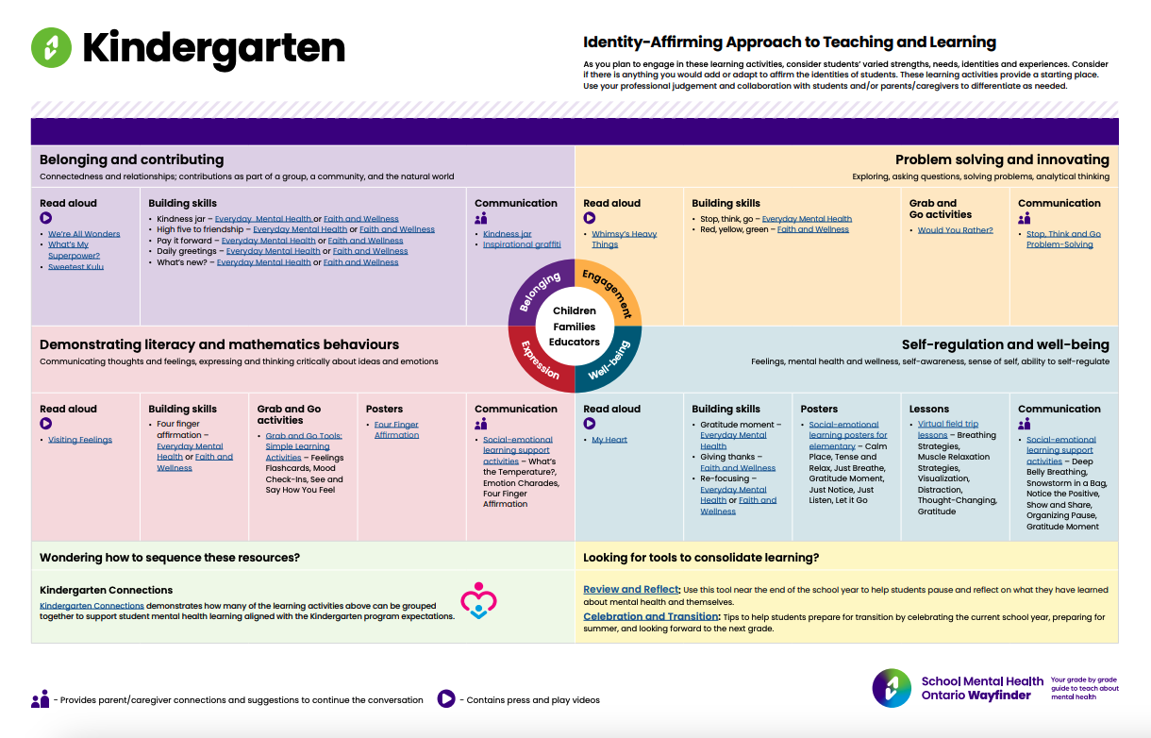
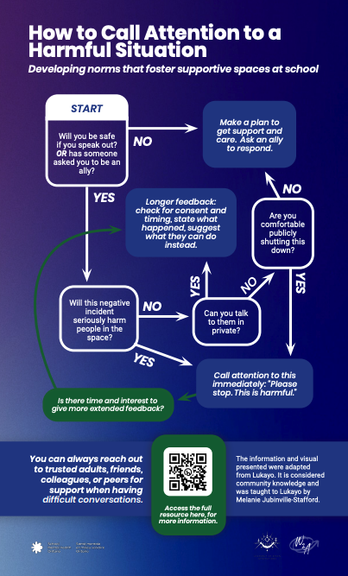
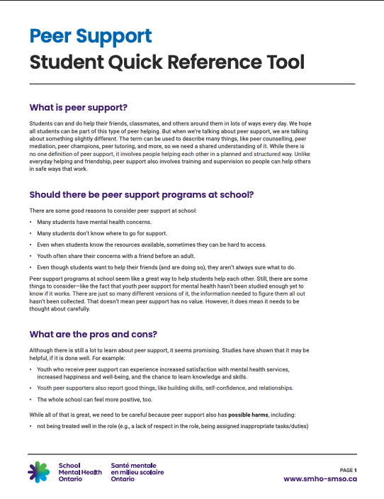
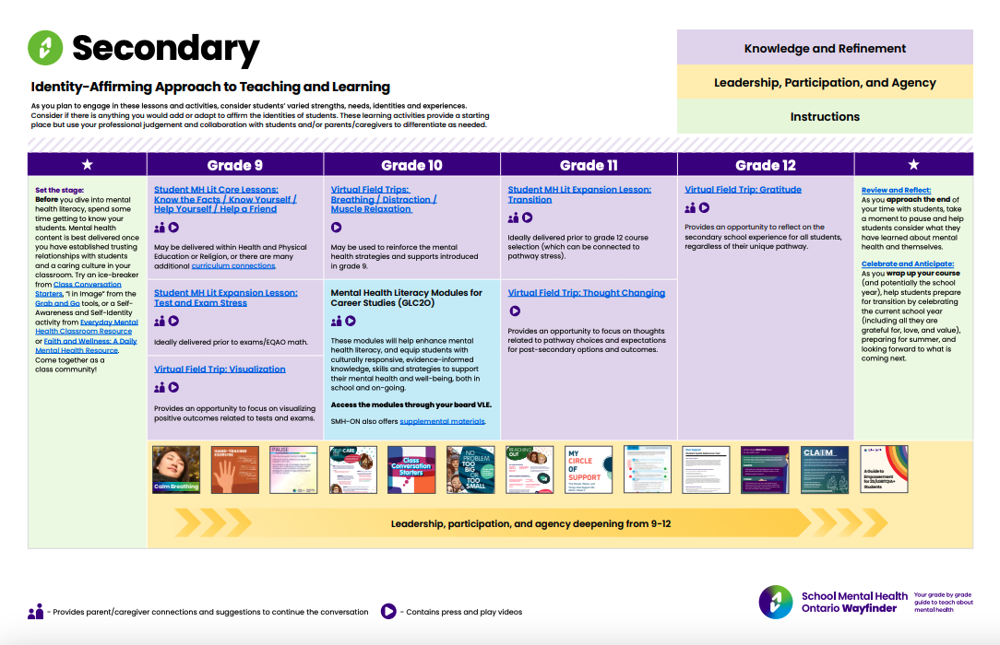

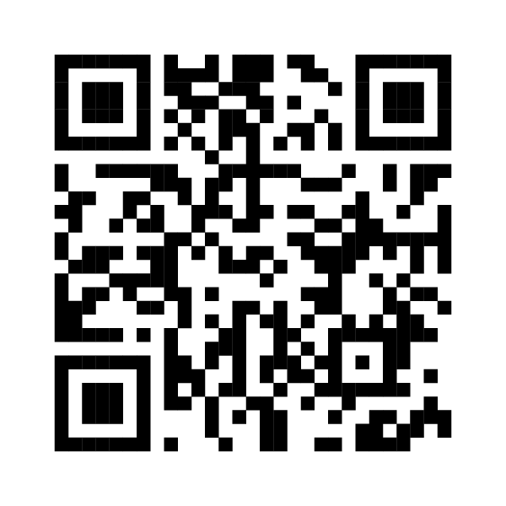
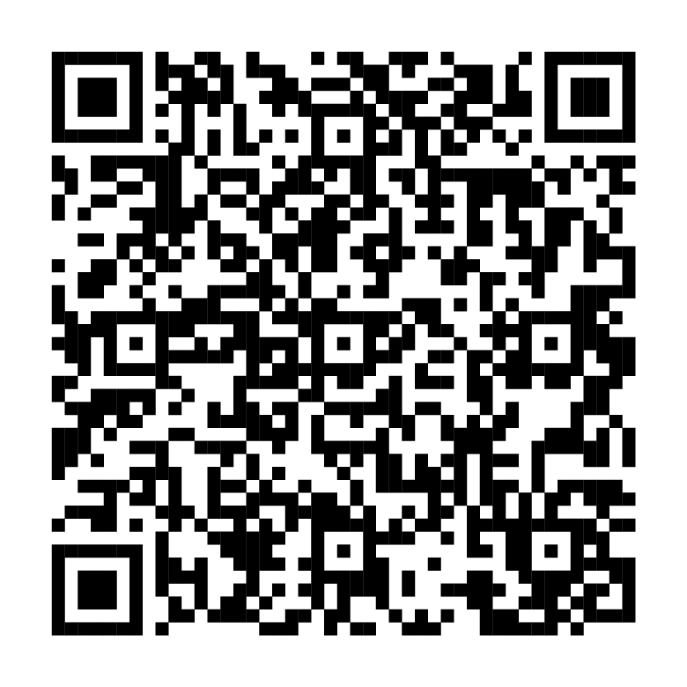
Resource spotlight
BUILD YOUR TOOLBOX
Wayfinder
Peer Support Reference Tool for Students
Tools for Student Groups: Developing Accountable and Healthy Group Agreements
Notes:
School Mental Health Ontario has a number of resources that you can use to support mental health promotion initiatives with students. These are a few of commonly used ones:
Wayfinder (https://smho-smso.ca/wayfinder/)
a digital guide of lessons and activities with easy-to-follow instructions to teach about mental health
Share Wayfinder and the resources within wayfinder with students as a tool for them to use while teaching others about mental health
See SHSM student leaders as an example of student carrying out mental health lesson plans for other students: https://smho-smso.ca/online-resources/student-engagement-toolkit/
Tools for Student Groups: Developing Accountable and Healthy Group Agreements (https://smho-smso.ca/online-resources/tools-for-student-groups-developing-accountable-and-healthy-group-norms/)
These resources focus on building accountable group agreements that address how to call attention to harmful situations and respond when you have caused harm
Both posters are guides and require a group discussion and collaboration to determine how to adapt and make group agreements that are most appropriate and supportive to your context
Peer Support Reference Tool for Students (https://smho-smso.ca/online-resources/peer-support-reference-tool-for-students/)
This resource introduces peer support as a structured way for students to support one another
It also outlines key considerations for setting up a peer support program and offers tips to ensure it meets the needs of your school community.

Slide 36
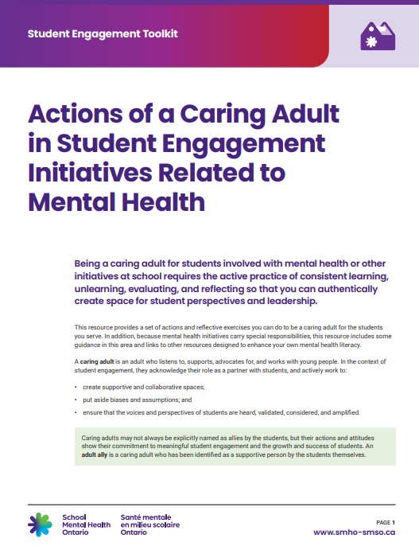
Actions of caring adults
EXPLORE STRATEGIES
1
Actions of a Caring Adult in Student Engagement Initiatives Related to Mental Health
Notes:
The next few slides will offer more information related to the role of caring adults. This information come from the Actions of a Caring Adult in Student Engagement Initiatives Related to Mental Health resource.

Slide 37

Caring adults
A caring adult is an adult who listens to, supports, advocates for and works with young people. They acknowledge their role as a partner with students and:
Create supportive and collaborative spaces.
Put aside biases and assumptions.
Ensure that students’ voices and perspectives are heard, validated, considered and amplified.
Notes:
The term "caring adult" may be new to some, as those who support student engagement are often referred to as adult allies. We have used the language of "caring adults" because students may not always label these individuals as allies, even though their actions and attitudes demonstrate a commitment to meaningful student engagement and the growth and success of students.
Caring adults can include those working directly with students as well as those behind the scenes who support student engagement and amplify student voices within their circles and networks.

Slide 38
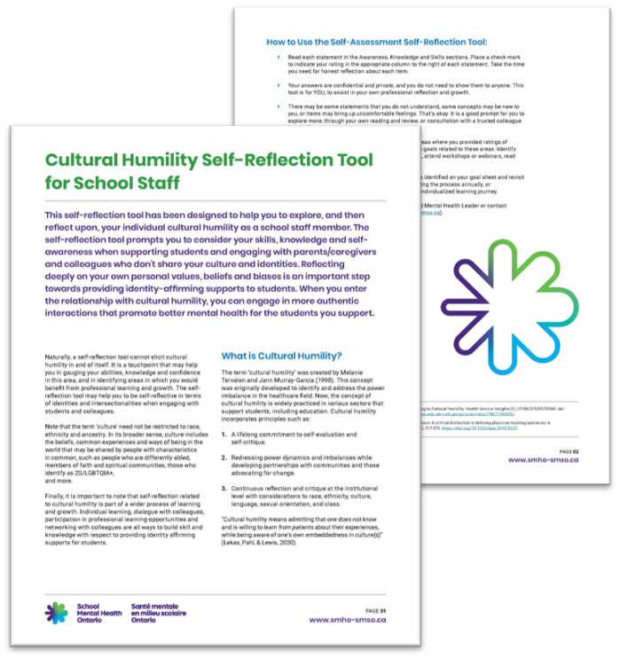
Actions of a caring adult
Reflect on your position and share power.
Practice cultural humility.
Create supportive and inclusive spaces.
Openly share information.
Know your role in a students’ circle of support.
Notes:
Meaningful student engagement happens more effectively within the context of authentic relationships with students. In building trusting and reciprocal relationships, traditional roles shift.
Reflect on your position and share power to minimize imbalances between staff and students.
Consider your role, actions, and procedures that may reinforce power dynamics, and explore your own identity in relation to students.
Recognize the strengths, talents, and abilities of both staff and students to foster collaboration and mutual learning. Be an agent of change by promoting student engagement in programming and planning, drawing on your own experiences as a young person.
Practice cultural humility by educating yourself about diverse intersectional identities. Seek information responsibly and utilize cultural humility and anti-oppression training to build equitable spaces.
Consult professionals, community leaders, and students for their insights.
Reflect critically on your own identities and how they may influence your interactions with students and the work you do. The Cultural Humility Self-Reflection Tool (pictured on the slide) can serve as a helpful starting point for this reflection.
Create supportive and inclusive spaces by considering both physical and social environments.
Ensure that physical spaces are accessible and adaptable, while virtual platforms accommodate all students.
Foster a psychologically safe social environment by involving students in developing group agreements and expectations.
Promote open communication by creating transparent materials tailored to students' developmental levels.
Provide orientation and basic mental health literacy, guiding students toward evidence-based information.
Be transparent about the limitations of school and board initiatives and encourage feedback to demonstrate that student contributions are valued.
Consider your role in a student’s mental health support network.
Familiarize yourself with pathways for mental health and cultural/faith-based support, while maintaining professional boundaries and following school or board processes for accessing mental health resources.
🧩 Related resources:
Cultural Humility Self-Reflection Tool for School Staff (https://smho-smso.ca/online-resources/cultural-humility-self-reflection-tool-for-school-staff/)
Cultural Humility Self-Reflection Tool for School Mental Health Professionals (https://smho-smso.ca/online-resources/cultural-humility-self-reflection-tool-for-school-mental-health-professionals/)
Tools for Student Groups: Developing Accountable and Healthy Group Agreements (https://smho-smso.ca/online-resources/tools-for-student-groups-developing-accountable-and-healthy-group-norms/)
How to Foster and Maintain Supportive Spaces for Black Youth (https://smho-smso.ca/online-resources/tip-sheet-how-to-foster-and-maintain-supportive-spaces-for-black-youth/)
Circle of Support and System Pathways – Flowchart, Planner and Desk Reference (https://smho-smso.ca/online-resources/circle-of-support-and-system-pathways-flowchart-planner-and-desk-reference/)
ONE-CALL Desk Reference (https://smho-smso.ca/online-resources/one-call-desk-reference/)
Prepare; Prevent; Respond: Suicide Prevention/Life Promotion Literacy for School Staff Quick Reference Guide for School Staff (https://smho-smso.ca/online-resources/prepare-prevent-respond-suicide-prevention-life-promotion-literacy-for-school-staff-quick-reference-guide-for-school-staff/)

Slide 39
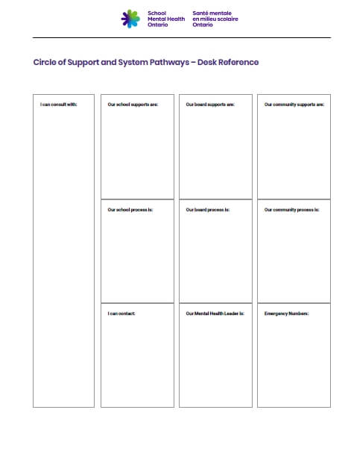
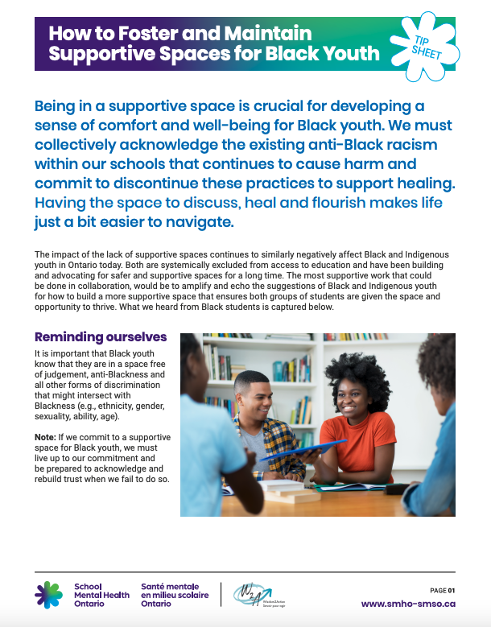
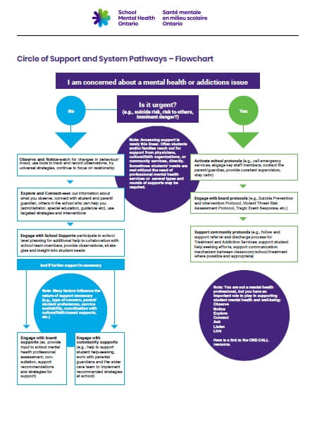
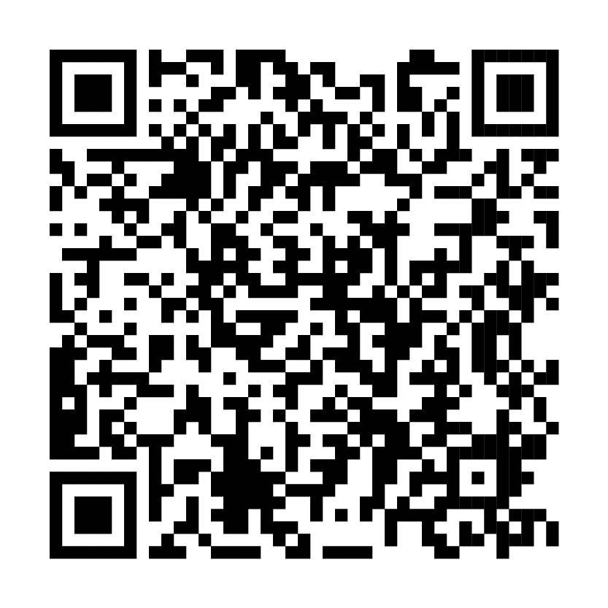
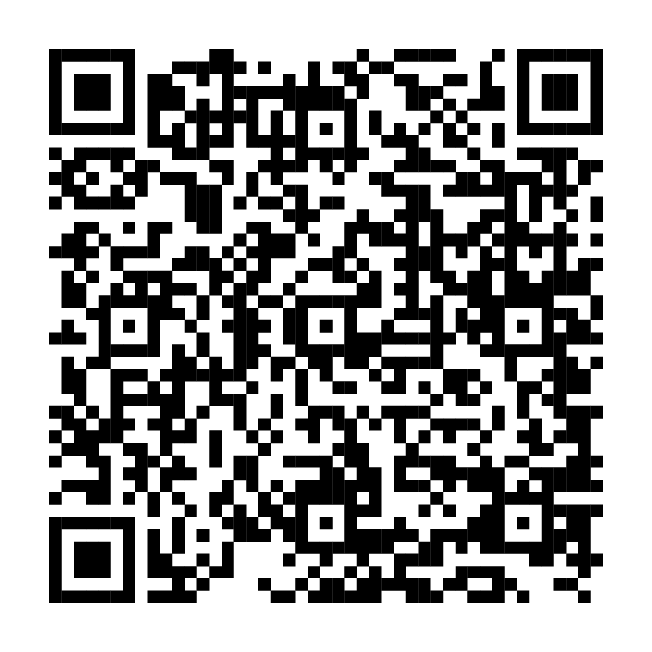
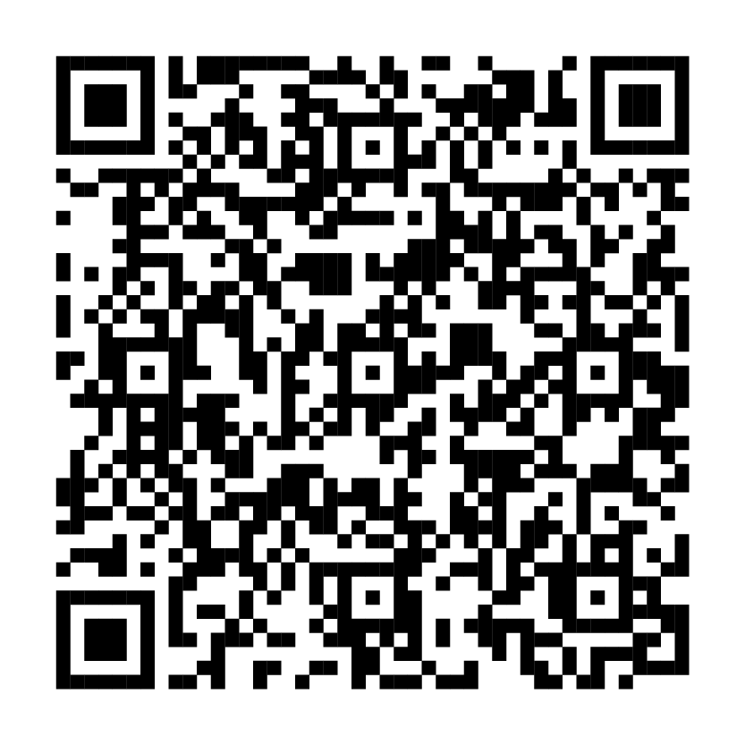
Resource spotlight
2
BUILD YOUR TOOLBOX
Cultural Humility Self-Reflection Tool for School Staff
Circle of Support and System Pathways
How to Foster and Maintain Supportive Spaces for Black Youth
Notes:
Cultural Humility Self-Reflection Tool for School Staff (https://smho-smso.ca/online-resources/cultural-humility-self-reflection-tool-for-school-staff/)
Designed for school staff to explore and reflect on their own cultural humility
Encourages reflection on skills, knowledge, and self-awareness
Also available for School Mental Health Professionals (https://smho-smso.ca/online-resources/cultural-humility-self-reflection-tool-for-school-mental-health-professionals/)
How to Foster and Maintain Supportive Spaces for Black Youth (https://smho-smso.ca/online-resources/tip-sheet-how-to-foster-and-maintain-supportive-spaces-for-black-youth/)
Being in a supportive space is crucial for developing a sense of comfort and well-being for Black youth
This tip sheet provides tips on fostering and maintaining supportive spaces enabling Black youth to flourish
Circle of Support and System Pathways – Flowchart, Planner and Desk Reference (https://smho-smso.ca/online-resources/circle-of-support-and-system-pathways-flowchart-planner-and-desk-reference/)
The decision-tree template, Circle of Support and System Pathways Flowchart, is designed as a guide for staff when they are concerned about a student and wondering if additional mental health support etc.) might be required
Working with your mental health leader, the text boxes in the worksheet may be populated to include local or specific board information (e.g. suicide protocol, community protocols, internal forms, processes

Slide 40
Reflection - 4
REFLECT
In what situations do you hold power in your role? How do you share power with students?
How do your personal identities (e.g., race, gender, ability, age, background) and assumptions shape your interactions with students?
Notes:
Notes:
Invite participants to reflect individually for a few minutes then discuss in pairs or small groups.
Create space for both successes and tensions
Consider using anonymous sticky notes or digital tools (e.g., Padlet, Mentimeter) if participants are hesitant to share.
-----

Slide 41
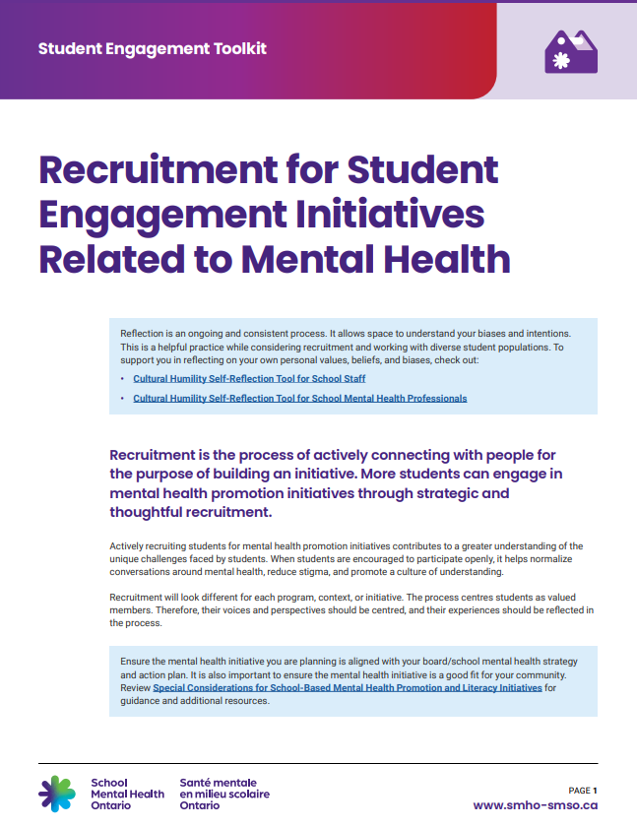
Recruitment
EXPLORE STRATEGIES
1
Recruitment for Student Engagement Initiatives Related to Mental Health
Notes:
We will now discuss the Recruitment for Student Engagement Initiatives Related to Mental Health resource.
Recruitment is the process of actively connecting with people to build an initiative. Recruiting students for mental health promotion initiatives contributes to a greater understanding of the unique challenges faced by students. The process understands students as valued members.

Slide 42
Reflection - 5
REFLECT
Which students are involved in engagement and leadership opportunities?
Who might be missing from the table? Why?
Notes:
Notes:
Invite participants to reflect individually for a few minutes then discuss in pairs or small groups.
Create space for both successes and tensions
Consider using anonymous sticky notes or digital tools (e.g., Padlet, Mentimeter) if participants are hesitant to share.
-----

Slide 43

Before you begin, consider:
a diversity of perspectives
relationships
power dynamics
intentionality
Key components of a recruitment plan:
build a team
develop a goal
select strategies
assess
Think beyond the typical or already engaged students and develop strategies that seek to connect with students who are also not typically engaged in school initiatives.
Notes:
Sometimes, the students you work with might not see themselves in leadership roles or haven’t had the chance to take on those kinds of opportunities before. When you’re recruiting students for mental health initiatives, it’s important to be intentional about reaching out to these students. Use your networks and the information you have to make sure they know about the opportunities and feel supported if they want to get involved. This means looking beyond the usual group of student leaders. Every student brings valuable insights based on their own experiences, and by connecting with a diverse group who represent different backgrounds and identities, your initiative can include a wider range of perspectives.
Even if recruitment isn’t your formal role, staying aware of who is being engaged and asking critical questions can foster more inclusive practices. Use these points to guide student-centered and equitable recruitment efforts.
When thinking about student recruitment, keep the following in mind:
Diverse perspectives: Every student brings knowledge from their own lived experience. Recruiting a diverse group helps ensure your initiative reflects a range of voices and identities.
Relationships: Students are more likely to engage when they feel seen and supported. Building genuine relationships helps them feel valued and comfortable to participate.
Power dynamics: Show students you're open to learning from them by being present in their spaces. This helps challenge traditional adult-student power imbalances.
Intentionality: Don’t rely on the same students who always show up. Think about who’s missing and create outreach strategies that include those not typically involved.
Consider how these students could be best reached. If you don't have a relationship with them, perhaps it would be better to have someone who does reach out to them.
When developing a recruitment plan:
Build a team that includes different partners in your school environment, such as students and school staff. They can help support various efforts of a mental health initiative.
Develop a goal that is aligned with the broader objectives of the initiative. A well-defined goal motivates and inspires the recruitment team, serving as a measurable benchmark for success
Select strategies that are tangible and relevant to reach students in your school community.
Assessment may include informal and formal conversations with student participants to understand their experiences and perceptions.
🧩 Related resources:
Cultural Humility Self-Reflection Tool for School Staff (https://smho-smso.ca/online-resources/cultural-humility-self-reflection-tool-for-school-staff/)
Cultural Humility Self-Reflection Tool for School Mental Health Professionals (https://smho-smso.ca/online-resources/cultural-humility-self-reflection-tool-for-school-mental-health-professionals/)

Slide 44
Some recruitment strategies
Put a face to the initiative
Small group or classroom presentations
Staff liaisons
Peer to peer
Social media, electronic communication platforms or posters
Staff nominations
Parent/caregiver partnership
Notes:
Here are some suggestions you may use to recruit students. These are merely suggestions. Work with your team to survey students in your school or board environment to determine what works, given your context.
Before moving ahead with any strategy, consider how the students you hope to engage can best be reached. If you don’t already have a relationship with them, it may be more effective for someone they trust (such as a staff member, peer, or community partner) to make the initial connection.
In each of these strategies, ensure that materials are available in accessible formats.
If you find that a strategy worked for a different initiative but is not working for the current one, step back and consult with your key partners to adapt your plans and find a solution forward.

Slide 45
Student quote 2
“All of our students are student leaders”
- Daunte Hillen
Notes:
Daunte Hillen, a ThriveSMH member, said, “all of our students are student leaders”
This is a reminder to all of us, that as we continue to endeavor in student engagement, we recognize the strengths that each student possesses, and we continue to challenge our own assumptions about student leadership and remain open to continue learning from the very young people we work with.
ℹ️ Source: https://smho-smso.ca/candid-conversations-student-insights-on-mental-health/

Slide 46

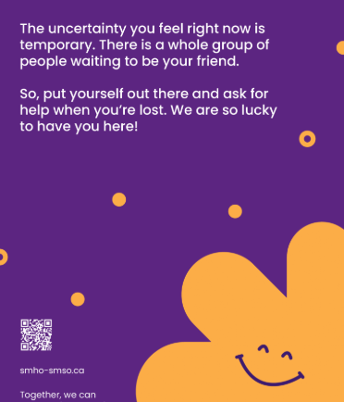

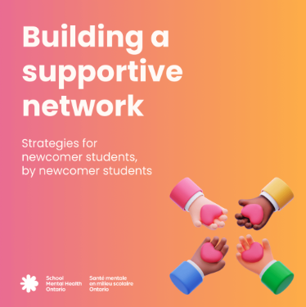
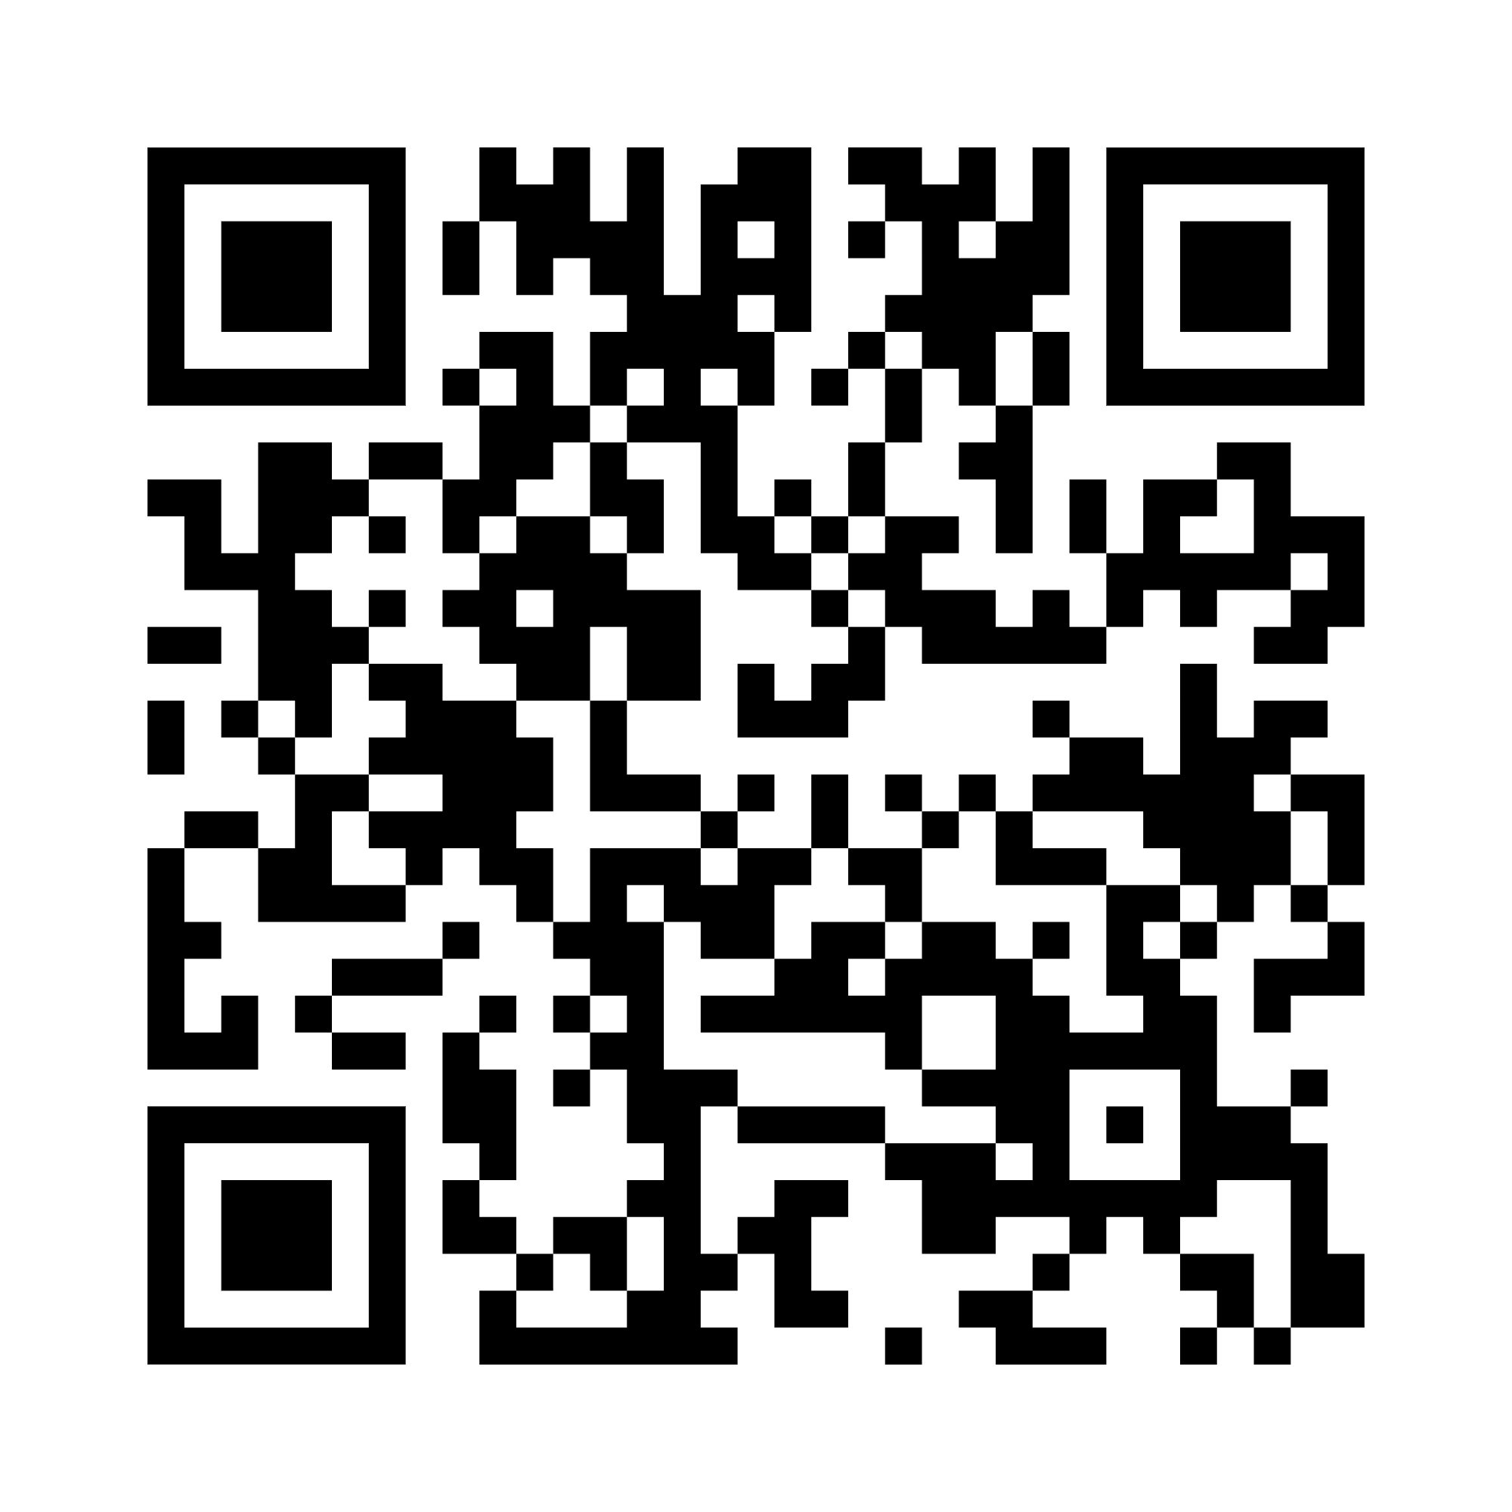
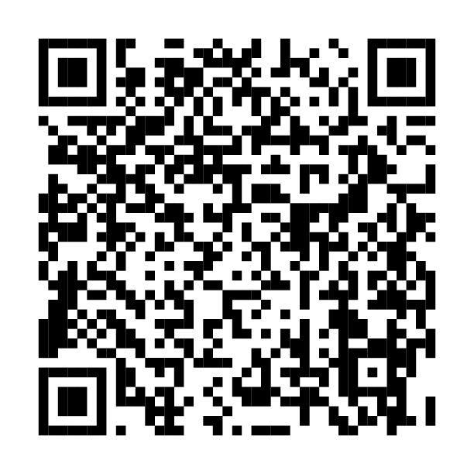
Resource spotlight 3
BUILD YOUR TOOLBOX
Life Promotion Toolkit and supporting resources
Newcomer student mental health resources
Notes:
Life Promotion Toolkit and supporting resources (https://smho-smso.ca/online-resources/life-promotion-toolkit-and-supporting-resources/)
The Life Promotion Toolkit (First Peoples Wellness Circle, Feather Carriers: Leadership for Life Promotion, and the Thunderbird Foundation) includes over 80 pages of activities designed by Indigenous youth to support a deeper sense of belonging, meaning, purpose, and hope.
While rooted in Indigenous ways of seeing, being, knowing, and doing, a life promotion approach benefits every student, Indigenous and non-Indigenous alike.
To help implement these activities, SMH-ON has developed companion resources including videos and info sheets. These materials provide practical strategies to integrate life promotion into classrooms and school communities in a respectful and meaningful way.
Work with students to select and carry out these activities in their communities.
Dissemination guide: Newcomer student mental health resources (https://smho-smso.ca/online-resources/dissemination-guide-newcomer-student-mental-health-resources/)
Work with students to adapt/share these resources in their communities to support the wellbeing of newcomer students.

Slide 47

Moving forward
DIG DEEPER
One thing I will start in my practice to strengthen student engagement is…
One thing I will stop in my practice to strengthen student engagement is…
One thing I will shift in my practice to strengthen student engagement is…
Notes:
Notes:
Ask participants to take a quiet moment to reflect on what they’ve learned.
Then, invite them to complete this prompt: One thing I will start, stop, or shift in my practice to strengthen student engagement is…
Have them write their response on a sticky note (physical or virtual) and/or invite a few volunteers to share their commitment out loud.
-----

Slide 48
About us 2

Slide 49
Accessibility statement 2
Accessibility and mental health are relatedAccessibility

