Slide 1
MH LIT: Student Mental Health in Action
Secondary Staff/Division Meeting
Deep Dive
Notes:
School Mental Health Ontario works together with Ontario school districts and school authorities to support student mental health.
In a memorandum from the Ministry of Education on January 12, 2021, Minister Lecce introduced the Student Mental Health Action Kit. This action kit is available on the School Mental Health Ontario website (www.smho-smso.ca). The kit is in response to on-going efforts to promote student mental health and well-being at school (both virtually and in-person) during difficult times, such as the COVID-19 pandemic. As part of this kit, School Mental Health Ontario is offering a series of lessons to support the development of basic mental health knowledge and help-seeking skills.
MH LIT: Student Mental Health in Action (a series of four approximately 45-minute lessons) is now available on the School Mental Health Ontario website.
Although educators are not mental health professionals, we have an important role in creating mentally healthy classroom environments, noticing students whom we may be concerned about, and teaching students about maintaining good mental health.
Today’s deeper dive into the lessons will help you get a sense of the materials and activities available. You are being asked to consider your interest, readiness and ability to participate. If interested, you would be joining me as part of a team that will also include our mental health professionals (if available at the school).
[Note to administrators: this slide deck may also be used to introduce this resource to (and engage the support of) student parliament/council/groups. It may also be used at division team meetings.]
[Note to administrators: a briefer introductory slide deck for Student MH LIT is also available within the "Implementation Materials for School Leaders" section of the resource on the SMH-ON website.]

Slide 2
Background and Rationale
There are important reasons to bring mental health learning into the classroom:
Students want to learn about mental health in the classroom
Promoting student mental health and well-being during the pandemic and beyond
Opening conversations
Helping students in need reach support
Offering valuable learning experiences
Providing opportunities to develop skills
Notes:
Student voice data from across the province continues to demonstrate that students want to learn about mental health in their classrooms as part of the regular school day. We also know that mental health has been on the minds of many, given our recent circumstances, and these lessons provide a ready-made way to bring this learning to our students during the pandemic and beyond.

Slide 3
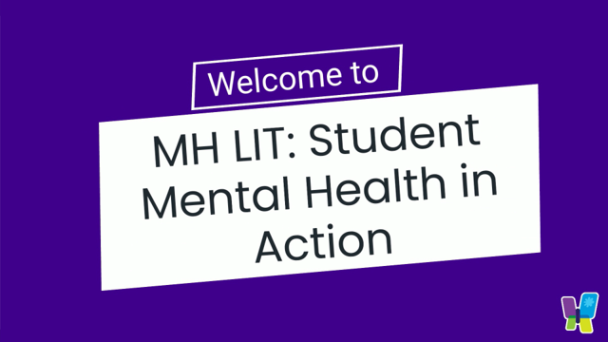
Introducing...Student MH LIT
Notes:
This brief, social media friendly video provides an overview of the lesson series (2:18 minutes).
https://youtu.be/poeTfsgCp-c
[Note: an additional video is available for each of the four lesson plans.]

Slide 4
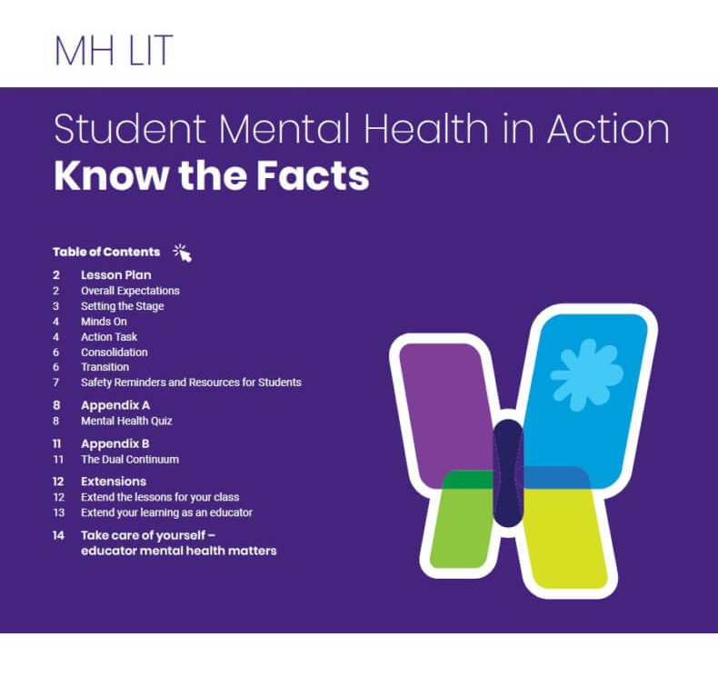
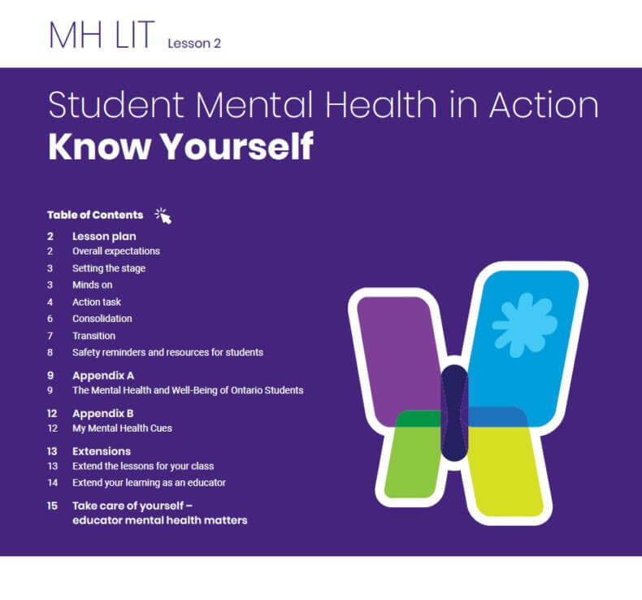
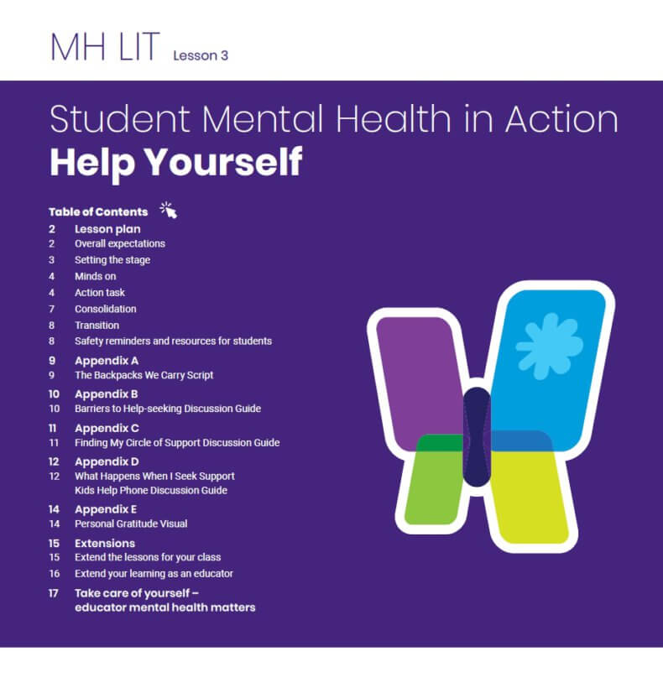
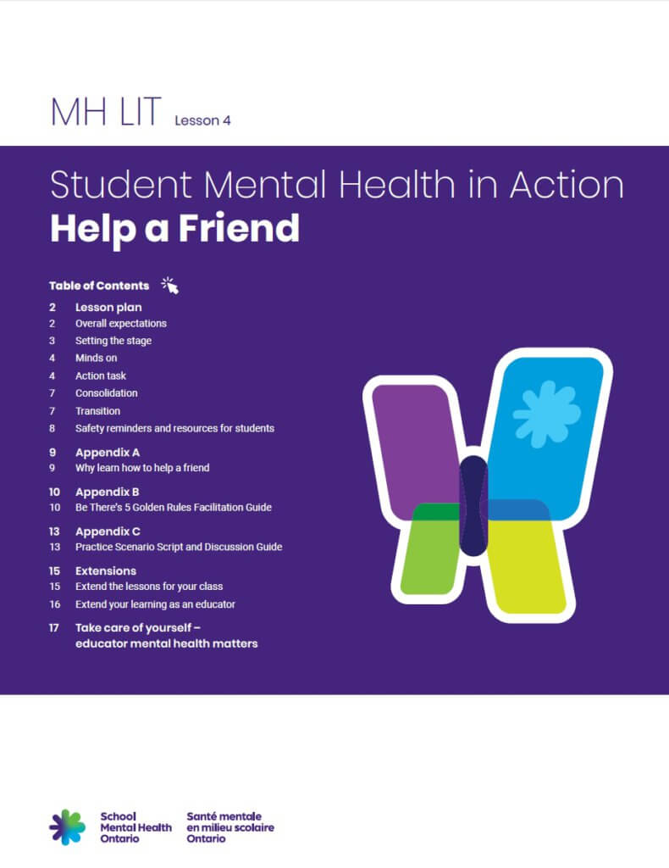
What does it include?​
Four 45-minute lessons to support the development of basic mental health knowledge and help-seeking skills:
Know the Facts
Know Yourself
Help Yourself - with Kids Help Phone
Help a Friend - with Be There powered by Jack.org
Notes:
MH LIT: Student Mental Health in Action is a series of four 45-minute lessons designed to be delivered by secondary school educators. The lessons focus on mental health and mental illness (the dual continuum), signs of mental health problems, strategies to support mental health and well-being, and how/where to access help for the student and their friends, when needed. The module provides additional supportive materials and extension activities.

Slide 5
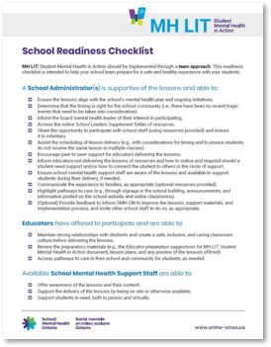
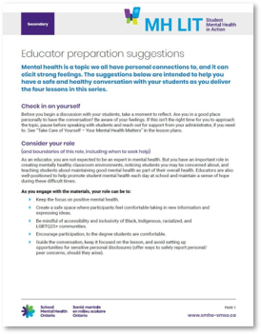
Supportive Resources
School Readiness Checklist
Implementation Materials for School Leaders
Educator Preparation Suggestions
Parent/Caregiver Resources
Notes:
In addition to the lessons, a number of supportive resources are included. In particular, you may be interested in:
the Readiness Checklist, which encourages a team approach and offers ways to help us prepare for a supportive experience for our students;
the educator preparation suggestions, which include ideas to build knowledge, engage supports, acknowledge stigma, and check in with students; and
the parent/caregiver resources, which are information sheets for each lesson that offer a summary of the content covered, ways to continue the conversation, and additional resources and help-seeking information.

Slide 6
Intended Audience
Secondary school students
All grades
All subject areas
As broad a reach as possible
Notes:
The aim is for Student MH LIT to reach as many students as possible. The lessons do not necessarily link with curriculum or a particular course to help extend that reach. Teacher prompts and guides are included to help educators from a variety of backgrounds deliver the lessons and, regardless of your subject area, the lessons can help create a positive environment in your classroom and help prepare students to learn.

Slide 7
Walk Through
Notes:
We are going to experience an activity from each of the four lessons. This will help give you a sense of what you can expect within the lessons, and the easy click 'n play nature of the activities.

Slide 8
Know the Facts
Notes:
Know the Facts is the first lesson in the series.
Its goals are to help students:
Challenge common misconceptions about mental health and consider their negative impact.
Demonstrate an understanding of mental health, mental illness, and the dual continuum.
Increase knowledge needed to help take care of their own well-being and the well-being of those around them.
Key messages include:
We all have mental health, just like we all have physical health.
Mental health is a good thing! We all want to have good mental health for ourselves, our family, and our friends.
Everyone can strive for good mental health, including those with mental illness.

Slide 9
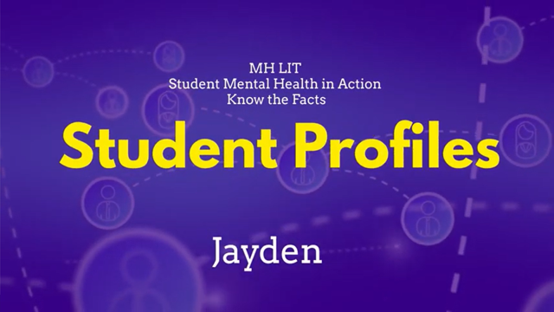
Try it Out
Notes:
In Know the Facts, students discuss how mental health and mental illness are two separate yet connected ideas. This video demonstrates how you can experience good mental health even though you may have a mental illness. There is a second video included in the lesson that shows how you can also experience poor mental health, even though you might not have a mental illness.
Video Length 0:51
YouTube: https://youtu.be/8oH6yEh-N_M
Vimeo: https://vimeo.com/536443715/8c0b3677d4

Slide 10
Know Yourself
Notes:
Know Yourself is the second lesson in the series.
Its goals are to help students:
Describe factors that can impact mental health.
Recognize indicators of their mental health.
Demonstrate an increased understanding of how to support their mental health.
Differentiate healthy from unhealthy coping strategies.
Key messages include:
We know the year has been a challenging one – we are here to help.
We can take care of our mental health, just like we take care of our physical health.
We can’t eliminate stress or challenges all together, but we can give ourselves resources to help manage them.

Slide 11
Try it Out
The Mental Health and Well-Being of Ontario Students Quiz
Click on the box that contains the best answer
Click here to start
Notes:
Know Yourself includes a quiz to help students learn about the mental health and well-being of their peers based on the Ontario Student Drug Use and Health Survey (OSDUHS). The OSDUHS is a survey that has been given to Ontario students every two years since 1977. In 2021, 2,225 students in grades 7-12 participated. We’ll click through a question to show you how the survey works. The quiz in the lesson is formatted the same way. It's easy to click and use. An educator guide is also available to aid class discussion.

Slide 12
How many students felt they had a good ability to cope with problems?
34%
54%
21%
72%

Slide 13
How many students felt they had a good ability to cope with problems?
34%
Correct!
34% of students rated their ability to cope with unexpected and difficult problems as excellent or very good.
Similarly, 34% rated their ability to cope as fair or poor.
Next

Slide 14
How many students felt they had a good ability to cope with problems?
34%
Not quite! The correct answer is…
34% of students rated their ability to cope with unexpected and difficult problems as excellent or very good.
Similarly, 34% rated their ability to cope as fair or poor.
Next
Notes:
Should students choose an incorrect response, they will receive feedback in this format.

Slide 15
Help Yourself
Notes:
Help Yourself is the third lesson in the series.
Its goals are to help students:
Increase awareness of when to seek support
Recognize common barriers to help-seeking
Increase awareness of mental health services and supports within the school and community
Increase knowledge of effective help-seeking strategies
Increased understanding of the process of engaging with support
Key messages include:
Getting help when you need it is an important part of taking care of your mental health.
Not everything that weighs you down is yours to carry alone.
Your problems don’t have to be big to talk to someone about them.

Slide 16
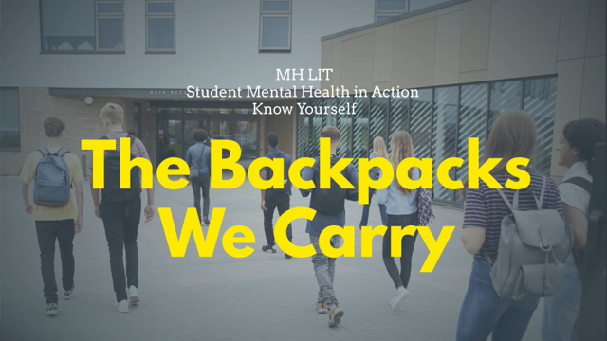
Try it Out
Notes:
Help Yourself includes a visualization activity for students. Again, the lessons include as many click and play options as possible. The video (3:07 minutes) is accompanied by the following reflection questions:
Imagine carrying a backpack like this all the time. How would it feel?
Would someone be able to carry it by themself? For how long?
What kind of items might be too heavy to carry alone?
What would it be like if we could see everyone’s backpack?

Slide 17
Help a Friend
Notes:
Help a Friend is the fourth lesson in the series.
Its goals are to help students:
Recognize when a friend needs mental health support
Use appropriate help-giving strategies to safely support a friend struggling with their mental health
Increase awareness of appropriate self-care and boundaries when supporting a friend
Key messages include:
We have an important role to play in supporting our friends.
Sometimes we need other people to play a role, too.
We do not have to carry our concern for our friend alone.
Even if our friend asks us not to, we need to seek support right away if there is a risk to their safety or anyone else’s.

Slide 18
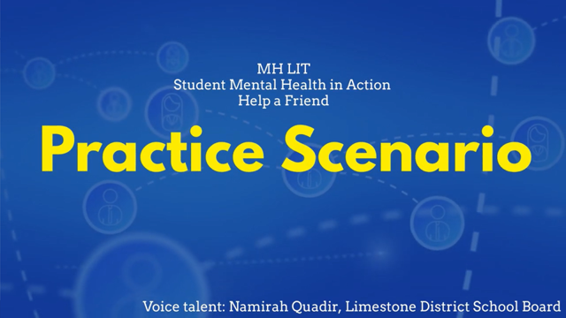
Try it Out
Notes:
In this lesson students are taught steps to help support a friend with a mental health concern. This video (2:31 minutes) provides students with a chance to consolidate and practice that learning. An educator guide is provided to help with the discussion. The voiceovers in both English and French were done by students.
Helping a Friend Practice Scenario (Virtual) - YouTube
Helping a Friend Practice Scenario (Virtual) (vimeo.com)

Slide 19
Next Steps
How can we continue to come together for planning and support?
What might you need to share these lessons with students?
How can we determine the best timing for the lessons in our school?
How could we bring the lessons to students in a coordinated manner?
How can we prepare students to participate and create safe spaces for these conversations?
How might the lessons complement other learning we are offering?
How can we attend to our own wellness as we support the well-being of our students?
Notes:
We want to take a team approach in delivering these lessons. If you are interested in learning more about this opportunity and coming together as part of that team, please let me know. Please also speak to me if you have any questions about the lessons or any other ideas on how we can use the School Mental Health Ontario resources in our school to support students.
[Note to administrators: an administrator implementation tip sheet is available within the "Implementation Materials for School Leaders" section of the resource on the SMH-ON website.]

Slide 20
Some final words from educators:
Well laid out, each step builds on the last and it's easy for Educators to use! I can do as much or as little as I am comfortable doing. It builds my confidence as an Educator as well.
Lots of good information, I like that I can make additions to the slides to meet the needs of the group I am working with.
This could be used anytime you want to create culture in your classroom.
There are so many different initiatives competing for teacher time, but this is of central importance. I think this is number one.
“At first when I read it over, I had some doubts about having the background to do this. But when I looked at the lessons, I felt comfortable.”
The lessons were a nice break from curriculum and chance to just chat. They got them ready to do their work.
Notes:
Educators who have used Student MH LIT shared the following about their experience.

Slide 21




ABOUT US
School
Mental Health
Ontario
We work together with Ontario school districts to support student mental health
www.smho-smso.ca
@SMHO_SMSO
@ThriveSMH
School Mental Health Ontario
Partner Youth Resource Hub: www.jack.org/covid
Notes:
I encourage you to look at the School Mental Health Ontario website, if you have not already done so. We have an important role in creating mentally healthy classroom environments, noticing students whom we may be concerned about, and teaching students about maintaining good mental health, and these resources can help us do so.

