Slide 1
MH LIT: Student Mental Health in Action
Secondary Staff
Introduction
Notes:
School Mental Health Ontario works together with Ontario school districts and school authorities to support student mental health.​
​
In a memorandum from the Ministry of Education on January 12, 2021, Minister Lecce introduced the Student Mental Health Action Kit. As part of this kit, School Mental Health Ontario developed MH LIT: Student Mental Health in Action, a series of lessons to support the development of basic mental health knowledge and help-seeking skills. This series of lessons is available on the School Mental Health Ontario Website (MH LIT: Student Mental Health in Action - School Mental Health Ontario (smho-smso.ca).​
​
Although educators are not mental health professionals, we have an important role in creating mentally healthy classroom environments, noticing students whom we may be concerned about and teaching students about maintaining good mental health.​
​
Today’s overview is to introduce you to the lessons. You are being asked to consider your interest, readiness and ability to participate. If interested, you would be joining me as part of a team that will also include our mental health professionals.​
​
[Administrator Note: Administrators who wish to provide staff with more detail about the lessons and a chance to experience some of the activities may also share the Second Staff/Division Meeting Deep Dive slide deck provided on the School Mental Health Ontario Website.]​
​

Slide 2
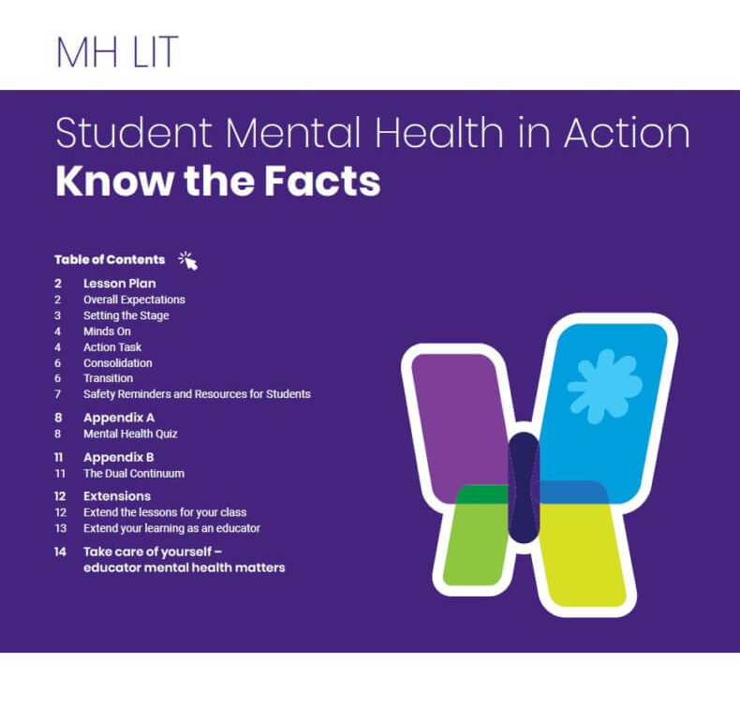
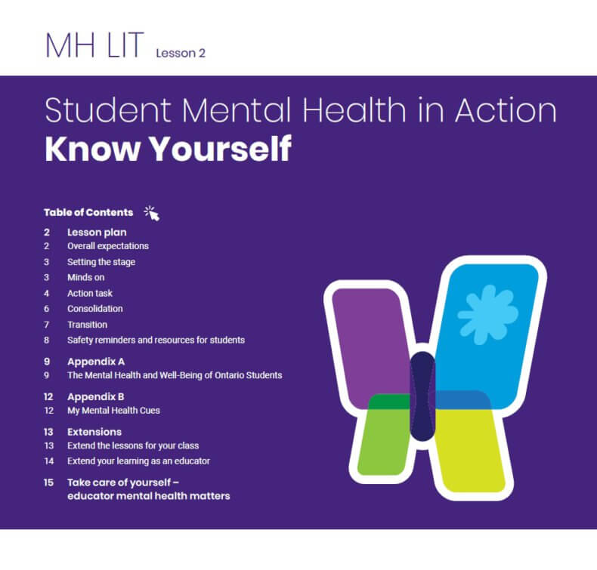
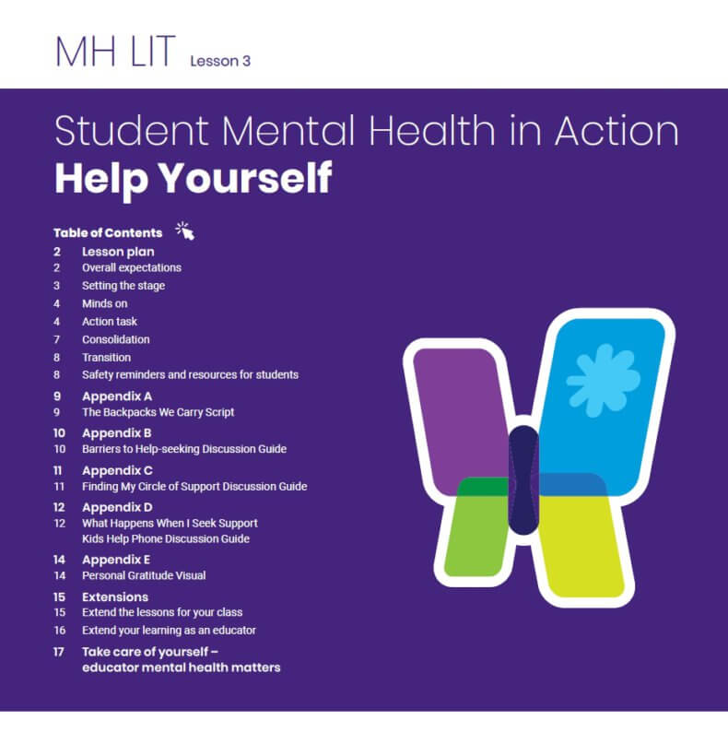
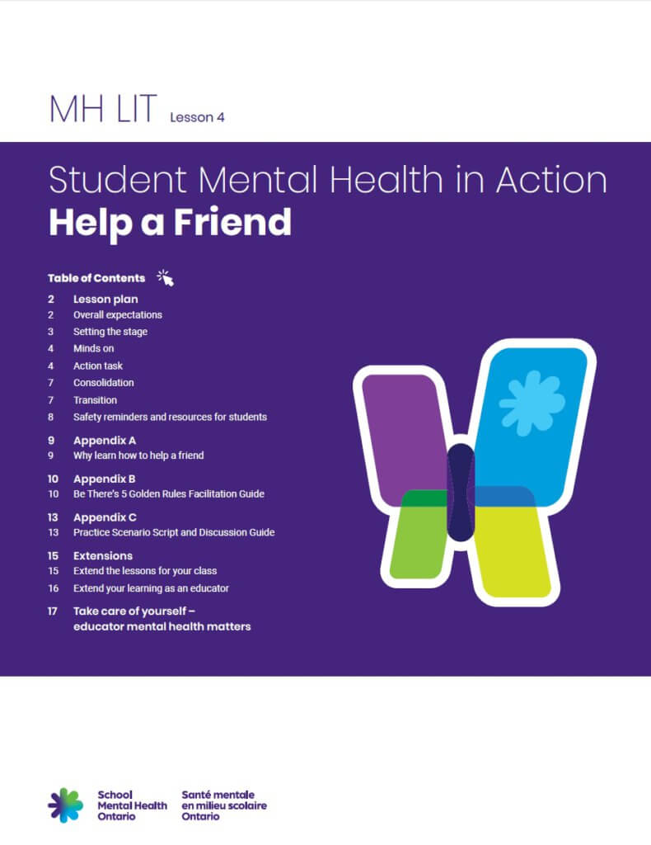
What does it include?​
Four 45-minute lessons to support the development of basic mental health knowledge and help-seeking skills:
Know the Facts
Know Yourself
Help Yourself - with Kids Help Phone
Help a Friend - with Be There powered by Jack.org
Notes:
MH LIT: Student Mental Health in Action is a series of four 45-minute lessons designed to be delivered by secondary school educators. The lessons focus on mental health and mental illness (the dual continuum), signs of mental health problems, strategies to support mental health and well-being, and how/where to access help for the student and their friends, when needed. The module provides additional supportive materials and extension activities.
We know that mental health is a very personal topic and that, for some staff and for some students, it may open up questions and strong feelings. That is why we will be using a team approach and will work with our mental health professionals to ensure that we have all the supports in place should a student require an opportunity for follow up support or additional debriefing.

Slide 3
Intended Audience
Secondary school students
All grades
All subject areas
As broad a reach as possible
Notes:
The aim is for Student MH LIT to reach as many students as possible. While the lessons may not necessarily make a direct link to your curriculum or course work, they can help create a positive environment in your classroom and help prepare students to learn. Teacher prompts and guides are included to help educators from a variety of backgrounds deliver the lessons.

Slide 4
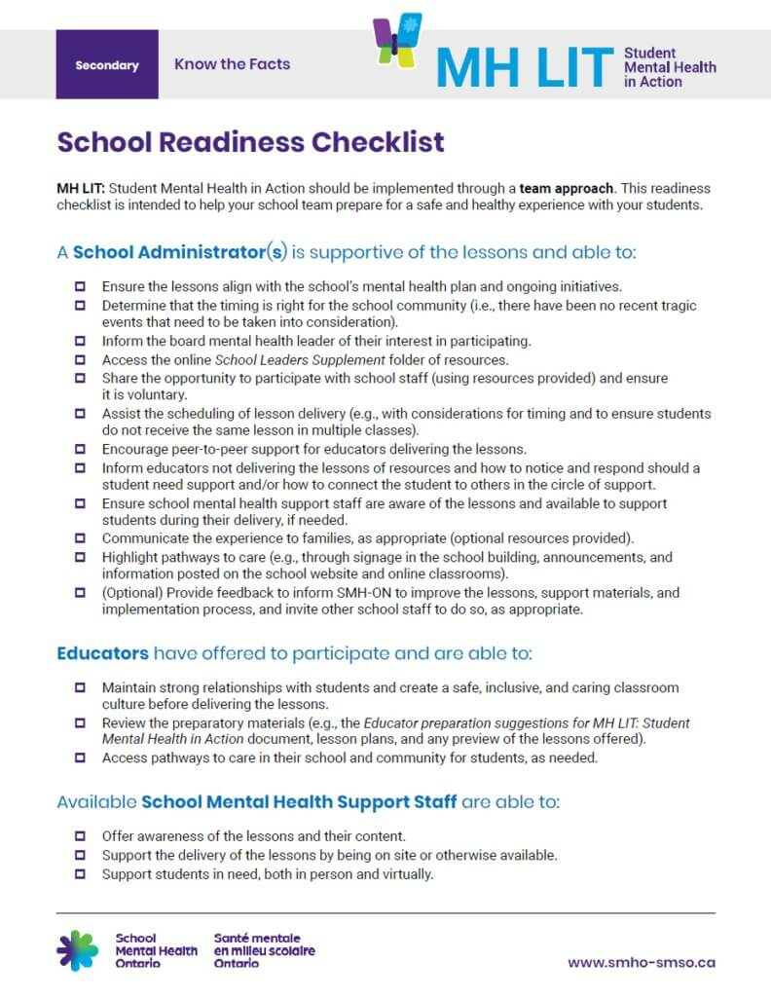
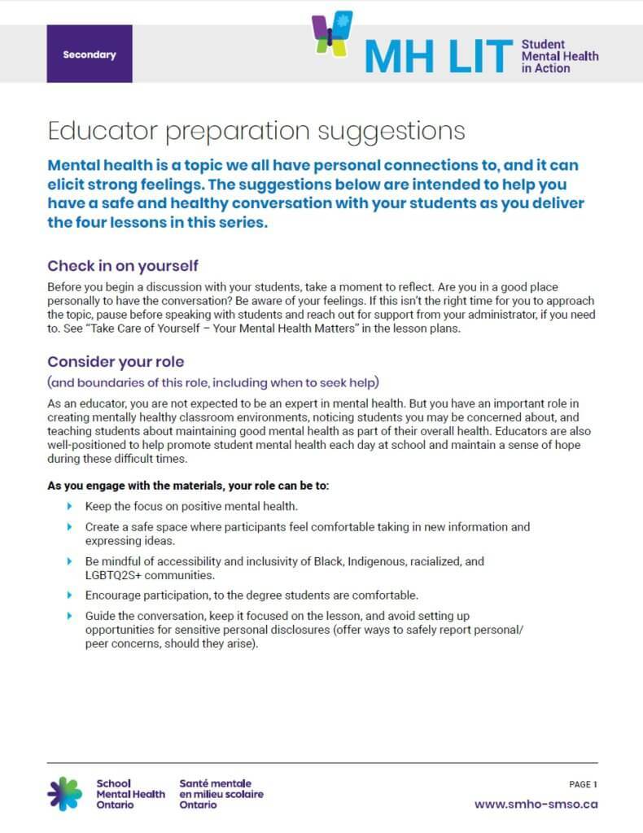
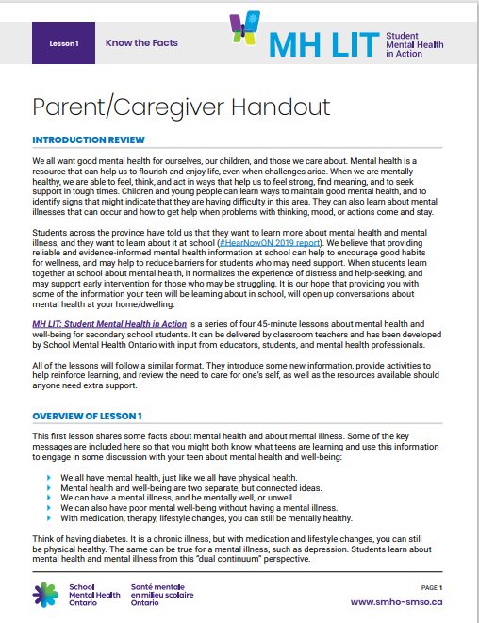
Supportive Resources
Notes:
We want to take a team approach in delivering these lessons. So, if you are interested in learning more about this opportunity, please let me know. I will be calling those who are interested in learning more to a meeting where I will share two resources prepared by School Mental Health Ontario. The School Readiness Checklist and the Educator Preparation Suggestions will help to prepare us as a team for a safe and healthy experience with our students and the parent/caregiver resources will encourage our families to continue these important conversations at home [Click each image for the resource]

Slide 5





ABOUT US
School
Mental Health
Ontario
We work together with Ontario school districts to support student mental health
www.smho-smso.ca
@SMHO_SMSO
@ThriveSMH
School Mental Health Ontario
https://smho-smso.ca/students/
Notes:
Again, I encourage you to take a deeper look at the School Mental Health Ontario website, if you have not already done so.
With enough interest to offer MH LIT: Student Mental Health in Action, I will let you know more about our implementation plan and when the lessons will be delivered. You will begin to hear announcements to highlight our focus on these lessons. We’ll be including information in our newsletter/webpage and through our school notification system so that our parents/caregivers can be made aware of the module as well.
As I already shared, we have an important role in creating mentally healthy classroom environments, noticing students whom we may be concerned about and teaching students about maintaining good mental health.
Do you have any questions about these lessons or any other ideas on how we can use the School Mental Health Ontario resources in our school to support students?

