Slide 1
Conversation starters about stress
3 sets of slides:
Stress 101
Stress and school
Getting help with stress
Notes:
This slide deck contains:
Considerations for delivery (slides 2-3)
Three sets of slides to share with students
Stress 101 (orange slides 4-17)
Stress and school (turquoise slides 18-29)
Getting help with stress (magenta slides 30-42)
Suggestions to continue the conversation (slide 43)
How to use the slide deck:
It is recommended that educators share the slides one set at a time, in the order suggested.
Each slide offers prompts and suggestions to help educators guide the conversation.

Slide 2
Educator considerations for delivery
Model reducing stress and promoting calm while engaging in the conversation (e.g., by dimming the lights, playing soft music, using a gentle tone of voice, inviting students to sit comfortably, choosing a time when you won’t be rushed, and so on). Explicitly highlight what you are doing so students make the connection to stress management.
Begin from a place of strength. Many students already have healthy ways of managing stress based on personal, family, cultural, and community strengths. Welcome a wide range of perspectives to help broaden the conversation.
Create a supportive space for the conversation by promoting openness and understanding and respecting students as complex individuals with diverse needs (e.g., revisit class agreements about welcoming and respecting different perspectives and opinions).

Slide 3
Educator considerations for delivery - 2
Educator considerations for delivery
Consider the opportunities. While stress is a part of day-to-day life, there may be times when a conversation could be particularly meaningful (e.g., prior to standardized testing like EQAO or transitions such as graduating/changing schools).
Offer multiple entry points to the conversation (e.g., a virtual or physical ‘parking lot’ or question box), while also respecting the choice to listen as a way to engage.
Prioritize your time together for learning about stress together as a class, rather than sharing individual stories. If there is a sensitive personal situation a student would like to speak about, invite them to see you after class.

Slide 4
Stress 101

Slide 5
What are some things that might stress students out?
Ice breaker
Notes:
Set the tone for the conversation. Reassure students that there are no wrong answers. This will help encourage participation/healthy discussion/debate about different sources of stress, possible strategies to manage it, and why some can be more effective for each of us than others. Provide think time and sharing time before moving on to the 'follow up' slide.

Slide 6

What are some things that might stress students out? – Follow-up
Follow-up
What are some things that might stress students out?
school
friends
sports and activities
parents/caregivers/family/siblings
current events
other ideas?
Notes:
This question provides opportunities to acknowledge and normalize common experiences of stress. In addition to the examples shared on the student-facing slide, students might bring up more specific concerns:
School - tests, homework, participating in class discussions, giving presentations
Friends/peers - peer pressure, fitting in, disagreements, bullying, prejudice/discrimination
Sports and activities - managing a busy schedule, making a team
Current events - locally, around the world, societal issues
Acknowledge the uniqueness of each student and create space for and validate their individual perspectives and experiences.
Teacher Prompt: “We are all unique. Different things may be stressful for each of us. We don’t all get stressed about the same things, but we all get stressed about something!”

Slide 7
What is stress?
Is stress bad?
A1
Notes:
Provide time for students to think and share before moving on to the 'follow up' slide.

Slide 8
What is stress? Is stress bad?
Follow-up
A1
Stress is the feeling we get that can come from difficult, challenging, or uncomfortable situations.
There are many kinds of stress. Some are helpful and some are not.
Other ideas?
Notes:
Stress is the pressure, tension, physical discomfort, and sometimes worry that can come from many different situations.
Provide examples of stressful situations to help students understand the definition of stress (e.g., when we have a test coming up, we are trying out for a team, or when we are excluded from our peers or made fun of for something that’s important to us). Sometimes even things we are looking forward to can cause stress, like a graduation, big party, or class trip, because they require us to adapt, grow, and try new things.
Not all sources of stress are the same. While we all encounter some common stressors (e.g., public speaking, trying out for a team, taking tests, and so on), some of us also face stress related to identity-based experiences such as racism or homophobia, or ongoing stress related to things like a medical condition or finances. For these sources of stress, it’s important to seek support from trusted, caring adults, as it is not up to individual students to adjust or adapt to the situation on their own.
Teacher prompt: “Everyone gets stressed at times. It doesn’t mean you shouldn’t try something. Stress can mean something is important to you, and it could help you do your best.”

Slide 9
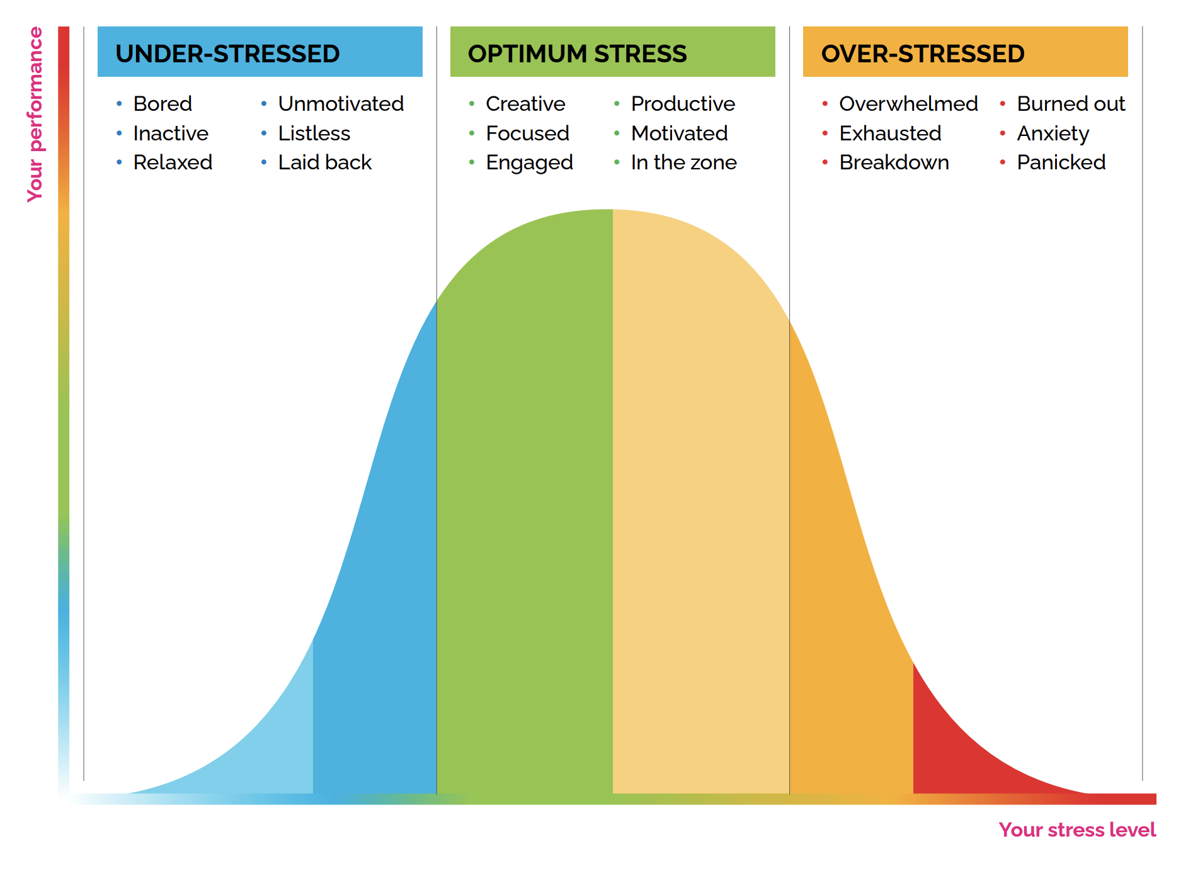
The stress curve
Follow-up
A1
Notes:
Unpack the Stress Performance Curve:
Lower levels of/no stress might leave students feeling bored or unmotivated.
A healthy amount of stress can be positive and even helpful—like when dealing with a situation makes us feel we are capable, learning, and growing. It can help us to perform our best and shows something is important to us, too.
Too much stress and we can feel overwhelmed and exhausted. Stress that goes on too long can also impact our health (including our mental health).

Slide 10
What are some possible signs of stress?
A2
Notes:
Provide time for students to think and share before moving on to the 'follow up' slide.

Slide 11
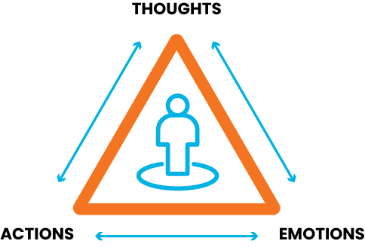
What are some possible signs of stress?
Follow-up
A2
Stress can show up in many ways. For example:
  a sore stomach even though we aren't sick
  feeling especially grumpy or irritable
  other suggestions?
Stress can show up differently
for each of us.
Notes:
What signs might tell us we are feeling stressed?
Provide students with an opportunity to reflect on a variety of different signs that might indicate stress. Some specific examples include:
Thoughts (e.g., expecting not to do well, thinking negative thoughts about ourselves)
Emotions (e.g., feeling worried, nervous, frustrated, angry)
Bodies (e.g., stomach aches, headaches, sore shoulders)
Actions (e.g., spending more time alone than usual, eating or sleeping habits change, don’t do as well at school as usual)
Teacher prompt: “I encourage you not to compare your answers to anyone else. Each of our experiences is important and valid, and we can all experience stress differently.”
Note: culture can influence the way we show, perceive, and experience stress. It will not be the same for all students.

Slide 12
What strategies could we use when we are feeling stressed?
How would we know when they are helping?
A3
Notes:
Provide time for students to think and share before moving on to the 'follow up' slide.

Slide 13
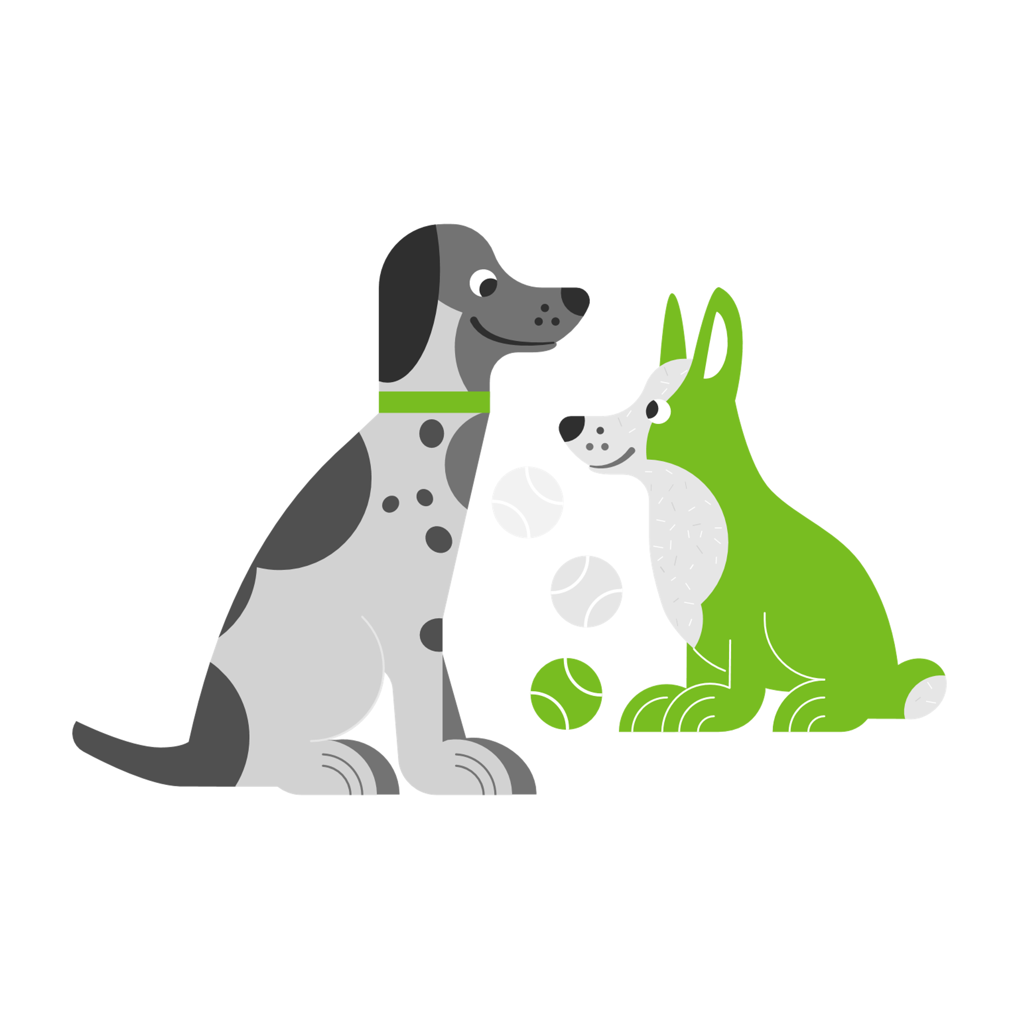


What strategies could we use when we are feeling stressed?
Follow-up
A3
a relaxing bedtime routine
spending time with a friend
doing something we enjoy
Notes:
What strategies could we use when we are feeling stressed?
Teacher prompt: “Stress is an everyday part of life. We can’t get rid of stressors or challenges all together, but for most common sources of stress we can learn and practice strategies to help manage them. Different strategies work for different people and that’s okay! We are each unique. There is no ‘best’ strategy everyone has to use.”
Students do many things to help manage stress:
Everyday routines, like getting enough sleep
Relaxing (e.g., stretching, reading, journalling, listening to music, etc.)
Connecting with people, pets and creatures, the land and nature, faith and spirit
Asking for help (remind students that it’s important to seek support from trusted, caring adults when they are experiencing sources of stress that are beyond their control, such as racism).
Students might have other ideas from their friends, families, communities, faiths, or cultures.
Are there other strategies that might be more helpful?

Slide 14



How would we know when they are helping?
Follow-up
A3
Strategies that are helpful make us feel better without adding to our stress or causing new problems.
Notes:
How would we know they are helping?
Teacher prompt: “Sometimes we use a strategy that we think will be helpful, but it ends up adding to our stress, like when we go online and spend so much time there we feel rushed doing other things we need to do.”
Invite students to reflect on the following:
How do you feel after you use a particular stress management strategy?
Does it fit with what is important to you?
Does it cause any problems?
Are there other strategies that might be more helpful?

Slide 15
Can we get better at strategies to help with stress?
A4
Notes:
Provide time for students to think and share before moving on to the 'follow up' slide.

Slide 16
Can we get better at strategies to help with stress?
Follow-up
A4
Yes! Practice can help us get better at strategies to help with stress, just like we can get better at drawing, playing the piano, or playing soccer.
Practicing when we aren't stressed is a great way to make sure we are ready to use a strategy when we really need it.
Notes:
Can we get better at strategies to help with stress?
Teacher prompt: “We can’t always choose whether we experience stress, but we can choose how we get ready for it. It may take some practice, but we can get better at strategies to help with stress, just like we can get better at drawing, playing the piano, or playing soccer. Practicing when we aren’t stressed is a great way to make sure we are ready to use a strategy when we really need it. You don’t wait to learn about passing the ball until a championship game. You practice and prepare before you get there.”
Different strategies work for different people, and different strategies work at different times, too (e.g., you can spend time with a pet at home but not at school), so it’s important to have a few options available and to practice them regularly.
Invite students to share ideas about how they could practice ways to manage stress regularly and make them part of everyday life. Could they practice a strategy at the same time each day, partner with a friend to practice, or leave themselves a reminder to practice? What other ideas do they have?

Slide 17
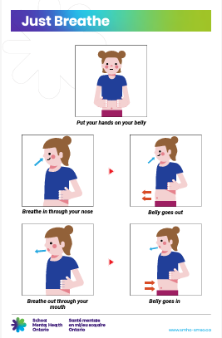
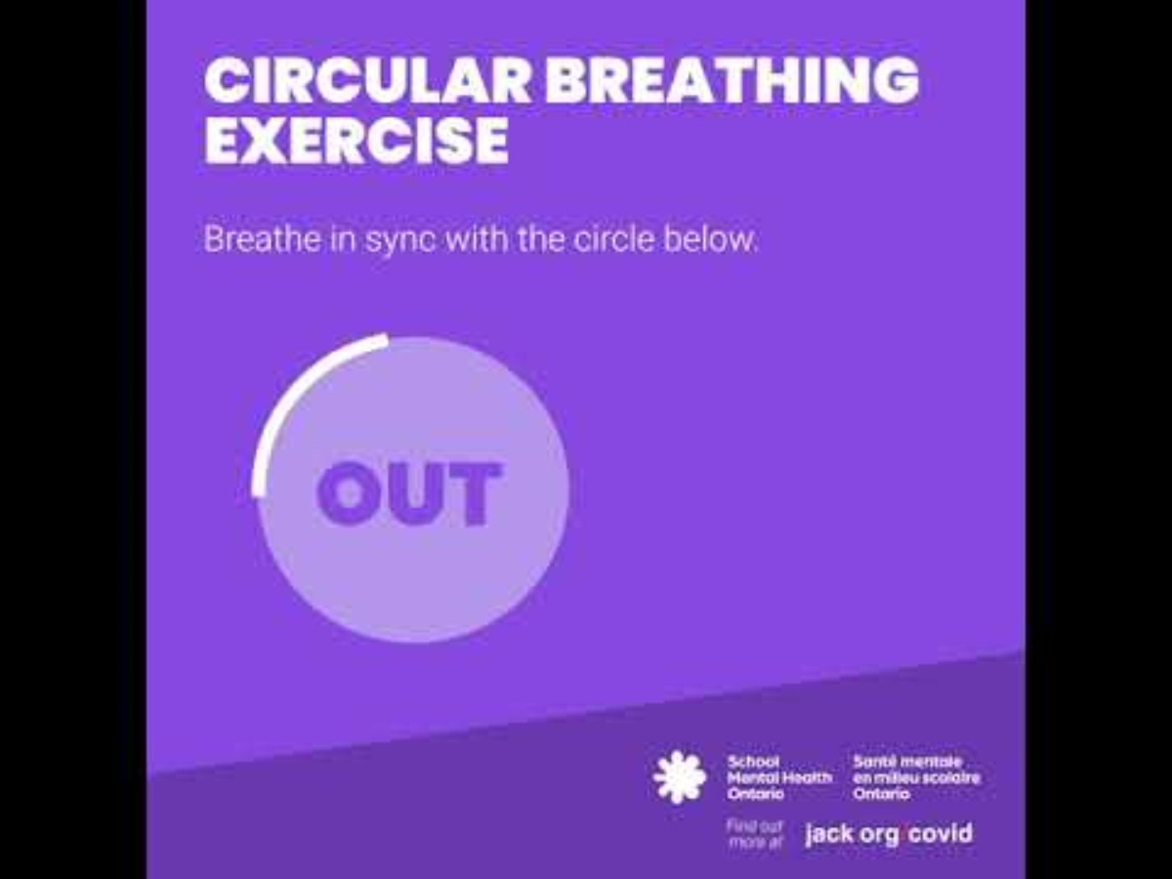
Supportive transition
Notes:
The Just Breathe poster and Circular breathing video are provided as two possible options. Offer students the opportunity to contribute ideas for other supportive transitions. Consider taking this opportunity to have students create a class list of helpful stress management strategies to refer to and practice throughout the school year. Activities shared by students are valuable and engaging! Simple activities like going outside for a walk or playing a short game or song that students enjoy are great options, too.

Slide 18
Stress and school

Slide 19
What kinds of things do students like about school?
Ice breaker
Notes:
Provide time for students to think and share before moving on to the 'follow up' slide.
This question provides the opportunity to learn about the interests of students, and to look for opportunities to weave them into learning activities and routines within the school day, when possible.

Slide 20






What kinds of things do students like about school? Follow-up
Follow-up
What kinds of things do students like about school?
friends
sports, clubs, activities
learning new things
favourite subjects
teachers/caring adults
class trips
Other ideas?
Notes:
What kinds of things do students like about school?
Note: during this conversation, consider students for whom school may present challenges and who may not have as many positive feelings.

Slide 21
What kinds of things might stress students out about school?
B1
Notes:
Provide time for students to think and share before moving on to the 'follow up' slide.
Note: Educators often have some influence over student stressors. Things like predictable routines, letting students know when a transition is coming, and taking movement breaks all support students to manage stress at school.

Slide 22
What kinds of things might stress students out about school? – Follow-up
Follow-up
B1
What kinds of things might stress students out about school?
tests/marks
not having enough free time
speaking in front of others
changes in the daily schedule
the noise or lighting
feeling left out or that they don't belong
Other ideas?
Notes:
What kinds of things might stress students out about school?
Just as students may like different things about school, they may find different things stressful, too.
There may be some things students may or may not feel comfortable mentioning, such as:
Racism, discrimination, bullying, feeling you don’t belong, not seeing your identity reflected
Not feeling comfortable during unstructured times, such as recess and lunch
Accessing learning supports that may be visible to other students
Difficulty with the social demands at school (e.g., being around others all day, group work, peer pressure, conflict with peers)
Feeling they’re not keeping up with peers in terms of workload, skills, or other learning

Slide 23
What are some strategies to help with stress that we can use at school?
B2
Notes:
Provide time for students to think and share before moving on to the 'follow up' slide.
Note: some strategies may not be obvious, such as washroom breaks that really serve the purpose of stress management. Students may not always make these connections, but educators can help students recognize these types of strategies and support them, when possible. Educators can also help by building stress management into the school day. This conversation is a great opportunity to learn about what strategies students find most helpful.

Slide 24
What are some strategies to help with stress that we can use at school? – follow-up
Follow-up
B2
What are some strategies to help with stress that we can use at school?
people – connecting with a caring adult or friend
places – going to a favourite spot in a school building or yard when we have free time
things – keeping a comforting object in our pockets, like a symbol of our faith or culture
Other ideas?
Notes:
What are some strategies to help with stress that we can use at school?
We can use many strategies at school to help us manage stress:
People: connecting with teachers, office staff, classmates, friends...
Places: going to a favorite place to sit, a spot in the school yard, the library, the gym...
Things: objects (e.g., a cross, photo, friendship bracelet) or practices (e.g., relaxing by breathing deeply, or thinking supportive thoughts like, “I’m doing my best.” or, “There are people who will help me if I need it.”) that support us.
Teacher prompt: “It can be helpful to know a few different stress management strategies. That way, we can be prepared for different situations, such as school, summer break, different weather, and so on.”

Slide 25
What can help with
test stress?
B3
Notes:
Provide time for students to think and share before moving on to the 'follow up' slide.
Note: educators can help prevent some stress associated with tests and other assessments and evaluations from occurring. For example, you can build stress management into assessment experiences. Things like encouraging an individual calming practice that works for students before a test, reinforcing the value of learning instead of marks, and encouraging students not to compare themselves to others all support students to manage test stress. Reflecting on assessment practises and then making small shifts can make a big difference for students.

Slide 26
What can help with test stress?
Follow-up
B3
routines that support us (e.g., getting enough sleep)
preparing/studying
asking for help, if we need it
focusing on learning instead of marks
using ways to relax, like breathing deeply or stretching
Other ideas?
Notes:
What can help with test stress?
There are many things students can do to help test stress that they may or may not be familiar with:
Our routines and taking care of ourselves (e.g., getting enough sleep, eating nutritious foods when we can)
How we prepare/study (e.g., studying away from distractions, if we can; keeping up with schoolwork)
Learning test-taking strategies (e.g., reading all the directions before we start; doing the easy questions first; checking over our work before we pass it in, if we have time)
Focusing on what we will do/learn instead of a mark
Not comparing ourselves to our friends, classmates, siblings, or anyone else
Learning and practicing ways to relax we can use during studying and tests, like breathing deeply, tensing and relaxing our muscles, or stretching our fingers and hands (see below for an example of tensing and relaxing)
Picturing ourselves doing our best, saying encouraging things to ourselves, and being kind to ourselves
Teacher prompt: “Many students feel stressed about tests and other assessments. There are many things we can do to help with test stress. And remember, a test is only one opportunity to show all you have learned. There are many others, too.”

Slide 27
What strategies can help when we try new or different things at school?
B4
Notes:
Provide time for students to think and share before moving on to the 'follow up' slide.
Note: this is another great opportunity to talk about transitions (including graduation from the school, should it be relevant to the class).

Slide 28
What strategies can help when we try new or different things at school? – Follow-up
Follow-up
B4
What strategies can help when we try new or different things at school?
Sometimes new experiences can be stressful. We can:
Be kind to ourselves. New experiences can be challenging for everyone.
Be patient and give ourselves time to get used to what is new.
Practice. Trying what is new a few times can help it feel more familiar.
More ideas?
Notes:
What strategies can help when we try new or different things at school?
Teacher prompt: “Trying something new can cause stress because it requires us to adapt and grow. It can be uncomfortable, for adults, too. But it doesn’t mean anything is wrong, it will never feel better, or we should stop trying, and there are things we can do to help.”
Be kind: instead of being hard on ourselves, we can tell ourselves that what we are feeling is because the experience is new, and we are stretching and growing. Those are good things! What we say to ourselves is called self-talk. It can have a big impact on how we feel and what we do. It’s as important as the way we speak to other people.
Be patient: know it takes time for all of us to learn/try new things.
Practice: often things get more comfortable the more we try them. And if we give ourselves a chance to get used to something, it won’t be as new anymore! There are lots of ways to practice. For example, we can try with a friend, record ourselves on a video, or ask a parent/caregiver to help us practice.
Ask for help if you need it!
If these ideas don’t seem to be helping, students can connect with someone else. Sometimes other people have figured out tips they can share, they can help us think of things to try, or they can just listen. Connecting with other people is a great way to help us manage stress.

Slide 29
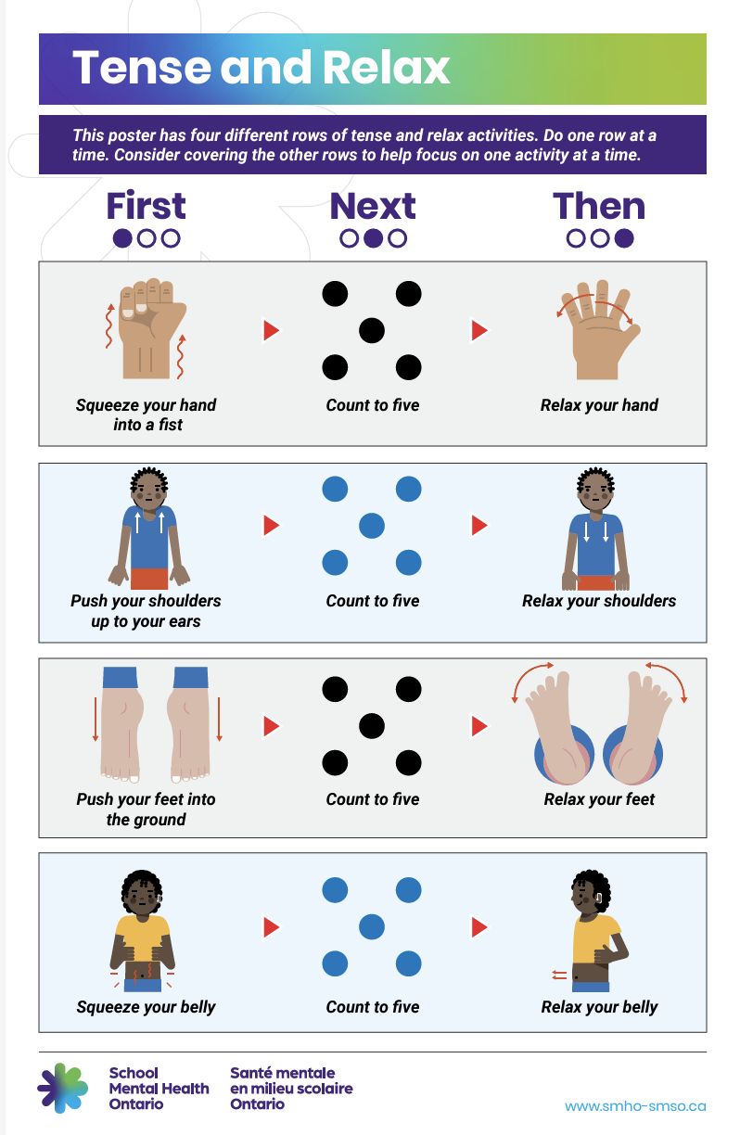
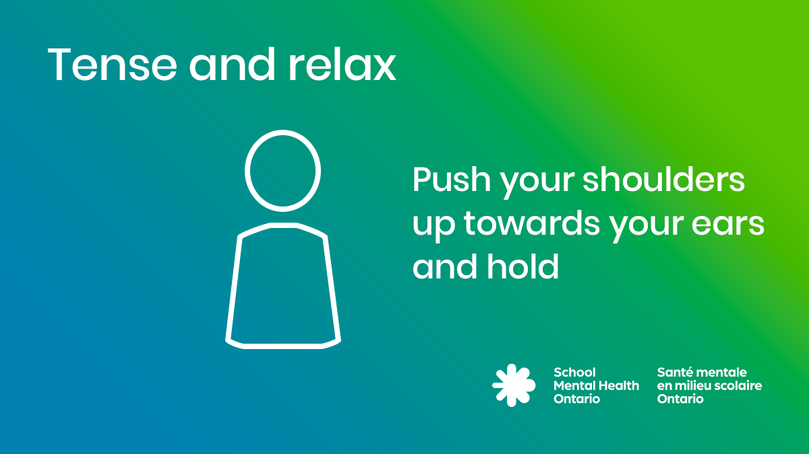
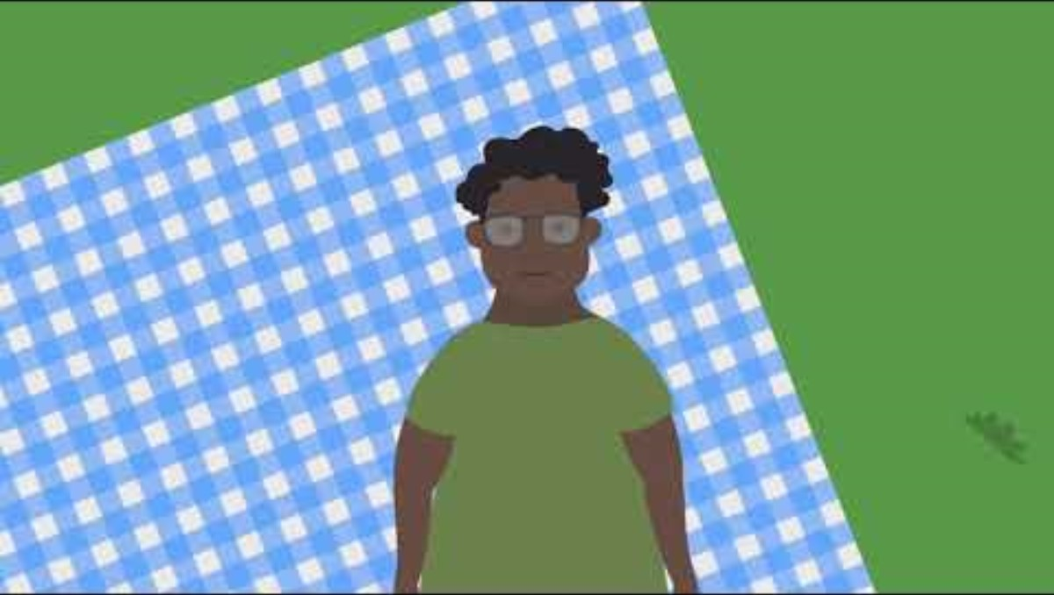
Supportive transition – stress and school
Supportive transition
Notes:
Use the Tense and Relax gif, video or poster provided or offer students the opportunity to contribute ideas for other supportive transition options. Simple activities like providing an opportunity for movement, or taking a deep breath are just as valuable as the strategies shared on this slide.
Tense and relax audio file: https://smho-smso.ca/wp-content/uploads/2021/10/tense-and-relax.mp3
Tense and relax video: https://youtu.be/J4mQm0hux1Q?si=5Ddky0fZyZSPSHOy
SEL posters: https://smho-smso.ca/online-resources/sel-posters/

Slide 30
Getting help with stress

Slide 31
What do we do when we need help with something?
Ice breaker
Notes:
Provide time for students to think and share before moving on to the 'follow up' slide.
Note: Acknowledge the uniqueness of each student and create space for and validate their individual perspectives and experiences. Reinforce that different cultures may have different practices for help seeking.

Slide 32
What do we do when we need help with something? Follow-up
Follow-up
What do we do when we need help with something?
Ask for help.
Keep trying on our own.
Stop trying or avoid what we need help with.
Other ideas?
Notes:
What do we do when we need help with something?
There are many things students might do when they need help:
Talk to/connect with others
Notice how other people are handling something similar
Read about what they need help with
Search for information online
Keep trying to manage alone
Get frustrated/some other emotion
Try to stay away from or avoid what they need help with
Give up
Teacher prompt: “It’s okay to ask for help. Everyone needs help at times!
If you have tried your best and still feel stuck, reach out to someone. Asking for help is an important skill for all of us to learn and a great way to help manage stress.”

Slide 33
How would we know we needed help with stress?
C1
Notes:
Provide time for students to think and share before moving on to the 'follow up' slide.

Slide 34
How would we know we needed help with stress? – Follow-up
Follow-up
C1
How would we know we needed help with stress?
If our strategies aren't helping and if what we are feeling is not going away and getting in the way of our lives, it's important to ask for help.
Some kinds of stress aren't our job to figure out on our own.
Notes:
How would we know we needed help with stress?
Teacher prompt: “Everyone has ups and downs, and we all experience stress. It’s part of life, and usually we know some strategies that can help us get back to feeling like ourselves. But sometimes stress can begin to affect our mental health. When that happens, we need help.”
Invite students to consider:
What have I tried?
Do I have other ideas? Could I try something else?
Is this stress helpful? Do I have ways to manage it even though it might be uncomfortable? Or do I need help?
If students feel they are unable to manage (or the source of stress is one they should not manage alone), encourage students to connect with someone. Reassure students that sharing problems can help us:
Think things through
Learn new ideas and ways to look at things
Feel heard and understood
Feel cared for and less alone
Sharing problems can help stress from getting bigger, too.
If what students are feeling is not going away and getting in the way of their lives, it’s important to ask for help and to do so as often as they need to.
Teacher prompt: “It’s important to seek support from trusted, caring adults, if we are facing stress from things like bullying or racism. It’s not up to us to get used to or manage that kind of stress on our own.”
Note: while it is important to share information about help-seeking with students, it's also important for caring adults to be a key part of the process. Support students by taking an active role in monitoring their well-being and reaching out, should you have any concerns.

Slide 35
Who could help us
manage stress?
C2
Notes:
Provide time for students to think and share before moving on to the 'follow up' slide.
Note: sometimes students feel they should be able to handle problems on their own, or they worry that the people around them are busy or experiencing their own sources of stress and students don’t want to add to what they are managing. There can also be stigma related to asking for help, which can be a barrier to receiving support. This is why it is so important to encourage help-seeking and make students aware of the supports available to them.

Slide 36
Who could help us manage stress? – Follow-up
Follow-up
C2
Who could help us manage stress?
people we trust and who care about us and our mental health
places we feel comfortable in our school and community or that offer support
things like stress management strategies and services that are always available (e.g., Kids Help Phone)
Other ideas?
Support can come in many forms!
Notes:
Who could help us manage stress?
Students might connect with:
A family member, friend, faith leader or Elder, teacher or other caring staff person at their school, doctor or nurse, coach or club leader
If students aren’t sure who to talk to, they can contact Kids Help Phone (call 1-800-668-6868 or text CONNECT to 686868). It’s free and available 24 hours a day.
If students aren’t sure if they need help, they can also speak to a caring adult or call or text Kids Help Phone to see if getting help might be a good idea.
If it’s an emergency (they or someone else is about to be hurt or there is some sort of danger), students need to connect right away. They can:
Find an adult they trust who is available right now.
Contact Kids Help Phone.
Go to the emergency room of their local hospital.
Call 911.
If you feel it is needed, you may wish to provide students with more information about what an emergency is (e.g., when someone is about to be hurt or isn’t safe).
Teacher prompt: “Reaching out for support is a great strategy to help care for your mental health. There are people who want to support you, and if something is important to you it is important enough to share. You don’t have to manage stress on your own.”

Slide 37
If we needed help, how could we start the conversation?
C3
Notes:
Provide time for students to think and share before moving on to the 'follow up' slide.
Note: students may have different ways of sharing their experiences. They may wish to share a problem or stressor through spoken language, sign language, writing/texting, drawing, or some other method. Consider the diverse learning styles of students and share examples relevant to the known identities of students.

Slide 38
If we needed help, how could we start the conversation? – Follow-up
Follow-up
C3
If we needed help, how could we start the conversation?
Can I talk to you about something?
I have a problem I need help with.
I've been feeling _____ lately and I'm not sure what to do about it.
Other ideas?
Use words that feel most comfortable to you.
Notes:
If we needed help, how could we start the conversation?
There are many words students might use to start a conversation with a caring adult. There are many ways to reach out, too:
Speak to someone in person
Call someone on the phone
Write a note
Use a digital method, like texting or email
Ask a friend to help you reach out - they could stay with you while you connect, too
Teacher prompt: “There are many ways to access help. What’s important is that you get the help you need and deserve.”

Slide 39
If a friend needs help with stress...
What could we say?
What could we do?
C4
Notes:
Provide time for students to think and share before moving on to the 'follow up' slide.

Slide 40
If a friend needs help with stress...
What could you say?
Follow-up
C4
How are you doing? Is everything okay?
I've notice you seem stressed lately. Do you want to talk about it?
Do you need help with anything?
Other ideas?
Notes:
What if a friend needs help with stress?
The same things that might tell students that they need help with stress can signal when a friend might need help, too. The best way to know if a friend needs help with stress is to ask!
If a friend says or does something that makes students worry about whether they are hurt or safe, it’s important to let an adult know right away, even if a friend asks us not to.
This is an opportunity to introduce a conversation about secrecy versus privacy.
Secrecy involves not telling anyone information, even people who need it.
Respecting privacy means sharing only the information needed and only with those who need it to help someone or keep them safe.
Teacher prompt: “There are things you can do to help when a friend is stressed, but it is important that you know you don’t have to do it alone. Other people can help, too. If you aren’t sure what to say to your friend, you can try, ‘This is too big for the two of us. We need more help. And if you aren’t sure where to begin or want to talk to someone, speak to a trusted adult.’”

Slide 41
If a friend needs help with stress...
What could you do?
Follow-up
C4
Check to see how they are doing.
Listen to them.
Share ideas with them.
Let them know you care about them.
Other ideas?
Notes:
Some days we have more time and energy to help our friends, and some days we have less. That’s okay! Reassure students that taking care of ourselves is important, too. Sometimes we also need other people to help—like when problems feel really big or hard to solve. We all need a circle of support. Students don’t have to help a friend all on their own.
Teacher prompt: “We can reach out to the same kinds of people we might connect with for ourselves if our friend is feeling stressed. We can share some ideas with our friend and ask what would work best for them.”

Slide 42
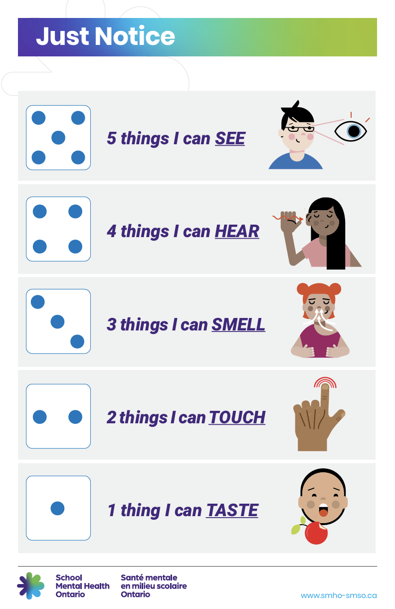
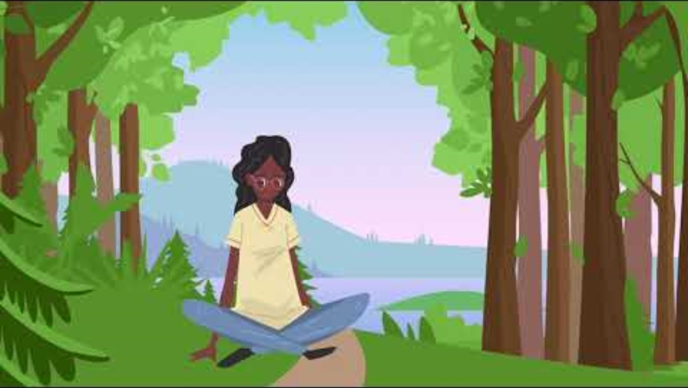
Supportive transition – getting help with stress
Supportive transition
Notes:
The Forest Visualization video or the Just Notice poster are provided as possible options for a supportive transition. Continue to offer students the opportunity to contribute other supportive transition ideas. Simple activities like providing a moment to chat with friends, time to doodle, or other activities that students enjoy are just as valuable as the poster/video shared.
Audio file for Just Notice: https://smho-smso.ca/wp-content/uploads/2021/10/just-notice.mp3
Social-emotional learning posters: https://smho-smso.ca/online-resources/sel-posters/

Slide 43
Continue the conversation
Help students build additional skills to manage stress. A variety of ready-made resources are available through School Mental Health Ontario.
Wayfinder is a grade-by-grade mental health promotion and literacy programming tool.
Sign up to download Wayfinder for your grade
Remember, educator practices can help reduce student stress, too!
Maintaining positive relationships with students within a caring school community and welcoming, inclusive classroom decreases student stress and increases emotional wellness and readiness to learn.
Mentally Healthy Classroom Reflection Tool
Educators play an important role in co-creating an environment that will help students feel more comfortable and give them the opportunity to do their best.
Student test and exam stress: The important role of educators

